Slide 1
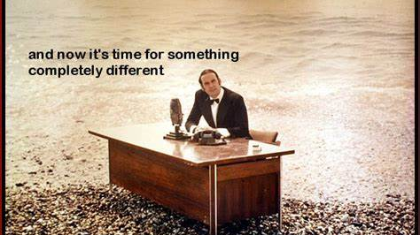

Slide 2
Goal: Introduce you to the flourishing field of Reinforcement Learning
Current excitement:
Deep Mind’s Alpha-Go success
Explaining Reinforcement Learning:
RL compared to Supervised Learning
Application examples
Computation & Program Flow for RL algorithms
Two pass algorithms
“Actor – Critic”
MDP
Notebook Examples
Personalization example
Context, unobservable belief state
Demo of Azure Personalizer
Navigation example
- maze representation
- function approximation
RL & Deep Learning
Other Sources

Slide 3
What is RL?
RL expands on statistical machine learning to include outcome values, in sequential models with feedback.
Think of learning a control or policy function.
“Episodic” learning by “trail & evaluation”

Slide 4
Domains where RL is applied
Process control (think robots)
Use sensor feedback to learn a control function (a policy)
AutoScale: Dynamic resource optimization
Adjust capacity using current levels to predict future needs.
“Bandit” problems
Learn the best choice of advertisements to display.
Dialog systems
“Chatbots”
Personalized recommendations
Recommend items based on a person’s previous purchases

Slide 5
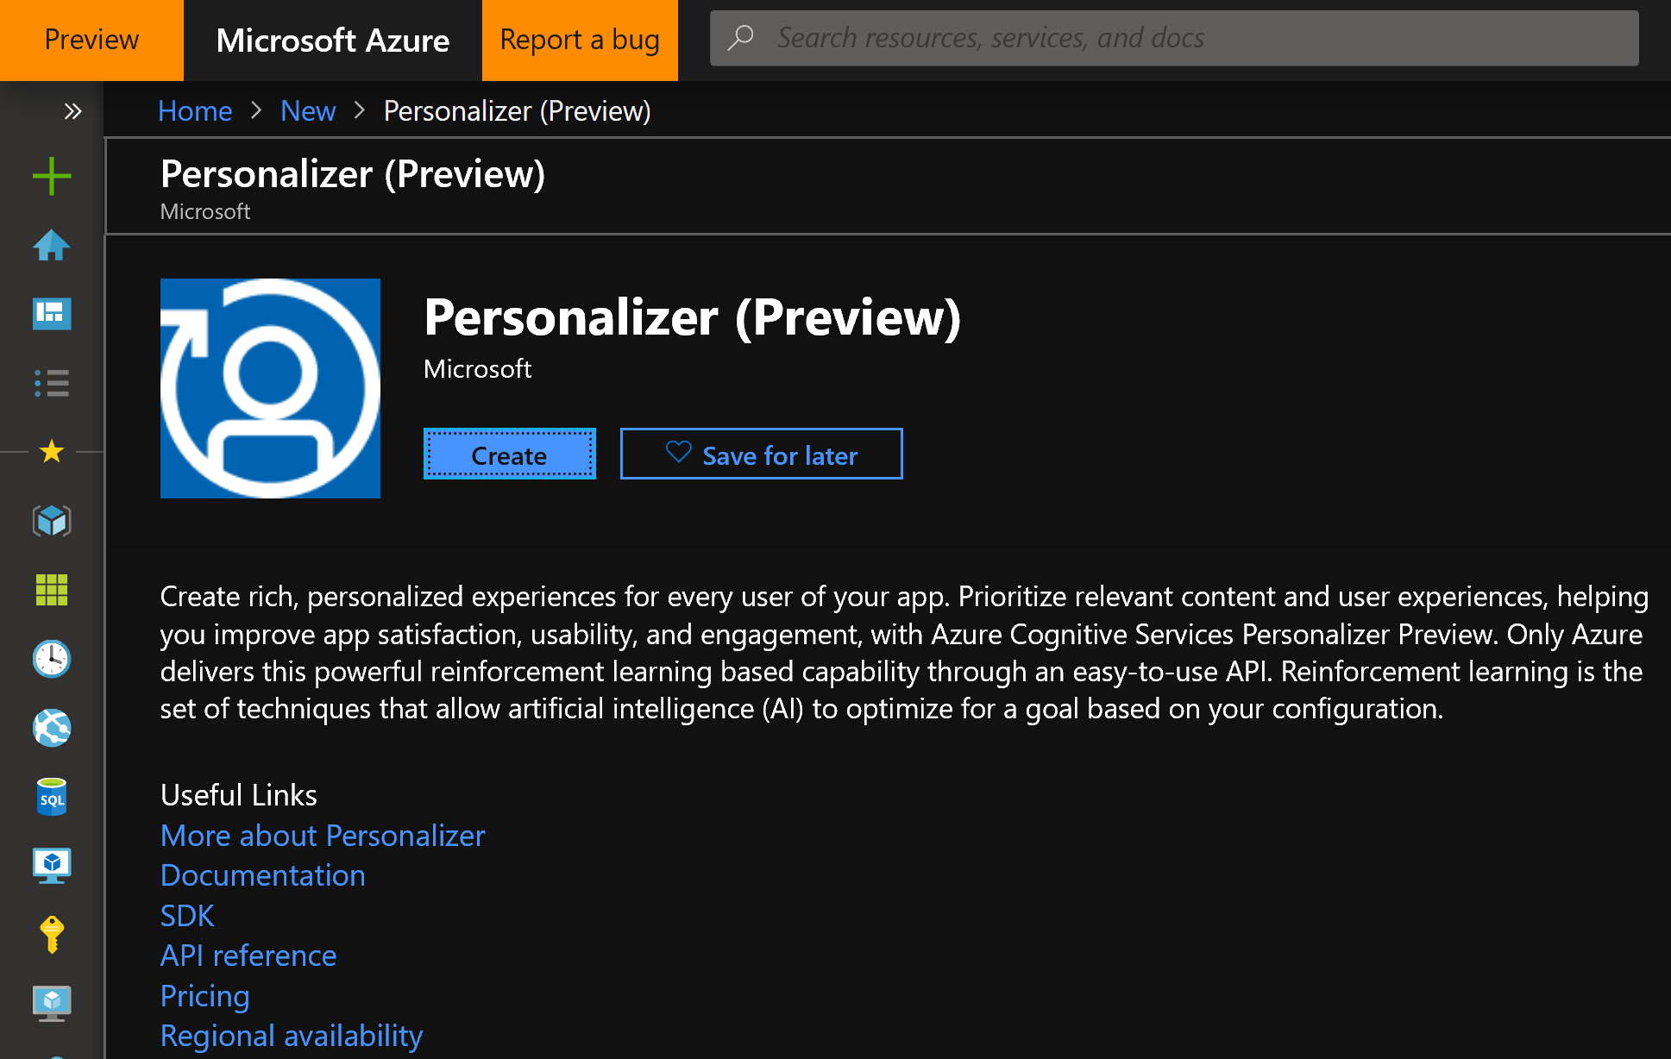

Slide 6
Supervised Machine Learning uses labels to learn to predict from features
Predict
Current features
Prediction
Model
Train
Historic features
Data labels

Slide 7
Reinforcement Learning computational components, in comparison, includes explicit rewards & actions.
Supervised Machine Learning
Current data
Predict
Prediction
Model
Historic data
Train
Data labels
Observed features
Agent
Action
Policy
Environment
State features
reward

Slide 8
A Markov Decision Process (MDP) view of a Reinforcement Learning model
S
S
S
S
S
C
a
a
a
a
r
r
r
r
r
stage t

Slide 9
Aspects of RL
Underlying Markov Decision Process – Solutions borrow from Dynamic Programming
Model-free solutions: Sampling from the environment takes the place of knowing the MDP state transition probability matrices.
“Credit Assignment” Rewards don’t necessarily occur when actions are taken
“Temporal Difference” learning. Iterative methods based on limited look-ahead.
Function Approximation for continuous state spaces & generalization
Exploration – Exploitation tradeoff. Take time to discover unexplored, possibly improved states and actions.

Slide 10
Multi-pass solution methods
Start
state
Goal
state
State sequence
Value iteration (backing up through time)
Policy iteration (optimize actions, unfolds forward)

Slide 11
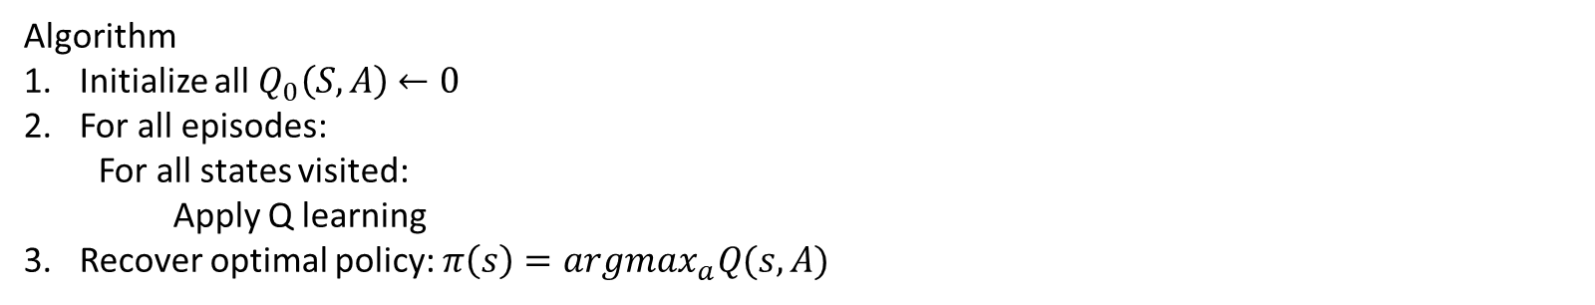
“Q-learning” – “value action function” – a well known solution approach.
$$Q_{t+1}\left(S, A\right)←Q_{t}\left(S,A\right)+α[r\left(S,A\right)+\max_{a}^{′}{Q_{t}\left(S^{′}, A^{′}\right)−Q_{t}(S,A)]}$$
Algorithm
Initialize all $Q_{0}\left(S,A\right)$ $←0$
For all episodes:
For all states visited:
Apply Q learning
Recover optimal policy: $π\left(s\right)=argmax_{a}Q(s, A)$

Slide 12
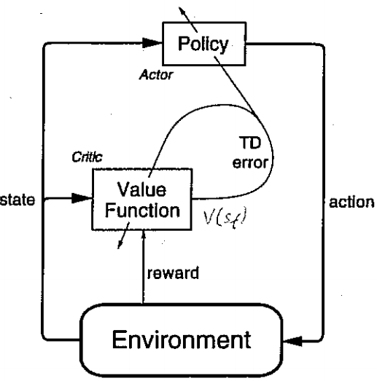
In an Actor-Critic algorithm, the Actor aims to improve the current policy based on the current value function, and the Critic improves the value based on the rewards generated by the current policy. Together they implement Generalized Policy Iteration, trying to converge on optimal value and policy functions.
Actor
“Temporal Difference (TD) =
Reward prediction error
Critic

Slide 13
Demo
Maze Navigation

Slide 14
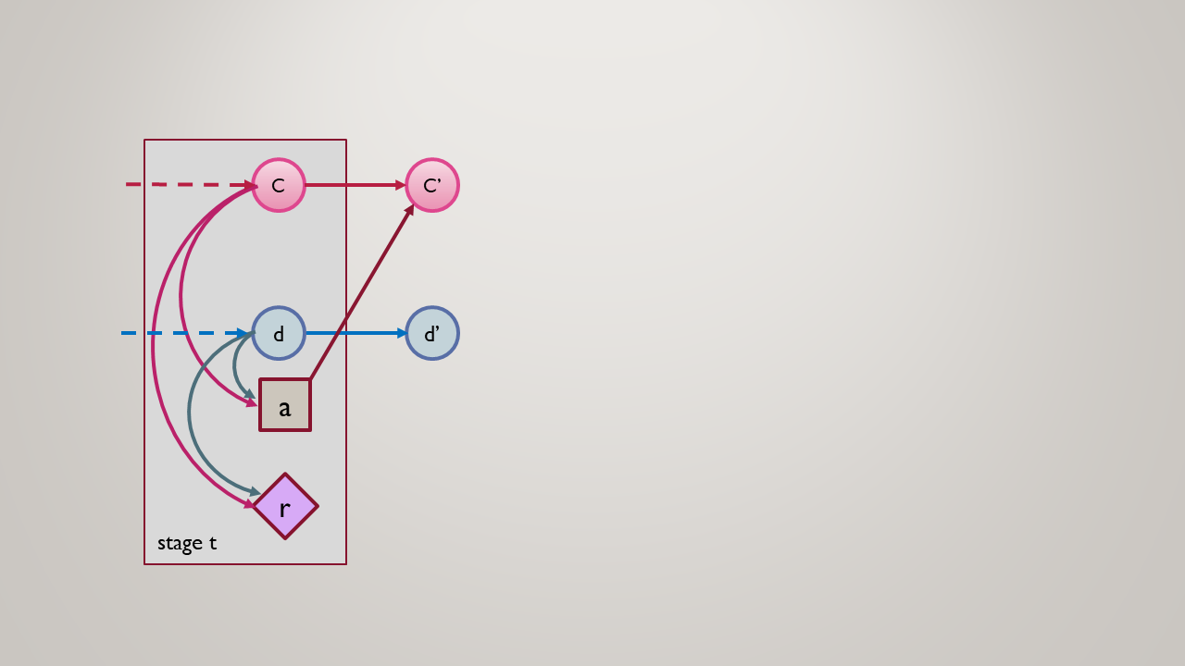
Reinforcement learning MDP
RL is the problem of controlling a Markov Chain with unknown probabilities.*

Slide 15
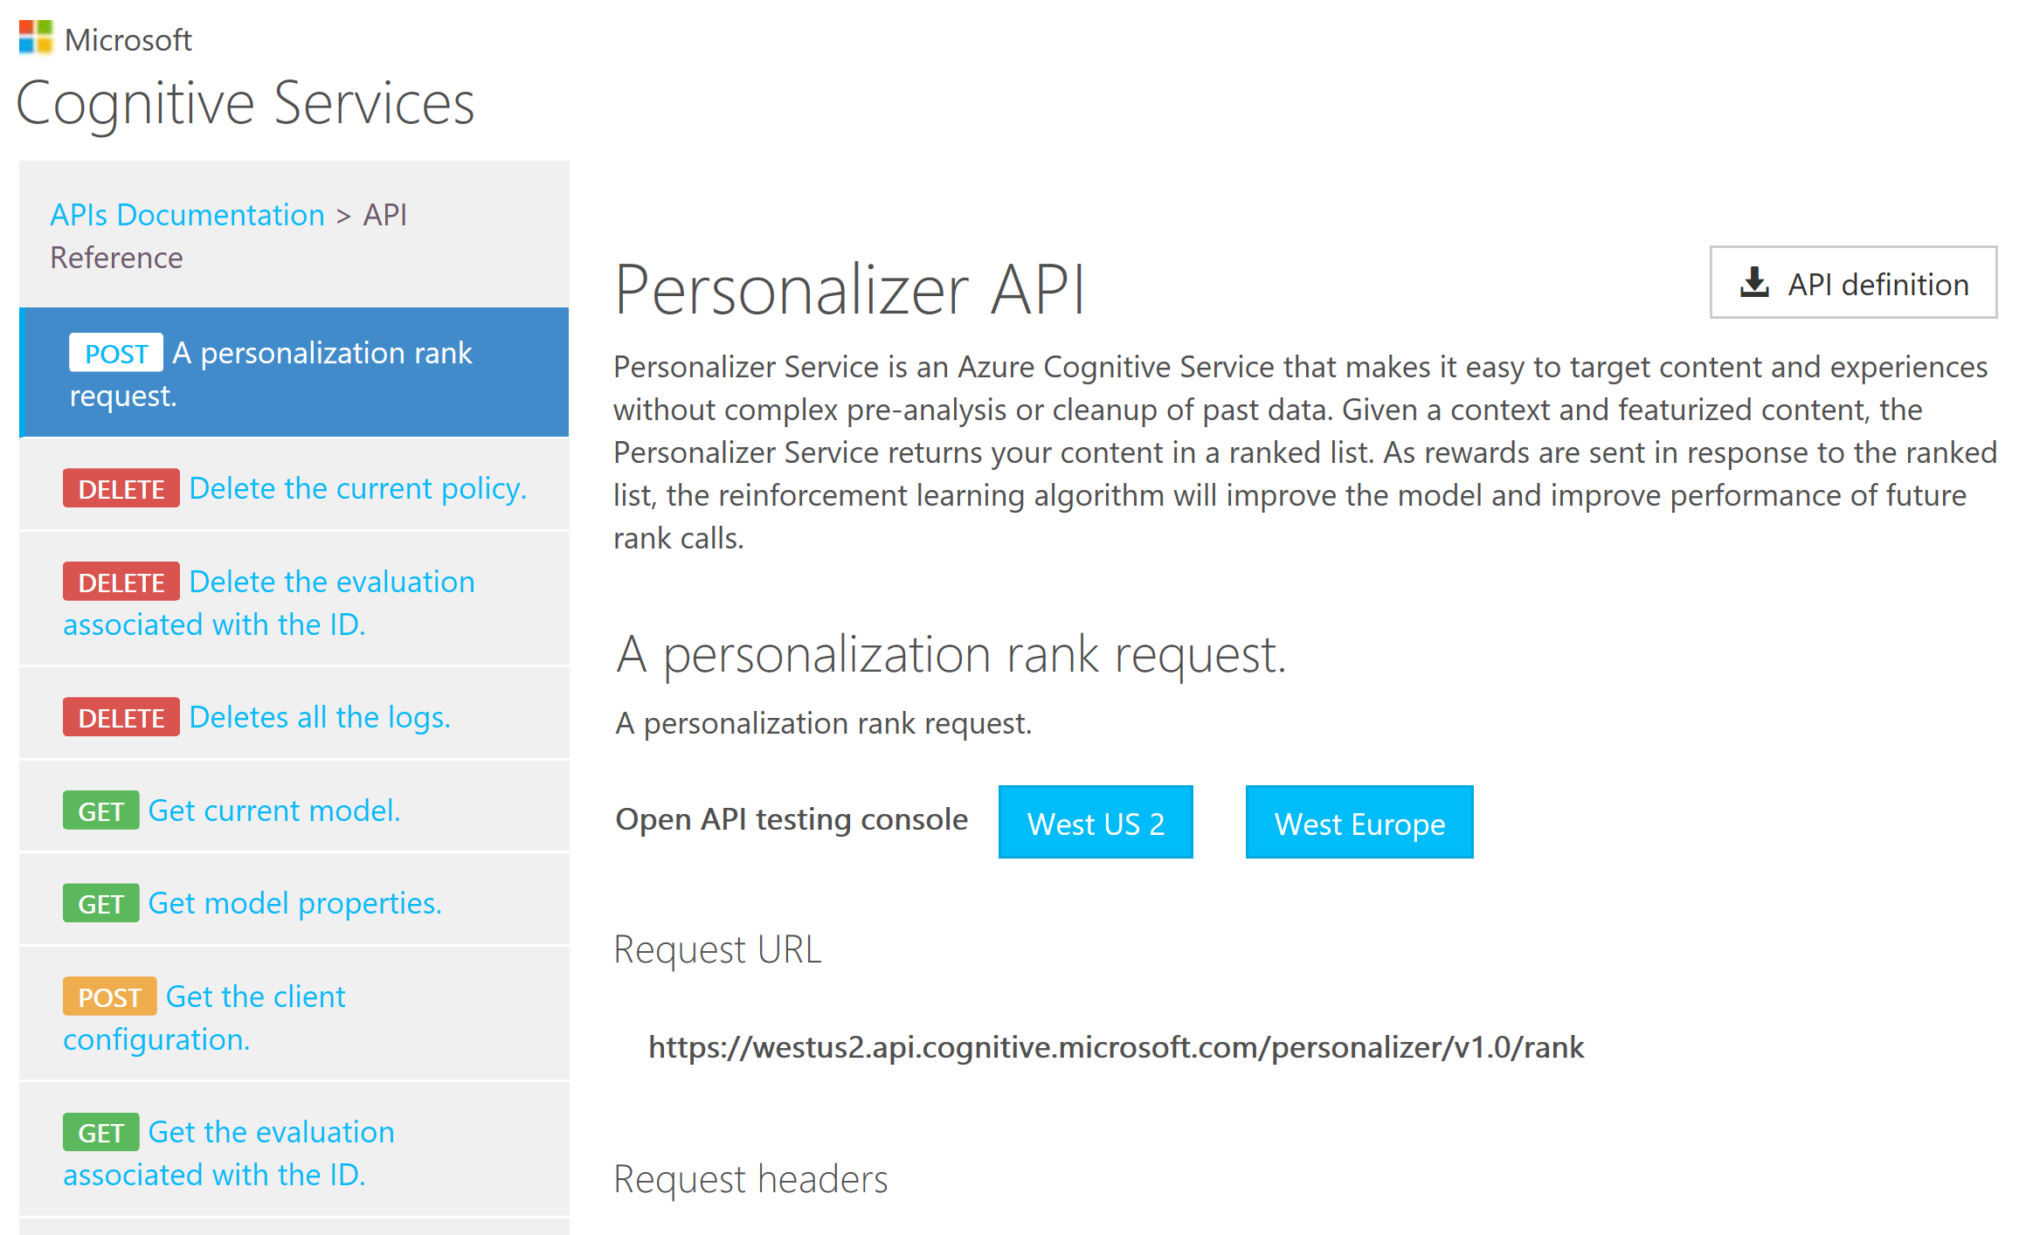

Slide 16
Origins of RL
”reinforcement learning can be viewed as a microcosm for the entire AI problem” - Russell & Norvig 2009
Early work in neuroscience’s “law of effect”
Samuels Checkers player (1959)
Tesauro “TD-Blackgammon” (1992)
Sutton and Barto (1998).
“Deep RL” (2014)
See Andrew G. Barto (2019) “Reinforcement Learning: Connections, Surprises, Challenges”, AI Magazine, vol 40:1, pp 3-16.

Slide 17
Current progress
RL’s sampling-based (“Monty-Carlo”), model-free approaches scale to environments with huge state spaces, not practical with MDP approaches.
Notable Advances in Deep RL:¹
”Deep-Q Network” (DQN) (Mnih et al., 2015), applied to video games.
AlphaGo (Silver et al., 2016a; 2017), used for Deep-Mind’s Go-Playing programs.
DeepStack (Moravˇcik et al., 2017) for imperfect information games.
Deep Mind reduces Data Centre Cooling Bill by 40%.²
Commercial applications, Startups: http://Bons.ai
1. YuxiLi(yuxili@gmail.com), “DEEP REINFORCEMENT LEARNING”, arXiv:1810.06339v1 (15 Oct 2018).
2. https://deepmind.com/blog/deepmind-ai-reduces-google-data-centre-cooling-bill-40/

Slide 18
Sources
OpenAI: https://openai.com/
Pybrain: http://pybrain.org/
RL-glue: https://sites.google.com/a/rl-community.org/rl-glue/Home/rl-glue
LibPG: http://code.google.com/p/libpgrl
RISE lab’s rlLib: https://rise.cs.berkeley.edu/projects/rllib/

Slide 19
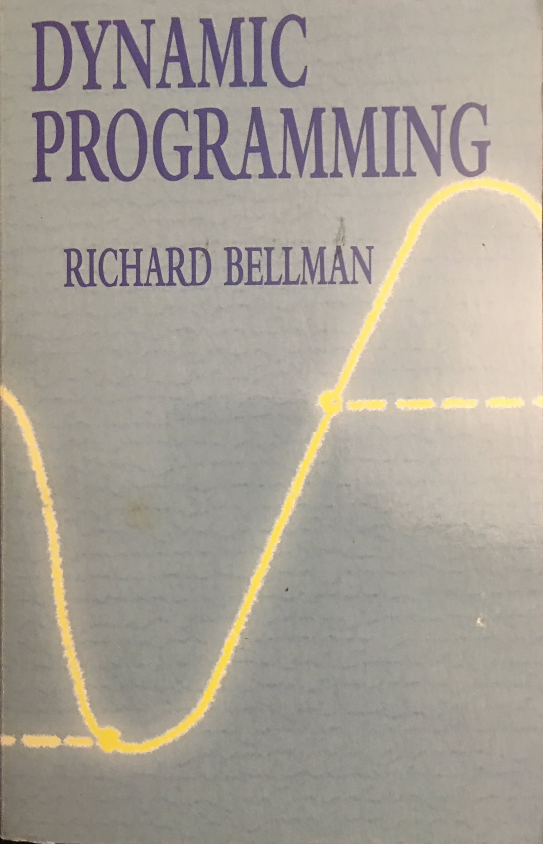
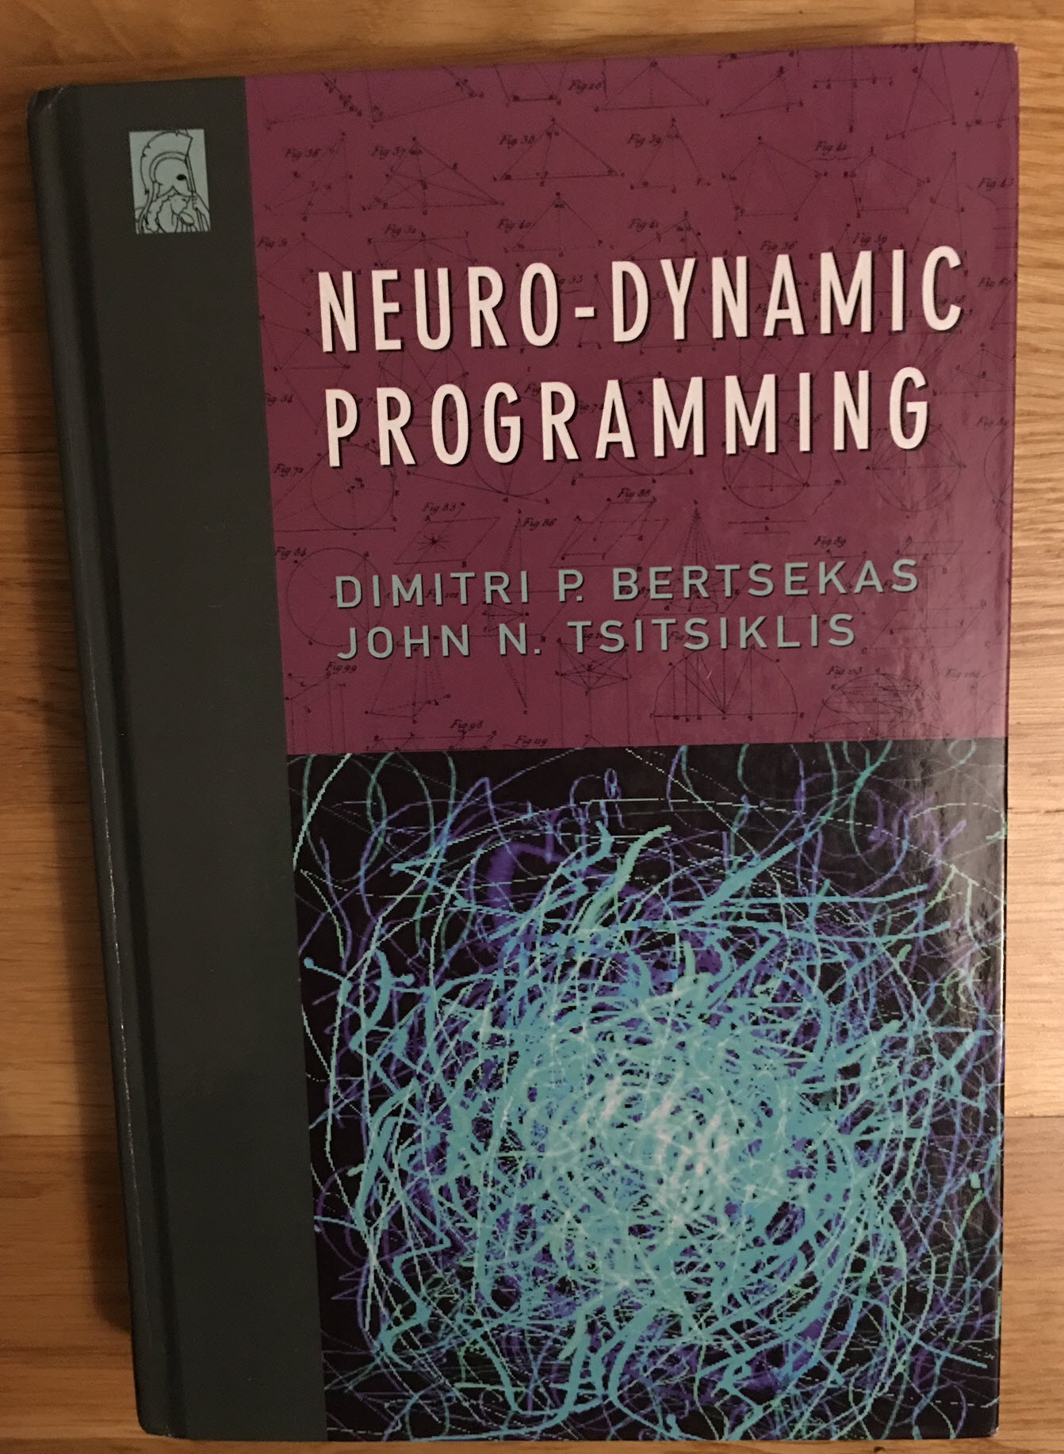
Recommended Books

Slide 20
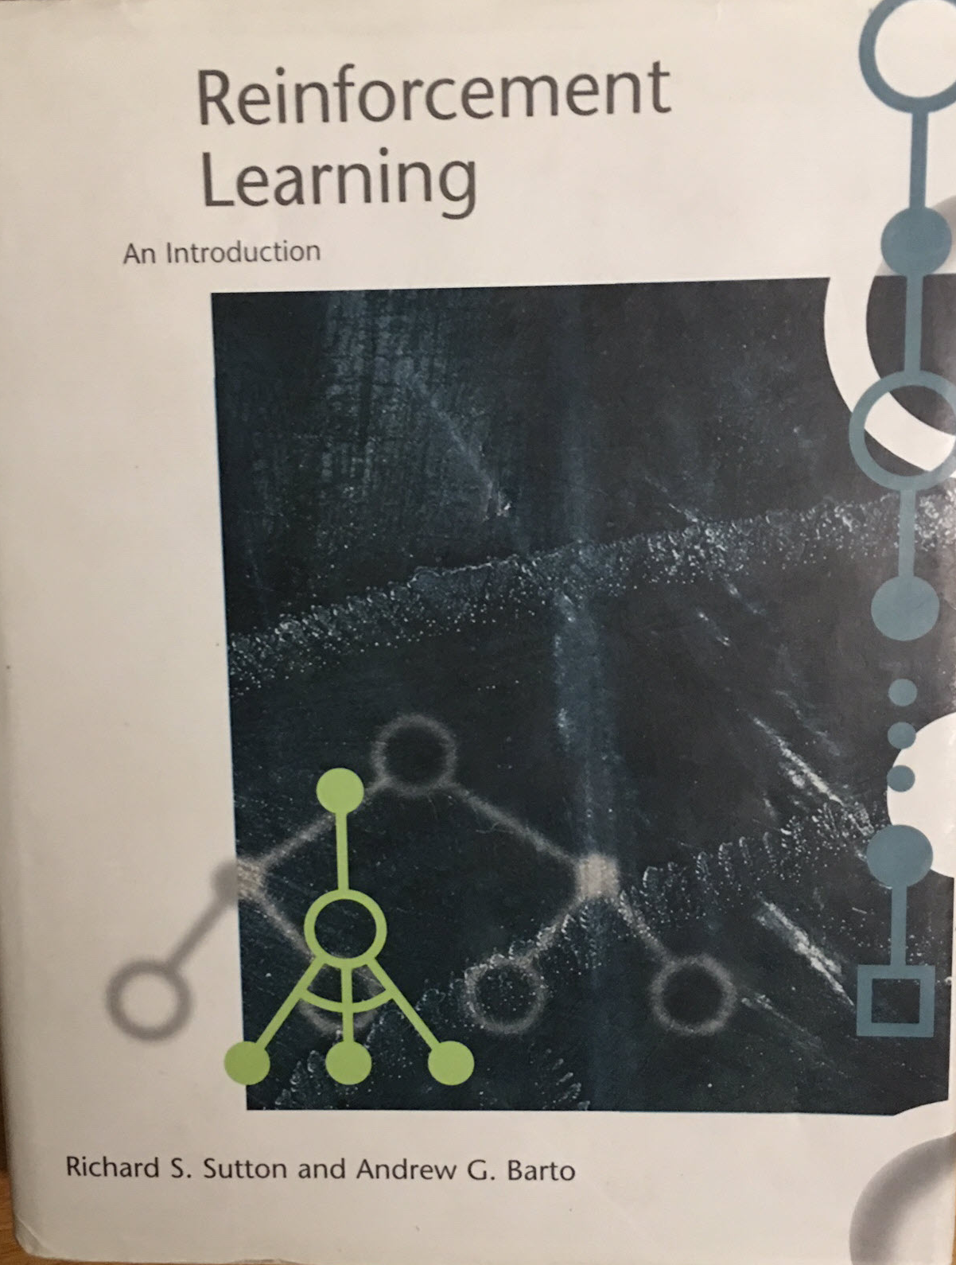
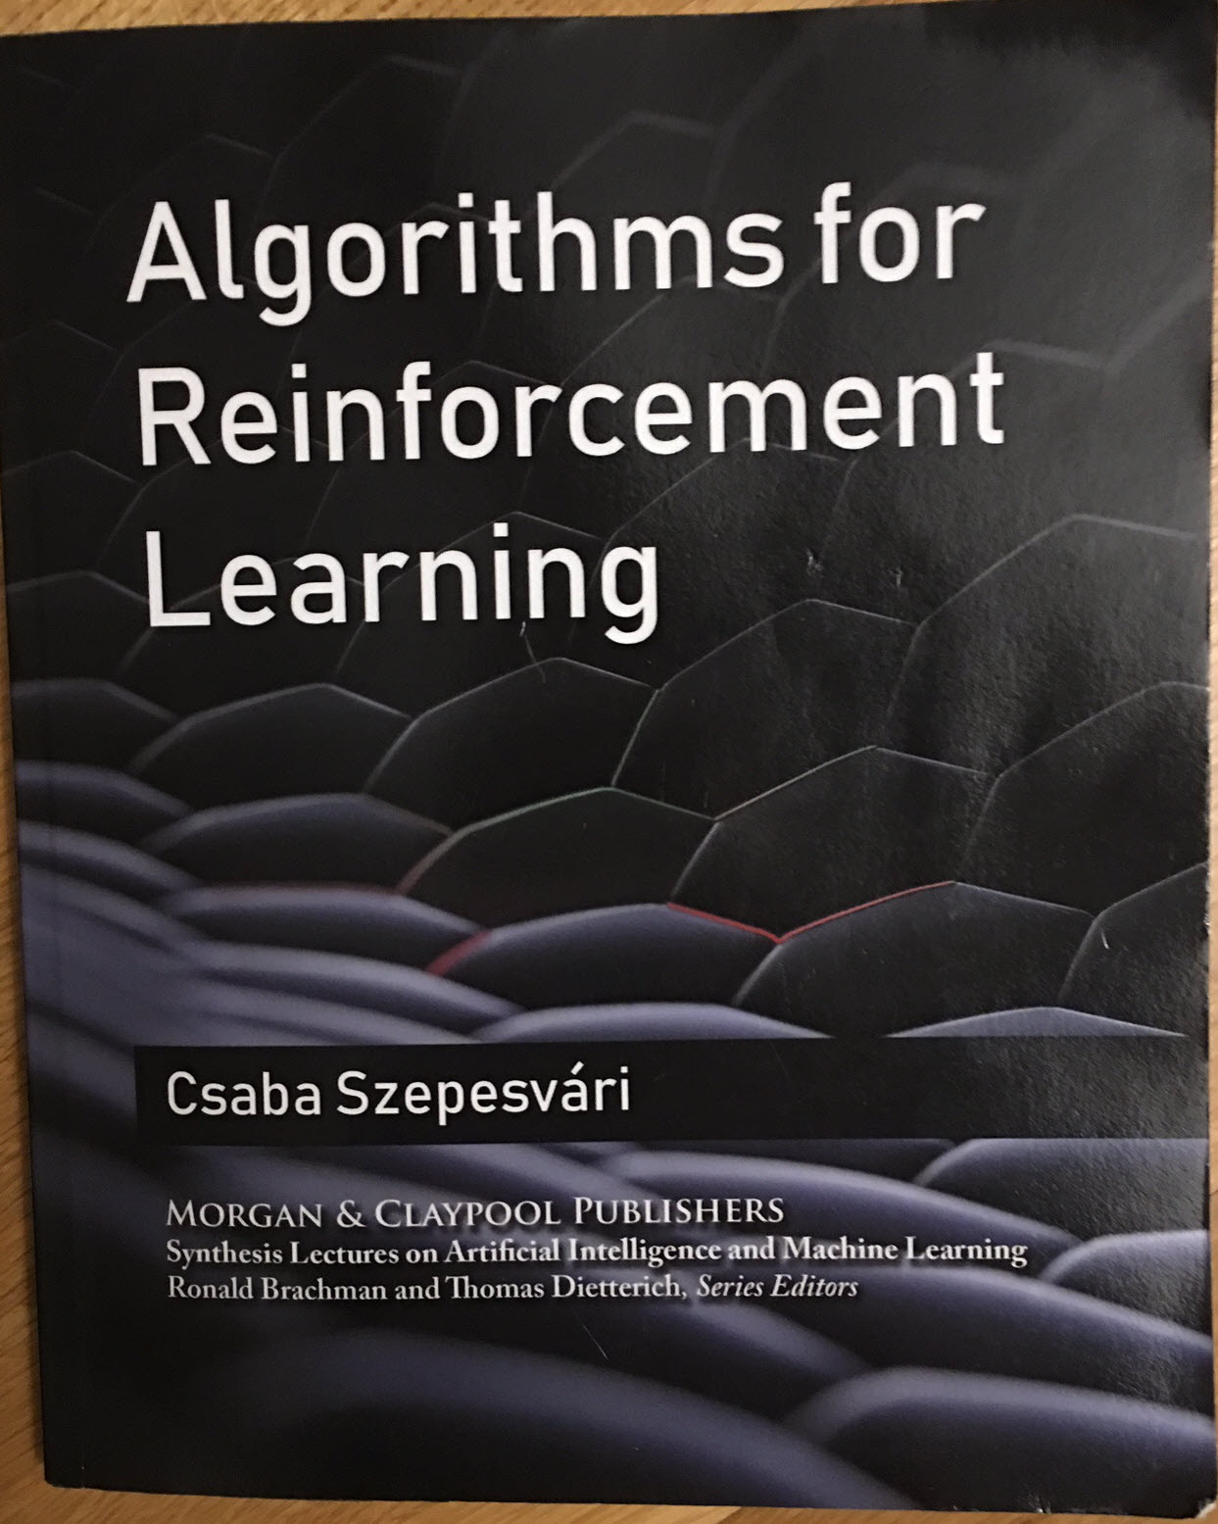

Slide 22
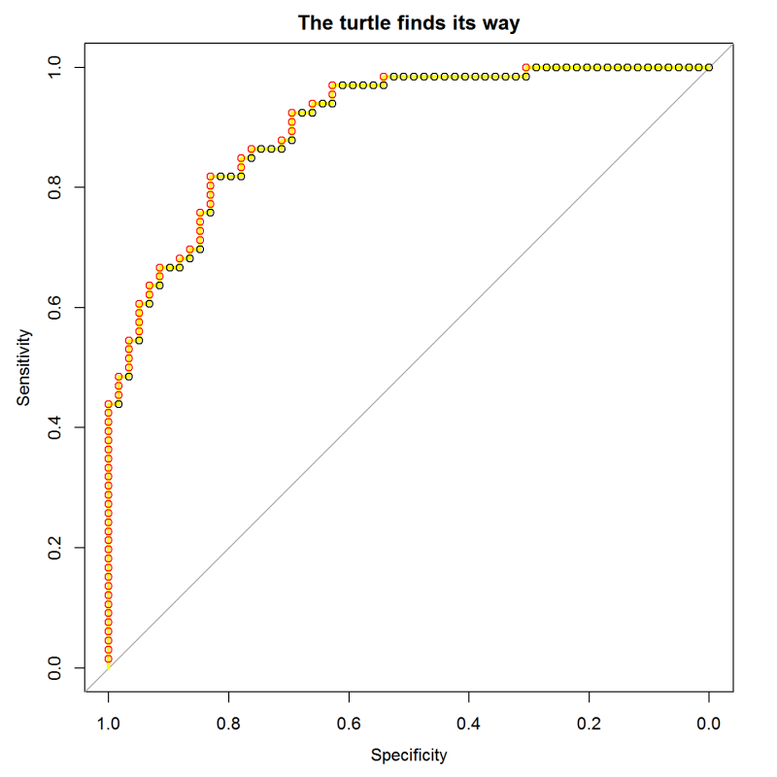
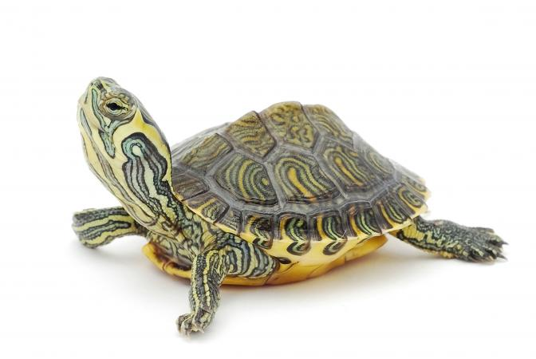
ROC Curve:
sort test cases by their score from the model
march along the sequence, stepping up for positives and right for negatives
This is the same as scanning across possible cutoff threshold values.
The slope of the curve shows the concentration of positives.
TPR
0.0 0.2 0.4 0.6 0.8 1.0
FPR
Notes:
The “turtle’s eye view” of ROC curves is described here:
https://blog.revolutionanalytics.com/2016/08/roc-curves-in-two-lines-of-code.html

Slide 23
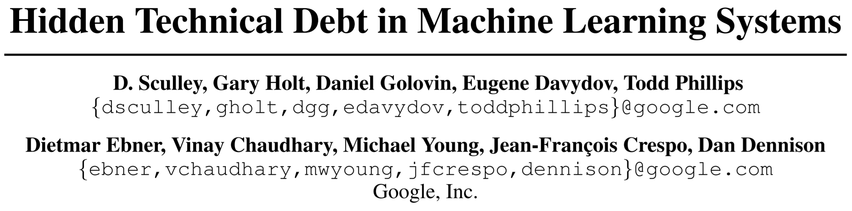
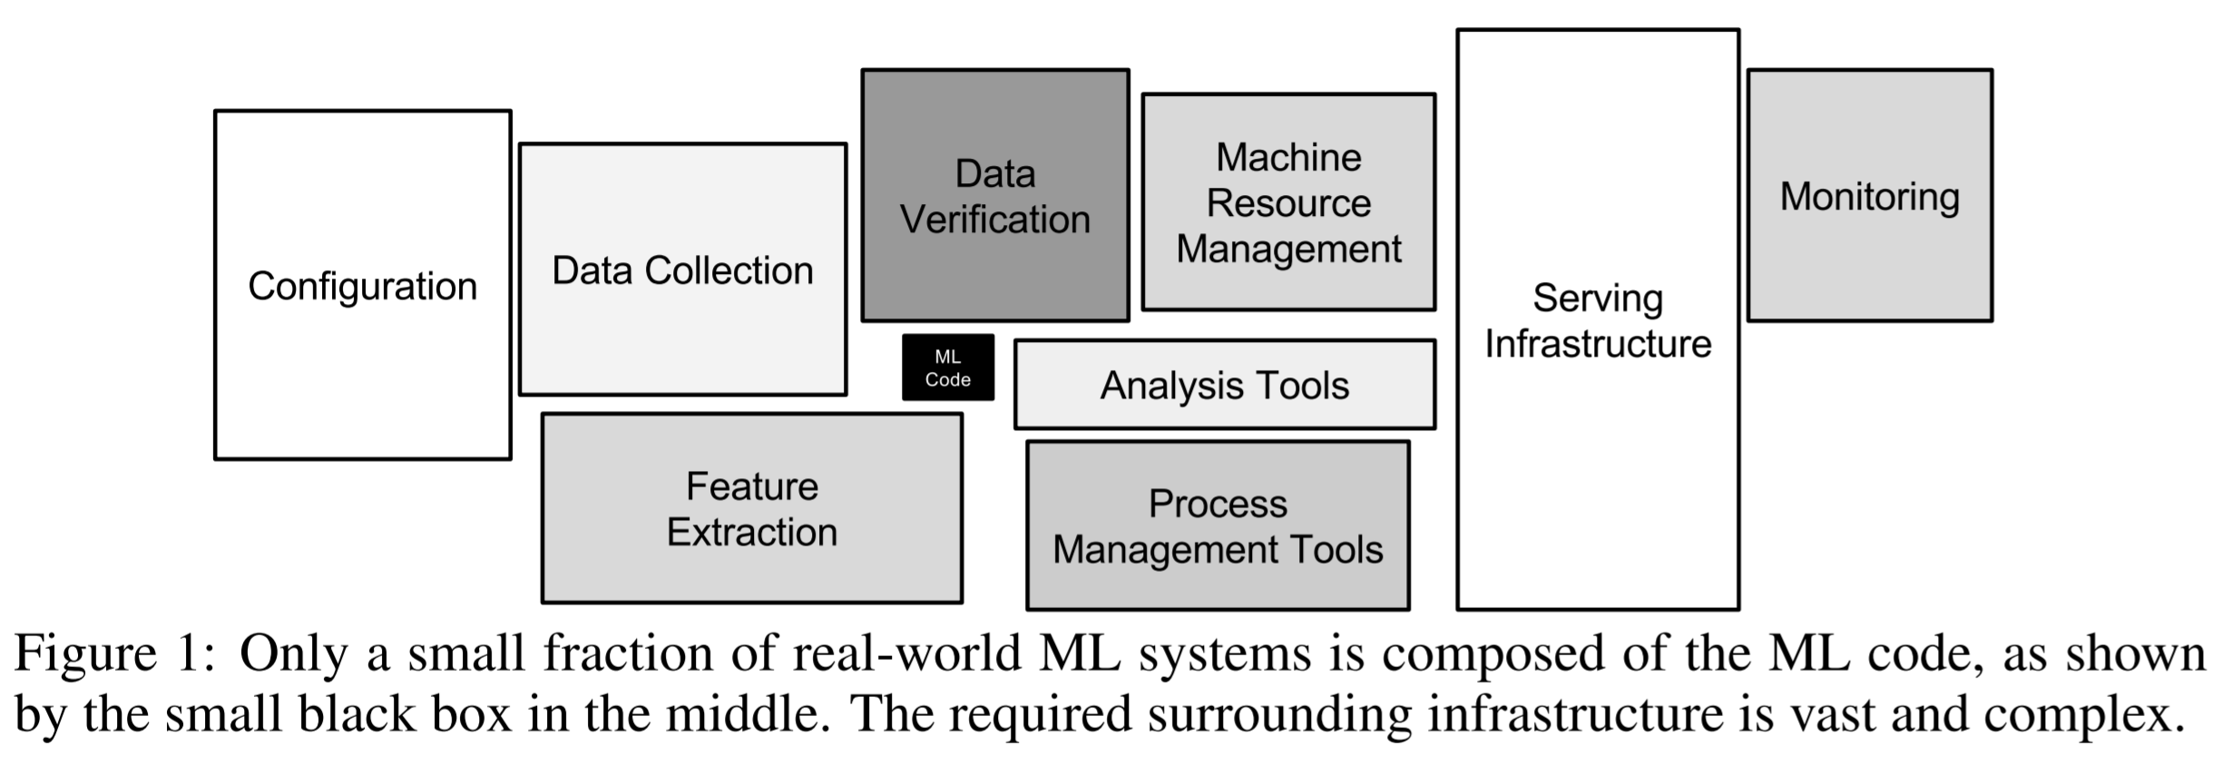
Notes:
ML code is just the little black box in the middle.

