Slide 1
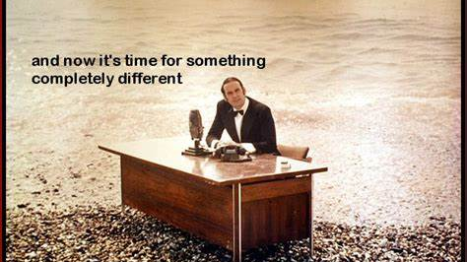

Slide 2
Goal: Introduce you to the flourishing field of Reinforcement Learning
Reinforcement Learning compared to Supervised Learning (10min)
Program Flow for RL (10 min)
Navigation example (20 min)
- maze representation
- function approximation
Personalization example (20 min)
Context, unobservable belief state
Demo Azure Personalizer

Slide 3
Supervised Machine Learning
Predict
Current features
Prediction
Model
Train
Historic features
Data labels

Slide 4
Reinforcement Learning
Supervised Machine Learning
Current data
Predict
Prediction
Model
Historic data
Train
Data labels
Observed features
Agent
Action
Policy
Environment
State features
Data labels
reward

Slide 5
Some examples from different domains.
Process control (think robots)
Use sensor feedback to learn a control function (a policy)
Personalized recommendations
Recommend items based on a person’s previous purchases
“Bandit” problems
Learn the best choice of advertisements to display.
Dialog systems
“Chatbots”
AutoScale: Dynamic resource optimization
Adjust capacity using current levels to predict future needs.

Slide 6
Aspects of RL – a Dynamic, optimizing, value-driven approach.
Underlying Markov Decision Process – Solutions borrow from Dynamic Programming
Model-free solutions: Sampling from the environment takes the place of knowing the state transition probability matrices.
Function Approximation for continuous state spaces & generalization
“Temporal Difference” learning. Iterative methods based on limited look-ahead.
Exploration – Exploitation tradeoff. Take time to discover unexplored, possibly improved states and actions.

Slide 7
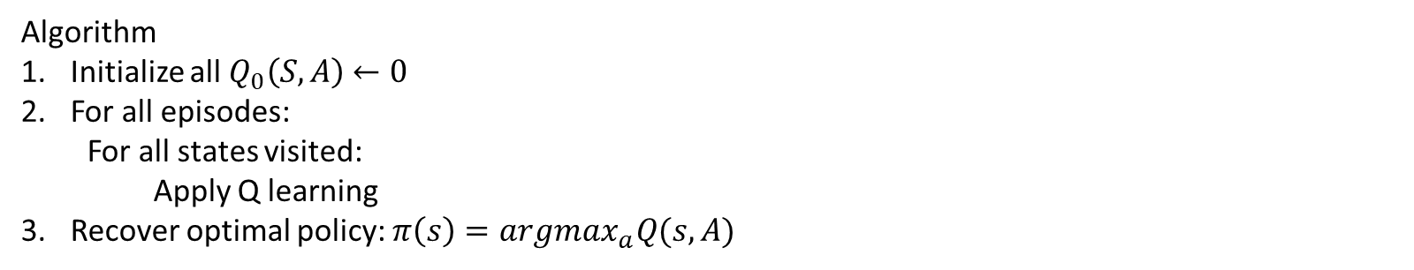
“Q-learning” – a well known solution approach.
$$Q_{t+1}\left(S, A\right)←Q_{t}\left(S,A\right)+α[r\left(S,A\right)+\max_{a}^{′}{Q_{t}\left(S^{′}, A^{′}\right)−Q_{t}(S,A)]}$$
Algorithm
Initialize all $Q_{0}\left(S,A\right)$ $←0$
For all episodes:
For all states visited:
Apply Q learning
Recover optimal policy: $π\left(s\right)=argmax_{a}Q(s, A)$

Slide 8
Multi-pass solution methods
Start
state
Goal
state
State sequence
Value iteration (backing up through time)
Policy iteration (optimize actions)

Slide 9
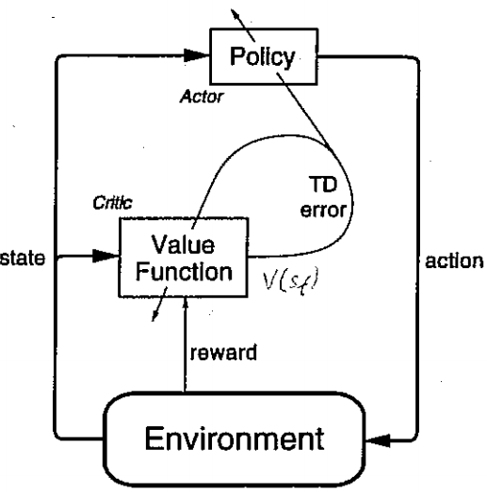
In an Actor-Critic algorithm, the Actor aims to improve the current policy based on the current value function, and the Critic improves the value based on the rewards generated by the current policy. Together they implement Generalized Policy Iteration trying to converge on optimal value and policy functions.

Slide 10
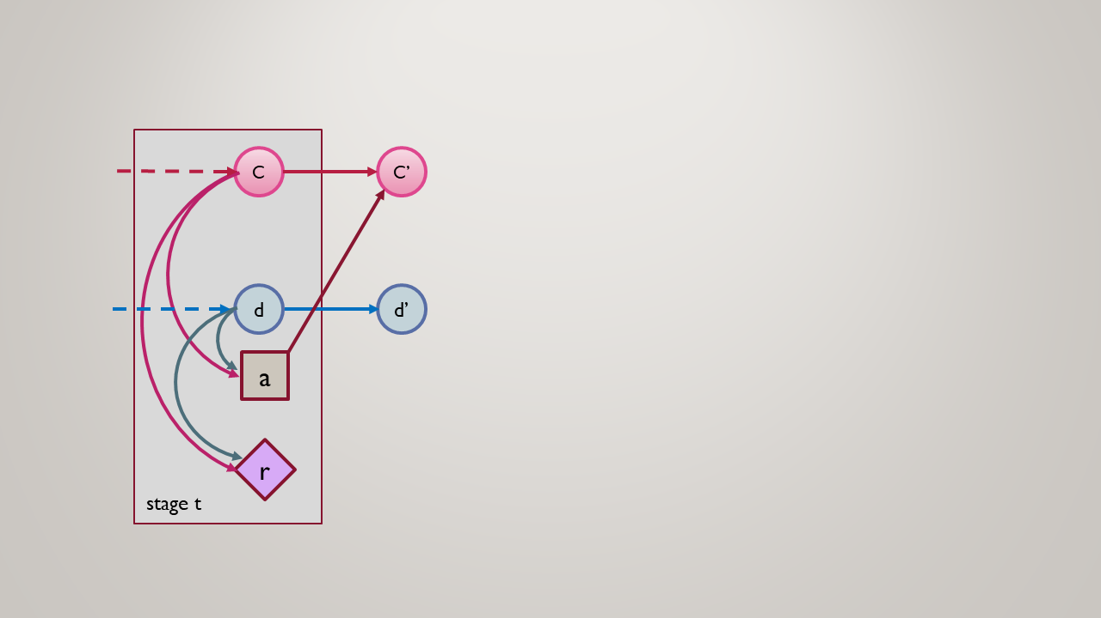
Reinforcement learning MDP
RL is the problem of controlling a Markov Chain with unknown probabilities.*

Slide 11
Progress in RL
Sammuels Checkers
Tesauro Blackgammon? Google data center management
Deep Mind Alpha Go – “Deep” reinforcement learning
Commercial applications. Startups.
(some measures of current performance)

Slide 12
Sources
OpenAI gym
Pybrain
RL-glue: https://sites.google.com/a/rl-community.org/rl-glue/Home/rl-glue
LibPG: http://code.google.com/p/libpgrl
RISE lab rlLib

Slide 13
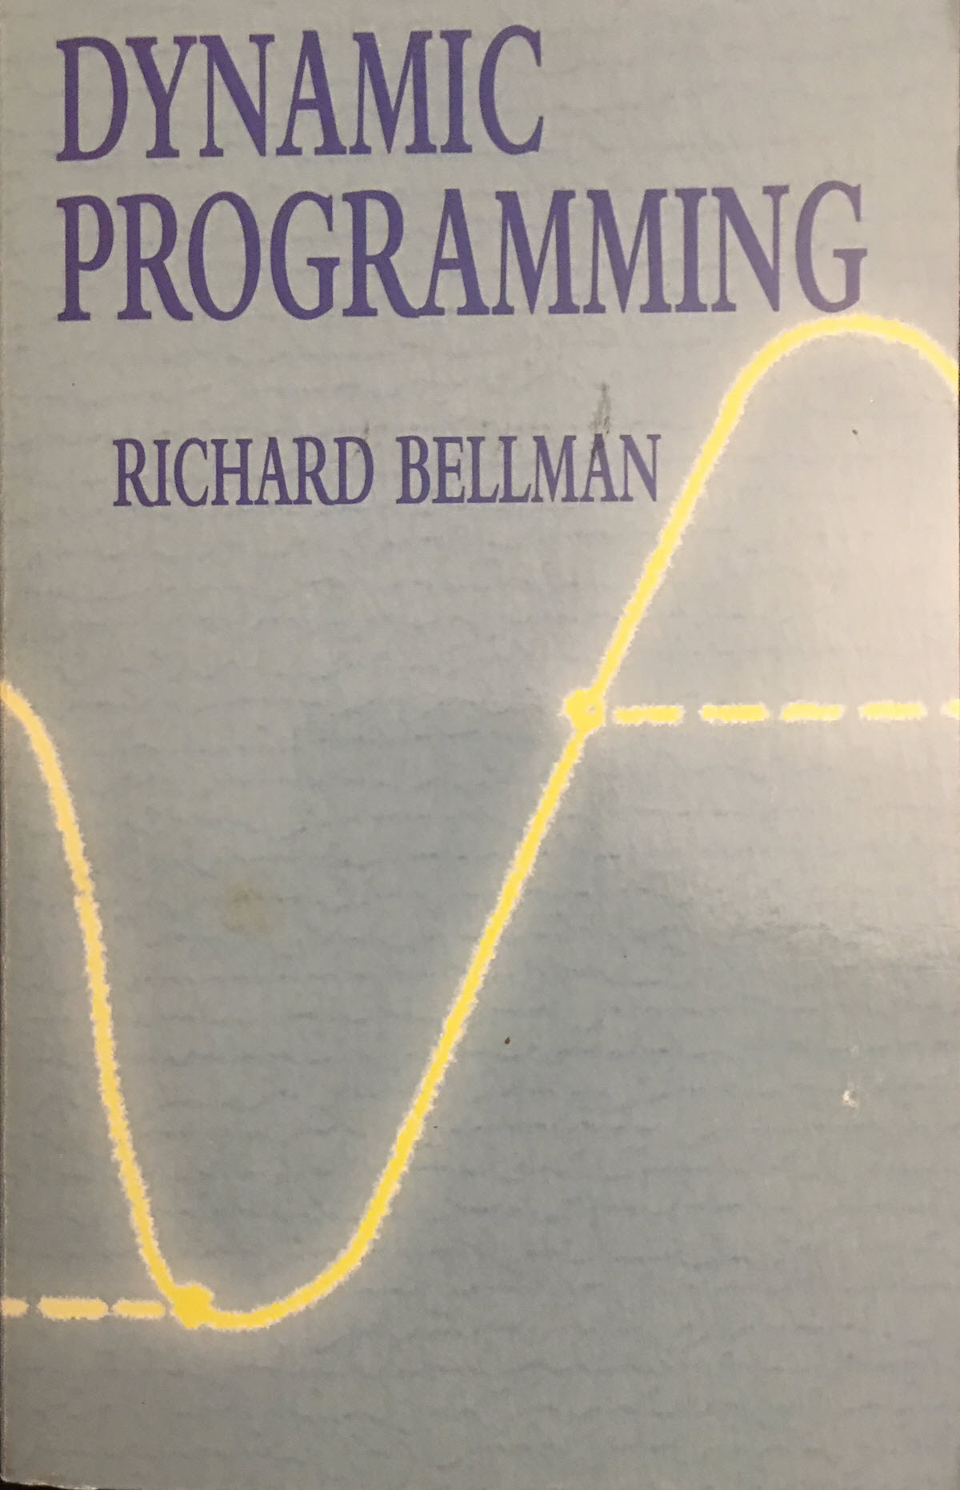
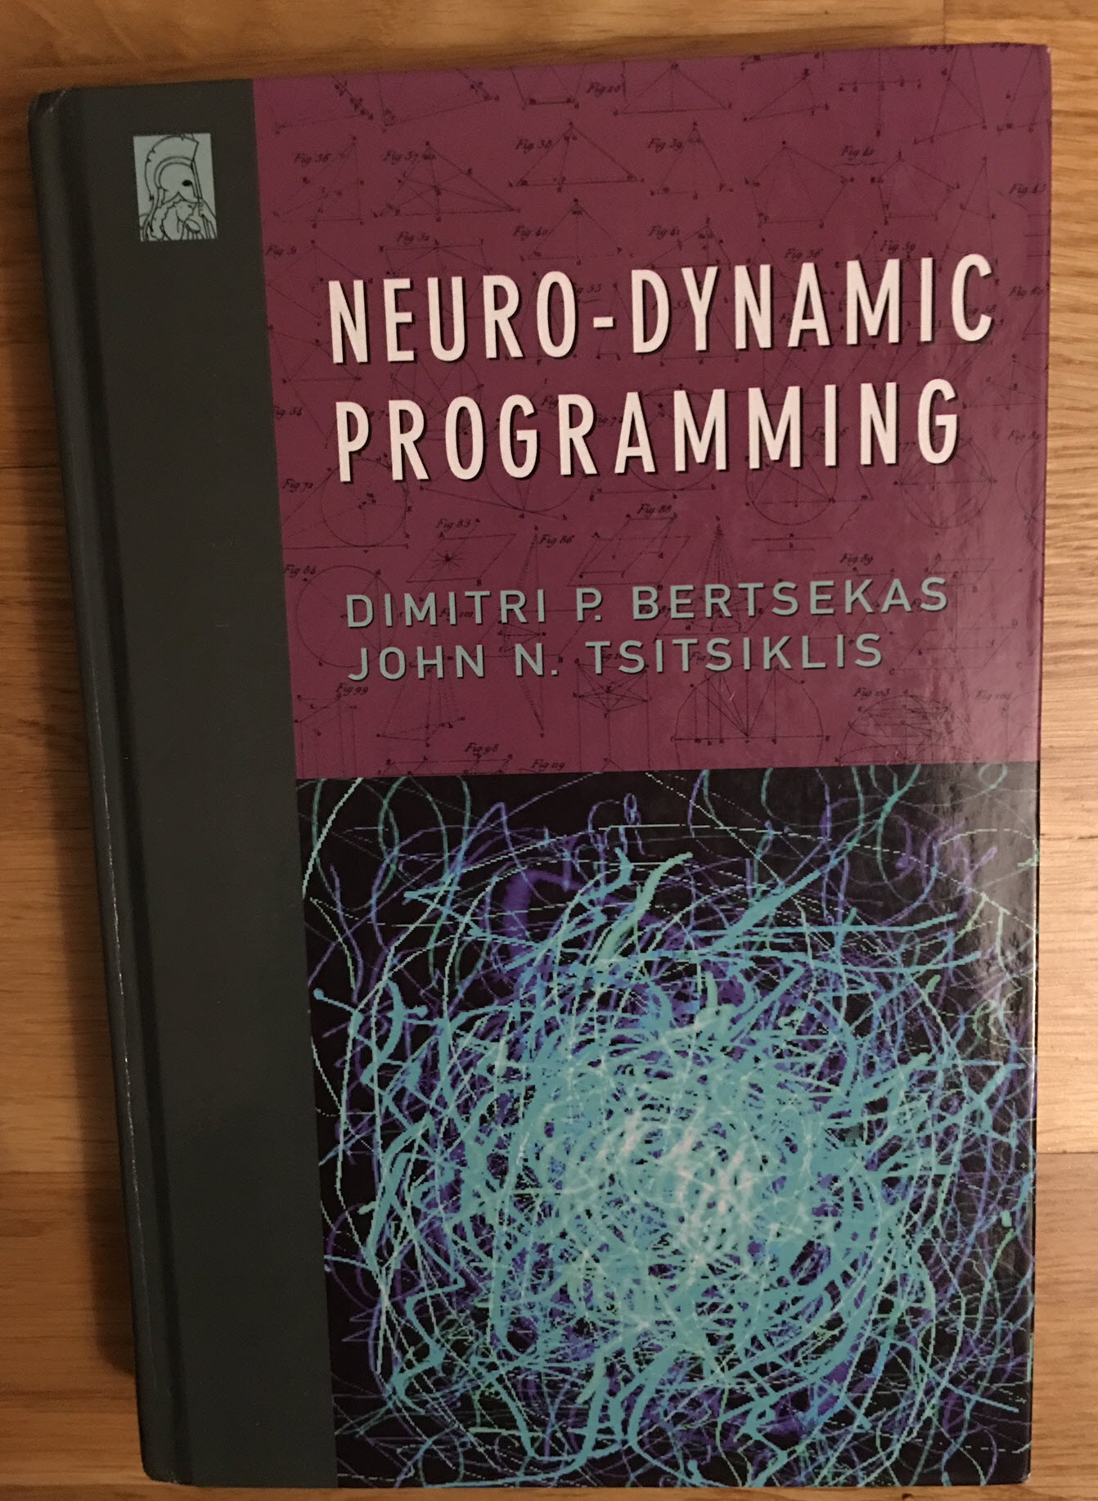
Books

Slide 14
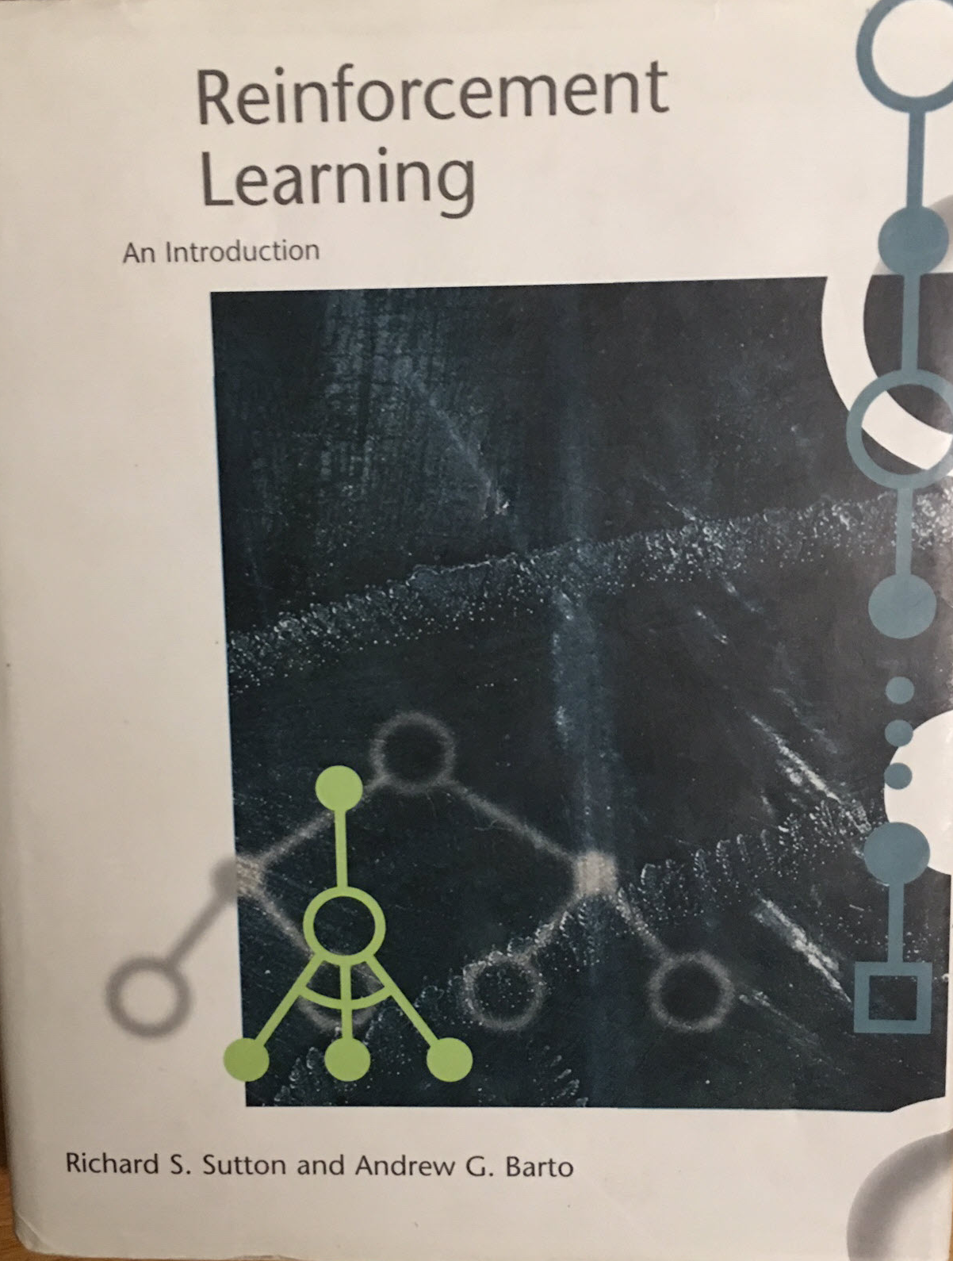
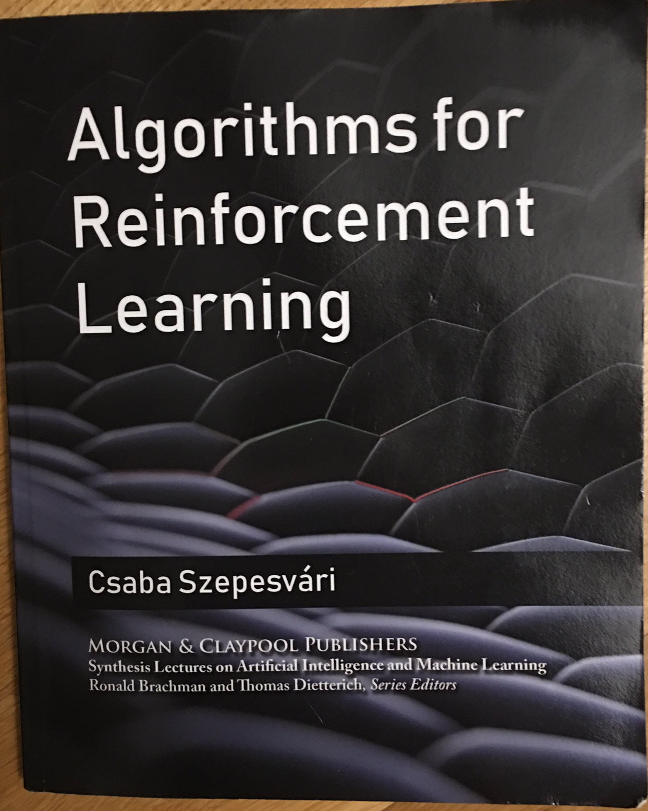

Slide 15
Demo
Speaker name

Slide 17
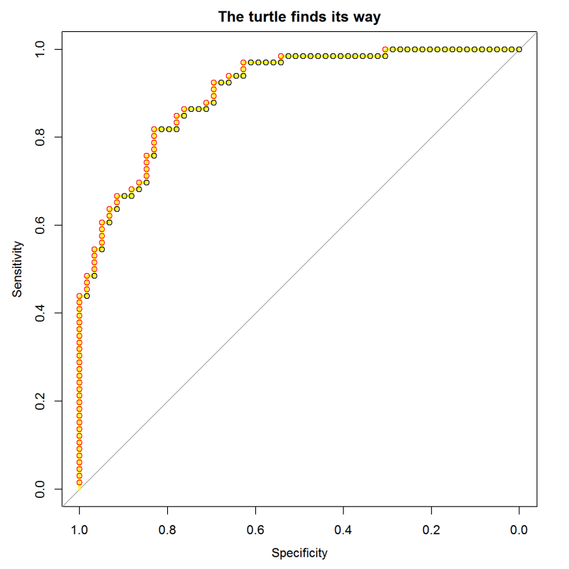
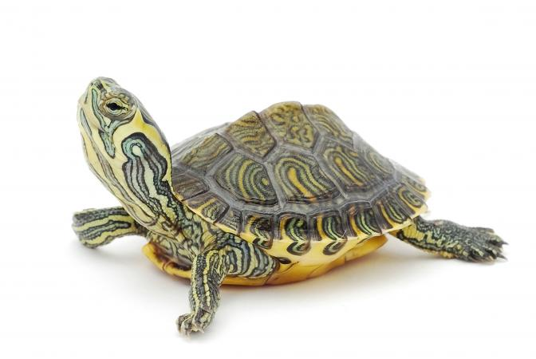
ROC Curve:
sort test cases by their score from the model
march along the sequence, stepping up for positives and right for negatives
This is the same as scanning across possible cutoff threshold values.
The slope of the curve shows the concentration of positives.
TPR
0.0 0.2 0.4 0.6 0.8 1.0
FPR
Notes:
The “turtle’s eye view” of ROC curves is described here:
https://blog.revolutionanalytics.com/2016/08/roc-curves-in-two-lines-of-code.html

Slide 18
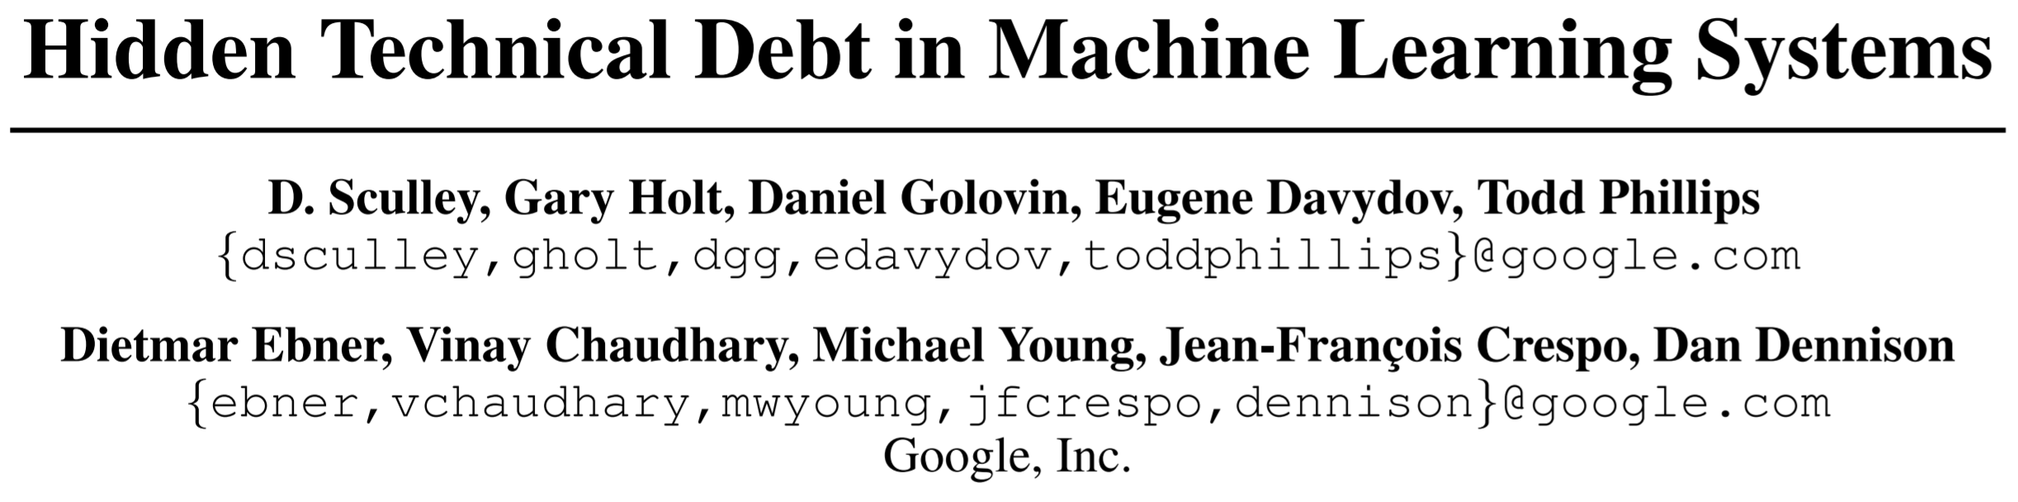
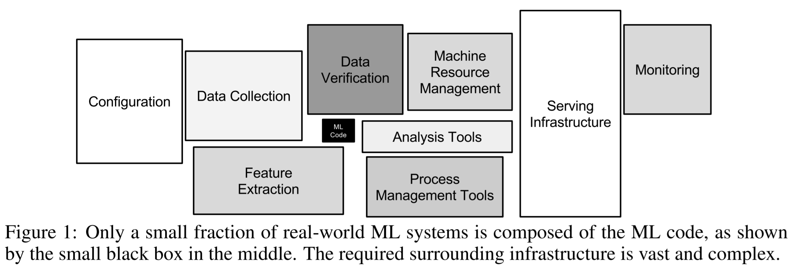
Notes:
ML code is just the little black box in the middle.

