Slide 1
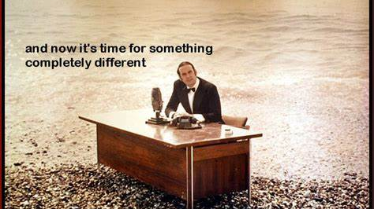

Slide 2
Reinforcement Learning Outline
Reinforcement Learning compared to Supervised Learning (10min)
Algorithms, Program Flow (10 min)
Navigation example (20 min)
- maze representation
- function approximation
Personalization example (20 min)
Context, unobservable belief state
Demo Other applications

Slide 3
Supervised Machine Learning
Predict
Current features
Prediction
Model
Train
Historic features
Data labels

Slide 4
Reinforcement Learning
Supervised Machine Learning
Current data
Predict
Prediction
Model
Historic data
Train
Data labels
Observed features
Agent
Action
Policy
Environment
State features
Data labels
reward

Slide 5
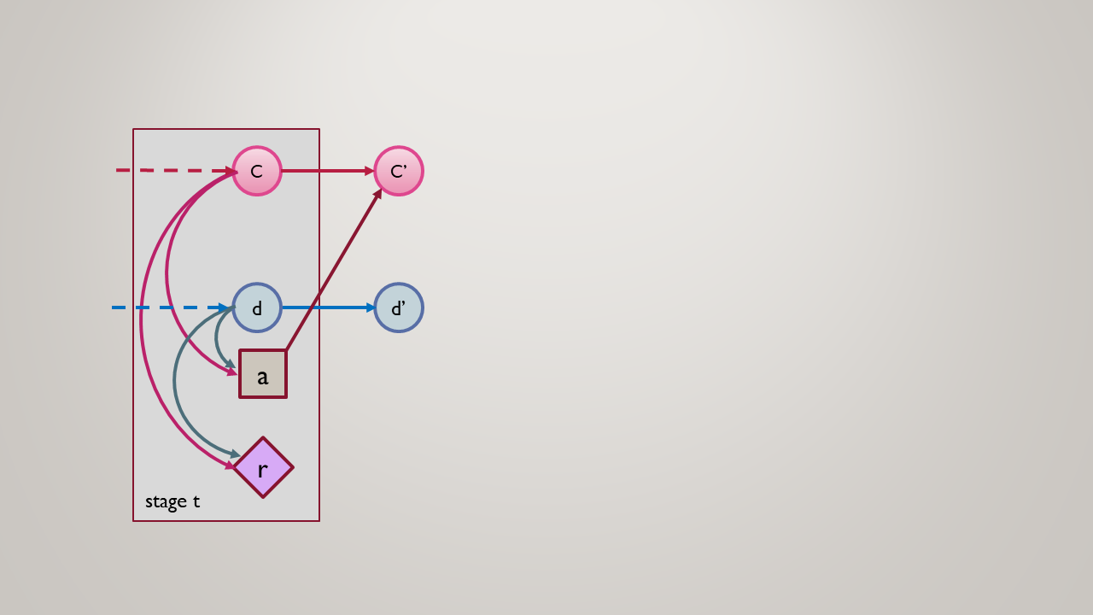
Reinforcement learning MDP
RL is the problem of controlling a Markov Chain with unknown probabilities.*

