Slide 2
Quantum Machine Learning
Nathan Wiebe and Mariia Mykhailova

Slide 3
Session goals
Understand what quantum computing is
Learn why it works
Introduce quantum machine learning
Learn how Q# can be used to build quantum neural networks
Notes:
This slide is required. Do NOT delete. This should be the first slide after your Title Slide.
This slide should describe what your goals are for this session. This information lets your audience know what you are trying to accomplish with your talk or tutorial—ie, what value will attendees get by investing 25 minutes or 2 hours of their time listening to you.
You should not spend more than 1 minute presenting this slide.
General examples of session goals could be (you will have to create your own specific goals):
Introduce a new technique or approach to solve a customer problem
Compare two approaches and explain why one is superior
Describe a project and the learnings that audience members can apply from it
Teach audience members how to use a specific technology

Slide 4
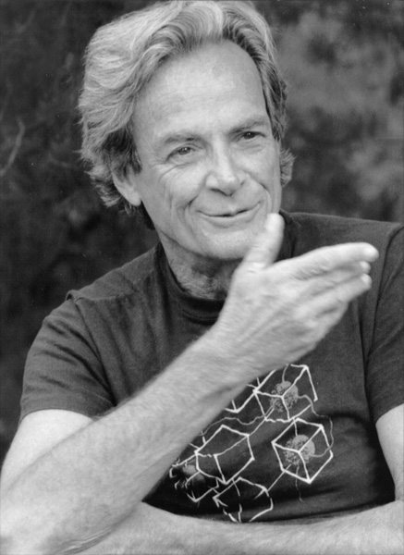
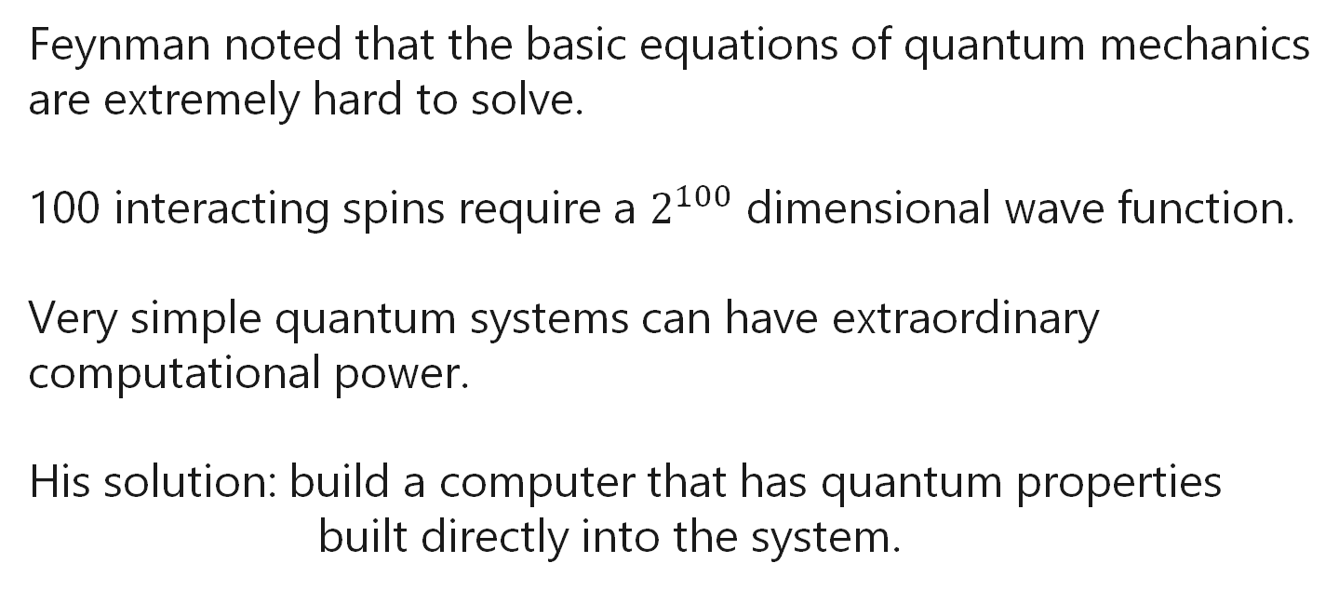
Quantum Mechanics and Computing
Feynman noted that the basic equations of quantum mechanics are extremely hard to solve.
100 interacting spins require a $2^{100}$ dimensional wave function.
Very simple quantum systems can have extraordinary computational power.
His solution: build a computer that has quantum properties built directly into the system.
Feynman
1982

Slide 5
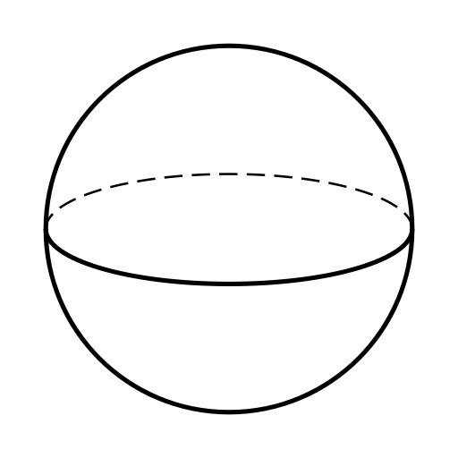



What is quantum computing?
A quantum computer is a machine that simply rotates quantum state vectors.
$2^{n}$ dimensional vector needs only $n$ quantum bits.
Measurement gives $n$bits of information.
$$ψ$$
$$Uψ$$

Slide 6
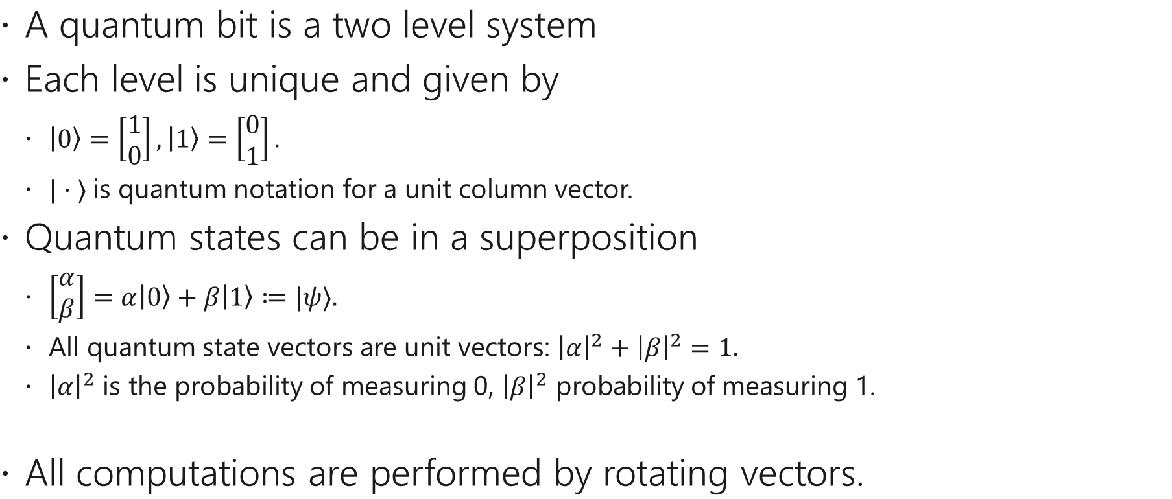


A Quantum Bit
A quantum bit is a two level system
Each level is unique and given by
$\left|0\right\rangle =\left[\begin{matrix}1 \\ 0\end{matrix}\right], \left|1\right\rangle =\left[\begin{matrix}0 \\ 1\end{matrix}\right].$
$|⋅ ⟩$is quantum notation for a unit column vector.
Quantum states can be in a superposition
$\left[\begin{matrix}α \\ β\end{matrix}\right]=α\left|0\right\rangle +β\left|1\right\rangle ≔|ψ⟩.$
All quantum state vectors are unit vectors: ${\left|α\right|}^{2}+{\left|β\right|}^{2}=1.$
${\left|α\right|}^{2}$ is the probability of measuring 0, ${\left|β\right|}^{2}$ probability of measuring 1.
All computations are performed by rotating vectors.
$$\left|0\right\rangle$$
$$\left|1\right\rangle$$

Slide 7
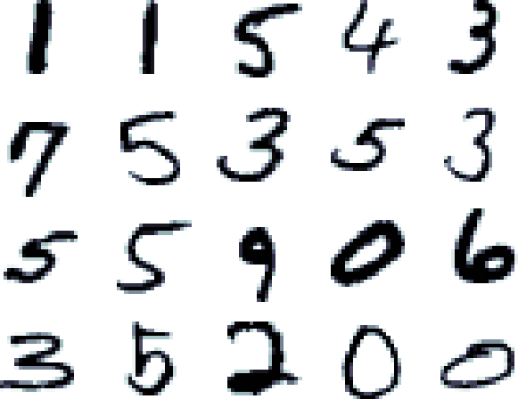
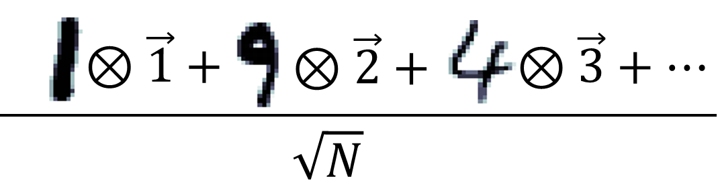

Structure of quantum algorithms
Encoding
Transformation
Measurement
Input Data
$$ψ=$$
Set of training vectors
Quantum state vector

Slide 8

Example
Flipping bits (X operation)
$$X(|0⟩)=|1〉 \\ X(|1⟩)=|0⟩ \\ X\left(X\left(|1⟩\right)\right)=|1⟩$$
Flipping phase of a bit (Z operation)
$$Z(|0⟩)=|0〉 \\ Z(|1⟩)=−|1⟩ \\ Z\left(Z\left(|1⟩\right)\right)=|1⟩$$

Slide 9
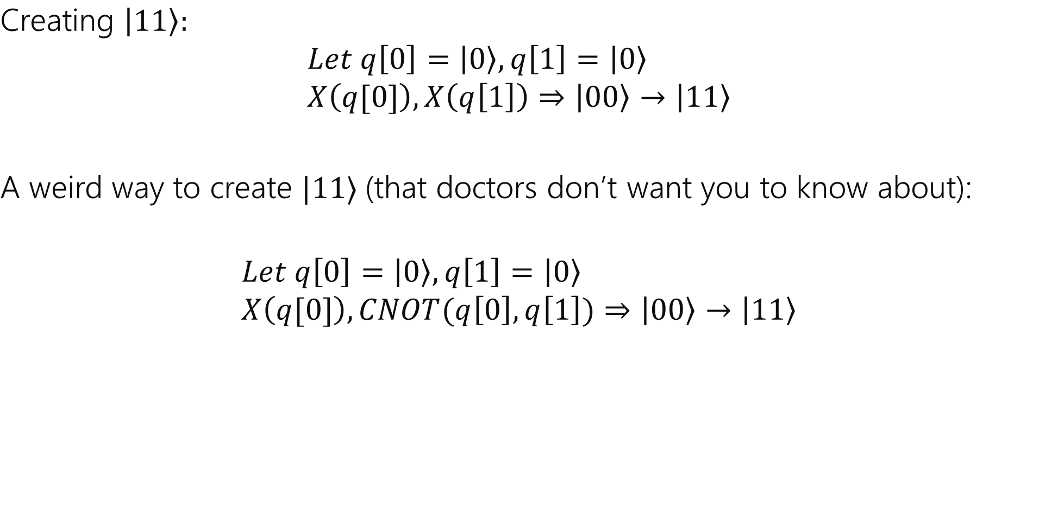
Example
Creating $\left|11\right\rangle :$ $$Let q\left[0\right]=\left|0\right\rangle ,q\left[1\right]=\left|0\right\rangle \\ X\left(q[0]\right), X\left(q\left[1\right]\right)⇒\left|00\right\rangle →\left|11\right\rangle$$
A weird way to create $|11⟩$(that doctors don’t want you to know about):
$$Let q\left[0\right]=\left|0\right\rangle ,q\left[1\right]=\left|0\right\rangle \\ X\left(q[0]\right), CNOT(q\left[0\right],q\left[1\right])⇒\left|00\right\rangle →\left|11\right\rangle$$

Slide 10

Example
Creating superposition
The Hadamard gate makes a 50/50 distribution of $|0⟩, |1⟩$
$$H\left(|0⟩\right)=\frac{|0⟩+|1⟩}{\sqrt{2}}≔\left|+\right\rangle \\ H\left(|1⟩\right)=\frac{\left|0\right\rangle −|1⟩}{\sqrt{2}}≔|−⟩$$
It also undoes superposition
$$H\left(H\left(|0⟩\right)\right)=|0⟩$$
H
H

Slide 11
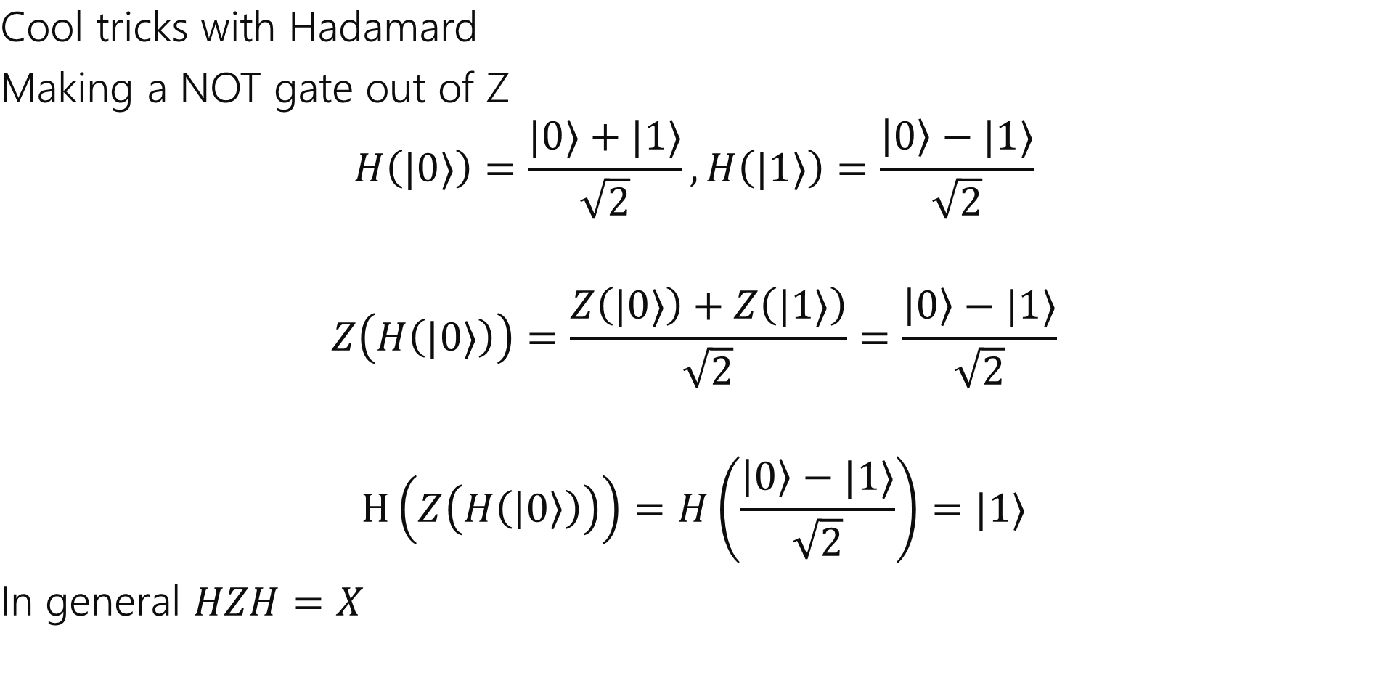
Example
Cool tricks with Hadamard
Making a NOT gate out of Z
$$H\left(|0⟩\right)=\frac{|0⟩+|1⟩}{\sqrt{2}},H\left(|1⟩\right)=\frac{\left|0\right\rangle −|1⟩}{\sqrt{2}}$$
$$Z\left(H\left(|0⟩\right)\right)=\frac{Z\left(|0⟩\right)+Z\left(|1⟩\right)}{\sqrt{2}}=\frac{\left|0\right\rangle −|1⟩}{\sqrt{2}}$$
$$H\left(Z\left(H\left(\left|0\right\rangle \right)\right)\right)=H\left(\frac{\left|0\right\rangle −|1⟩}{\sqrt{2}}\right)=|1⟩$$
In general $HZH=X$

Slide 12



Single qubit rotations
How do you make quantum superpositions that aren’t 50/50?
Any 1 qubit state can be made with 2 rotations!
$$Ry(−θ/2,|0⟩) = cos⁡(θ)|0⟩ +sin⁡(θ)|1⟩$$
|0⟩
z
$$\cos\left(θ\right)\left|0\right\rangle +\sin\left(θ\right)|1⟩$$
$$\frac{\text{|0}\text{⟩}+\text{|}\text{1}\text{⟩ }}{\sqrt{2}}$$
x
|1⟩

Slide 13
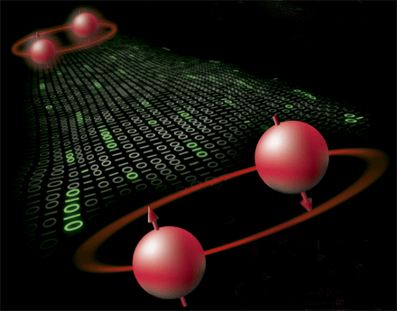
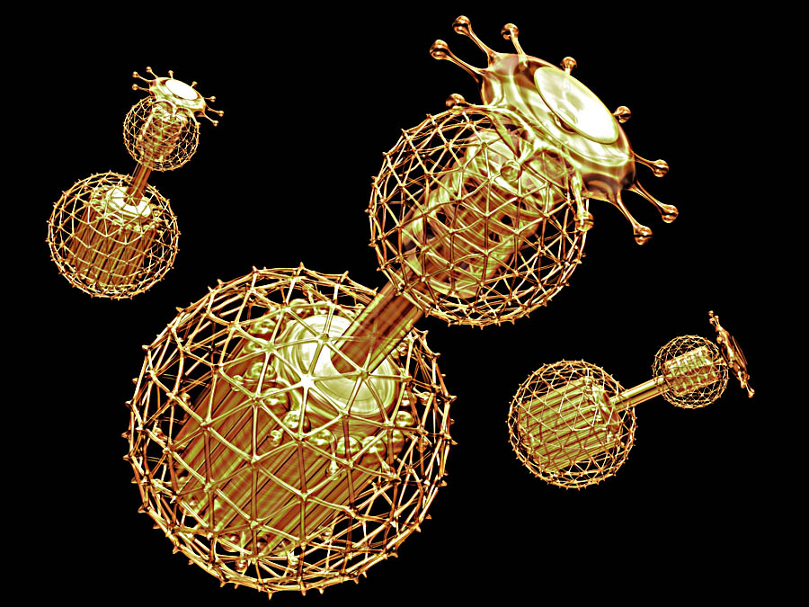
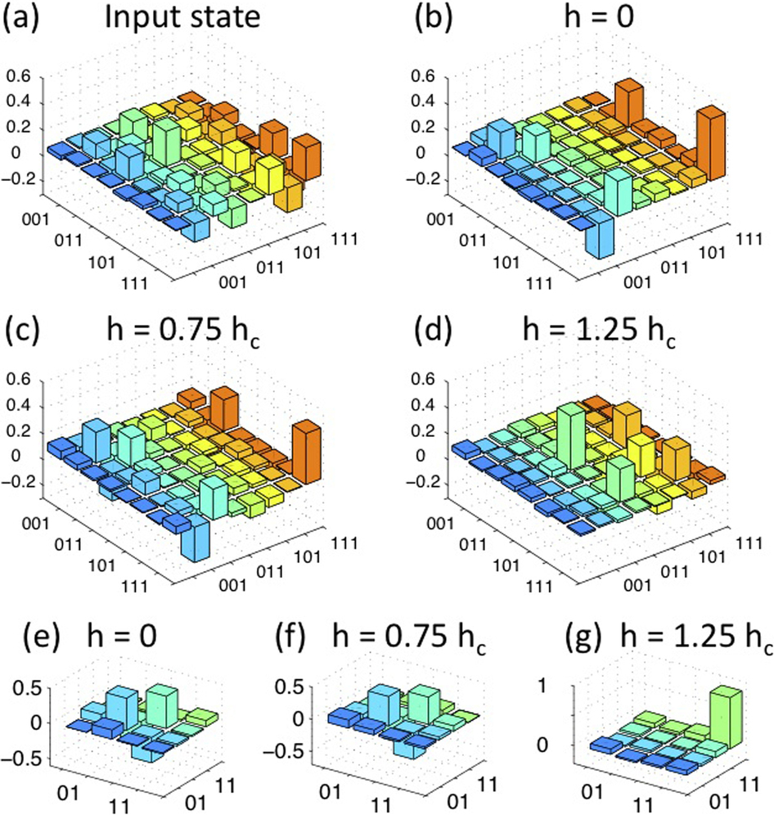
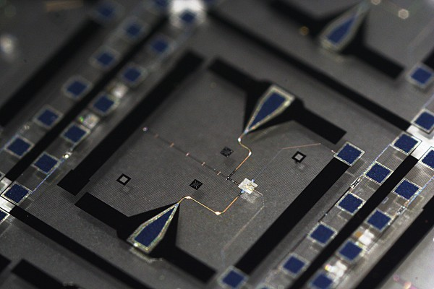
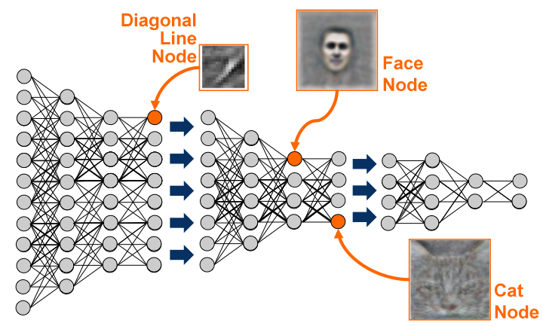
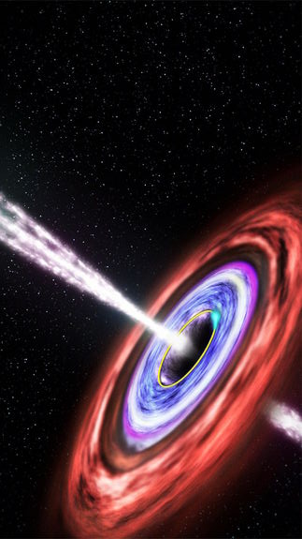
Goals of quantum ML
Find new applications of quantum computers to machine learning.
Devise new methods to learn information about quantum systems.
Understand the fundamental limits physics places on learning.

Slide 14



Quantum Perceptrons
Linear Perceptron:
A vector v is in class 0 if $v⋅n>0,$
It is in class 1 if $v⋅n<0.$
A quantum perceptron works by
Choose initial guess for angle $θ$.
Taking a quantum state vector ${\left|ψ\right\rangle }_{train}$ as input.
${\left|ψ\right\rangle }_{train}→Ry\left(θ\right){\left|ψ\right\rangle }_{train}.$
The state is measured and the result is stored.
The above steps are repeated and the most likely outcome is set to be the class.
This is repeated for each training vector in the set.
The classification error is computed and the weights $θ$is updated to optimize the training error.
Class 0
n
$$θ =π/2$$
Class 1
P(success) = 50%
P(success) = 100%

Slide 15
Quantum Perceptron Training Code github.com/Microsoft/MLADS2018-QuantumML
Quantum Development Kit docs.microsoft.com/quantum
The Quantum Katas github.com/microsoft/quantumkatas
Open Source Libraries and Samples github.com/microsoft/quantum github.com/microsoft/quantumlibraries

