Slide 1
Modern SharePoint Workshop
Module 4: Hub Sites

Slide 2
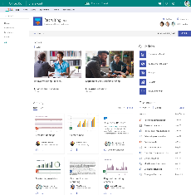
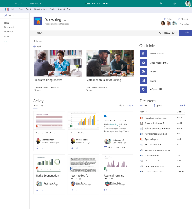
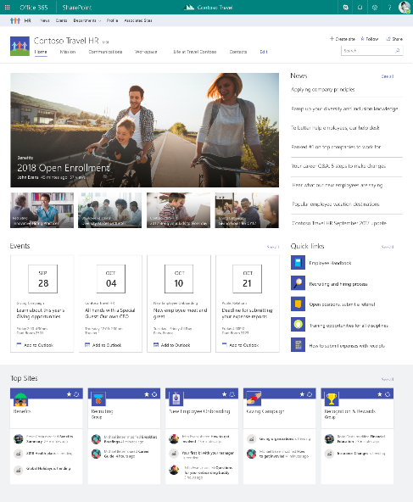
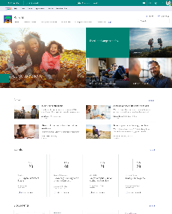
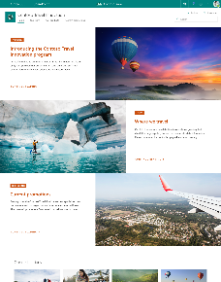
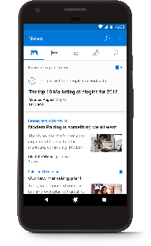
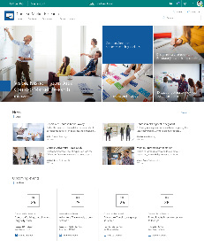
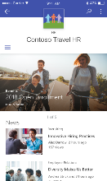
SharePoint hub sites
team sites
hub site
Brings together related team sites and communication sites
Roll up news and site activity
Search across related sites
Cross-site navigation
Consistent look-and-feel across sites
Admins create, users adopt and use
communication sites

Slide 3



A dynamic, ever-changing digital workplace
Acquired sales
Travel innovation
Vendor agreements
Customer connections
Legal portal
Travel
Programs
Company-wide
Quarterly reports
Regional sales
Sales
Expense tracker
Cultural
Eco
Records center
Adventure
Benefits
planning
Big wins
Customer
Event planning
Benefits
Regional partner outreach
Recognition & rewards
New hires
EMEA
EMEA sales
Policies
key
HR
Hub site
Communication site
Team site
Partner solution
Custom portal

Slide 4
A dynamic, ever-changing digital workplace
Acquired sales
Travel innovation
Vendor agreements
Customer connections
Legal portal
Travel
Programs
Regional sales
Company-wide
Quarterly reports
Sales
Expense tracker
Cultural
Eco
EMEA sales
Records center
Adventure
Benefits
planning
Big wins
Customer
Event planning
Benefits
Regional partner outreach
New hires
EMEA
Recognition & rewards
Policies
key
HR
Hub site
Communication site
Team site
Partner solution
Custom portal

Slide 5
SharePoint sites: building blocks for your intranet
Hub sites
Team sites
Communication sites
A communication site or team site
Created by users or admins
Created by admins
Created by users or admins
Navigation
Theme and logo
Search scope
News and activity rollup

Slide 6
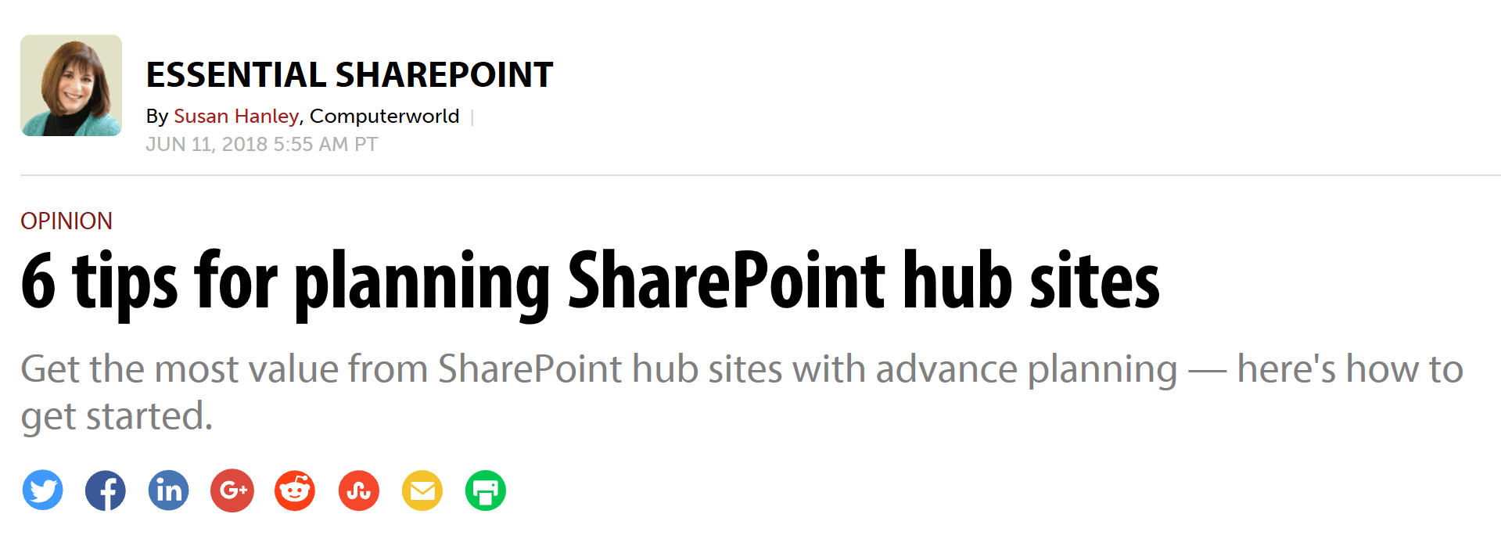
6 tips for planning SharePoint hub sites
https://www.computerworld.com/article/3280102/enterprise-applications/6-tips-for-planning-sharepoint-hub-sites.html

Slide 7
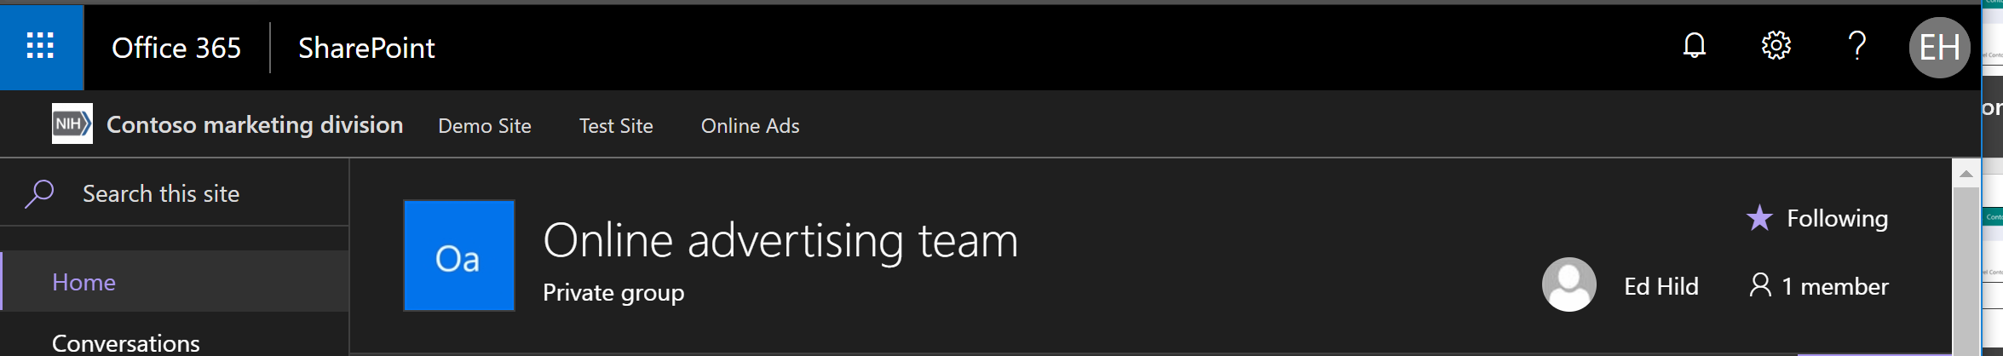
Shared Navigation
Notes:
At the top of a hub site and any associated sites, above the site navigation, is the hub site navigation bar. If you are the hub site owner, you can customize this navigation bar with links that make sense for your hub site and associated sites.

Slide 8
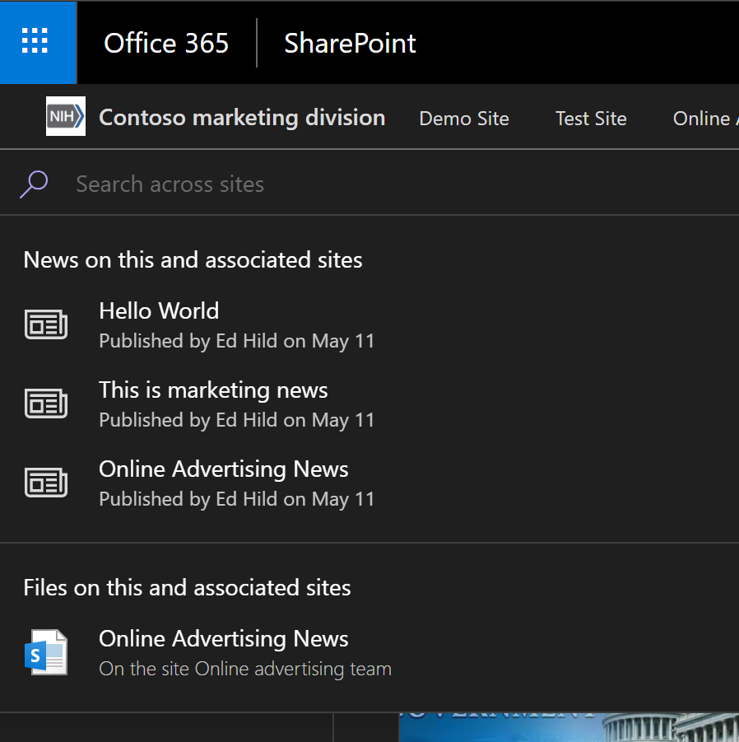
Search across the hub
Notes:
When you search from a SharePoint hub site, content on the hub site itself along with content on any associated sites is returned in the search results. Users will only see content for which they have access to.

Slide 9
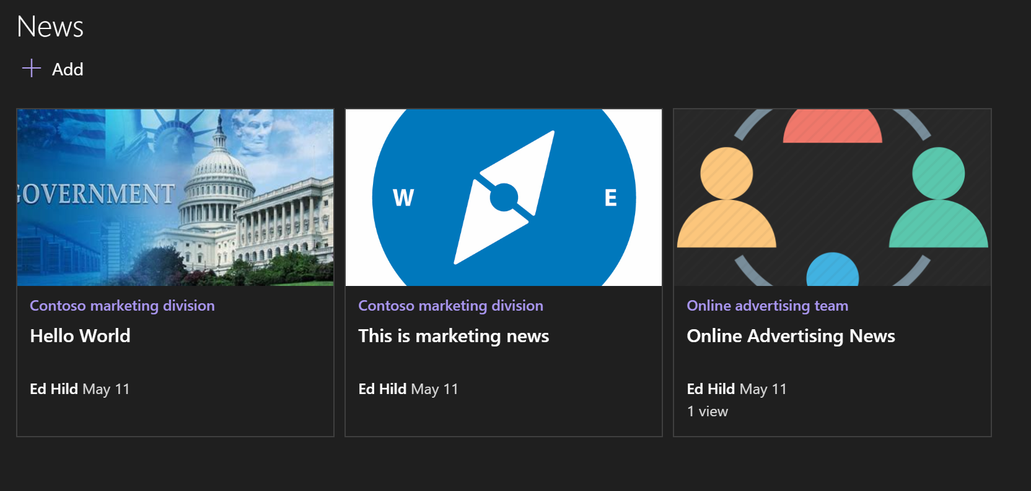
News roll up
Notes:
News published on a hub site and on any associated sites is automatically aggregated and shown on the home page of the hub site by using the News web part. You can choose which associated sites display news on the hub site home page and users will only see news for sites they have access to. Clicking on a news article link takes you to the site on which the article appears.

Slide 10
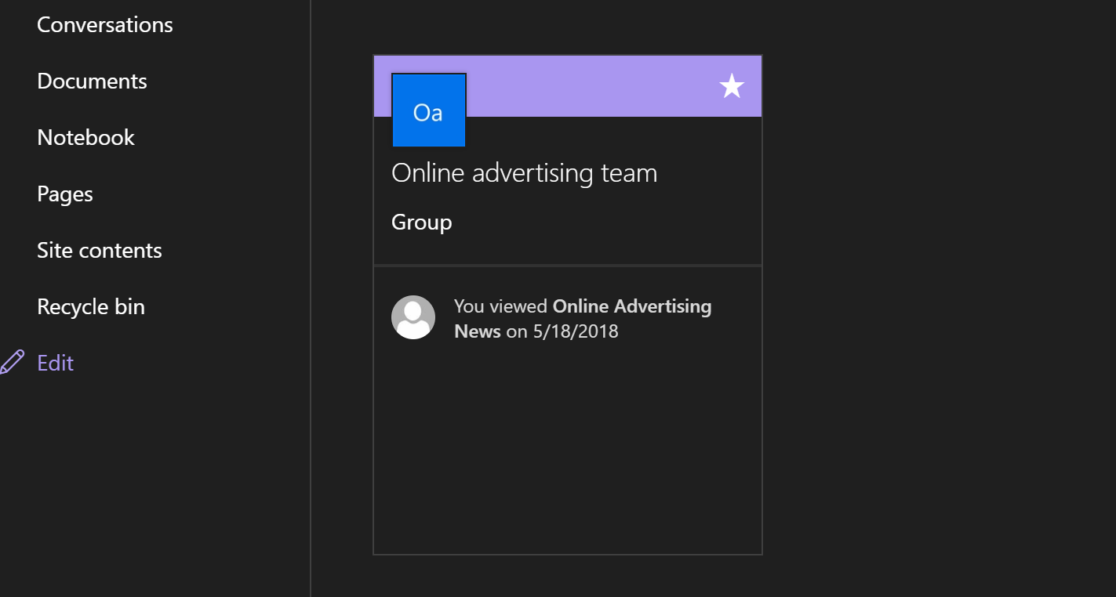
Associated Sites
Notes:
Display the most active sites associated with the hub site on the home page by using the Sites web part.

Slide 11
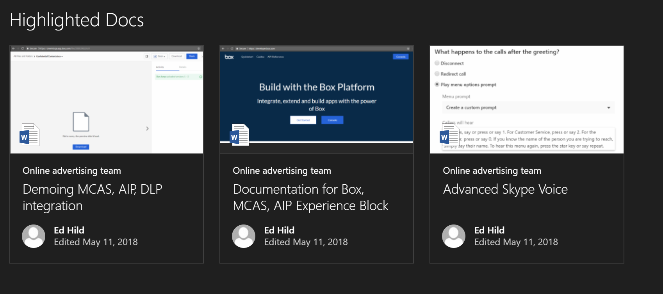
Highlighted Content
Notes:
Use the Highlighted content web part to dynamically display content from sites associated with the hub site on the home page.

Slide 12
Important Points
Sites associated with a SharePoint hub site don't inherit the permissions of the hub site or any other sites associated with it.
Hub settings will only appear on modern pages
You can create up to 50 hub sites for an organization
No limit to the amount of associated sites
A lot of the Hub functionality is Search driven. You may need to wait for Indexing to occur for content from the associated sites to appear
Cannot cross geos in a multi-geo tenant

Slide 13
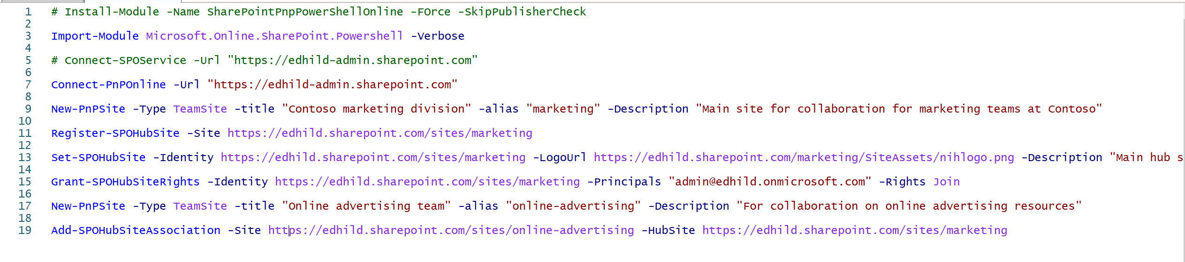
Hub Sites PowerShell

Slide 14
Important PowerShell Commands
Register-SPOHubSite url Converts a site to a hub site and enables hub features
Grant-SPOHubSiteRights -Identity -Principals GroupEmail -Rights Join Controls which users are allowed to establish the join of an associated site
Add-SPOHubSiteAssociation –Site url –HubSite url Establishes a new association between site and the hub (can also be done in the browser)

Slide 15
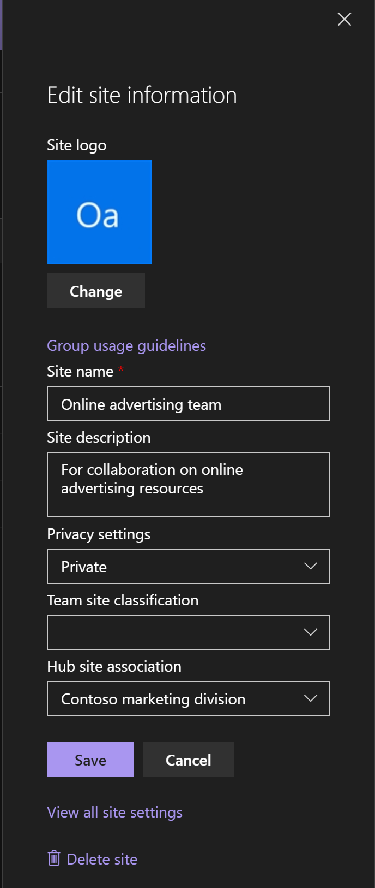
Associating a Site to Hub

Slide 16
Communication sites, pages, and web parts roadmap
 | Pages & news | Web parts | Communication & hub sites
Q1 2018 | Content bar on pages and news Create News from SharePoint Home Authoring canvas updates (Font size, color, highlight, advanced formatting, indent) Start from existing Page or News Promote page as News Create & Edit Tables Multi-column sections canvas updates Mobile notifications | Kindle News (gets hub support) Planner Sites Twitter Yammer (native + mobile) | New tenant admin with communication site support Site scripts and site theming
Q2 2018 | News and Pages integration into Microsoft Teams Email News digest Page change management (Version history, edit session) Custom metadata | Image improvements Page properties (metadata) PowerApps Office 365 connectors Weather | Rollout of Hub sites to 100% Custom metadata for pages and news, and web part support Content approvals and custom flows with Microsoft Flow
Q3 2018 | Page Layouts Canvas updates for spacing and new layouts @ mention in comments with notifications | Highlighted content updates Stream improvements | Audience Targeting of pages and news

