Slide 1



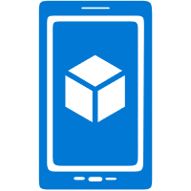
Database from IoT Demo Solution
Azure Spatial Anchor Service
Mixed
Reality API
Cosmos DB
Android
Application
iOS
Application
HoloLens
UWP Application

