Slide 1
Key Logger Detector
CSE 337L
Cryptography Lab

Slide 2
Done By
Bhasva Teja Chava – AP20110010241
Challa Hemantha Krishna– AP20110010282
Eswar Pavan B– AP20110010271
Yeswanth D– AP20110010238

Slide 3
CONTENTS
What is keylogger
Working of keylogger
Features of keylogger
Keylogger Detection

Slide 4
What is keylogging
It is an act of tracking and recording every keystroke entry made on a computer, often without the permission or knowledge of the user.
Each keystroke transmits a signal that tells your computer programs what you want them to do.
A program or hardware device that capture every key impression on the system.
Used to monitor user’s activities.

Slide 5
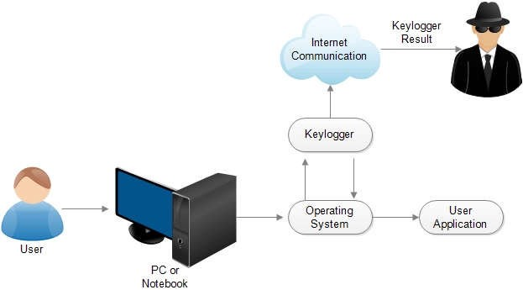
How a keylogger works
When we type something on a keyboard it send a signal to OS, this keylogger captures that signal with the help of internet and send it via mail using Smtp ports to the end user.

Slide 6
Importance of Key logger
Keyloggers are a surveillance tool with legitimate uses for personal or professional IT monitoring.
Keyloggers can be used for a variety of purposes; hackers may use them to maliciously gain access to your private information, while employers might use them to monitor employee activities.

Slide 7
Features of Key logger
Remote viewing email delivery
Log exporting
Optimal stealth mode
Log Filtering

Slide 8
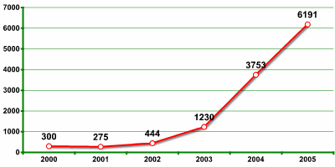
Key logging functionality of one company in Verisign’s recent report as rapid growth in malicious program

Slide 9
Keylogger Detector
Antivirus software can detect keystroke loggers. When antivirus software scans your device for keystroke loggers and other types of malware, it acts as a keystroke logger detector.
Anti-viruses act as a first line of defense against keyloggers, but often they are unable to detect the viruses and the computer ends up being infected. Keylogger Detector aims to provide another layer of defense by providing a monitoring tool that monitors the common ways keyloggers send information from the computers to the hacker and warns the users for the same.

Slide 10
How does Detector work?
This program focuses on combating keylogger software by monitoring all running applications, targeting those attempting to communicate through popular SMTP ports for Gmail, Yahoo, Microsoft for both Windows and Linux machines.
Once the software has targeted an application that is communicating through specific SMTP ports, the process will be paused, and the user will be notified of the potential threat. Then, the user will be asked if this process should be added to a trusted whitelist to continue running as normal or kill the process immediately and be added to a blacklist so that any other time this process is detected it will be automatically terminated.

Slide 11
Popular SMTP servers that are monitored by the Keylogger Detector are:
smtp.gmail.com StartTLS 587
smtp.live.com SSL 465
smtp.live.com StartTLS 587
smtp.office365.com StartTLS 587
smtp.mail.yahoo.com SSL 465
smtp.aol.com StartTLS 587
smtp.att.yahoo.com SSL 465
We will constantly check these SMTP ports to detect any suspicious activity. By doing so, we will instantly know if a keylogger tries to send our data from our machine to the hacker through email.
The user is then prompted with a whitelisting decision.
We add that process to the whitelist if the user presses the key "y," else we put it to the blacklist.
We terminate any processes that are found to be on the blacklist.

Slide 12
Conclusion
Keyloggers work by logging all the keystrokes and storing the file locally for a fixed period, after which they send the log file to the hacker through an email. Knowing this, we design a Keylogger Detector that monitors the most used SMTP ports to detect the processes trying to communicate using email.
The best way to protect yourself and your equipment from falling victim to keyloggers is to scan your system regularly with a quality cybersecurity program.

Slide 13
Thank You

