Slide 1


MapReduce and Apache Spark
Bhathiya Bandara
239147H

Slide 2

Agenda
Introduction to MapReduce and Apache Spark
Demo in Amazon EMR
Experiment Results
Compare and contrast MapReduce and Apache Spark
Conclusion

Slide 3

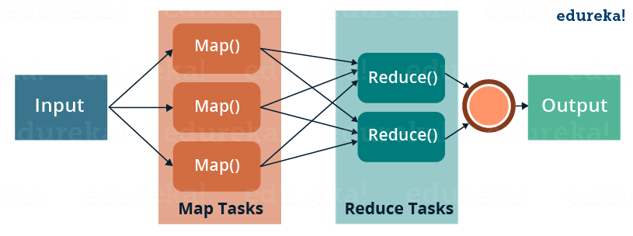
MapReduce
Programming Model and Framework allows to process and analyze large datasets
Run in distributed and parallel manner
It was first introduced by Google in 2004
Contain main two phases
Mapper
Input data is divided into smaller chunks and processed in parallel by multiple nodes
Outputs key value pairs
Reducer
Key-value pairs are shuffled and sorted
then reduced to produce the final output

Slide 4
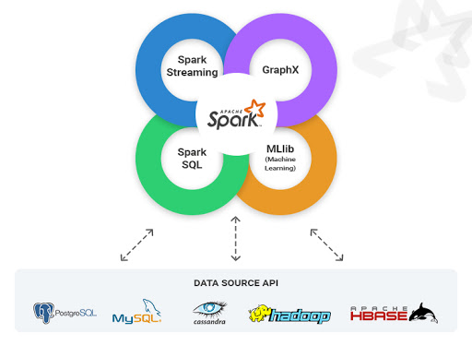
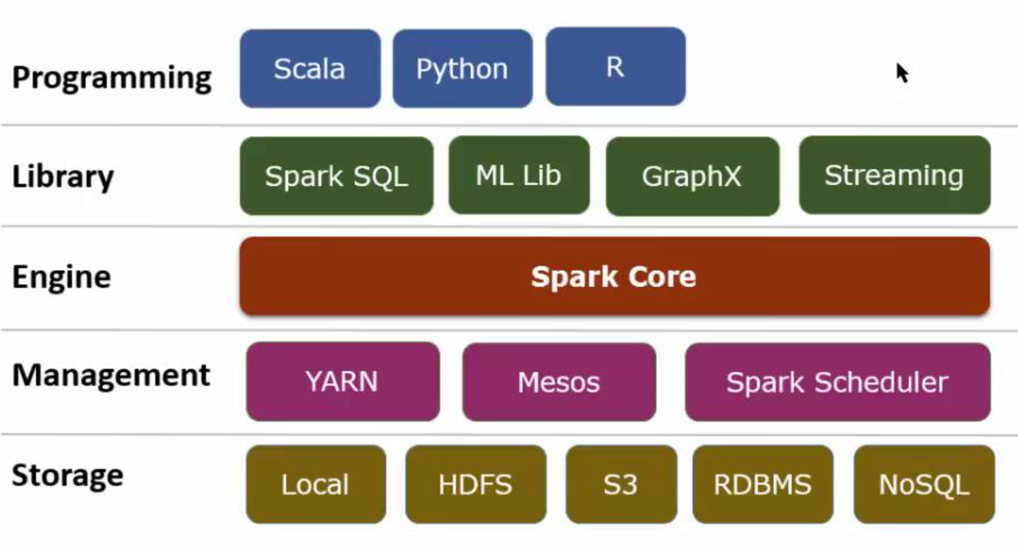
Apache Spark
Open-source distributed computing system
It was first introduced in 2012
Spark is an in-memory processing system which decrease the processing delay.
Supports variety of programming languages, including Java, Scala, and Python
supports a wide range of data sources, including Hadoop Distributed File System (HDFS), Cassandra, MySQL
Includes ML library and support Spark SQL

Slide 5
Demo

Slide 6
Results

Slide 8
MapReduce and Apache Spark
Factor | Spark | MapReduce
Data Processing capability | Batch Processing/ Real Time processing Use In memory | Batch Processing Use file systems
Speed | Very Fast compared to MapReduce | High Latency Computing
User Friendliness | Development effort is less | Development effort is High
Resource Usage | Need more memory/ Store data in Memory | Need less Memory / Store data in Disks
Programming language | Supports Java, Scala, Python, R | Supports Java and Python

Slide 9

Conclusion
Based on the results, as expected, we can see that Spark Performance is much better than the Hadoop Hive
Hadoop is better for batch processing and handling large files, while Spark is better for real-time processing and interactive analytics.

Slide 10

THANK YOU

