Slide 1





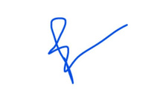


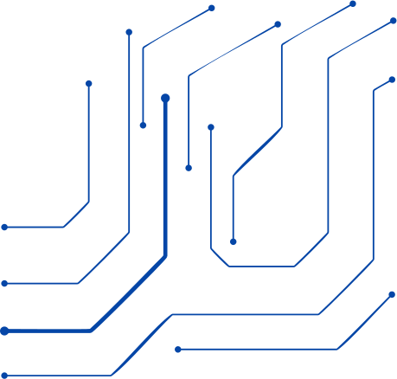
Certificate oF Participation
This certificate is presented to
NAME_PLACEHOLDER​
for successfully participating in the Two Days Workshop organized by the Department of Computer Science & Engineering at Netaji Subhas University of Technology, New Delhi from 10th-11th March, 2025 on
“Fundamentals of Deep Learning and its Applications for Security”
Dr. Geetanjali
Convenor
Dr. Preeti Kaur
Coordinator

