Slide 1

Analysis of Few Segmentation Algorithms IMGS609 Exploratory Project 02 Presented By: Ramesh Bhatta CIS RIT Imaging Science PhD Program
Rochester Institute Of Technology, One Lomb Memorial Drive
Rochester, New York, 14623

Slide 2
Introduction:
Image segmentation: It is the process of dividing a digital image into various image segments, often known as image regions or image objects.
APPLICATIONS:
Medical image analysis
Object Identification
Video surveillance
Satellite image analysis and so on.
This project was chosen to explore and visualize the different Image Segmentation Algorithms.
Number of Algorithms are proposed for Image Segmentation, here I used 5 (3 from scratch and two more advanced ones) of them and tried to visualize/analyze their outcomes.
Simple Thresholding Based Image Segmentation Algorithm
Region Growing Based Image Segmentation Algorithm
Edge Detection(Roberts) Based Image Segmentation Algorithm
K-mean Clustering Based Image Segmentation Algorithm
Mean Shift Clustering Based Image Segmentation Algorithm

Slide 3
Technical Description of Methods:
Any simple image can be used as an input/data to the three algorithms and results can obtained from each algorithms as follows:
Thresholding Based Image Segmentation Algorithm:
Thresholding is the simplest method of segmenting images. In simple thresholding method we replace each pixel in of a grayscale image with a dark pixel if the image intensity is less than certain threshold and with a bright pixel if the pixel intensity is greater than that threshold. I here used two techniques for choosing the threshold for getting different ROI:
1. Manual Histogram Based Thresholding
In this techniques, we manually investigate the histogram of a grayscale image and determine the values of threshold we would like to use to differentiate different regions in the image.
2. Multi-Otsu Thresholding
In this technique we do not use the threshold values manually for different ROI in the image but use automatic multi-Otsu thresholding to separate the pixels of an input mage into unique classes, each depending on the intensity of gray levels within the image.

Slide 4
Explanation Of The Steps:
Grayscale Image
Segmented Image
Thresholding
Automatic Thresholding
Manual Thresholding

Slide 5
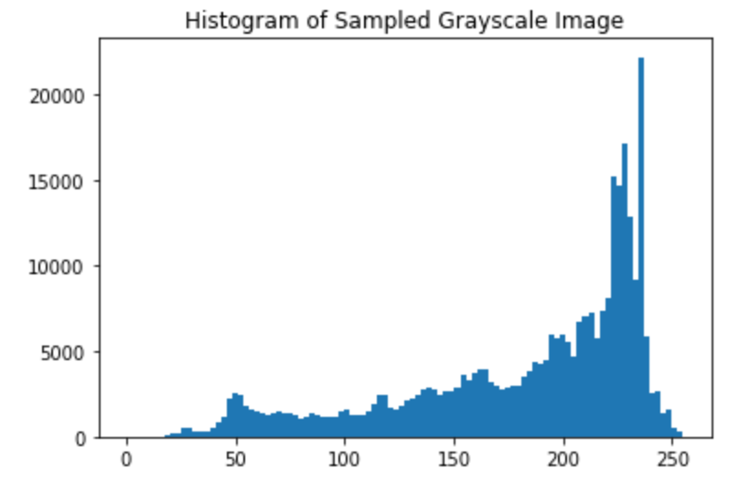
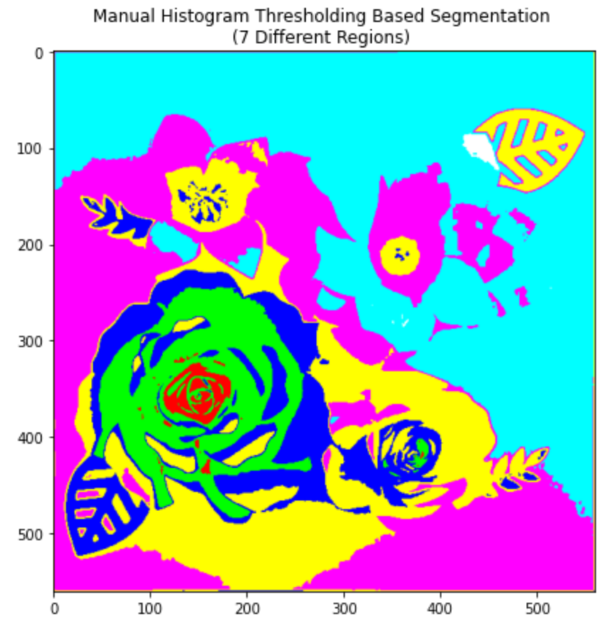
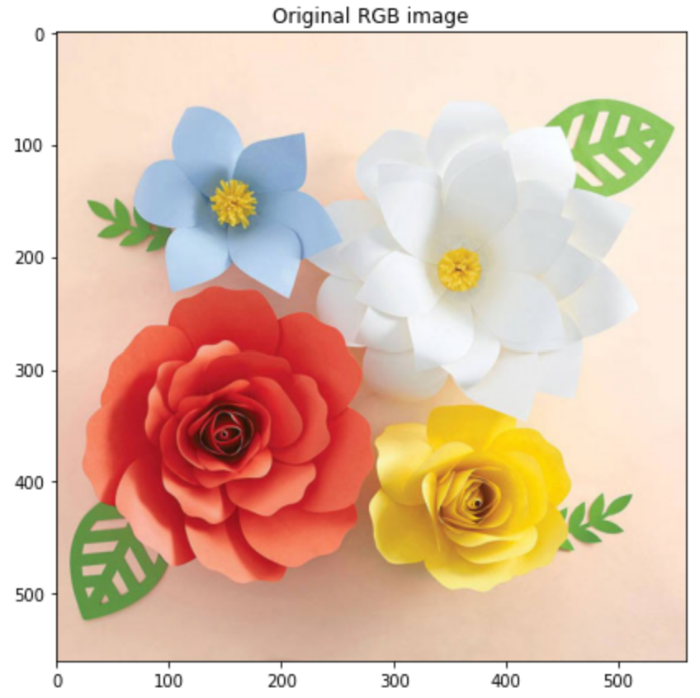
RESULT: The Visual Results For Thresholding Based Image Segmentation are presented below: 1.
Histogram Based Thresholding Segmentation
Sample Image Source: https://dejavuboutik.com/products/big-bloom-garden-party-flowers-diy-craft-kit

Slide 6
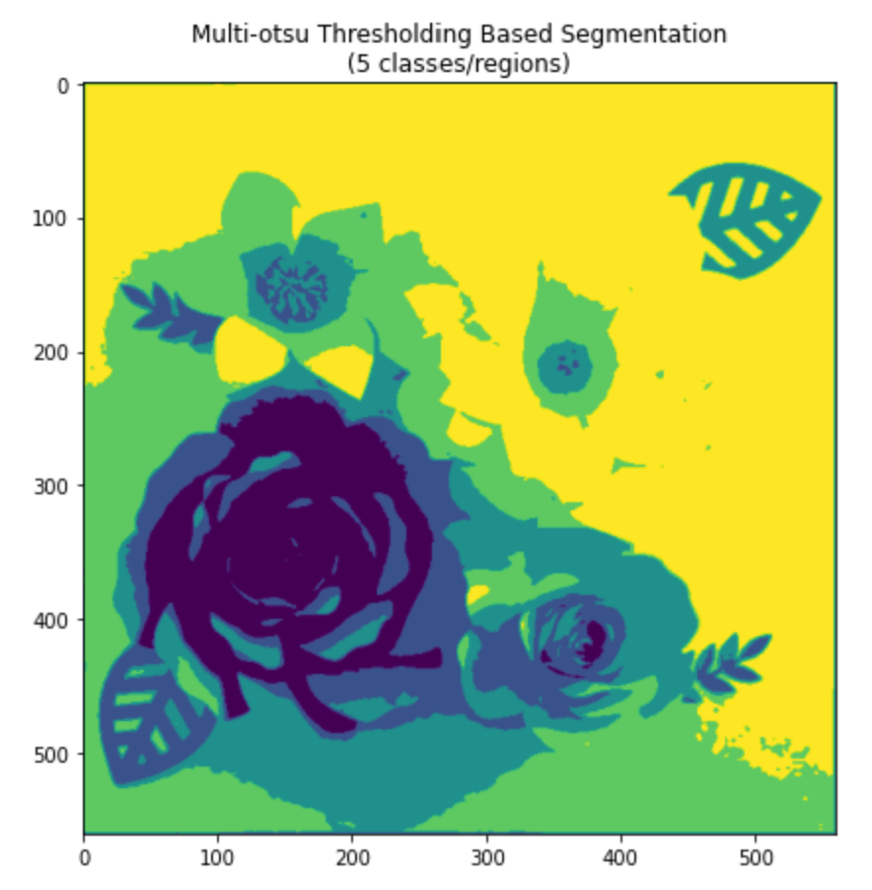
RESULT contd: 2. Otsu Thresholding Based Segmentation
Multi-Otsu Thresholding Segmentation
Sample Image Source: https://dejavuboutik.com/products/big-bloom-garden-party-flowers-diy-craft-kit

Slide 7
B. Region Growing Based Segmentation Algorithm
This segmentation method evaluates initial seed points' surrounding pixels to determine whether those pixels should be included in the region.
Grayscale Image
Determine the neighbors
Determine if the seed pixel show some similarity to neighboring pixels
Select a seed pixels
If Yes, set the seed pixel value to true and move to next neighboring pixel
Repeat the process and grow the region until all the similar neighboring pixel are covered
Keep Iterating until discontinuity if sound

Slide 8
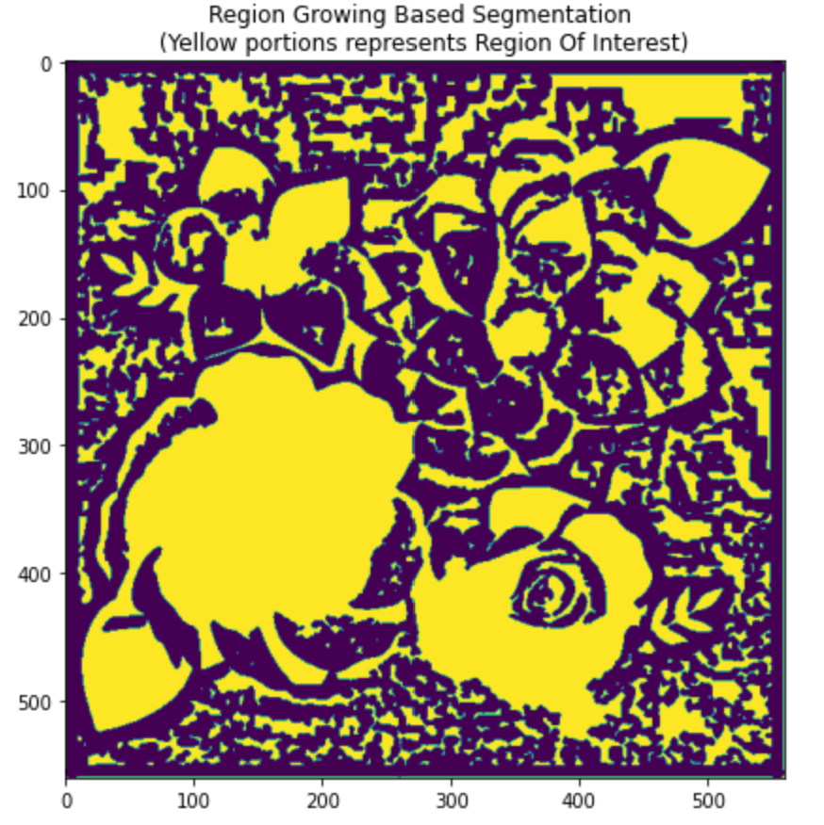
RESULT: Region Growing Based Segmentation
Region Growing Based Segmentation
Sample Image Source: https://dejavuboutik.com/products/big-bloom-garden-party-flowers-diy-craft-kit

Slide 9
C. Edge Detection Based Image Segmentation Algorithm(Roberts Edge detection):
Grayscale Image
Edge Detection
Output Segmented image

Slide 10
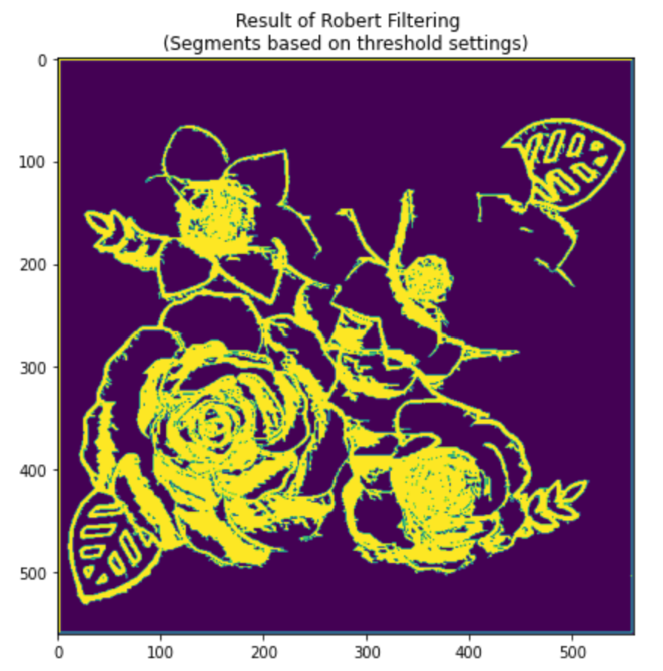
RESULT: Edge Detection Based Image Segmentation
Edge Detection Based Image Segmentation
Sample Image Source: https://dejavuboutik.com/products/big-bloom-garden-party-flowers-diy-craft-kit

Slide 11
D. K-Mean clustering Based Segmentation Algorithm:
The K-means clustering algorithm is an unsupervised algorithm that can be used to separate the area of interest from the background. It partitions the given image pixels into K-clusters or regions based on the K-centroids.
Grayscale Image
K-Mean Clustering
Output Segmented image
2. Place each pixel to their closest centroid which gives us K-clusters
3.Iterate: Compute and place new centroid of each cluster and reassign closer pixels to new cluster until no change in new cluster is observed
1. Choose k-clusters and select random k centroids(pixels in images)

Slide 12
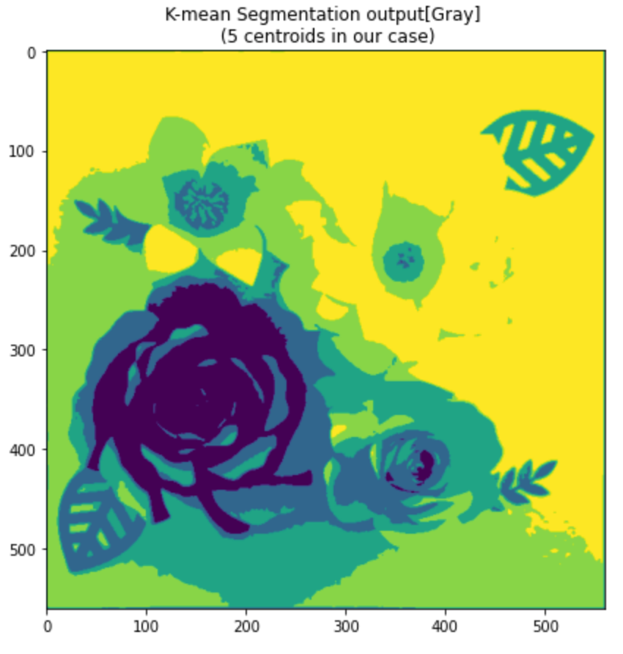
RESULT: K-Mean Clustering Based Image Segmentation
K-mean Clustering Based Image Segmentation
Sample Image Source: https://dejavuboutik.com/products/big-bloom-garden-party-flowers-diy-craft-kit

Slide 13
E. Mean-Shift clustering Based Segmentation Algorithm:
Mean Shift is also an unsupervised algorithm used for clustering. It is more flexible and gives accurate clustering because of its non-parametric nature and doesn’t require any predefined cluster shape.
Grayscale Image
Mean-Shift Clustering
Output Segmented image
2. Calculate the center of gravity(“mean”) of W
3.Iterate: Shift the search window to the mean and repeat until mean converges to a value.
1. Initialize random seed, and window W
4. Merge windows that end up near the same “peak” .

Slide 14
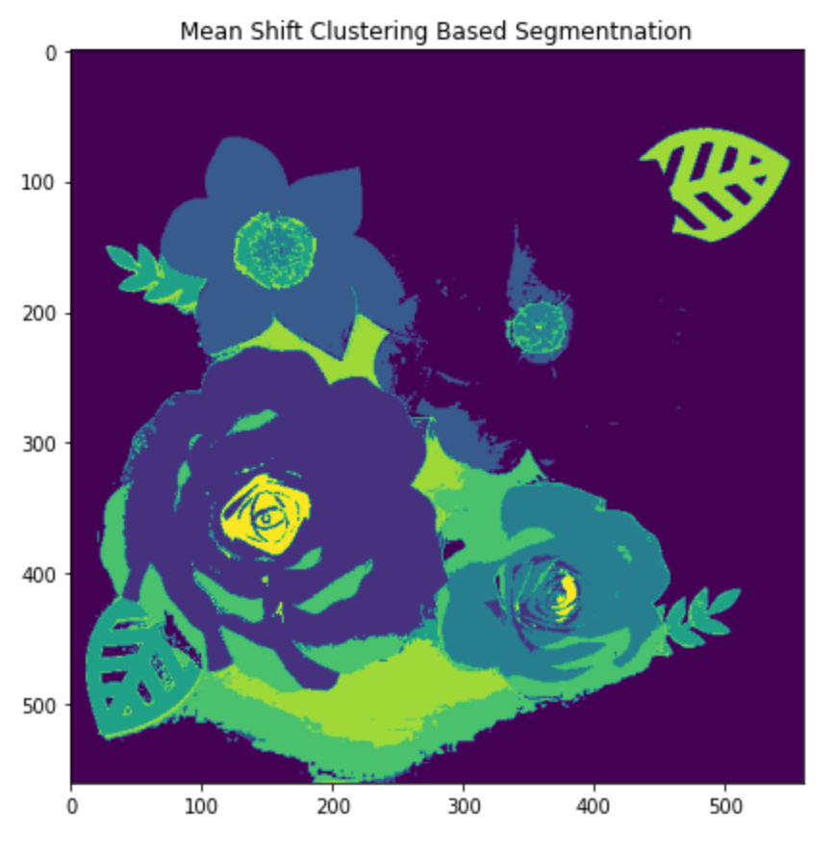
RESULT: Mean-Shift Clustering Based Image Segmentation
Mean Shift Clustering Based Image Segmentation
Sample Image Source: https://dejavuboutik.com/products/big-bloom-garden-party-flowers-diy-craft-kit

Slide 15
Summary
Manual thresholding using histogram is a tedious and unscalable algorithm.
As we moved towards more complex and advanced algorithm, the better segments of image and distinct regions were observed. Segmentation based on Mean shift clustering is the best among all the above as expected.
Deep Learning and Neural Network Based Segmentation Algorithms may be used to get better result than above algorithms.

Slide 16
References:
[1] Zhou, W., Du, X., & Wang, S. (2021). Techniques for Image Segmentation Based on Edge Detection. 2021 IEEE International Conference on Computer Science, Electronic Information Engineering and Intelligent Control Technology, CEI 2021, 400–403. https://doi.org/10.1109/CEI52496.2021.9574569
[2] Pantofaru, C. (2005). A Comparison of Image Segmentation Algorithms.
[3] http://notmatthancock.github.io/2017/10/09/region-growing-wrapping-c.html
[4] Chaturvedi, A., Khanna, R., & Kumar, V. (2016). An Analysis of Region Growing Image Segmentation Schemes. International Journal of Computer Trends and Technology, 34(1), 46–51. https://doi.org/10.14445/22312803/IJCTT-V34P108

Slide 17
THANK YOU!!

