Slide 1
Creation of a 3-D Gantry System
A Proposal

Slide 2
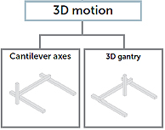
Problem
Monitoring and control of a system in one, two, and three dimensions
Development of a third dimension to a two-dimensional gantry system
EleksLaser-A3 Pro 5500mW Laser Engraving Machine
Difference between cantilever axis and 3-D gantry
Location of Third Axis
Power and weight of gantry

Slide 3
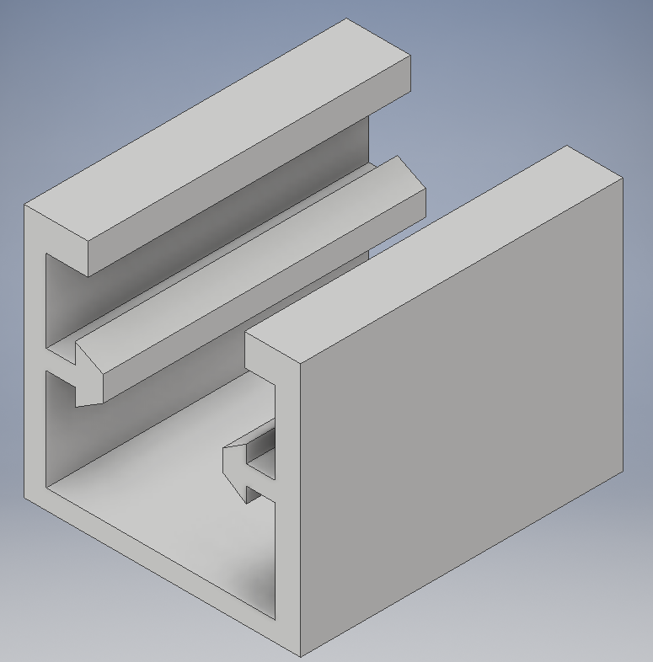
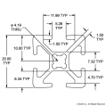
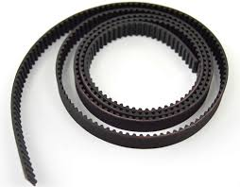
Components
Infrared/Ultrasonic Proximity Sensors
Senix ToughSonic 3 Ultrasonic Sensor
Three-dimensional Tracking Sensor System
20-2020 beams
Stepper Motor
Nema 23 CNC 2.8A (11lbs holding weight)
3-D printed parts
Toothed belt custom fit for beam
Guide for third gantry beam

Slide 4
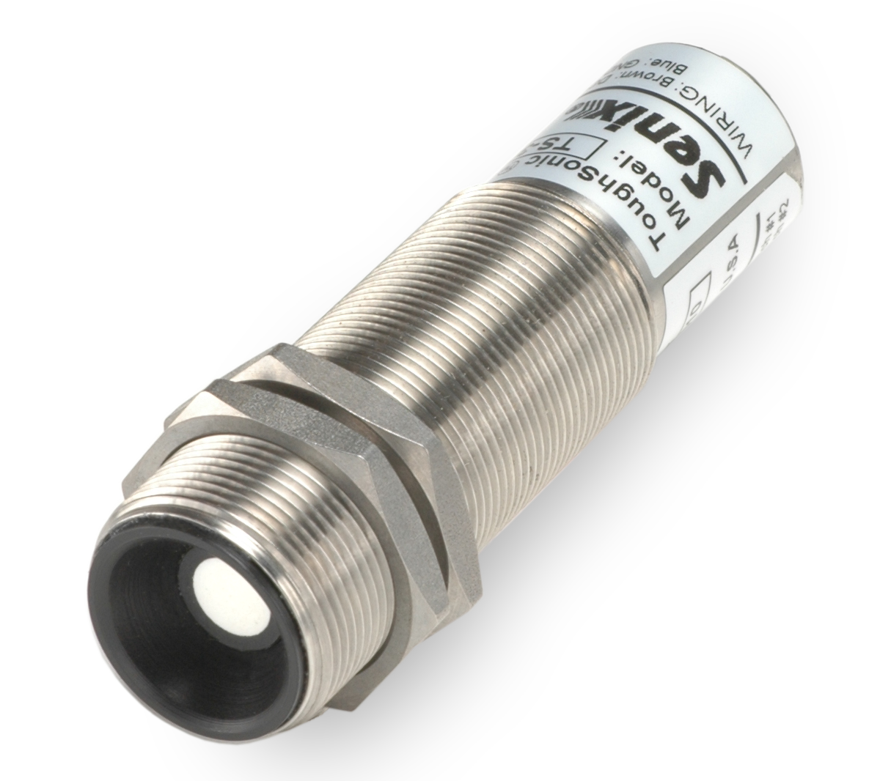

First Phase: One Dimension
Elevated axis monitored by proximity sensor on one end
Less wear on motor
More precise control
Can be created using 20-2020 beams and part of the 2-D Gantry
Proximity sensor located on end
0.086 mm accuracy
Can be put into place using 3-D printed parts

Slide 5
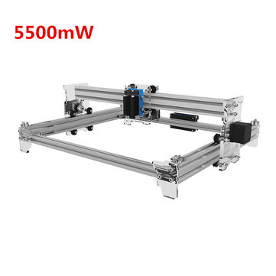
Second Phase: Two Dimensions
Complete set-up of 2-D Gantry
Attach second proximity motor to new axis

Slide 6
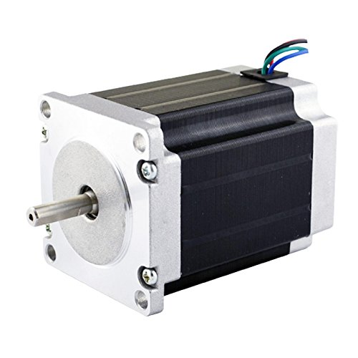
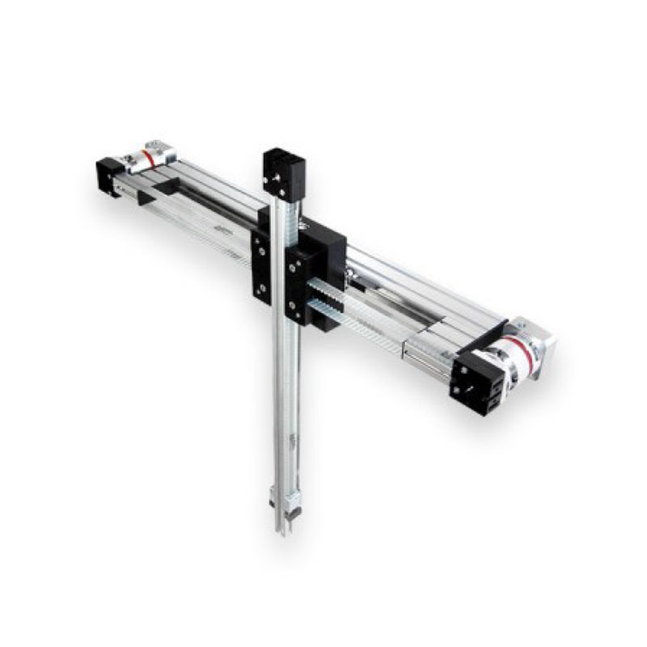
Third Phase: Application to 2-D Gantry
“True” 3-D Gantry
Attachment to Y-Axis
Suspension of original gantry system
Attached to 20-2020 beams by drilled holes through supports
Third beam attached to laser platform
Proximity sensor attached to end of third beam

Slide 7
Final Dimensions of Third Phase
Enclave: 90 cm by 200 cm by 75 cm
Gantry within enclave: 60 cm by 46 cm by 63 cm
Working area: 30 cm by 36 cm by 45 cm
Control of 4 degrees of freedom
Three axises
Laser intensity control

Slide 8
Final Cost
2-D Gantry: $439.90
Proximity Sensors: $1647.00
Request a Quote
Nema Stepper Motor: $26.00
7 6-foot 20-2020 beams: $94.29
Final Cost: $2207.19 + shipping & tax

Slide 9
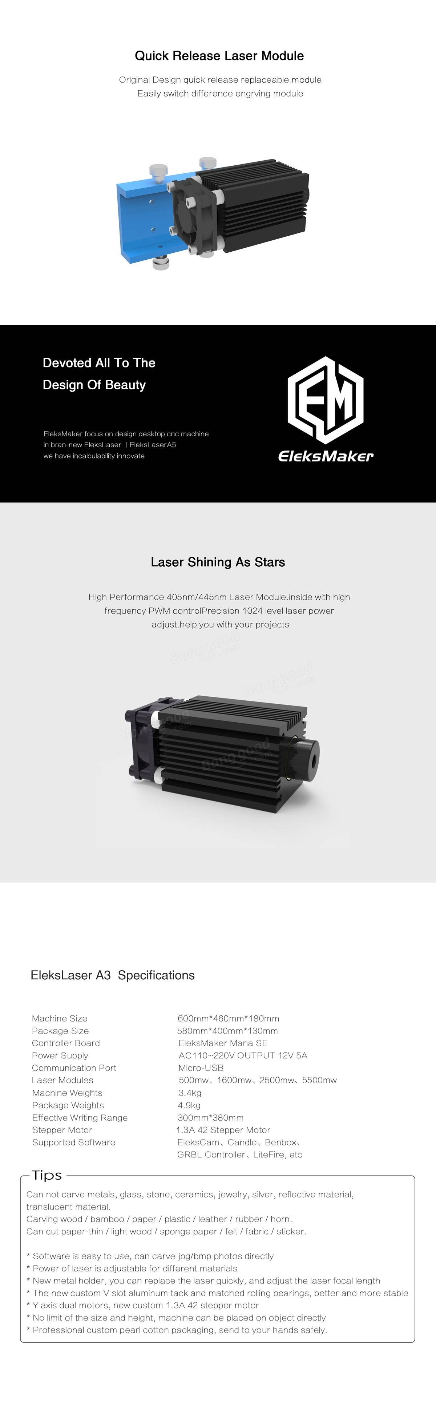
Future Work
Laser module
Degree of freedom
Implementation of different sensors
Spatial sensing
3-D tracking

