Slide 1
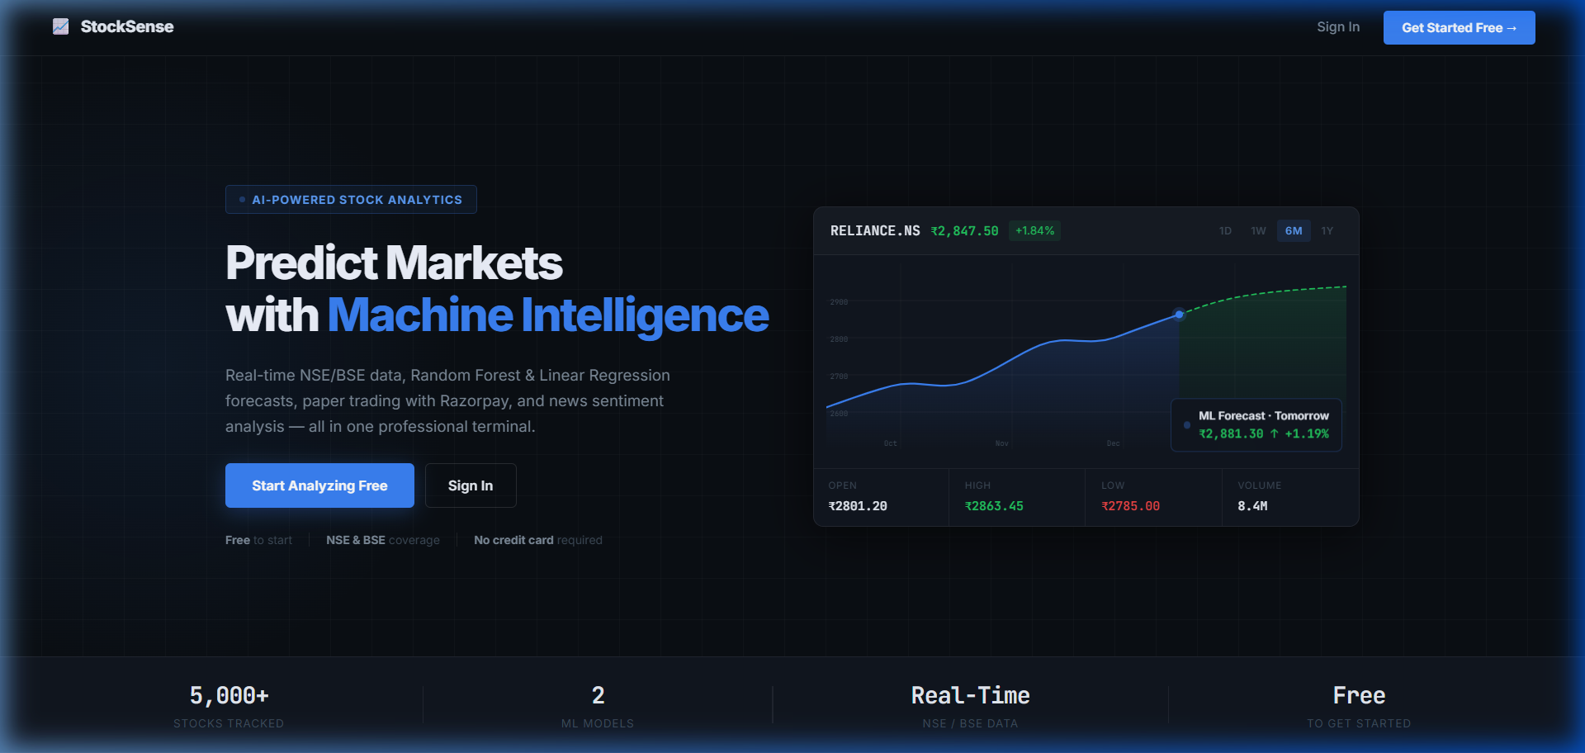
StockSense AI
Your personal AI-powered stock market assistant.
Search any stock. Get real-time prices, AI predictions, news sentiment & paper trading — all in one app.
Free to Use
Indian Stocks (NSE/BSE)
AI Predictions
1 / 13

Slide 2
The Problem
Why do people avoid the stock market?
😰
⏱️
🤷
💸
Too Confusing
Time-Consuming
No Guidance
Fear of Loss
Charts and numbers look overwhelming without any guidance.
Tracking multiple stocks manually every day is exhausting.
No easy way to know if a stock will go UP or DOWN.
Scared to invest real money without practicing first.
StockSense AI solves ALL of this — for FREE, with real data and AI.
2 / 13

Slide 3
Our Solution — StockSense AI
One app. Real-time data. AI predictions. Paper trading.
AI Prediction shown right on the homepage
Search 5,000+ NSE/BSE stocks instantly
Free to use — no credit card required
Real open/high/low/close prices from Yahoo Finance
3 / 13

Slide 4
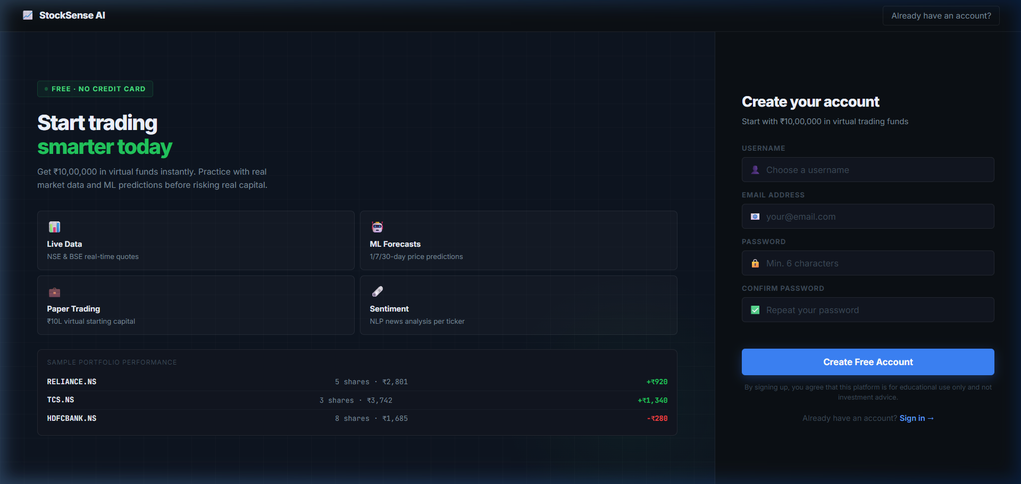
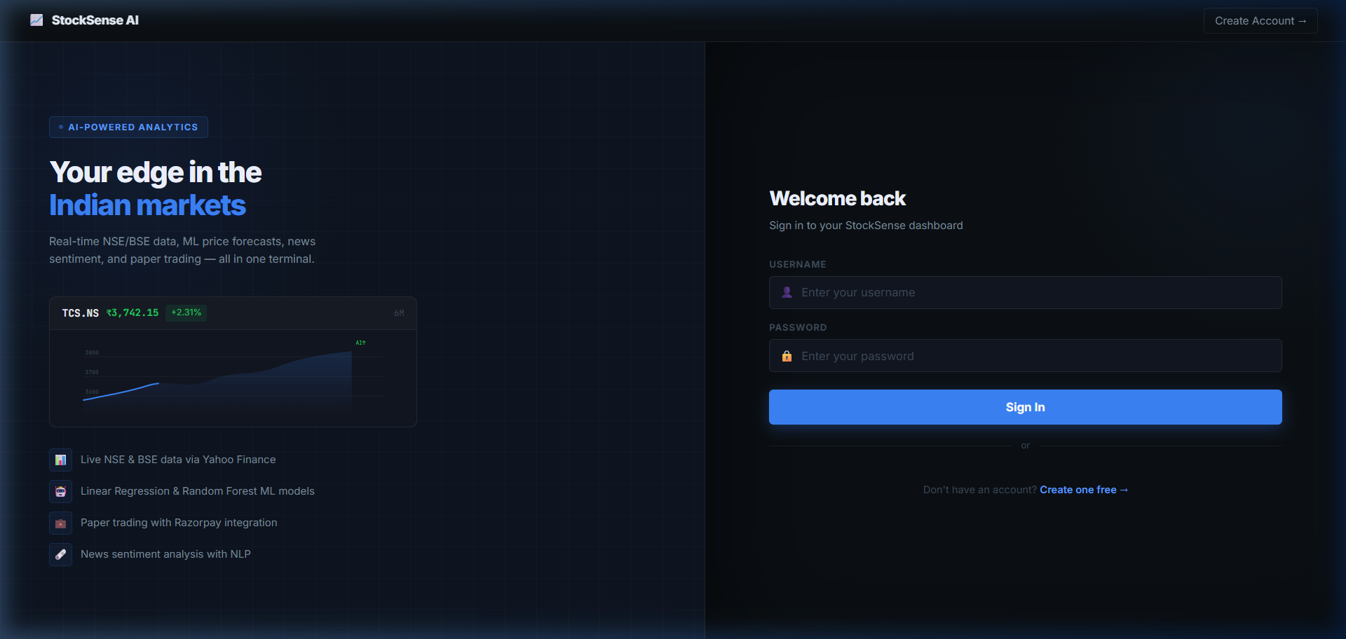
Getting Started — Sign Up & Log In
Takes less than 30 seconds. No credit card. No charges.
→
Step 1: Fill in your username, email & password and click Create Free Account.
Step 2: Enter your username & password. You're in! Your dashboard loads instantly.
4 / 13

Slide 5
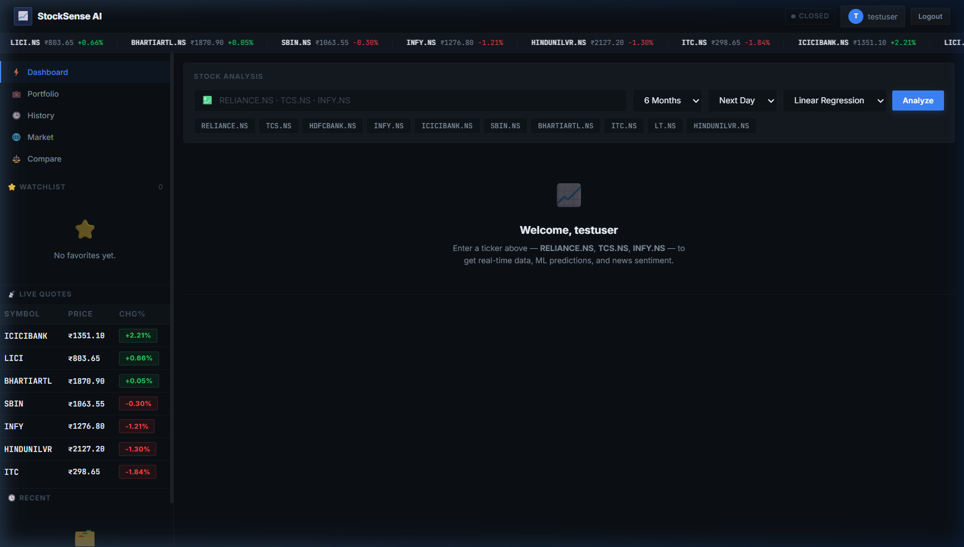
Your Dashboard — Everything at a Glance
Live stock prices, your watchlist, and market movers — all on one screen.
Live ticker tape on top
Search any stock here
Watchlist with live prices
Quick stock badges
5 / 13

Slide 6
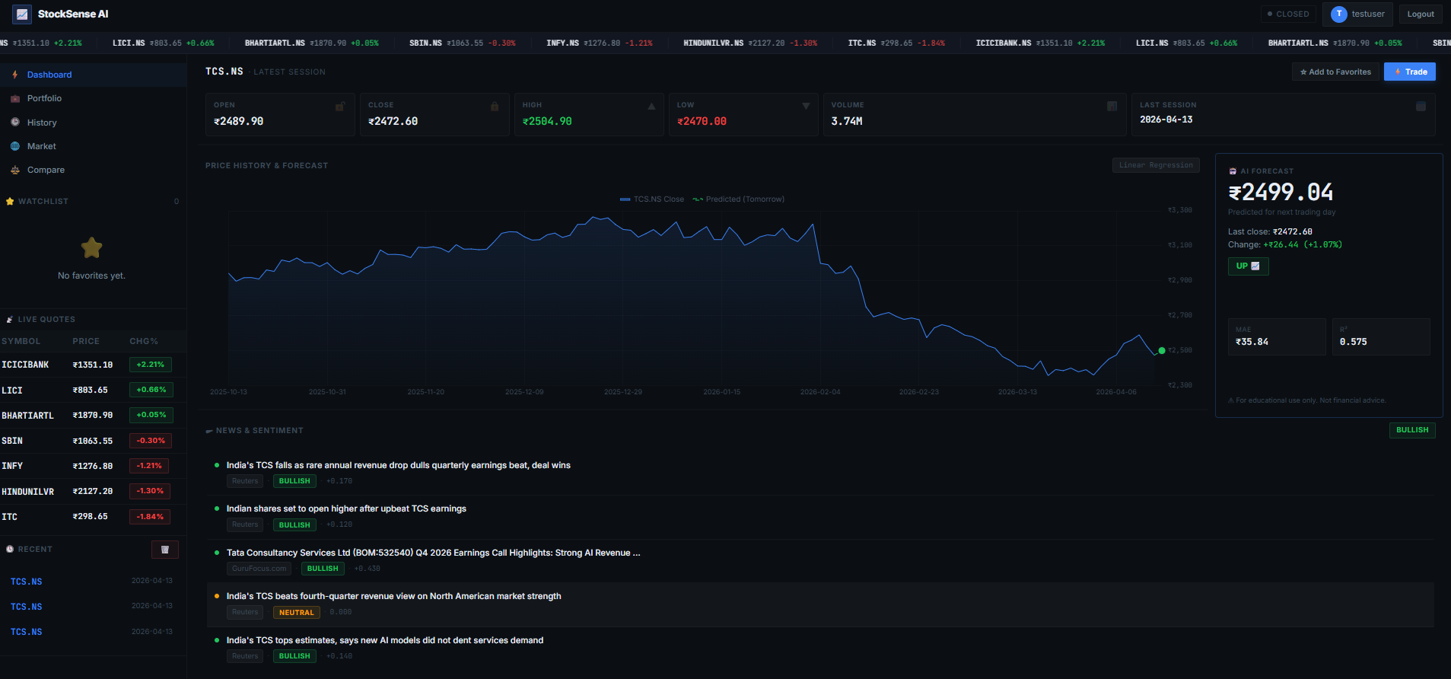
Search a Stock — Get AI Prediction in Seconds
Type any ticker (e.g. TCS.NS, RELIANCE.NS) and hit Analyze.
AI says: TCS.NS will be ₹2499 tomorrow (+1.07%)
Price chart — 6 months of real historical data
Model accuracy scores — MAE & R² shown clearly
News Sentiment Bullish / Bearish / Neutral
6 / 13

Slide 7
How the AI Prediction Works
A simple 5-step process — no technical knowledge needed!
📡
🔍
🧠
✅
🎯
Step 1 Collect Data
Step 2 Find Patterns
Step 3 Train the AI
Step 4 Test Accuracy
Step 5 Predict
Downloads last 6 months of daily closing prices
→
Looks at the last 10 days to spot price trends
→
Trains on 80% of the data — like studying past exams
→
Tests on the remaining 20% to check performance
→
Uses last 10 days to predict tomorrow's closing price
Result: The AI tells you — "TCS.NS predicted price tomorrow: ₹2,499 ( +1.07% ) Trend: UP"
7 / 13

Slide 8
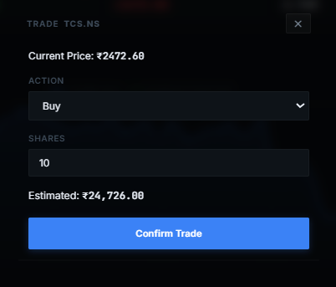
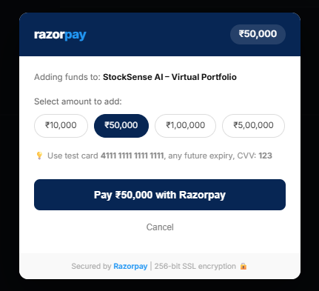
Practice Trading — Risk Free!
Every user gets ₹10,00,000 virtual money to buy & sell real stocks.
1
Start with ₹10 Lakh in virtual money — free!
2
Search a stock, check the AI prediction
3
Click Trade, enter number of shares
4
Pay via Razorpay*, trade recorded instantly
5
Watch your portfolio grow (or learn lessons!)
Your Portfolio page shows: total invested, current value, and profit/loss for each stock you hold.
* Razorpay is used for secure payment simulation (paper trading only)
8 / 13

Slide 9
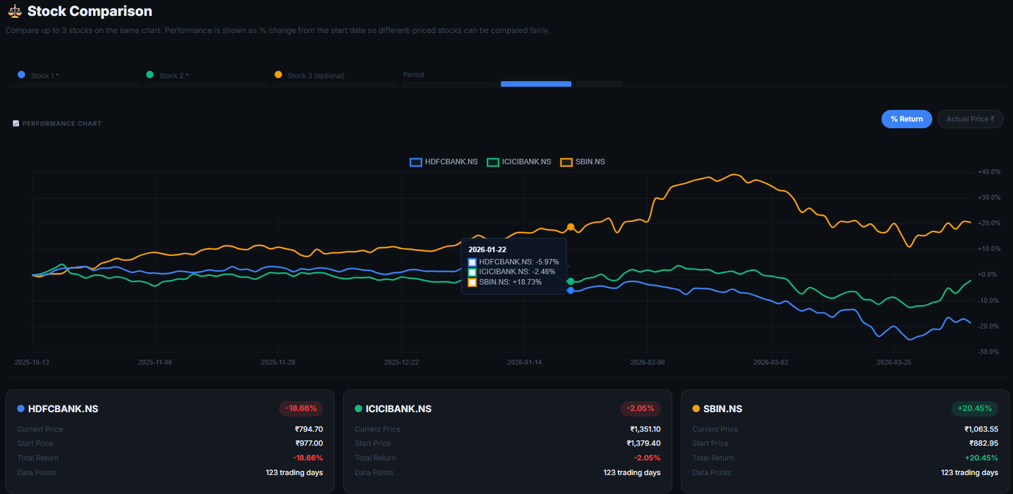
Compare Stocks Side-by-Side
"Is TCS better than Infosys this year?" — Find out in one click.
Enter 2 or 3 stock names → The chart shows how each stock performed from Day 1. Stocks are shown as % change so you can fairly compare TCS (₹2500) vs Infosys (₹1500).
9 / 13

Slide 10
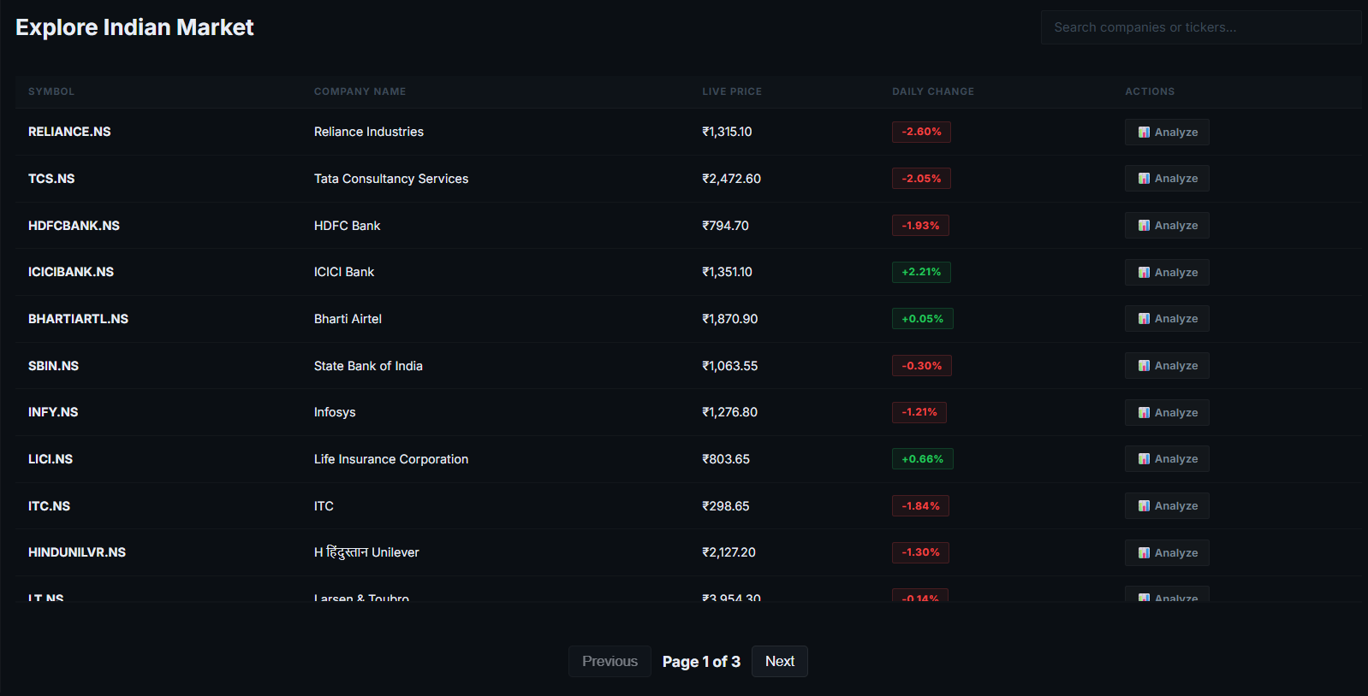
Market Explorer — Browse All Indian Stocks
Browse 5,000+ NSE/BSE stocks. Search by name. See live prices.
Scroll or search through all listed Indian stocks — see live price, day change & % change. Click any stock to jump straight to its full analysis page.
10 / 13

Slide 11
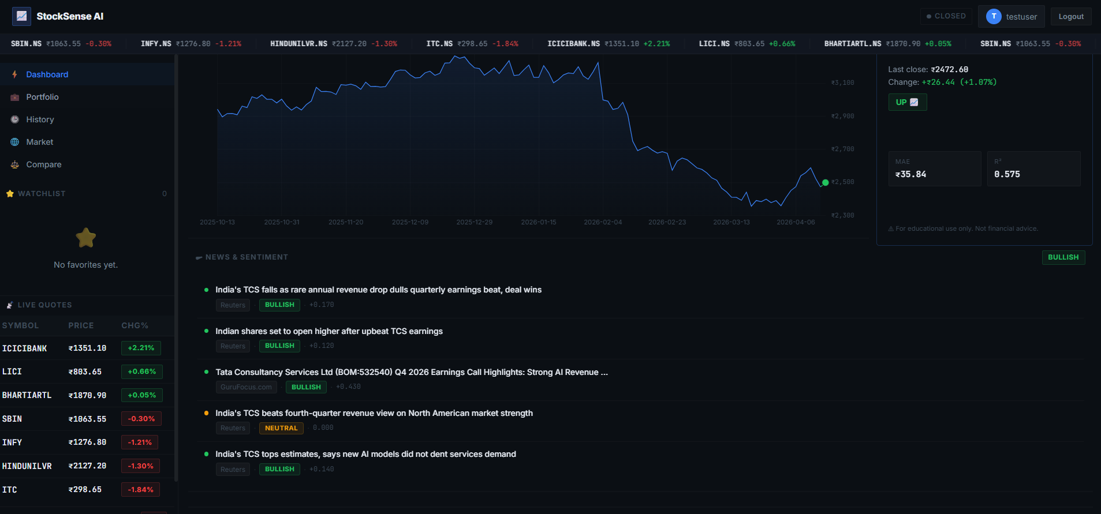
News Sentiment — Is the Market Feeling Bullish?
The app reads the latest news about any stock and tells you the mood.
BULLISH
BEARISH
NEUTRAL
Positive news — good sign. More people are likely buying.
Negative news — caution. More people might be selling.
Mixed or no strong news. Not a clear signal either way.
11 / 13

Slide 12
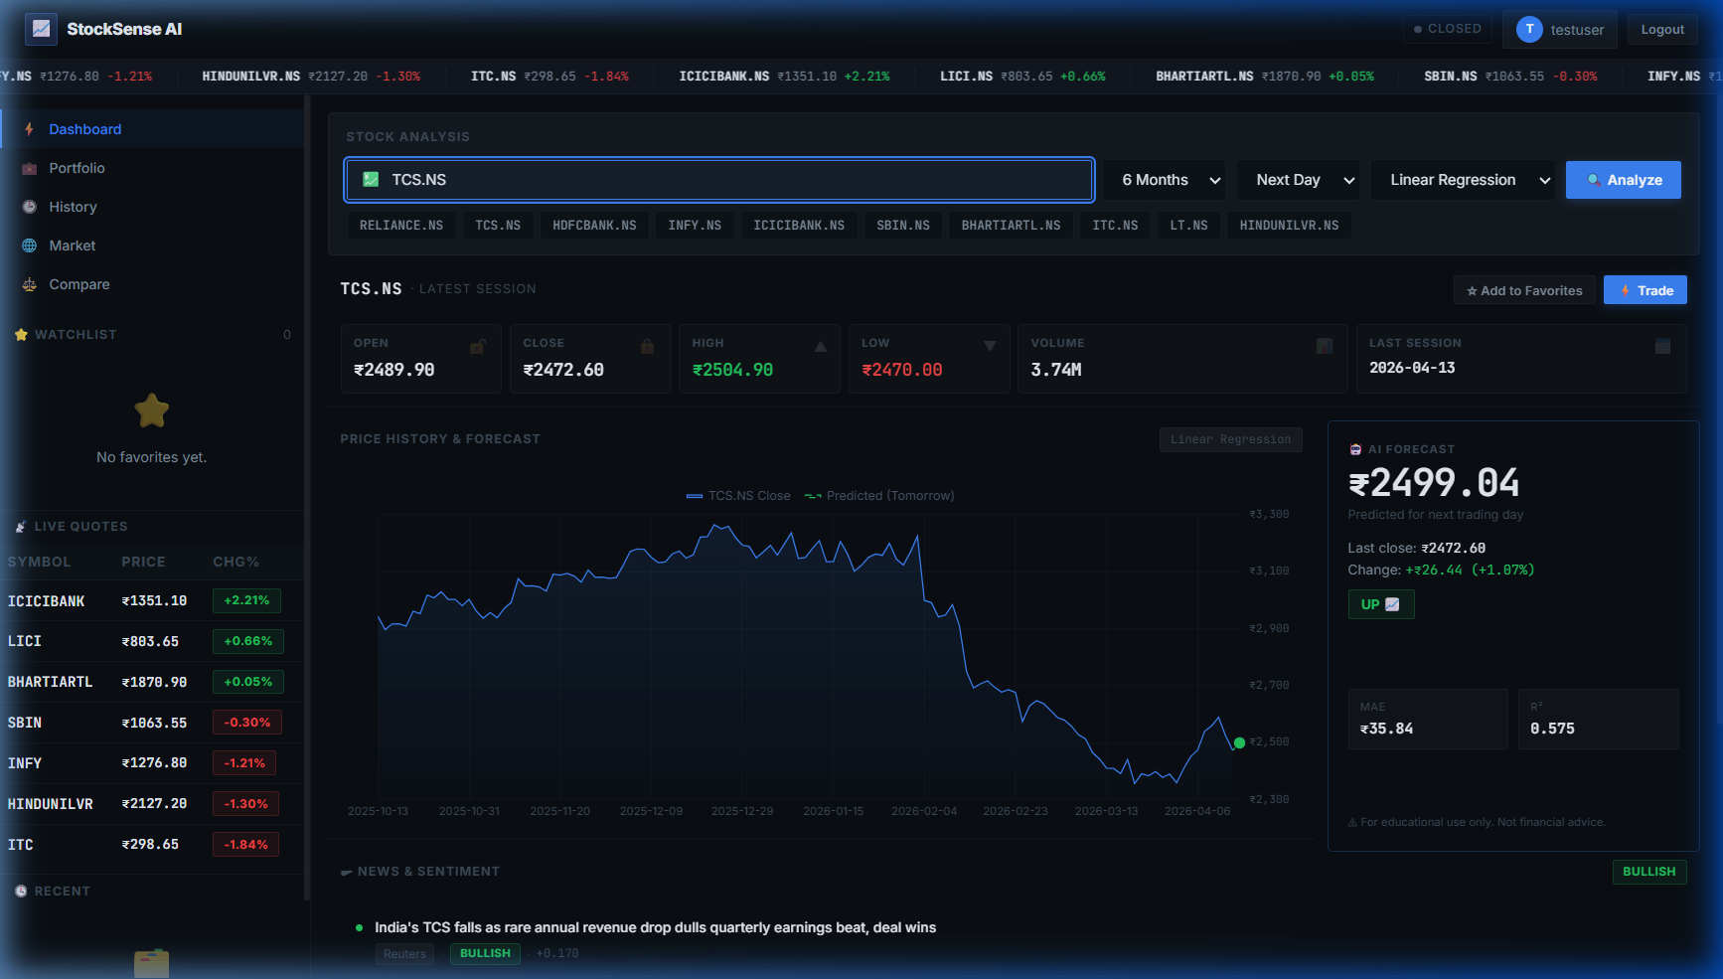
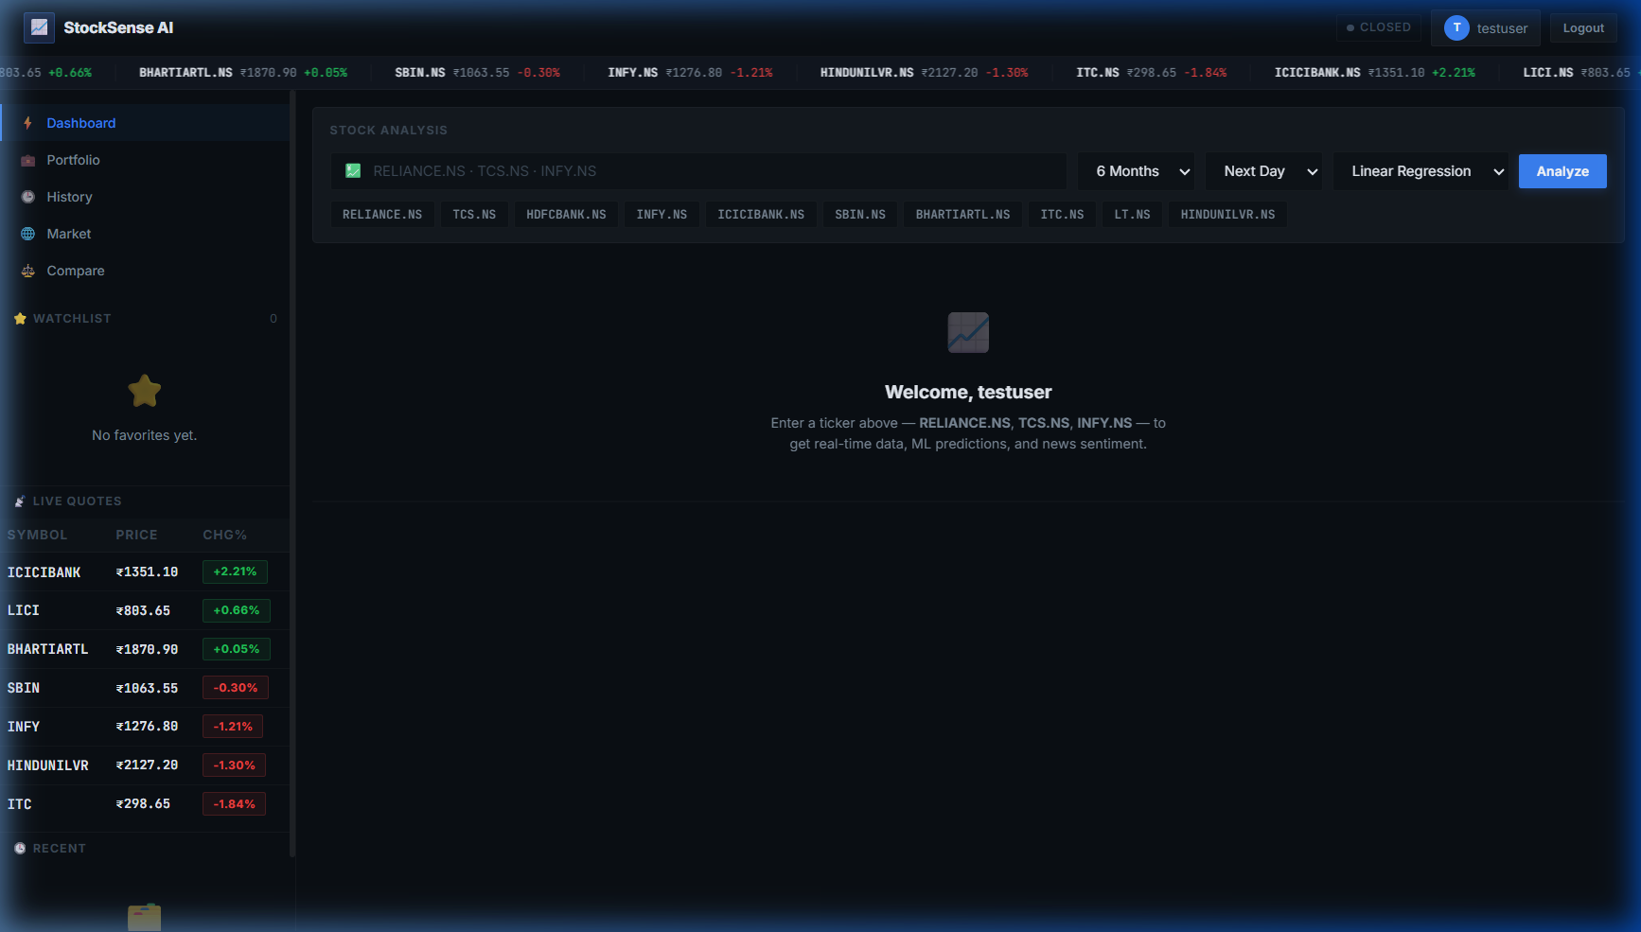
Your Complete Journey with StockSense AI
From first visit to trading — here's the full flow.
1
2
3
4
5
→
→
→
→
Visit the website
Create an account
See your dashboard
Analyze a stock + AI
Buy & track portfolio
All of this is FREE, works with real NSE/BSE data, and runs in your browser — no app to install!
12 / 13

Slide 13
Thank You!
StockSense AI
Smart Stock Analytics & AI-Powered Price Prediction for Indian & Global Markets
Real-Time Data
AI Predictions
Paper Trading
News Sentiment
Stock Compare
Market Explorer
TEAM DETAILS -
Bhaumik Hinunia – AP24110010182
Prakhar Raj – AP24110010193
Manya Srivastava – AP24110010171
Jayanti Yadav – AP24110010132
13 / 13

