Slide 1
ADVANCED EXPLORATORY DATA ANALYSIS
Retail Transaction Data Analysis
Univariate, Bivariate & Multivariate Analysis Using Python
Presented by: Bhavdeep Kaur
Organization / Project: NextHikes IT Solutions
Technologies: Python | Pandas | NumPy | Matplotlib | Seaborn

Slide 2
1
Project Overview & Objective
INTRODUCTION
DATASET
OBJECTIVES
100,000 retail transaction records
Understand distributions & patterns
18 original variables
Analyze relationships between variables
Customer, product, pricing, payment,
shipping & return information
Detect and interpret outliers
Measure correlation
Numerical, categorical & date
variable types
Extract meaningful business insights
Raw Dataset
→
Data Quality
→
Univariate
→
Bivariate
→
Multivariate
→
Correlation
→
Outliers
→
Insights
The analytical pipeline followed throughout this presentation, from raw data to business insight.
NextHikes IT Solutions | Advanced EDA — Retail Transaction Data
2

Slide 3
2
Dataset Exploration & Data Quality
DATA QUALITY ASSESSMENT
100,000
✓
✓
✓
Missing values
Duplicate rows
Invalid numerical values
Initial Rows
0 found
0 found
0 found
18
✓
✓
✓
Invalid dates
Categorical whitespace issues
Calendar gaps
Original Columns
0 found
0 found
0 found
100%
"Before visualization, the dataset was validated for null values, duplicates, invalid values and logical inconsistencies. It passed these checks without requiring row deletion or value correction."
Pricing Consistency
between recorded &
expected final price
— Data Quality Assessment, Section 1.7
NextHikes IT Solutions | Advanced EDA — Retail Transaction Data
3

Slide 4
3
Preparing the Dataset for Analysis
FEATURE ENGINEERING
18
Original Variables
DERIVED TIME & GROUP FEATURES
order_year
order_month
order_month_name
↓
Data Type Preparation
order_date → datetime
order_quarter
order_day_of_week
order_day_name
order_year_month
age_group
↓
+7
Time Features
Final Dataset Shape
↓
+1
Age Group Feature
100,000 rows × 26 columns
↓
Original 18 variables expanded with 7 temporal features and 1 demographic grouping feature to support multivariate analysis.
26
Analytical Variables
NextHikes IT Solutions | Advanced EDA — Retail Transaction Data
4

Slide 5
4
Numerical Variables — Statistical Summary
UNIVARIATE ANALYSIS
Variable | Mean | Median | Std Dev | Skewness
Age | 41.56 | 42.00 | 13.85 | ≈ 0
Product Price | 30,164.53 | 30,148.00 | 17,139.68 | ≈ 0
Quantity | 2.50 | 3.00 | 1.12 | ≈ 0
Discount (%) | 15.01 | 15.00 | 8.95 | ≈ 0
Final Price | 64,165.72 | 49,752.39 | 49,969.28 | 0.93
Delivery Days | 5.51 | 5.00 | 2.87 | ≈ 0
Final Price Skewness = 0.93 — the clear distributional outlier among all numerical variables.
NextHikes IT Solutions | Advanced EDA — Retail Transaction Data
5

Slide 6
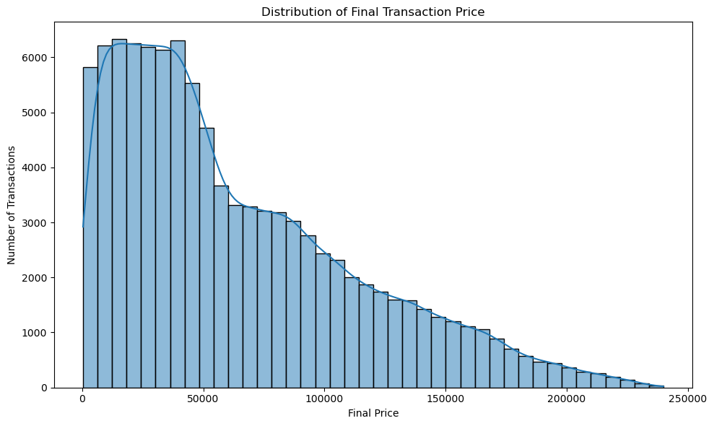
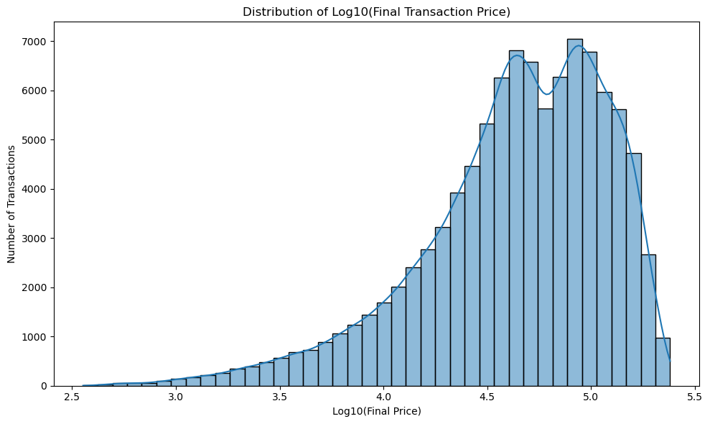
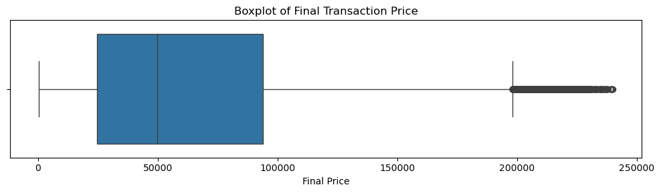
5
Understanding the Major Distributions
UNIVARIATE ANALYSIS
Final Price — Boxplot
Final Transaction Price — Histogram + KDE
Log10(Final Transaction Price) Distribution
Key takeaway: Most transactions are concentrated in lower-to-medium price ranges, while a smaller number of high-value transactions extend the upper tail — consistent with the right-skewed distribution and elevated kurtosis.
NextHikes IT Solutions | Advanced EDA — Retail Transaction Data
6

Slide 7
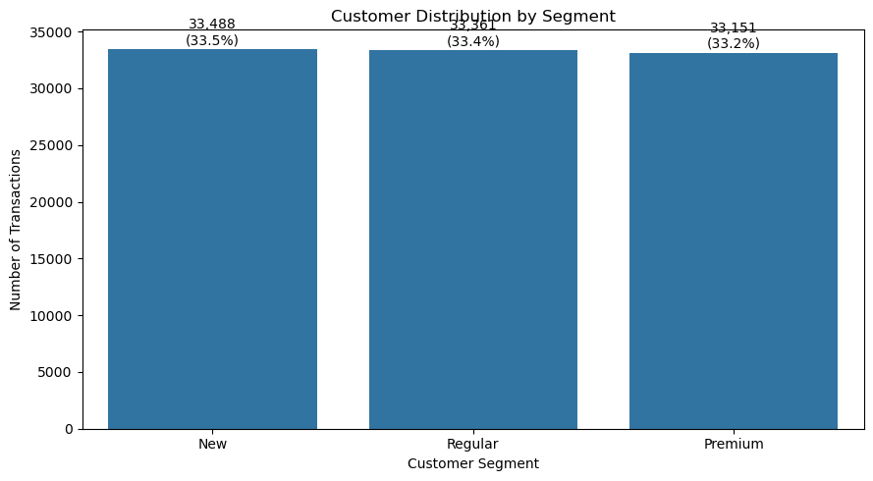
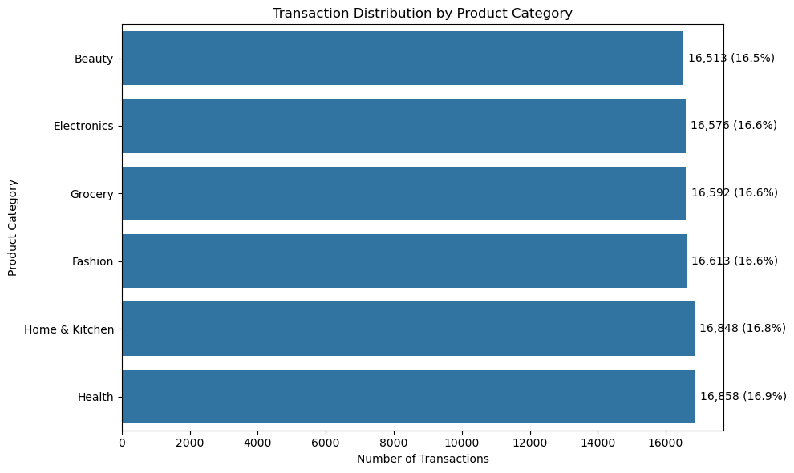
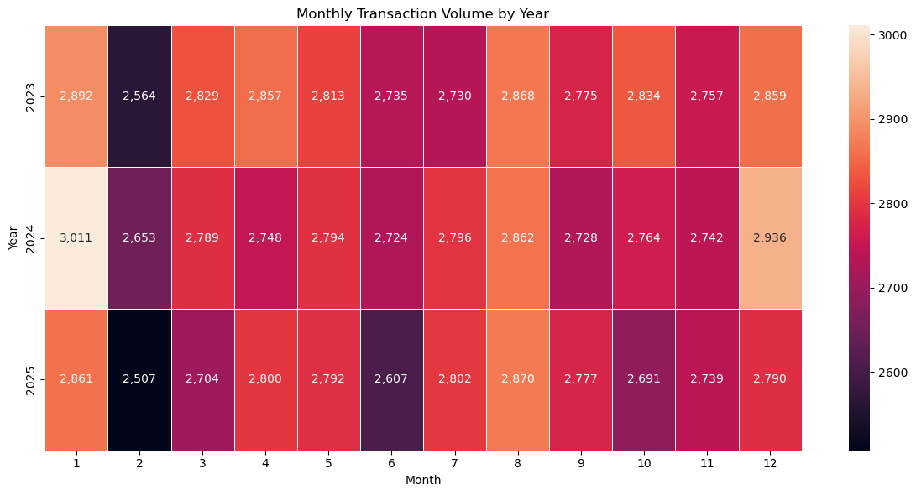
6
Customer, Product & Temporal Distribution
UNIVARIATE ANALYSIS
Customer Distribution by Segment
Transaction Distribution by Product Category
Year-Month Transaction Heatmap
Key takeaway: Customer segment (New 33.5% / Regular 33.4% / Premium 33.2%) and product-category distributions are broadly balanced, while transaction activity remains stable across the three-year period with some recurring monthly variation.
NextHikes IT Solutions | Advanced EDA — Retail Transaction Data
7

Slide 8
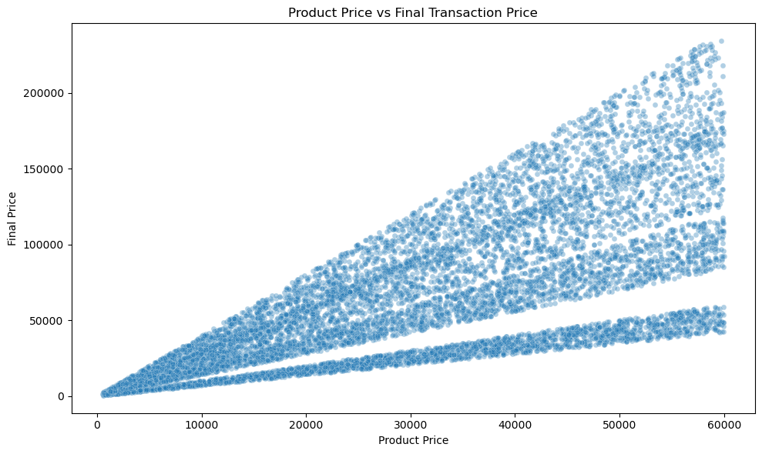
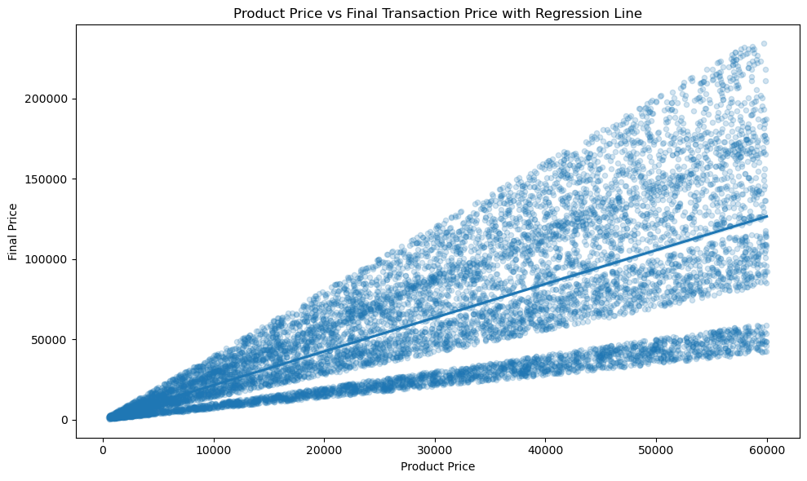
7
Product Price is the Strongest Transaction-Value Driver
BIVARIATE ANALYSIS
Strong
Positive
Relationship
r = 0.73
Higher product prices are strongly associated with higher final transaction values. This is structurally expected, since product price is a direct component of final price.
Product Price vs Final Transaction Price — Scatter
With Regression Line
NextHikes IT Solutions | Advanced EDA — Retail Transaction Data
8

Slide 9
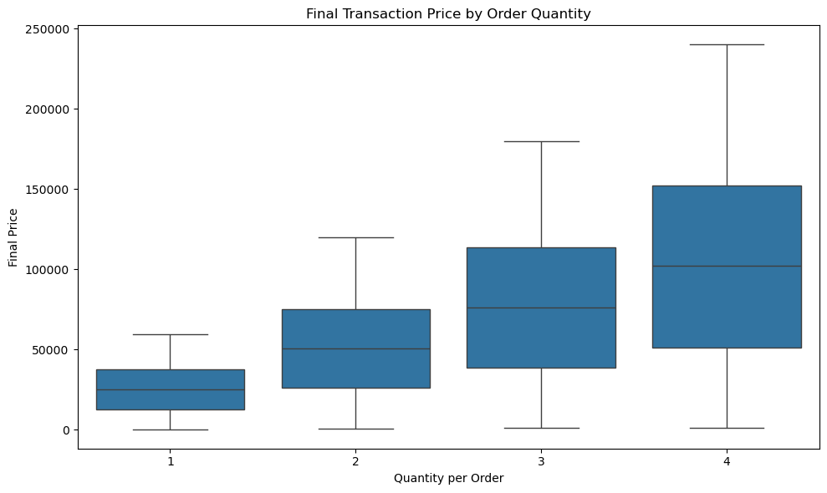
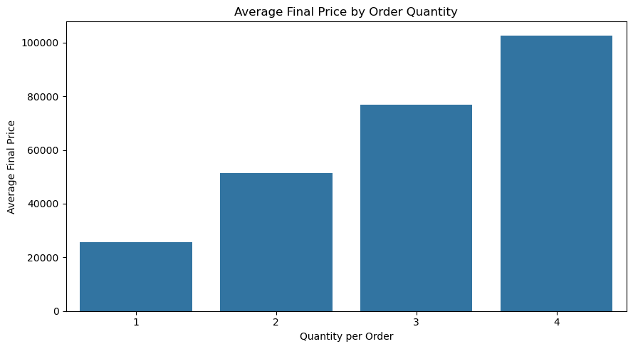
8
Order Quantity and Transaction Value
BIVARIATE ANALYSIS
Quantity | Avg. Final Price
1 | ₹25,595.96
2 | ₹51,382.11
3 | ₹76,837.73
4 | ₹102,663.72
₹102,663.72
Average Final Price by Order Quantity
Final Price by Order Quantity — Boxplot
Average final price at
Quantity = 4
Key takeaway: Average transaction value increases consistently as order quantity increases.
NextHikes IT Solutions | Advanced EDA — Retail Transaction Data
9

Slide 10
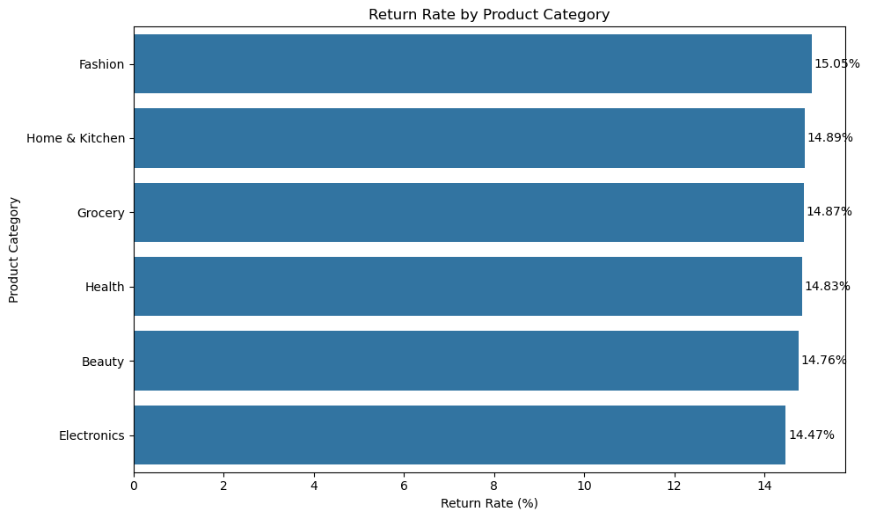
9
Customer Segments and Return Behavior
BIVARIATE ANALYSIS
A. CUSTOMER SEGMENT × FINAL PRICE
Segment | Avg. Final Price
Premium | ₹64,430.45
Regular | ₹64,303.15
New | ₹63,766.75
Premium customers have the highest average final price, but the difference across segments is small and distributions overlap substantially.
Return rates by product category are tightly clustered, ranging from 14.47% to 15.05%.
Return Rate by Product Category
Not every categorical difference is practically large, even when the ranking differs.
NextHikes IT Solutions | Advanced EDA — Retail Transaction Data
10

Slide 11
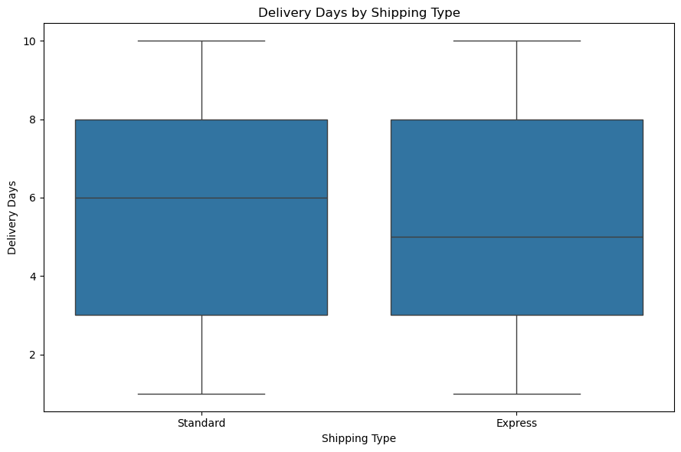
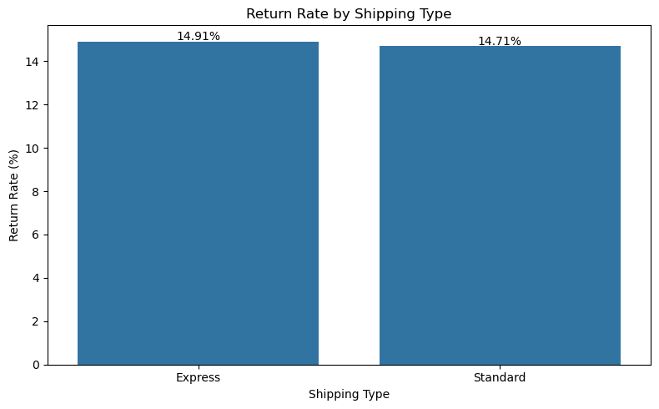
10
Shipping Type, Delivery Time & Returns
OPERATIONAL ANALYSIS
Shipping Type | Avg. Delivery | Return Rate
Express | 5.50 days | 14.91%
Standard | 5.51 days | 14.71%
Nearly identical
performance
Express and Standard shipping show almost identical average delivery times and very similar return rates.
Delivery Days by Shipping Type
Return Rate by Shipping Type
This contrasts with the project's example expectation that Express would significantly reduce delivery time.
NextHikes IT Solutions | Advanced EDA — Retail Transaction Data
11

Slide 12
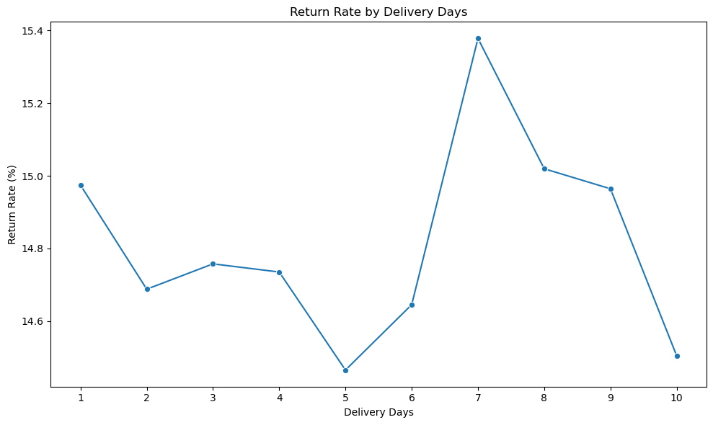
11
Delivery Duration vs Return Rate
BIVARIATE ANALYSIS
Metric | Result
Highest return rate | 7 days → 15.38%
Lowest return rate | 5 days → 14.46%
Spearman correlation | −0.0061
No consistent trend. Return rates fluctuate across delivery durations but do not show a consistent increasing or decreasing pattern.
The NextHikes brief anticipated increasing returns with longer delivery — the data here does not support that relationship.
Return Rate by Delivery Days
NextHikes IT Solutions | Advanced EDA — Retail Transaction Data
12

Slide 13
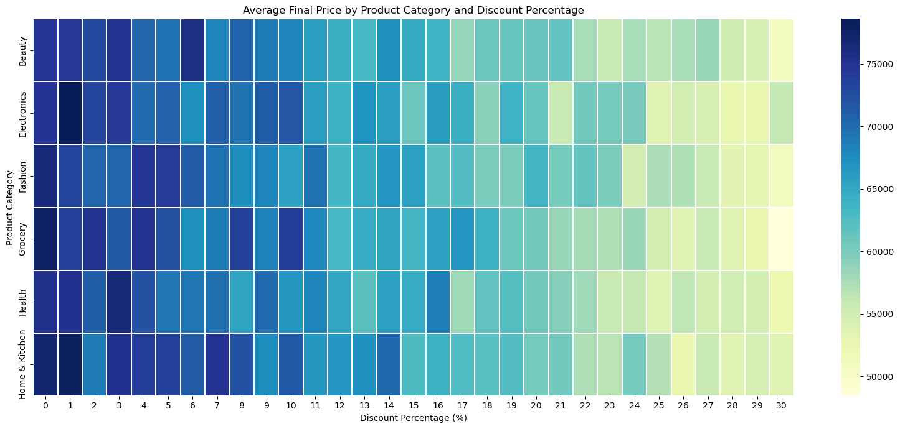
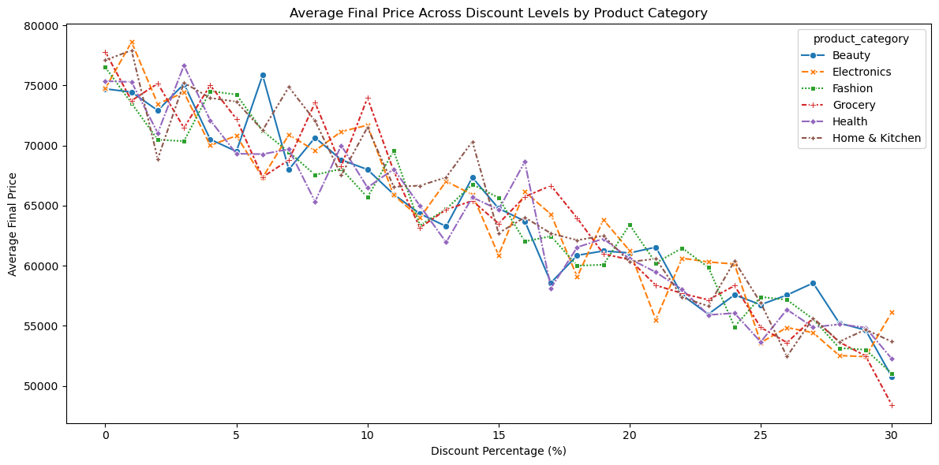
12
How Discounts Interact with Product Categories
MULTIVARIATE ANALYSIS
Avg. Final Price by Category & Discount % — Heatmap
Avg. Final Price Across Discount Levels by Category
₹76,029.98
₹52,051.12
Average final price generally declines as discount increases, with a broadly similar pattern across categories.
Avg. price at 0% discount
Avg. price at 30% discount
Advanced insight: the heatmap reveals the interaction of Category + Discount % + Final Price across all 100,000 transactions without overwhelming the audience.
NextHikes IT Solutions | Advanced EDA — Retail Transaction Data
13

Slide 14
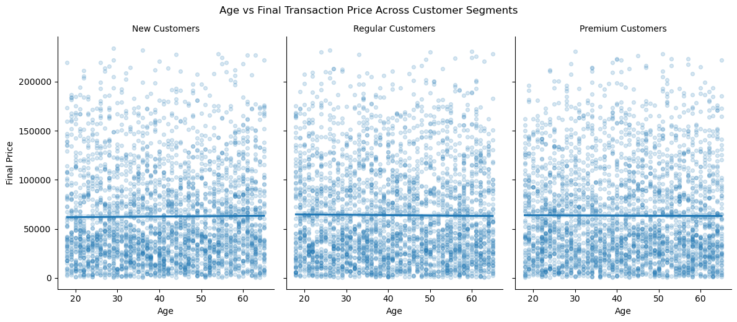
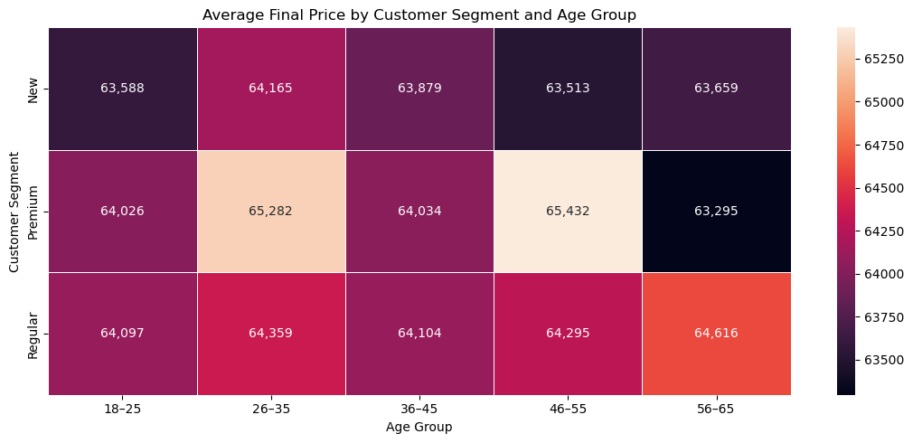
13
Customer Segment × Age × Transaction Value
MULTIVARIATE ANALYSIS
Age vs Final Price Across Customer Segments
Average Final Price by Segment & Age Group
≈ 0
Customer segment does not substantially change the near-zero relationship between age and final transaction value.
Actual finding: highest Premium average is in the 46–55 age group, at ₹65,432.07.
All segment-wise age–price correlations
NextHikes IT Solutions | Advanced EDA — Retail Transaction Data
14

Slide 15
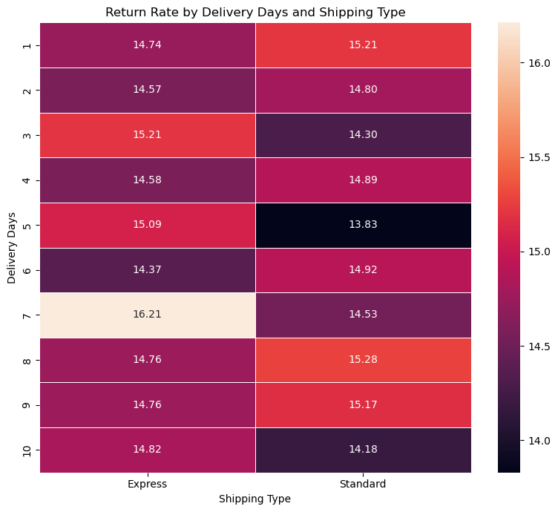
14
Interaction of Delivery Time, Shipping Type & Returns
MULTIVARIATE ANALYSIS
16.21%
Highest observed cell — Express + 7 days
14.82%
Express + 10 days, by comparison
Why multivariate analysis matters: Combining shipping type and delivery duration still does not reveal a consistent increase in return probability — it lets us see individual combinations instead of relying only on overall averages.
Return Rate by Delivery Days and Shipping Type
NextHikes IT Solutions | Advanced EDA — Retail Transaction Data
15

Slide 16
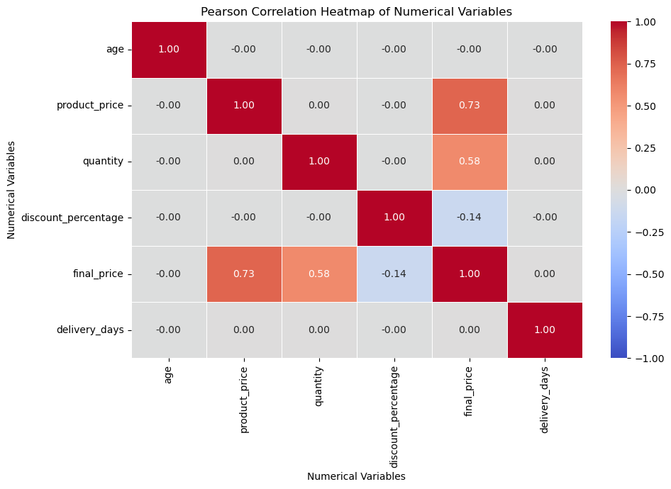
15
Correlation Structure & Outlier Investigation
STATISTICAL ANALYSIS
STRONGEST RELATIONSHIPS WITH FINAL PRICE
Variable Pair | r
Product Price ↔ Final Price | 0.73
Quantity ↔ Final Price | 0.58
Discount ↔ Final Price | -0.14
Age ↔ Final Price | ≈ 0
Delivery Days ↔ Final Price | ≈ 0
OUTLIER SHARE (FINAL PRICE ONLY)
1.34%
0.50%
Pearson Correlation Heatmap
IQR outliers
Z-score outliers
Key takeaway: high-value final_price observations are statistically unusual but internally valid, and were therefore retained.
NextHikes IT Solutions | Advanced EDA — Retail Transaction Data
16

Slide 17
16
Key Insights & Business Takeaways
CONCLUSION
KEY FINDINGS
RECOMMENDATIONS
1. Transaction Value
Focus transaction-value analysis on product price and quantity.
Product price and quantity are the strongest numerical factors associated with final transaction value.
2. Discounts
Evaluate discount strategies together with transaction value and product mix.
Average final price generally decreases as discount percentage increases.
3. Customer Demographics
Use multi-factor analysis rather than relying on age, shipping type or payment method alone to explain returns.
Age has virtually no linear relationship with transaction value.
4. Returns
Preserve valid high-value transactions when analyzing revenue distributions.
Return rates remain relatively stable across categories, payment methods, shipping types and delivery durations.
5. Outliers
"EDA provides a strong foundation for deeper statistical modelling and predictive analysis."
High-value transactions are statistically unusual but valid, and should be retained.
NextHikes IT Solutions | Advanced EDA — Retail Transaction Data
17

Slide 18
Thank You
Questions & Discussion
Bhavdeep Kaur | NextHikes IT Solutions

