Slide 1
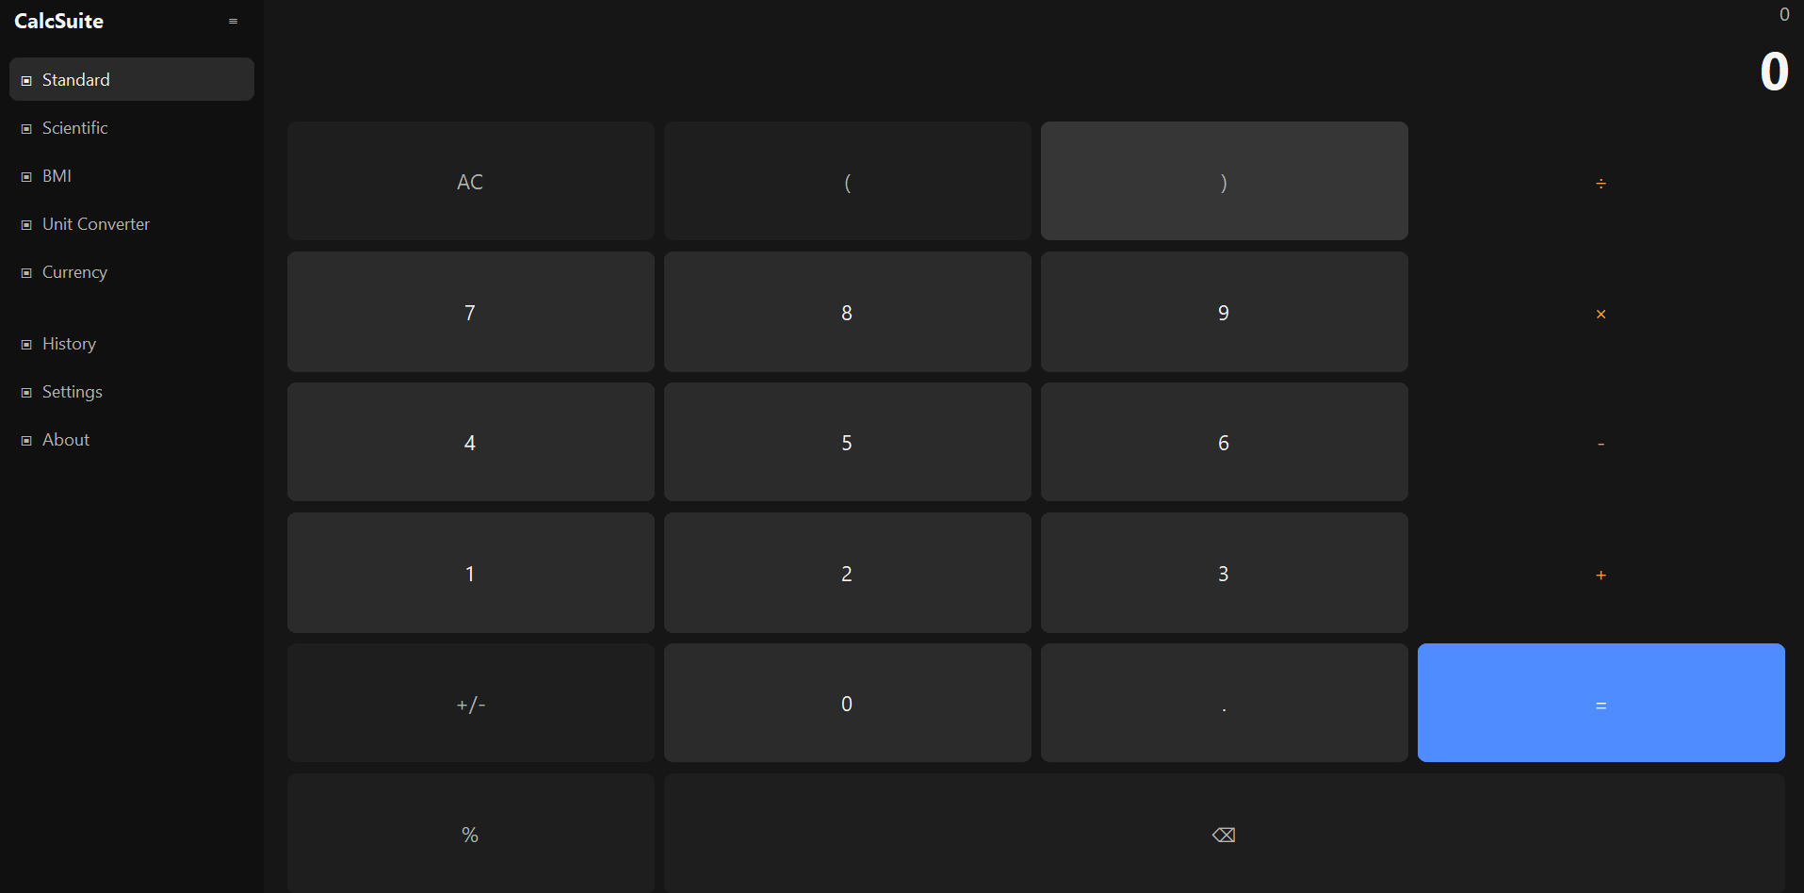
SOFTWARE PROJECT PRESENTATION
CALCSUITE
A Modern, Modular Desktop Calculator Suite
Multiple calculation tools — one unified, responsive desktop application.
PRESENTED BY
Bhavdeep Kaur
PROJECT ASSIGNED BY
Next Hikes IT Solutions
CALCSUITE
01 / 07

Slide 2
WHY THIS PROJECT
Problem & Project Objective
THE PROBLEM
THE OBJECTIVE
Traditional calculator apps focus only on basic arithmetic. For anything else, users are forced to juggle separate tools.
Multiple calculation utilities → One unified desktop application
Scientific calculations
BMI calculation
Unit conversion
Currency conversion
Calculation history
Build a versatile calculator application
Provide multiple calculation modes
Create a consistent, user-friendly interface
Develop a modular, future-extensible architecture
Basic Calculator
+
Scientific Calculator
+
Converters
+
Utilities
▾
CALCSUITE
CALCSUITE
02 / 07

Slide 3
PRODUCT OVERVIEW
What Does CalcSuite Do?
CALCSUITE
▾
STD
Standard
SCI
Scientific
UTL
Utilities
+ − × ÷ operations
Decimals & percentages
Negative numbers
Full keyboard support
Trigonometric functions
Powers, roots, logarithms
Factorial & constants
DEG / RAD modes
BMI Calculator
Unit Converter
Currency Converter
▾
History
Settings
About
Application-wide utilities — shared across every calculation module
CALCSUITE
03 / 07

Slide 4
PRODUCT CAPABILITIES
Key Features
MOD
RES
HIS
KEY
Modular Architecture
Responsive Interface
Unified History
Keyboard Support
Separate modules make CalcSuite easier to maintain and extend.
The UI adapts across window sizes — normal and maximized layouts.
Calculations and conversions are stored and reusable in one place.
Common operations can be performed entirely from the keyboard.
VAL
SET
CNV
ERR
Input Validation
Persistent Settings
Conversion Tools
Error Handling
Invalid inputs and math errors are handled gracefully.
User preferences are stored and reloaded between sessions.
Unit and currency conversion extend the app beyond arithmetic.
The app avoids crashes and gives understandable feedback.
Accuracy + Usability + Modularity
CALCSUITE
04 / 07

Slide 5
UNDER THE HOOD
Technology Stack & Application Architecture
TECHNOLOGY STACK
APPLICATION ARCHITECTURE
PY
Python
Primary programming language
UI LAYER
CTK
CustomTkinter
Sidebar
Display
Forms
Modern desktop GUI framework
TK
Tkinter
▾
Supporting desktop UI functionality
Math / Decimal
CORE LOGIC — CALCULATION ENGINES
DEC
Calculations & numeric precision
Standard
Scientific
BMI / Units / Currency
JSN
JSON
Local storage for settings & history
▾
REQ
Requests
DATA
Live currency-rate communication
PYT
Pytest
History
Local Storage (JSON)
Automated testing of calculation logic
UI → Logic → Data — kept separate so future modules drop in without touching existing code.
CALCSUITE
05 / 07

Slide 6
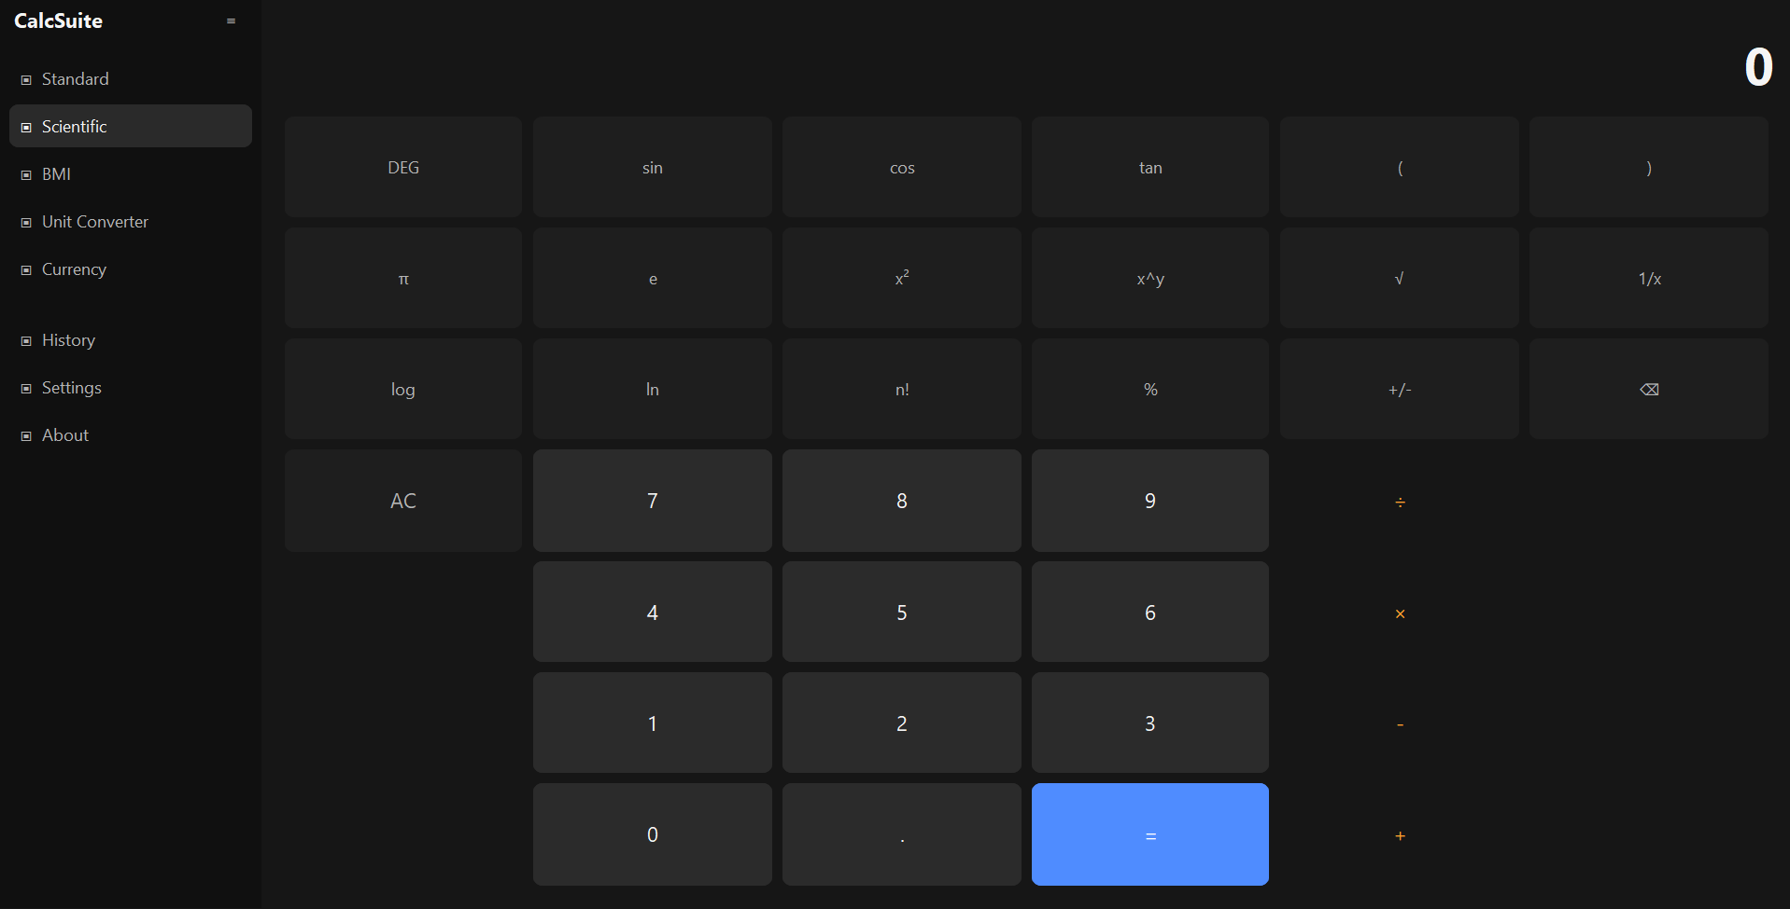
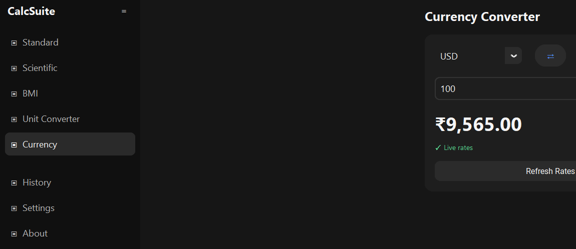
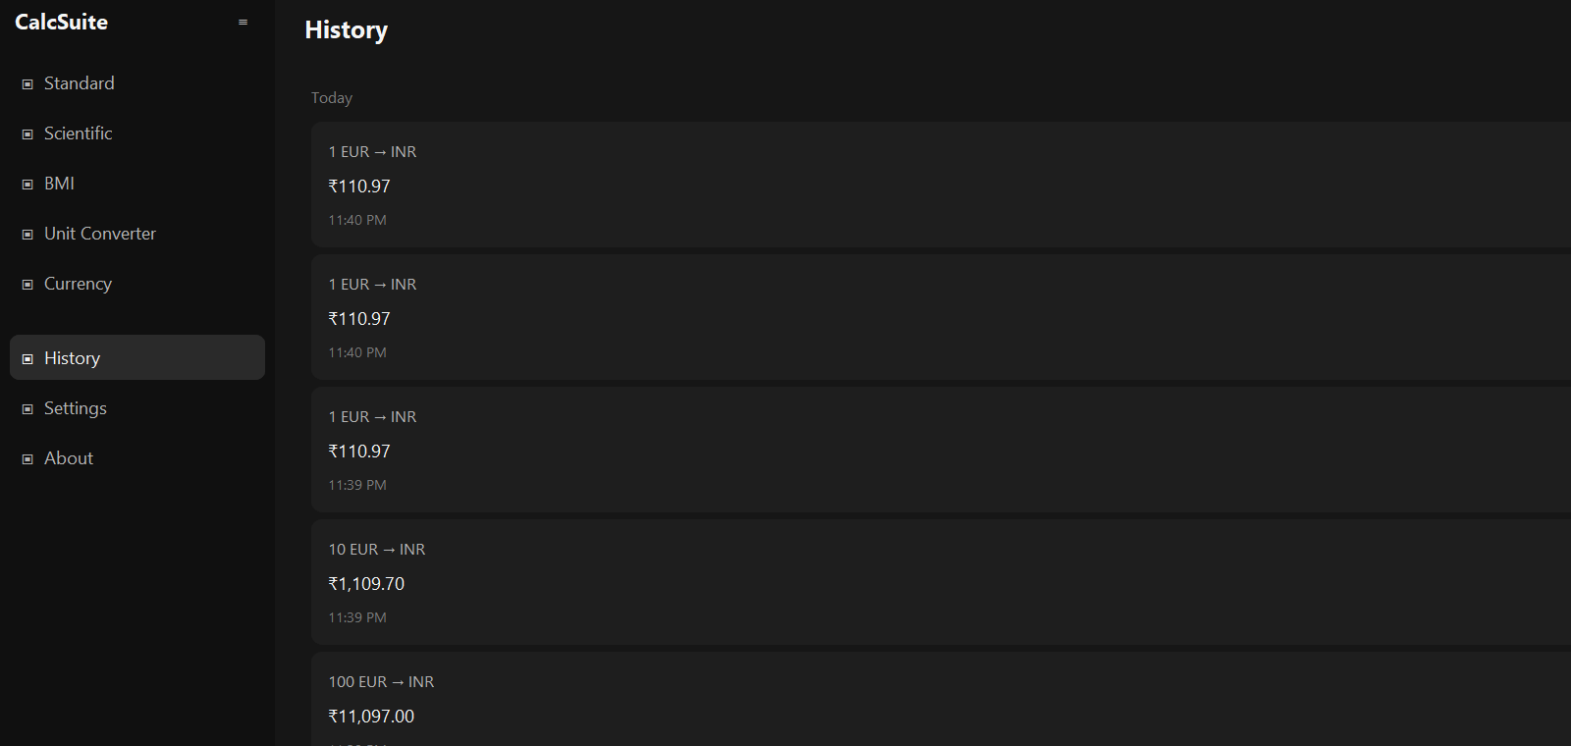
SEE IT IN ACTION
CalcSuite — Application Showcase
STANDARD
SCIENTIFIC
Core arithmetic & keyboard input
Advanced mathematical operations
CURRENCY CONVERTER
HISTORY
Live exchange rates, practical everyday use
Persistent, reusable calculation records
CALCSUITE
06 / 07

Slide 7
WRAPPING UP
Outcome & Future Scope
PROJECT OUTCOME
KEY LEARNING
FUTURE SCOPE
Everyday & scientific calculations
BMI calculation
Unit & currency conversion
Persistent calculation history
Customizable settings
Python desktop app development
Responsive GUI design
Modular software architecture
Validation & error handling
Data persistence & API integration
Automated testing (pytest)
CURRENT
Standard · Scientific · BMI · Unit Converter · Currency · History · Settings
PLANNED
Programmer & Statistics Calculator
Loan / GST / Tax Calculator
Date & Time Calculator
Equation Solver
Thank You
Presented by Bhavdeep Kaur — Next Hikes IT Solutions
CALCSUITE
07 / 07

