Slide 1
Submitted by
Name: Bhavadharini C
Register Number: 715521104006
NM Id: au715521104006(892609CC0580BBB8F1246594F016266B)
College: PSG Institute of Technology and Applied Research
Gmail: bhavadharinic@gmail.com
Degree: B.E Computer Science Engineering –Year III

Slide 2
PROJECT TITLE
DROWSINESS DETECTION SYSTEM USING CNN

Slide 3


AGENDA
Problem Statement
Project Overview
End Users
Solution and Value Proposition
Modeling
Results
Conclusion
3/21/2024 Annual Review

Slide 4

PROBLEM STATEMENT
Driving while drowsy is a critical safety issue that contributes to numerous accidents, injuries, and fatalities on roads worldwide. Despite the awareness campaigns and regulations in place, drowsy driving remains a persistent problem due to its subtle onset and the lack of effective preventive measures. The primary challenge lies in detecting drowsiness in real-time and providing timely interventions to prevent accidents.

Slide 5

PROJECT OVERVIEW
Problem: Drowsy driving: a global safety hazard causing accidents and fatalities.
Objective: Develop a real-time drowsiness detection system using deep learning.
Solution: Utilize CNNs and image processing to analyze facial expressions and eye movements for signs of drowsiness. Continuous monitoring, immediate alerts, integration with vehicles or wearables, customizable alerts. Enhanced road safety, reduced accidents and costs, adaptable and user-friendly design. Our system offers proactive drowsiness detection to prevent accidents and save lives.

Slide 6

WHO ARE THE END USERS?
Drivers: Individuals operating vehicles, especially long-haul truck drivers, taxi drivers, and commuters.
Fleet Management Companies: Companies managing large fleets of vehicles for commercial purposes.
Transportation Authorities: Government agencies responsible for road safety regulations and policies.

Slide 7

YOUR SOLUTION AND ITS VALUE PROPOSITION
Deep Learning Model: Employs a CNN-based architecture for robust analysis of facial expressions and eye movements. CNNs excel in feature extraction, critical for detecting subtle signs of drowsiness.
Image Processing Techniques: Applies advanced image processing algorithms to extract relevant features from facial images. Detects key indicators such as eye closure and yawning to accurately identify drowsiness.
Real-time Monitoring: Provides continuous monitoring of driver behavior for prompt alerts and interventions. Ensures timely action to prevent accidents, enhancing road safety.
Integration: Seamlessly integrates with existing vehicle systems or wearables, ensuring compatibility and ease of use. Enhances accessibility and usability for drivers across different platforms.
Customizable Alerts: Offers personalized alert preferences based on individual driving habits and comfort levels. Allows users to tailor alerts to their preferences, optimizing the user experience.

Slide 8

THE WOW IN YOUR SOLUTION
High Accuracy: Our model achieves high accuracy in detecting drowsiness, minimizing false positives and false negatives.
Real-time Response: The system provides immediate alerts, ensuring prompt action to prevent accidents.
Adaptability: The model can be integrated into existing vehicle systems or wearable devices for widespread adoption.
Customizable Alerts: Users can customize alert preferences based on their driving preferences and comfort levels.
8

Slide 9
MODELLING
Model Architecture: Sequential model with multiple convolutional layers followed by max-pooling for feature extraction. Utilizes dense layers for classification, with dropout regularization to prevent overfitting.
Training Data: Diverse datasets covering various driving conditions and demographics, ensuring model robustness. Includes images of both open and closed eyes, as well as yawning instances for comprehensive training.
Evaluation Metrics: Standard metrics such as accuracy, precision, recall, and F1-score used to assess model performance. Validation results demonstrate the model's effectiveness in drowsiness detection.
9

Slide 10
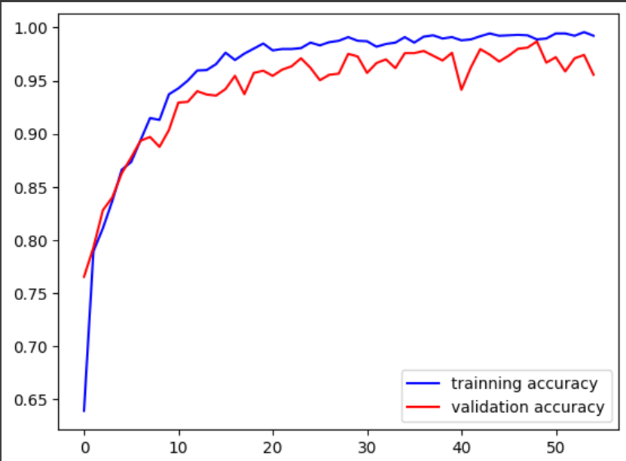
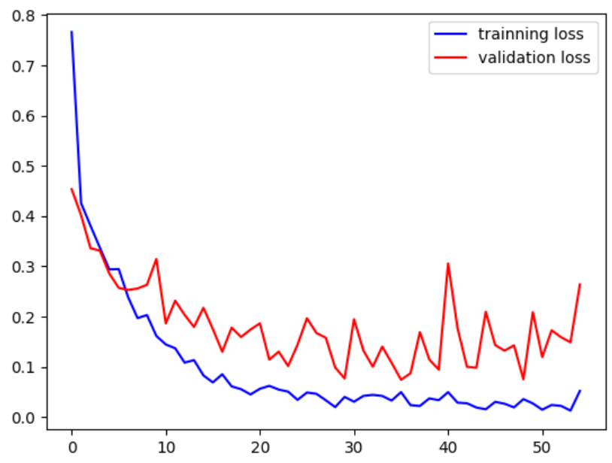
RESULTS
Achieves significant improvement over traditional methods, with high validation accuracy and minimal loss. Demonstrates the model's capability to accurately detect drowsiness and prevent accidents.
10

Slide 11
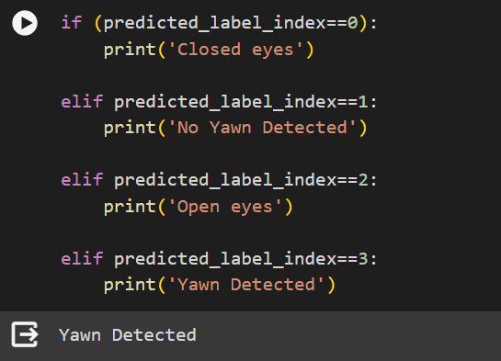
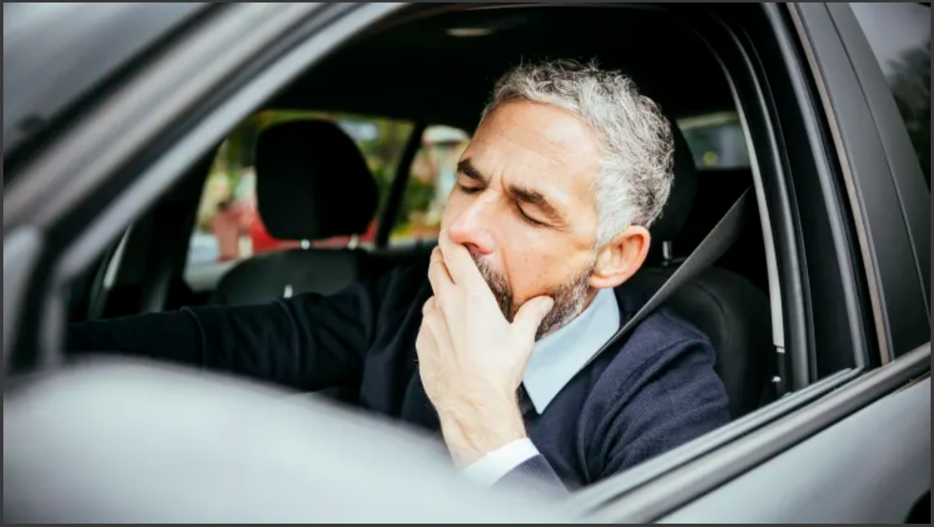
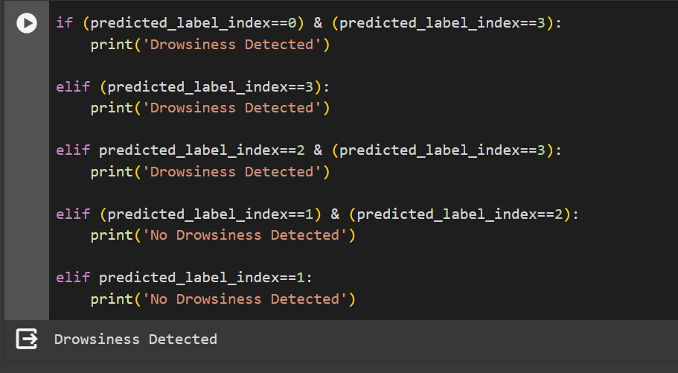
RESULTS…
OUTPUT
SAMPLE INPUT

Slide 12
CONCLUSION
The developed model offers a proactive solution to address the pervasive issue of drowsy driving.
Promising results underscore the potential for enhancing road safety through innovative technology.

