Slide 1

International Conference on Digital Technology and Engineering 2025
Title:
Multimodal Utterance Detection System for Enhanced AI Interpretation
Paper ID:437
Presented by: Ashish Mathew Deepak, Sashtiga K
Co-Authors:
1. Ashish Mathew Deepak
2. Sashtiga K
3. Bhavadharini G
4. Vanitha V
5. Himanshu Shekhar
6. Abhilash Dodla
7. Aditya Jain

Slide 2
International Conference on Digital Technology and Engineering 2025
Abstract:
Multimodal framework to detect AI-directed vs. conversational utterances.
Uses DistilBERT (dialogue acts), Whisper (ASR), HuBERT (emotion).
Features fused into 779-dimensional vector → input to MainClassifier.
Trained on DailyDialog & PolyAI/WOZ datasets.
Performance: 96.75% accuracy, 95.03% precision, 98.85% recall, 96.90% F1.
Handles dataset bias & aligns with IEEE P7003 fairness guidelines.
Optimized for real-time inference (<150 ms GPU, 200 ms edge).

Slide 3
International Conference on Digital Technology and Engineering 2025
Contents:
Introduction
Literature Survey
Proposed work
Experimental results & Discussion
Screenshots
Conclusion
References

Slide 4
International Conference on Digital Technology and Engineering 2025
Introduction:
Virtual assistants enable natural human–computer interaction.
Widely used: smartphones, smart homes, automotive, enterprise.
Core challenge: Detect if utterance is AI-directed or general conversation.
Emotional/personal utterances can be AI-directed → nuanced intent needed.
Accurate detection improves responsiveness, trust, and relevance.
Real-world speech: noise, accents, emotion; datasets often imbalanced.

Slide 5
International Conference on Digital Technology and Engineering 2025
Literature Survey:
Dialog Act Recognition: HMMs → LSTMs/GRUs; struggled with noisy/emotional speech.
Multimodal Emotion Fusion: Audio-text emotion modeling using HuBERT & wav2vec 2.0; improves context understanding.
Dataset Limitations & Bias: Prior models failed on ambiguous/emotional utterances; textual + prosodic features help.
AI-Directed Utterance Detection: Enhances intent disambiguation with contextual embeddings and emotion fusion.
Ethical & Responsible AI: IEEE P7003 compliance ensures fairness, transparency, and reproducibility.

Slide 6
International Conference on Digital Technology and Engineering 2025
Gaps In Literature Survey:
Lack of unified multimodal representation (text + emotion + intent)
Difficulty disambiguating emotionally or pragmatically ambiguous utterances
Dataset imbalance & poor generalization across dialogue types
Overreliance on text-only features; ignores paralinguistic cues
Limited robustness to noise, accents, and multi-speaker environments
High-latency models unsuitable for real-time deployment
Insufficient fairness, transparency, and reproducibility measures

Slide 7
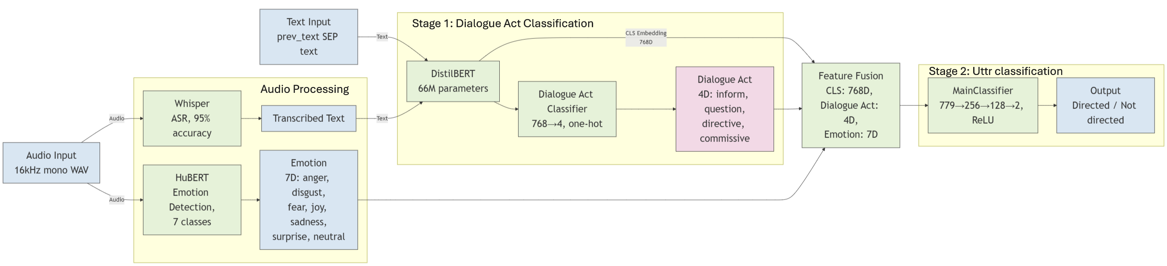
International Conference on Digital Technology and Engineering 2025
Proposed work:

Slide 8
International Conference on Digital Technology and Engineering 2025
Proposed work:
Multimodal framework for AI-directed utterance detection
Two-stage pipeline:
1.Dialogue Act Classification (DistilBERT)
2.Directedness Classification (Text + Audio)
Multimodal Fusion → Text + Dialogue Act + Emotion (779-dim)
Audio Modules: Whisper (Speech-to-Text), HuBERT (Emotion Detection)
Optimized for real-time inference (<150 ms), robust under noise

Slide 9
International Conference on Digital Technology and Engineering 2025
Proposed work:
Text Processing (Stage 1)
DistilBERT → [CLS] embedding + Dialogue Act label (4 classes)
Feature Fusion
Combine [CLS] embedding, Dialogue Act label, and HuBERT emotion vector → 779-dim
Directedness Classification (Stage 2)
Feed-Forward Neural Network → Directed / Non-Directed
Optimized for real-time inference (<150 ms)
Audio Handling
Whisper → speech-to-text
HuBERT → emotion extraction
Training & Deployment
Trained on DailyDialog + PolyAI WOZ
Weighted loss + AdamW optimizer

Slide 10
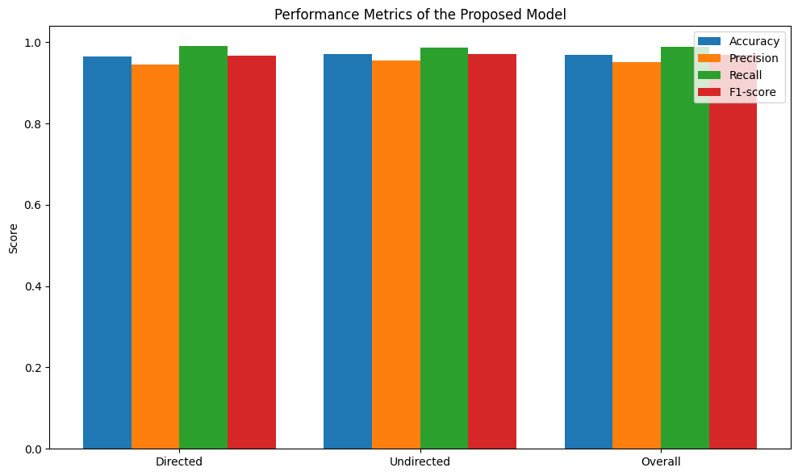
International Conference on Digital Technology and Engineering 2025
Experimental results & Discussion:
Error Analysis:
Misclassifications in ambiguous or rare utterances
Eg. “What’s the weather like?” → Inform
Eg. “I’ll need a reminder.” → Low sample frequency
System Strengths:
Whisper ensures ~95% transcription accuracy
Strong generalization across datasets

Slide 11
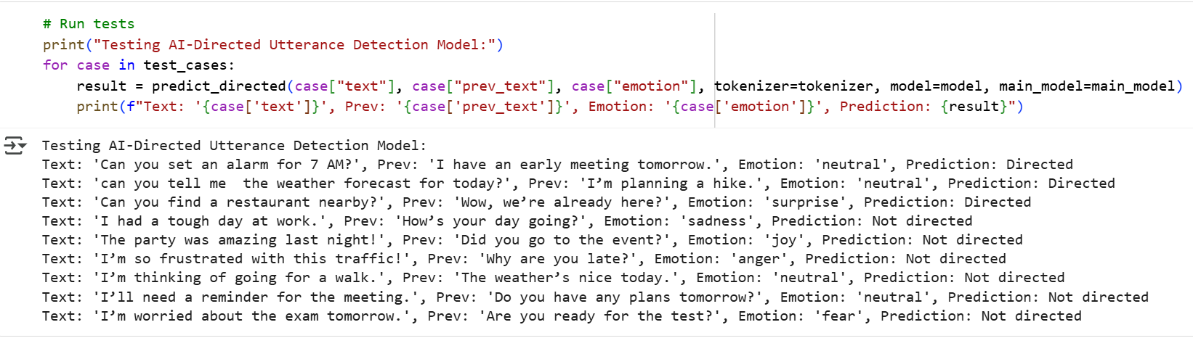
International Conference on Digital Technology and Engineering 2025
Screenshots:

Slide 12
International Conference on Digital Technology and Engineering 2025
Conclusion:
High Performance
Robust & Fair
Ethical & Scalable
Multimodal & Adaptable
Future Enhancements
Long-Term Scalability

Slide 13
International Conference on Digital Technology and Engineering 2025
C. M. Lee and S. Narayanan, "Toward detecting emotions in spoken dialogs," IEEE Trans. Speech Audio Process., vol. 13, no. 2, pp. 293–303, Mar. 2005.
S. Poria, N. Majumder, R. Mihalcea, and E. Hovy, "Emotion recognition in conversation: Research challenges, datasets, and recent advances," IEEE Access, vol. 7, pp. 100943–100953, 2019.
O. Busso et al., "IEMOCAP: Interactive emotional dyadic motion capture database," IEEE Trans. Affective Comput., vol. 1, no. 1, pp. 18–49, Jan. 2012.
S. Koelstra et al., "DEAP: A dataset for emotion analysis using physiological signals," IEEE Trans. Affective Comput., vol. 3, no. 1, pp. 18–31, Jan. 2012.
L. Chen et al., "A model of intent recognition based on dialogue acts and emotion signals," Information Sciences, vol. 647, pp. 1–17, 2024.
M. Z. Uddin and A. Ghazal, "Emotion recognition using speech and neural structured learning," Neurocomputing, vol. 409, pp. 321–335, 2020.
H. Babushkin et al., "Multimodal sentiment analysis across text, audio and visual features," Information Fusion, Sep. 2017.
T. Wu et al., "Intent recognition model incorporating sequential sentence structure," Information Sciences, vol. 678, pp. 145–161, 2025.
R. S. Barbon, "DistilBERT: Knowledge distillation for compact transformer models," Sensors, vol. 22, no. 21, p. 8184, 2022.
G. Ektefaie et al., "Multimodal learning with graph neural networks (CMGNNs)," Nature Machine Intelligence, 2023.
D. Griol and H. Callejas, "Combining statistical dialog management and intent recognition," IEEE J. Artif. Intell. Mach. Learn., vol. 5, no. 4, pp. 245–258, 2024.
R. Kavi and J. Anne, "Intent recognition using DistilBERT on banking and CLINC150 datasets," IEEE Access, vol. 12, pp. 3045–3056, 2024.
R. Subramanian et al., "Audio emotion recognition by deep learning and classical ML methods," Expert Syst. Appl., vol. 162, 2021.
A. Badshah et al., "Speech emotion recognition from spectrograms with deep CNNs," Appl. Sci., vol. 11, no. 9, p. 4204, 2021.
J. Zhang, C. Li, and M. Wang, "Attention-based fully convolutional network for speech emotion recognition," Pattern Recognit. Lett., vol. 123, pp. 110–117, 2018.
X. He and X. Li, "Machine learning paradigms for speech recognition: An overview," IEEE Trans. Audio, Speech, Lang. Process., vol. 21, no. 3, pp. 229–256, 2013.
G. E. Dahl et al., "Context-dependent pre-trained DNNs for large-vocabulary speech recognition," IEEE Trans. Audio, Speech, Lang. Process., vol. 20, no. 1, pp. 30–42, 2012.
T.-W. Kim and K.-C. Kwak, "Speech emotion recognition using transfer learning and explainable techniques," Appl. Sci., vol. 14, no. 4, p. 1553, 2024.
R. Breazeal and L. Aryananda, "Recognition of affective communicative intent in robot-directed speech," Auton. Robots, vol. 12, pp. 83–104, 2002.
F. Eyben et al., "OpenEAR: The Munich open-source emotion and affect recognition toolkit," in Proc. IEEE BIBM, pp. 287–293, 2009.
C. Louvan and F. Magnini, "Advances in dialogue agents through intent classification," IEEE Trans. Knowl. Data Eng., 2020.
Y. Nguyen and M. Shcherbakov, "Improving intent classification via diacritic restoration," IEEE Access, vol. 9, pp. 21567–21579, 2021.
A. Waibel et al., "Time-delay neural networks for phoneme recognition," IEEE Trans. Acoust., Speech, Signal Process., vol. 37, no. 3, pp. 328–339, Mar. 1989.
J. Kothapeta, "Multimodal emotion classification using speech and facial features," IEEE Trans. Emerg. Top. Comput. Intell., 2024.
W. Chan et al., "Listen, attend and spell: Neural network for conversational speech recognition," in Proc. ICASSP, 2016.
Z. Zhang, T. Guo, and M. Chen, "DialogueBERT: Self-supervised pre-training for dialogue understanding," IEEE Trans. Neural Netw. Learn. Syst., 2022.
O. Recasens et al., "Addressee detection in multimodal contexts," in Proc. NeurIPS, pp. 2025–2033, 2015.
M. Majumder et al., "DialogueGCN: Graph-based emotion recognition in conversations," in AAAI Conf. Artif. Intell., 2019.
S. Poria et al., "Fusing audio, textual and visual features for sentiment analysis of news videos," IEEE Intell. Syst., vol. 31, no. 2, pp. 82–88, 2016.
L.-P. Morency et al., "Context-dependent sentiment analysis in user-generated videos," in IEEE Comput. Soc. Annu. Meeting, 2017.

