Slide 1
UE18CS390B – Project Phase – 2
END SEMESTER ASSESSMENT
Project Title : Smart Classroom Environment
Project ID : 71
Project Guide : Dr. Annapurna D
Project Team : Akshaya Visvanathan (PES2201800089)
Bhavan Naik (PES2201800047)
Akhil S Kumar (PES2201800137)
Atharva Moghe (PES2201800131)

Slide 2
Outline
Abstract
Summary of Requirements and Design ( Phase - 1)
Summary of Methodology / Approach (Phase - 1)
Design Description
Modules and Implementation Details
Project Demonstration and Walkthrough
Test Plan and Strategy
Results and Discussion
Lessons Learnt
Conclusion and Future Work
References

Slide 3
Abstract
Problem Statement
A proposal for an IoT-based intelligent environment, with the primary objective of energy optimization and an intelligent, yet reliable attendance system that focuses on reducing latency to give an enhanced learning experience.

Slide 4
Abstract
Abstract and Scope
For a long time, attendance has always been taken manually. This has caused multiple discrepancies and has wasted useful class time.
In addition to this, classroom equipment like fans etc. have occasionally been left on thereby wasting considerable energy.
We are planning to firstly implement this project in our own campus and then extend it to other institutions.

Slide 5
Summary of Requirements and Design
EXISTING SOLUTIONS TO OUR PROBLEM:
Face Recognition Attendance System (Delays)
Fingerprint Sensors (Only in offices, Outside the room)
Centralized A.C./Heater (Single Temperature for everyone)
Manual Fans (Not automatic leading to disruption in class)

Slide 6
Summary of Requirements and Design
REQUIREMENTS:
Optical Biometric Sensor Module: to record individual fingerprints.
Spatial Sensors: to check which part of the room is occupied to make the system spatial aware.
WPF/UWP: to make the dashboard application for administrator management.

Slide 7
Summary of Requirements and Design
DESIGN APPROACH:
The assortment IoT sensors installed in the classrooms are durable and need not be replaced often.
The server installation too is a one-time process. However, the ThingSpeak and Firebase backends need to be paid for on a yearly basis depending on the usage.
The ML models used for attendance summarization and fan speed detection are reused and some extra layers(mechanism) have been added on top of that. These models are constantly learning from manual user intervention.

Slide 8
Summary of Requirements and Design
DESIGN CONSTRAINTS, ASSUMPTIONS AND DEPENDENCIES:
Server systems in the Institutions:
- Our project also highly depends upon how the server system exists at a particular institution. If there is no existing server, it would be very easy to implement.
Existing Wiring in Institutions:
- It depends which wiring system exists at the institution because our project would work on almost every existing wiring system unless it’s very old.

Slide 9
Summary of Requirements and Design
DESIGN DETAILS:
Novelty/ Uniqueness of the Project:
- Automated yet reliable attendance system that would help improve classroom learning. Fool proof solution is important keeping in mind the innovative ways students find to bypass attendance systems.
- Real-time implementation that is independent of the wiring system and hence may be extended to Government schools and colleges, in order to reduce their electricity costs.
- Help reduce harmful effects of unsolicited energy consumption on the environment and save our planet for future generations.

Slide 10
Summary of Methodology / Approach
MODULE 1: ATTENDANCE SYSTEM
Attendance can be taken electronically by means of a biometric optical fingerprint scanner.
Security and integrity can be ensured by making the biometric module portable and modular - a small phone sized module carried by the teachers.
The teacher can pass around/have each of the students scan their prints and register their attendance with no manual intervention.

Slide 11
Summary of Methodology / Approach
MODULE 2: ELECTRICITY OPTIMIZATION:
Spatial sensors placed at the edges of classrooms will notify the system of movement and activity in the room.
Edge computed algorithms ensure that the lights and fans are turned on only at specific portions of the room incase of a large classroom/hallway.
In case of manual fans, temperature monitors are used to add a level of cost-effective automation.

Slide 12
Design Description
Research Project
Algorithm used and explain the logical workflow.
Prototype/Product based Project
Add as many slides as required to cover the following aspects:
Master class diagram
Use case Diagram
Sequence, Packaging and Deployment Diagrams

Slide 13
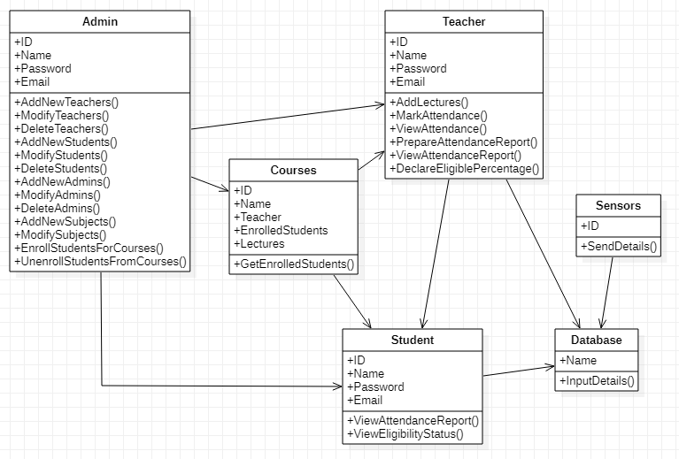
Design Description
MASTER CLASS DIAGRAM:

Slide 14
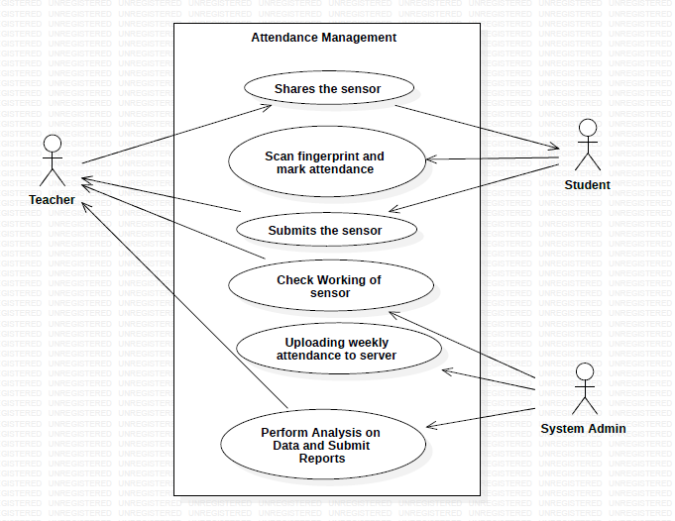
Design Description
USE-CASE DIAGRAM:

Slide 15
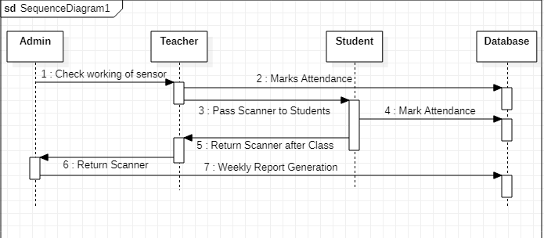
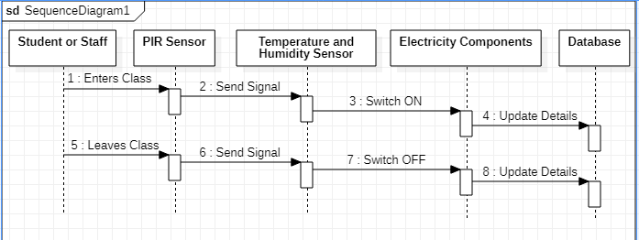
Design Description
SEQUENCE DIAGRAM:
Attendance Module:
Electricity Module:

Slide 16
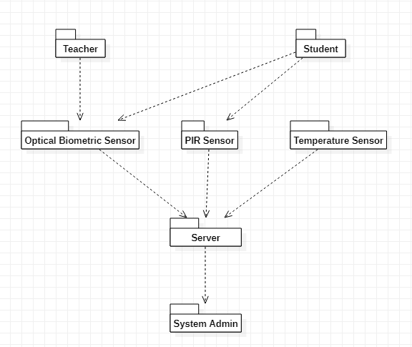
Design Description
PACKAGING DIAGRAM:

Slide 17
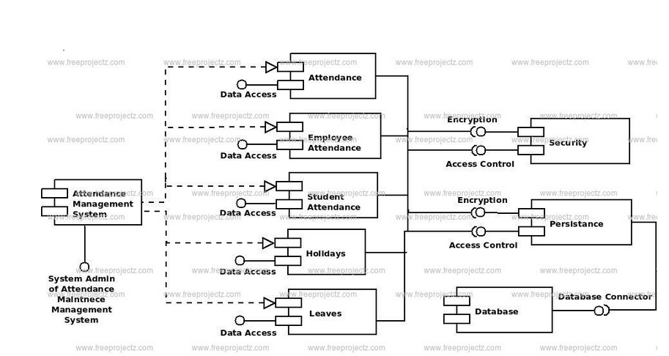
Design Description
DEPLOYMENT DIAGRAM: (ATTENDANCE MODULE)

Slide 18
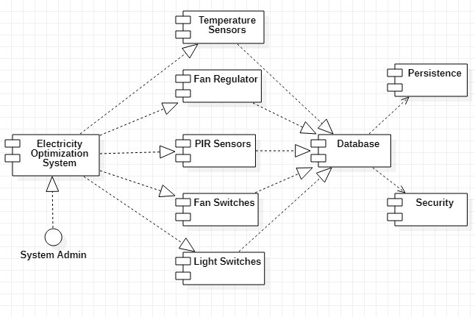
Design Description
DEPLOYMENT DIAGRAM: (ELECTRICITY MODULE)

Slide 19
Modules and Implementation Details
MODULE 1: ATTENDANCE SYSTEM
- Optical Biometric Sensor Module
- ESP32
- Arduino IDE
MODULE 2: ELECTRICITY OPTIMIZATION SYSTEM
- Spatial PIR Sensors
- Arduino IDE
MODULE 3: WINDOWS APPLICATION
- WPF: Windows Presentation Foundation
- UWP: Universal Windows Platform
MODULE 4: DATABASE SYSTEMS
- MySQL
- XAMPP Server

Slide 20
Project Demonstration
Module 1:
- Automatic Attendance System: Bhavan (PES2201800047)
Module 2:
- Electricity Optimization System: Akshaya (PES2201800089)
Module 3:
- Windows Application: Akhil (PES2201800137)
Module 4:
- Database Management System: Atharva (PES2201800131)

Slide 21
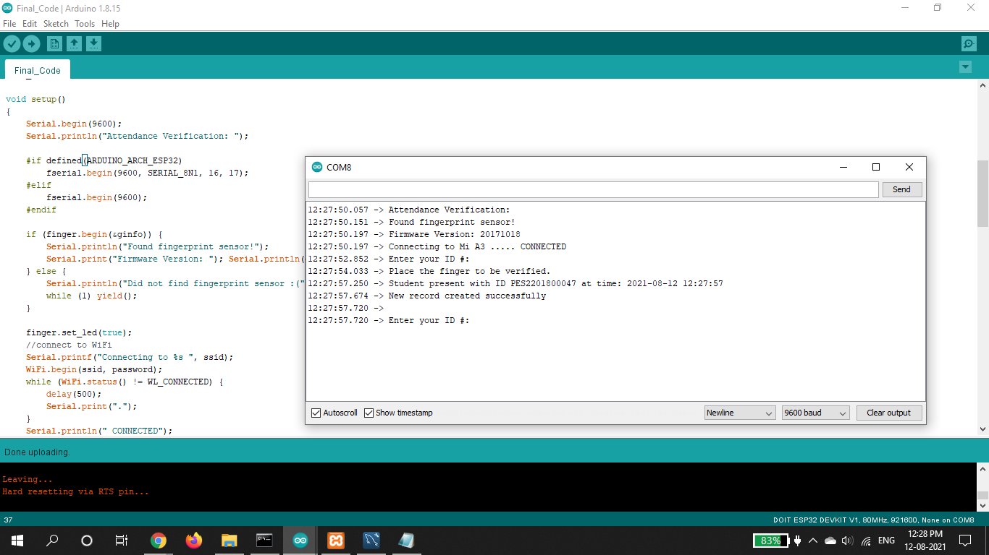
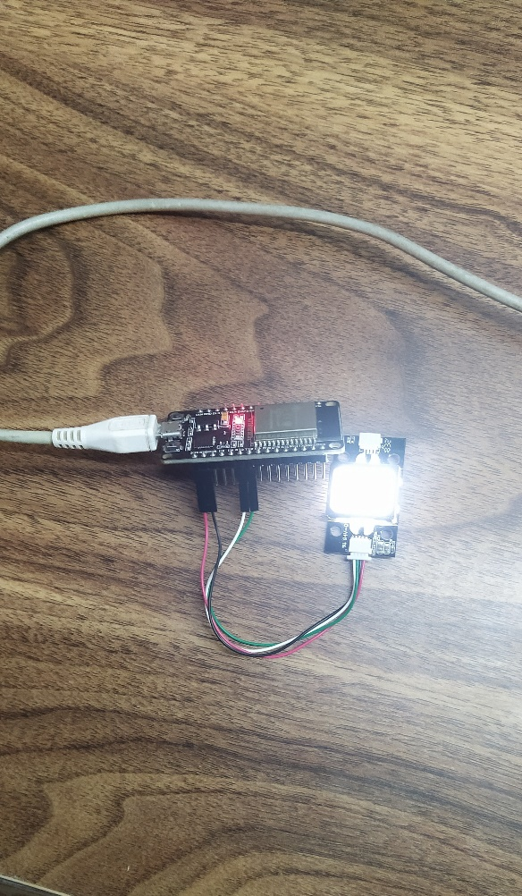
Walkthrough
Module 1: Automatic Attendance Module

Slide 22
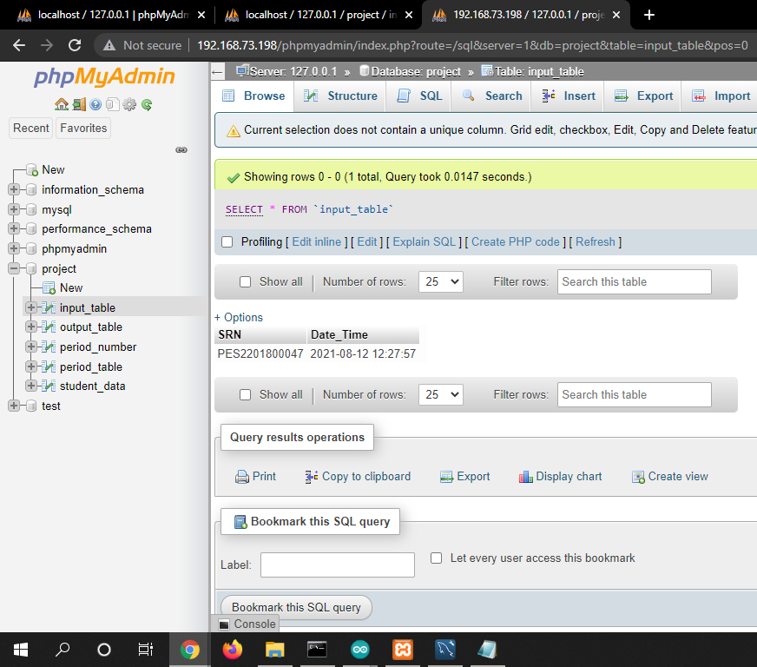
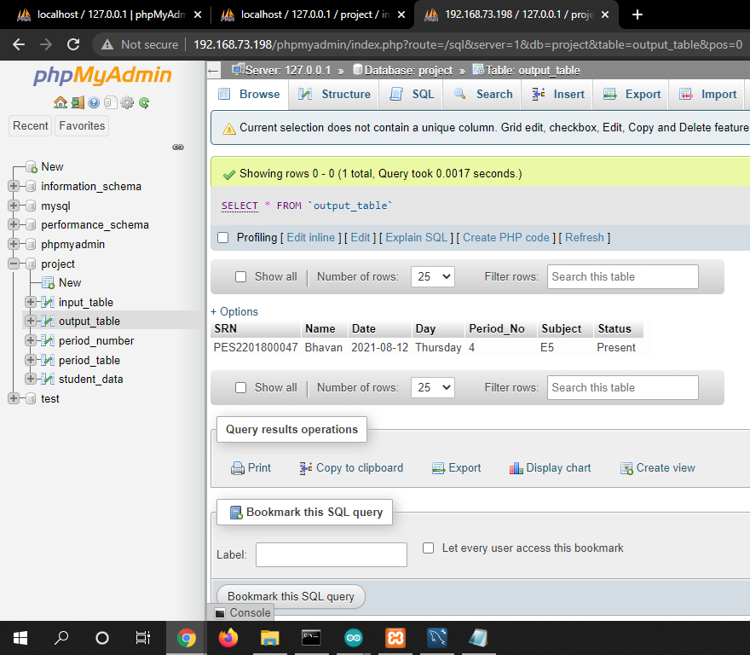
Walkthrough
Input Table Output Table

Slide 23
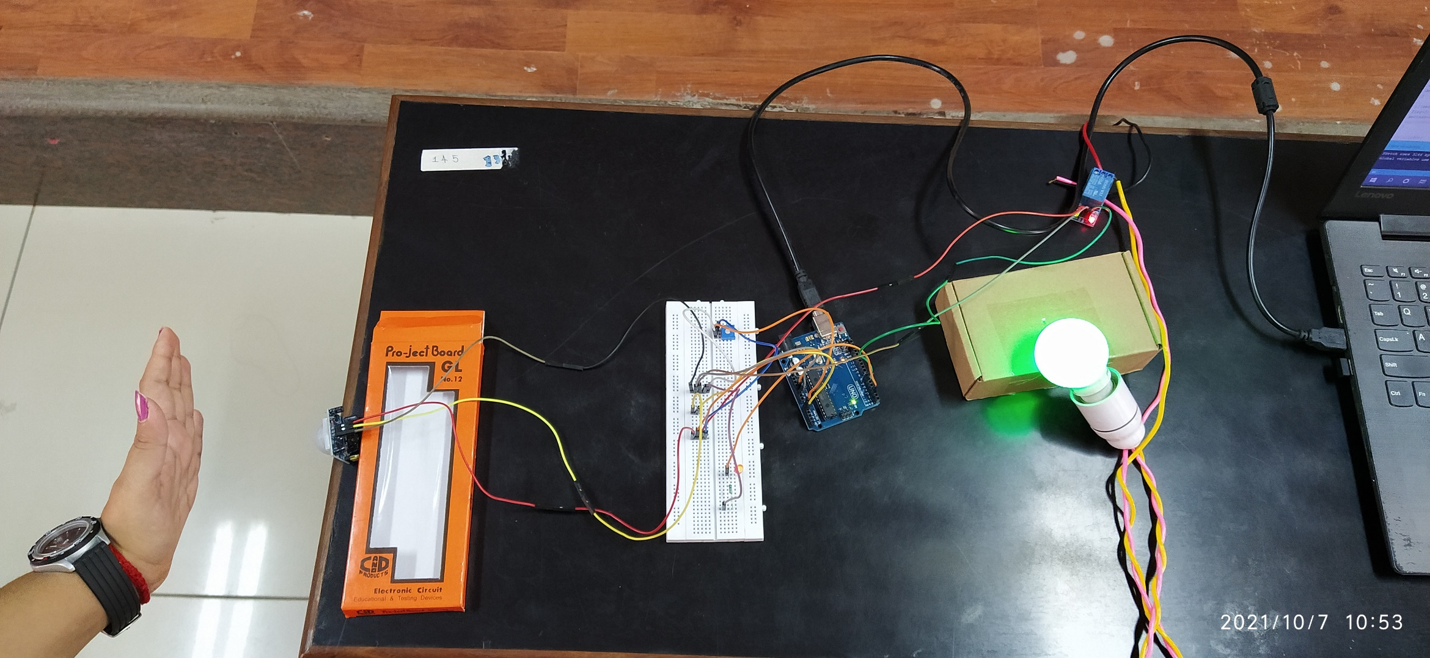
Walkthrough
Module 2: Electricity Optimization Module

Slide 24
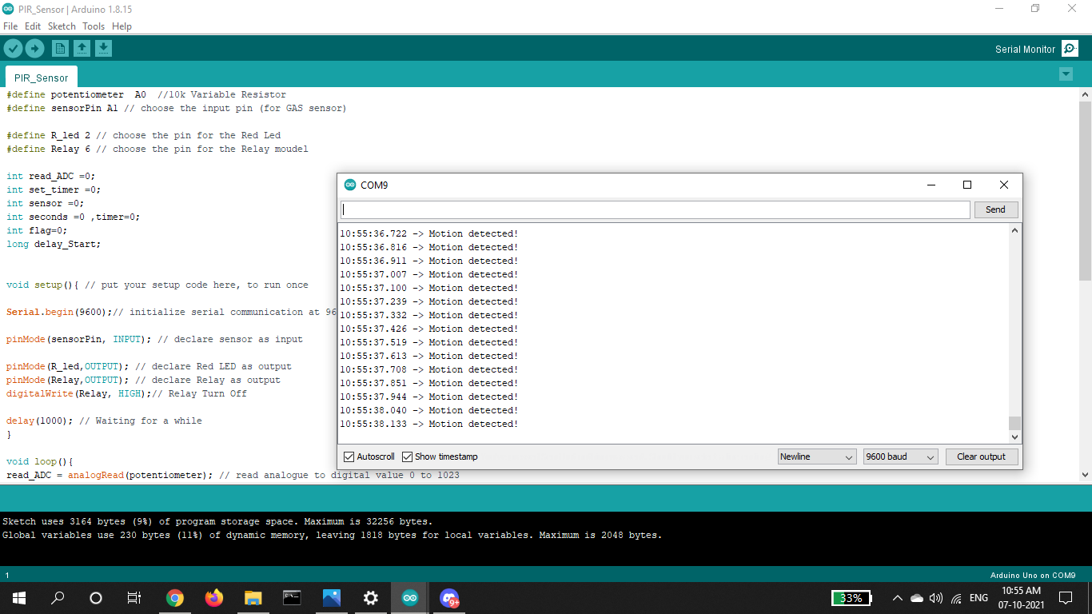
Walkthrough
Module 2: Electricity Optimization Module

Slide 25
Walkthrough
Module 3: Windows Application

Slide 26
Walkthrough
Module 3: Windows Application

Slide 27
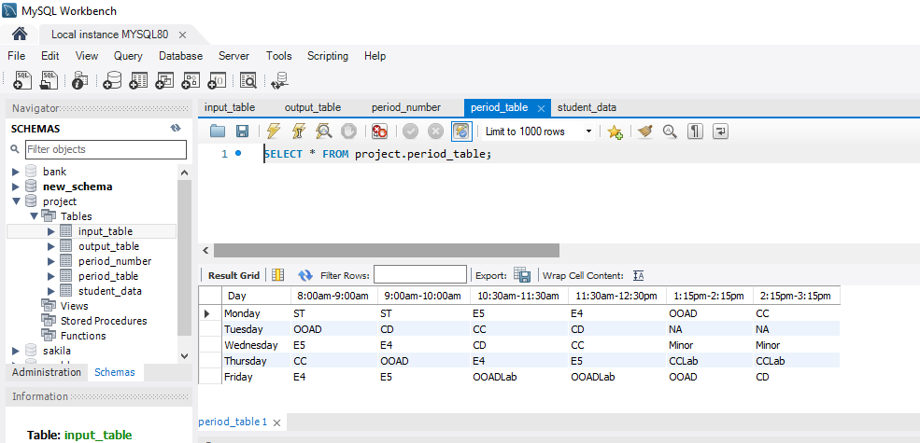
Walkthrough
Module 4: Database Management System

Slide 28
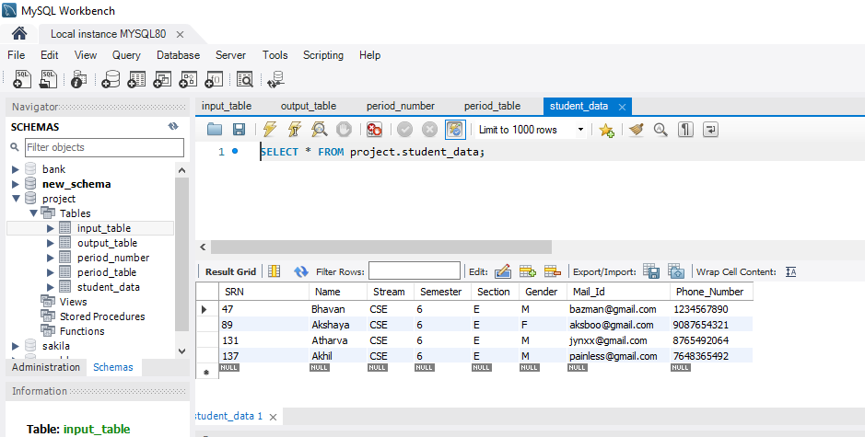
Walkthrough
Module 4: Database Management System

Slide 29
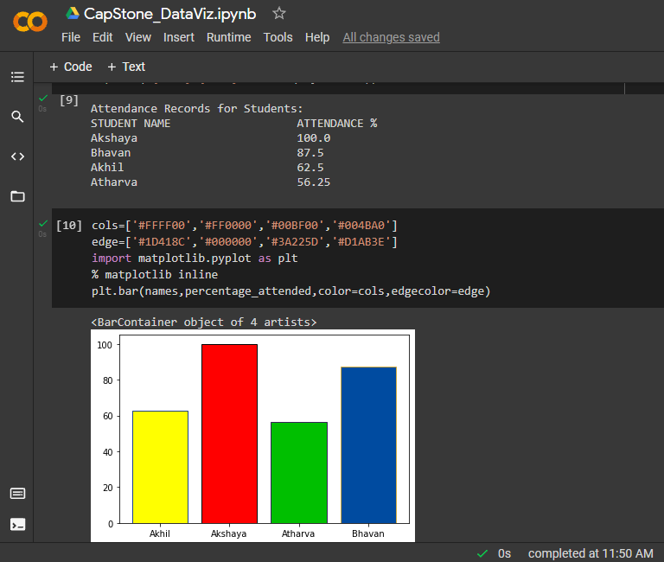
Walkthrough
Data Visualization

Slide 30
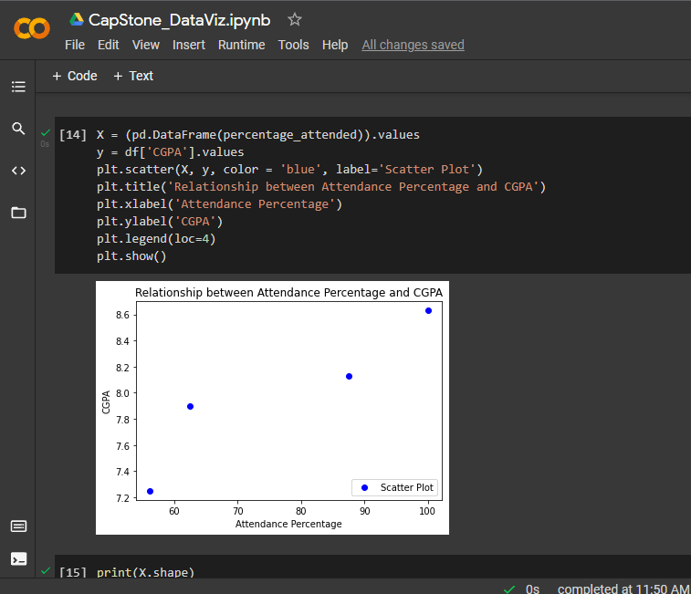
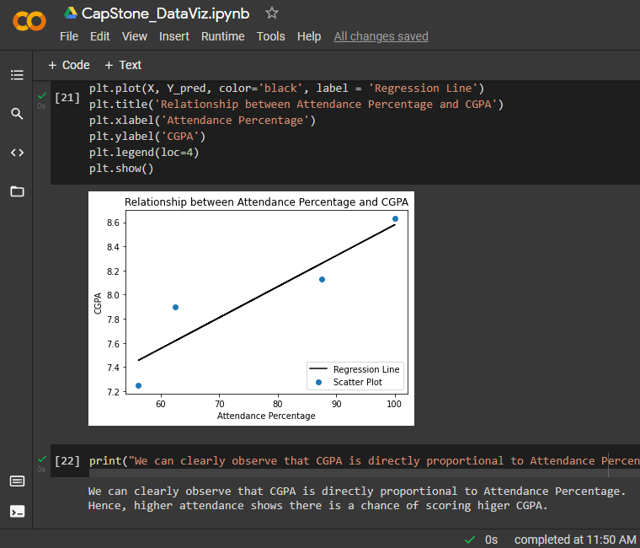
Walkthrough
Data Visualization

Slide 31
Test Plan and Strategy
Attendance Module:
▪ Checking if fingerprint scanner is working or not.
▪ Checking if fingerprint scanner is able to map the fingerprint to the ID of the student.
▪ Checking if the data sent to the database is correct or not.
Electricity Optimization Module:
▪ Checking if the module senses motion.
▪ Checking if the module sends correct data to the database.
Windows Application:
▪ Checking if the app is able to change/update the database.
▪ Checking if the app is able to handle multiple logins at the same time.
▪ Checking if the app gives the right data back to the admin.
Database System:
▪ Checking the data sent by fingerprint scanner and map it to the correct class and marking the status.
▪ Checking the data sent by the electricity optimization module and add correct values to the database.
▪ Checking of the data given by the system to the admin is correct or not.

Slide 32
Results and Discussion
Results are the same as expected from the system.
All the modules are working as they are supposed to be running.
There are no major deviations from the original expected outputs.
The only main deviation from the original plan is that we were not able to collect data from all students of a particular class due to the pandemic and only data belonging to the group members is used in this project.

Slide 33
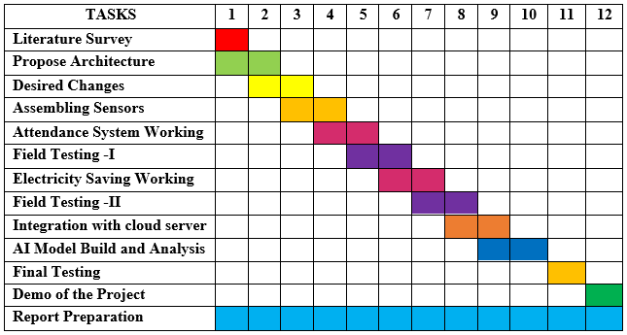
Schedule
We, as a team, have followed most of the schedule perfectly except for one part which was procuring and assembling the components since it was delayed considerable due to the restrictions.

Slide 34
Documentation
Project report submitted in department: Submitted with Guide Approval.
IEEE Format of Paper current status: Completed, Approved from Guide and Plagiarism Report Generated.
Which Conferences are you targeting: ICDSMLA 2021
Video (2-3 minutes) of your project: Live demo for all modules
Add the Github repository link: https://github.com/Bhavan-Naik/CapStone_Team-71
All artifacts of your project uploaded in the CSE Project repository: Yes

Slide 35
Conclusion and Future work
Conclusion: We have successfully completed the project along with the reports.
All the modules of the project are running as expected and the reports match to the running project as well.
Future Work:
Add a couple of other modules to get all-in-one university system for the better and easier functioning of the institute.
Next Steps:
To extend the project from one institution to multiple institution level.

Slide 36
References
Y. Mehmood, F. Ahmad, I. Yaqoob, A. Adnane, M. Imran and S. Guizani, "Internet-of-Things-Based Smart Cities: Recent Advances and Challenges," in IEEE Communications Magazine, vol. 55, no. 9, pp. 16-24, Sept. 2017, doi: 10.1109/MCOM.2017.1600514.
https://ieeexplore.ieee.org/abstract/document/8030479
M. Caţă, "Smart university, a new concept in the Internet of Things," 2015 14th RoEduNet International Conference - Networking in Education and Research (RoEduNet NER), 2015, pp. 195-197, doi: 10.1109/RoEduNet.2015.7311993. https://ieeexplore.ieee.org/abstract/document/7311993
Q. Miao, F. Xiao, H. Huang, L. Sun and R. Wang, "Smart attendance system based on frequency distribution algorithm with passive RFID tags," in Tsinghua Science and Technology, vol. 25, no. 2, pp. 217-226, April 2020, doi: 10.26599/TST.2018.9010141. https://ieeexplore.ieee.org/stamp/stamp.jsp?tp=&arnumber=8821515

Slide 37
References
J. Yu, W. Gong, J. Liu, L. Chen, K. Wang and R. Zhang, "Missing Tag Identification in COTS RFID Systems: Bridging the Gap between Theory and Practice," in IEEE Transactions on Mobile Computing, vol. 19, no. 1, pp. 130-141, 1 Jan. 2020, doi: 10.1109/TMC.2018.2889068. https://www2.cs.sfu.ca/~jcliu/Papers/MissingTagIdentification.pdf
Suresh S., H. N. S. Anusha, T. Rajath, P. Soundarya and S. V. P. Vudatha, "Automatic lighting and Control System For Classroom," 2016 International Conference on ICT in Business Industry & Government (ICTBIG), 2016, pp. 1-6, doi:10.1109/ICTBIG.2016.7892666. https://ieeexplore.ieee.org/abstract/document/7892666
S. Bhattacharya, G. S. Nainala, P. Das and A. Routray, "Smart Attendance Monitoring System (SAMS): A Face Recognition Based Attendance System for Classroom Environment," 2018 IEEE 18th International Conference on Advanced Learning Technologies (ICALT), 2018, pp. 358-360, doi: 10.1109/ICALT.2018.00090. https://ieeexplore.ieee.org/abstract/document/8433537

Slide 38
References
D. He and S. Zeadally, "An Analysis of RFID Authentication Schemes for Internet of Things in Healthcare Environment Using Elliptic Curve Cryptography," in IEEE Internet of Things Journal, vol. 2, no. 1, pp. 72-83, Feb. 2015, doi: 10.1109/JIOT.2014.2360121. https://ieeexplore.ieee.org/document/6907930
R. Sarmah, M. Bhuyan and M. H. Bhuyan, "SURE-H: A Secure IoT Enabled Smart Home System," 2019 IEEE 5th World Forum on Internet of Things (WF-IoT), 2019, pp. 59-63, doi: 10.1109/WF-IoT.2019.8767229.
https://ieeexplore.ieee.org/document/8767229

Slide 39
Any other information
IEEE Report Link: https://docs.google.com/document/d/1qxi3upmOSM61n3BVeq5PylEkey1lJMuf/
Project Completion Percentage: 100%

Slide 40
Thank You

