Slide 1
UE18CS390B – Capstone Project Phase – 2
Project Progress Review #1
Project Title : Smart Classroom Environment
Project ID : 71
Project Guide : Dr. Annapurna D
Project Team : Akshaya Visvanathan (PES2201800089)
Bhavan Naik (PES2201800047)
Akhil S Kumar (PES2201800137)
Atharva Moghe (PES2201800131)

Slide 2
Outline
Abstract and Scope of the Project
Capstone Project Phase – 1
Summary of work
Inferences drawn from Literature Survey
Expected Deliverables
Gantt chart

Slide 3
Abstract and Scope
Problem Statement:
A proposal for an IoT-based intelligent environment, with the primary objective of energy optimization and an intelligent, yet reliable attendance system that focuses on reducing latency to give an enhanced learning experience.
Abstract:
For a long time, attendance has always been taken manually. This has caused multiple discrepancies and has wasted useful class time.
In addition to this, classroom equipment like fans etc. have occasionally been left on thereby wasting considerable energy.
Scope:
We are planning to firstly implement this project in our own campus and then extend it to other institutions.

Slide 4
Summary of Work Done in Capstone Project Phase - 1
Identified a valid problem statement.
Read and went through multiple research papers for reference and ideas to help us formulate a plan to tackle the problem statement.
Found out Functional and Non-Functional requirements.
Created a cost estimation document containing all the hardware that will be used also segregating the recurring costs and the onetime costs.
Compared our design to the old one showing key differences as to why our design is better.
Created a documented high level design document containing the following: Master Class Diagram, Architecture Choices, State Diagrams, User-Interface Diagrams, External-Interfaces, Packaging and Deployment Diagrams for both our Solutions, Design Details.

Slide 5
Work to be Done in Capstone Project Phase - 2
Going into the next phase of our project, the first thing we must do is to assemble the sensors together for our product and produce a “prototype” of our product which will then lead to the first wave of testing, and we will be collecting feedback and then making desire changes and testing till we get the outcome we desire.
After that we will begin the integration of the product with the cloud server to store all the data that we will be collecting from our sensors, making the AI models, continue with the final wave of testing, provide the demo.

Slide 6
Expected Deliverables
List of Tasks/Modules:
- Windows app/ Dashboard: Hub
- Fingerprint Scanner Integration
- Energy Conservation System
- Database System
- Integration of all Components
- Testing
Work Done:
- Search for Simulators
- Dataset
- Component Acquisition
- Assignment of Tasks

Slide 7
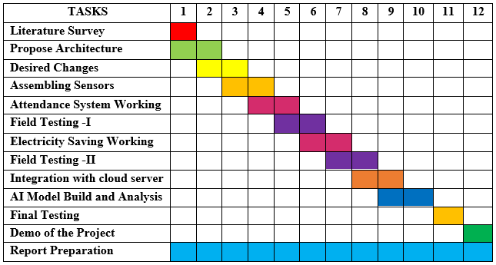
Gantt Chart

Slide 8
References
M. Caţă, "Smart university, a new concept in the Internet of Things," 2015 14th RoEduNet International Conference - Networking in Education and Research (RoEduNet NER), 2015, pp. 195-197, doi: 10.1109/RoEduNet.2015.7311993.
Q. Miao, F. Xiao, H. Huang, L. Sun and R. Wang, "Smart attendance system based on frequency distribution algorithm with passive RFID tags," in Tsinghua Science and Technology, vol. 25, no. 2, pp. 217-226, April 2020, doi: 10.26599/TST.2018.9010141.
Suresh S., H. N. S. Anusha, T. Rajath, P. Soundarya and S. V. P. Vudatha, "Automatic lighting and Control System For Classroom," 2016 International Conference on ICT in Business Industry & Government (ICTBIG), 2016, pp. 1-6, doi: 10.1109/ICTBIG.2016.7892666.
S. Bhattacharya, G. S. Nainala, P. Das and A. Routray, "Smart Attendance Monitoring System (SAMS): A Face Recognition Based Attendance System for Classroom Environment," 2018 IEEE 18th International Conference on Advanced Learning Technologies (ICALT), 2018, pp. 358-360, doi: 10.1109/ICALT.2018.00090.

Slide 9
Thank You

