Slide 1
UE18CS390B – Capstone Project Phase – 2
Project Progress Review #2
Project Title : Smart Classroom Environment
Project ID : 71
Project Guide : Dr. Annapurna D
Project Team : Akshaya Visvanathan (PES2201800089)
Bhavan Naik (PES2201800047)
Akhil S Kumar (PES2201800137)
Atharva Moghe (PES2201800131)

Slide 2
Outline
Abstract and Scope of the Project.
Suggestions from Review – 1.
Approach & Architectural Design or Framework.
Project Progress and Demonstration.
Timeline for Pending Tasks.
Conclusion.
References.

Slide 3
Abstract and Scope
Problem Statement:
A proposal for an IoT-based intelligent environment, with the primary objective of energy optimization and an intelligent, yet reliable attendance system that focuses on reducing latency to give an enhanced learning experience.
Abstract:
For a long time, attendance has always been taken manually. This has caused multiple discrepancies and has wasted useful class time.
In addition to this, classroom equipment like fans etc. have occasionally been left on thereby wasting considerable energy.
Scope:
We are planning to firstly implement this project in our own campus and then extend it to other institutions.

Slide 4
Suggestions from Review - 1
Provide the suggestions and remarks given by the panel members:
1. Concerns on type of ML/AI analysis used for the Project.
Mention the feasibility on the same showing the progress:
1. Explored Tableau and Neo4j graph database application as a tool for visualization.

Slide 5
Proposed Methodology / Approach -1
Attendance:
Attendance can be taken electronically by means of a biometric optical fingerprint scanner.
Security and integrity can be ensured by making the biometric module portable and modular - a small phone sized module carried by the teachers.
The teacher can pass around/have each of the students scan their prints and register their attendance with no manual intervention.

Slide 6
Proposed Methodology / Approach -2
Electricity Optimization:
Spatial sensors placed at the edges of classrooms will notify the system of movement and activity in the room.
Edge computed algorithms ensure that the lights and fans are turned on only at specific portions of the room incase of a large classroom/hallway.
In case of manual fans, temperature monitors are used to add a level of cost-effective automation.

Slide 7
Design Approach
User Groups:
Teachers
Students
Administrator
Application Components:
Attendance Logging Component
Power Component
Temperature Modulation Component
Database Component
Data Components:
Raw Fingerprint Data
Power Consumption Values
Current Room temperature
Database connectors

Slide 8
Design Constraints, Assumptions & Dependencies
Server Systems in the Institutions:
Our project, to an extent, depends upon how the server system exists at a particular institution.
Existing Wiring in Institutions:
It depends which wiring system exists at the institution because our project would work on almost every existing wiring system unless it’s very old.
Authenticity of Collected Data:
Due to the present scenario, we must fabricate the data required in our project.

Slide 9
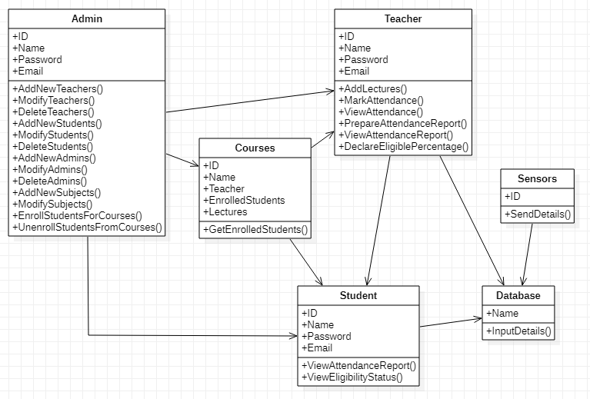
Design Description
Class Diagram:

Slide 10
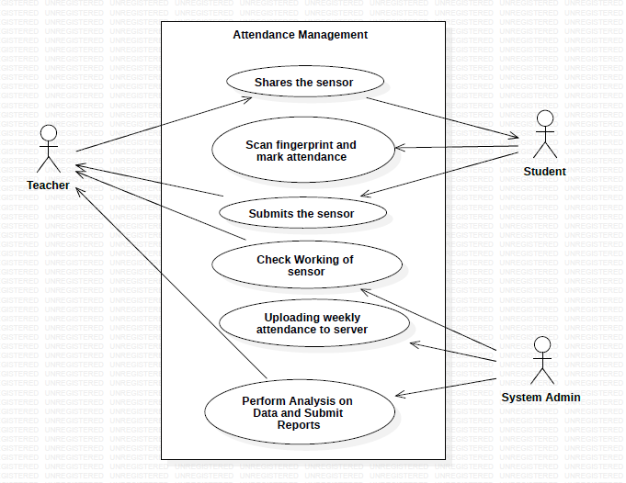
Design Description
Use-Case Diagram:

Slide 11
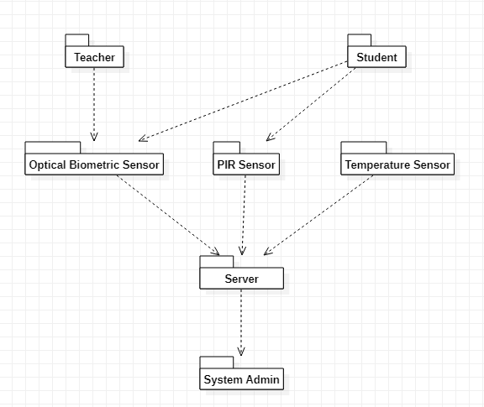
Design Description
Packaging Diagram:

Slide 12
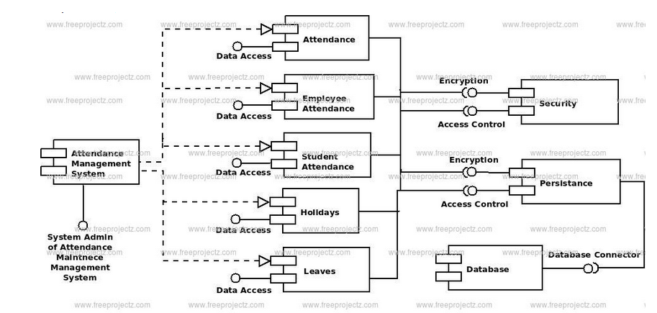
Design Description
Deployment Diagram (Attendance):

Slide 13
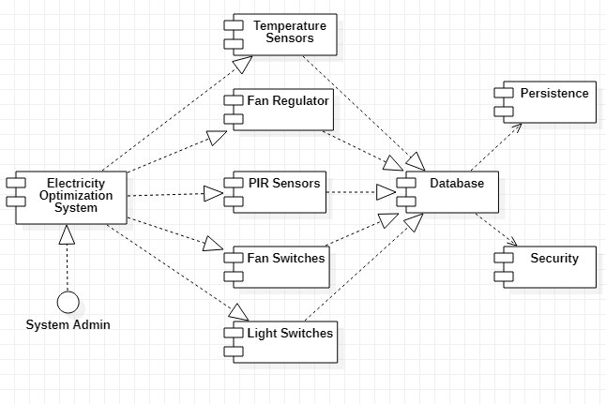
Design Description
Deployment Diagram (Electricity Optimization):

Slide 14
Expected Deliverables
List of Tasks/Modules:
- Windows app/ Dashboard: Hub
- Fingerprint Scanner Integration
- Energy Conservation System
- Database System
- Integration of all Components
- Testing
Work Completed:
- Assignment of Tasks
- Component Acquisition
- Database System
- Fingerprint Scanner Integration

Slide 15
Project Progress So far
Progress so far:
Literature Survey
Architecture Proposal
Desired Changes
CapStone Phase-1 Report
Assignment of Tasks
Component Acquisition
Database System
Fingerprint Scanner Integration
Major part of Windows Application completed
Started with Data Visualization
Percentage completion of the project: 75%

Slide 16
Project Demonstration
Windows Application/ Dashboard: Akhil
Fingerprint Scanner: Bhavan
Energy Conservation System: Akshaya
Database Systems: Atharva

Slide 17
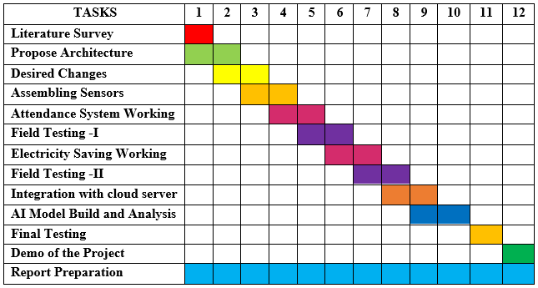
Timeline – Update on Pending Tasks

Slide 18
Conclusion
The Sensors have been accumulated.
The Database has been created.
The Fingerprint Scanner Module is up and running.
The Electricity Component is yet to be assembled.
The Windows Dashboard is almost completed.
We have started the data visualization part of the project and are currently experimenting on various tools.
Integration and Final Testing must be done.

Slide 19
References
M. Caţă, "Smart university, a new concept in the Internet of Things," 2015 14th RoEduNet International Conference - Networking in Education and Research (RoEduNet NER), 2015, pp. 195-197, doi: 10.1109/RoEduNet.2015.7311993.
Q. Miao, F. Xiao, H. Huang, L. Sun and R. Wang, "Smart attendance system based on frequency distribution algorithm with passive RFID tags," in Tsinghua Science and Technology, vol. 25, no. 2, pp. 217-226, April 2020, doi: 10.26599/TST.2018.9010141.
Suresh S., H. N. S. Anusha, T. Rajath, P. Soundarya and S. V. P. Vudatha, "Automatic lighting and Control System For Classroom," 2016 International Conference on ICT in Business Industry & Government (ICTBIG), 2016, pp. 1-6, doi: 10.1109/ICTBIG.2016.7892666.
S. Bhattacharya, G. S. Nainala, P. Das and A. Routray, "Smart Attendance Monitoring System (SAMS): A Face Recognition Based Attendance System for Classroom Environment," 2018 IEEE 18th International Conference on Advanced Learning Technologies (ICALT), 2018, pp. 358-360, doi: 10.1109/ICALT.2018.00090.

Slide 20
Thank You

