Slide 1
UE18CS390A – Capstone Project Review #2
(Project Requirements Specification and Literature Survey)
Project Title : Smart Classroom Solutions
Project ID : 71
Project Guide : Dr. Annapurna
Project Team : Akshaya Visvanathan (PES2201800089)
Bhavan Naik (PES2201800047)
Akhil S Kumar (PES2201800137)
Atharva Moghe (PES2201800131)

Slide 2
Outline
Abstract
Motivation Scope of the Project
Suggestions from Review – 1
Functional and Non - Functional Requirements
Literature Survey
Capstone (Phase-I & Phase-II) Project Timeline
Conclusion
References

Slide 3
Abstract
Problem Statement:
A proposal for an IoT-based intelligent environment, with the primary objective of energy optimization and an intelligent, yet reliable attendance system that focuses on reducing latency to give an enhanced learning experience.

Slide 4
Motivation and Scope of the Project
Motivation:
For a long time, attendance has always been taken manually. This has caused multiple discrepancies and has wasted useful class time.
In addition to this, classroom equipment like fans etc. have occasionally been left on thereby wasting considerable energy.
Scope:
We are planning to firstly implement this project in our own campus and then extend it to other institutions.

Slide 5
Suggestions from Review – 1
Provide the suggestions and remarks given by the panel members:
Extension of the project to Smart Campus.
Inclusion of Sound Acoustics as a part of the project.
Work on type of server that would be used.
Mention the feasibility on the same showing the progress:
We are thinking of adding a humanitarian part and a few other features, thereby extending the project.
We have dropped the plan of including Sound Acoustics.
We have come to a conclusion of using ThingSpeak in our project.

Slide 6
User Classes and Characteristics
• Students:
The students take the fingerprint scanner from the teacher for every class, mark their attendance and pass it around the class.
• Teachers:
The teachers carry the fingerprint scanner attached to the mic system and then would pass the fingerprint scanner around to collect attendance.
• System Admin:
The system admin monitors the attendance of the students and basically looks after the entire working of the attendance.

Slide 7
Constraints / Dependencies / Assumptions / Risks
• Availability of Raspberry Pico:
Raspberry Pico is very new to the market and needs to be tested whether it satisfies all the requirements for the project.
• Server Systems in the Institutions:
Our project, to an extent, depends upon how the server system exists at a particular institution.
• Existing Wiring in Institutions:
It depends which wiring system exists at the institution because our project would work on almost every existing wiring system unless it’s very old.

Slide 8
Functional Requirements
Attendance Management System:
Validity Tests: Individual Fingerprints scanned to Database.
Error Handling and Recovery: Manual Attendance, Automatic Verify.
Sequence of Operations: Scan -> Relay -> Verification.
Classroom Energy Management:
Validity Tests: Power System, Bidirectional Switch Connections.
Error Handling and Recovery: Circuit Breakers.
Sequence of Operations: Check -> Modulate -> Switch.

Slide 9
Performance Requirements:
Our product is designed to be extremely versatile, and it doesn’t have any specific conditions to work under and no external factors are going to affect the performance of the product.
Safety Requirements:
Our project uses a 5V relay which allows a relatively low voltage to easily control higher power circuits.
Security Requirements:
Security is not an issue with our product as the device will always be in the possession of the teacher. The data collected will be stored safely on a server which is only accessible by the floor admin.
Non - Functional Requirements

Slide 10
Literature Survey
Paper Details | Objective of paper, Techniques/Methods | Advantages | Limitations
https://ieeexplore.ieee.org/abstract/document/8433537 | Smart Attendance Monitoring System (SAMS): A Face Recognition Based Attendance System for Classroom Environment | Automatic attendance management system for convenience or data reliability. | Highly Time Consuming and Insecure.
https://ieeexplore.ieee.org/abstract/document/7892666 | Automatic lighting and Control System For Classroom | Automatic lighting and control using Arduino for the efficient use of energy in Classroom condition. | Manual switch ON and OFF option not available.
https://ieeexplore.ieee.org/abstract/document/7311993 | Smart University: A New concept on the Internet of Things | Create a sustainable campus environment that helps build a cohesive learning experience. | Loss of data due to volume generated and transmission via MCS.

Slide 11
Literature Survey
Paper Details | Objective of paper, Techniques/Methods | Advantages | Limitations
https://ieeexplore.ieee.org/abstract/document/8821515 | Smart attendance system based on frequency distribution algorithm with passive RFID tags. | Strong anti-interference capability and non-intrusiveness. | Easy for students to find loopholes.
https://ieeexplore.ieee.org/document/8519856 | IoT-Aided Charity: An Excess Food Redistribution Framework | Food Waste Reduction and Management. | Heavily affected by external factors like time and transportation.

Slide 12
Summary of Literature Survey
The use of Internet of Things in the advanced world is the focal point of enthusiasm of numerous analysts and standardization bodies since quite a long while. The project will introduce the total adaptation of approaches of an intelligent classroom framework. We will likewise introduce a composition of the proposed model.
As a conclusion of extensive literature survey, we have curated the following results:
In general, campuses spread over a fairly large area and it is very difficult for management to track everything that happens. Daily, thousands of students, teachers and visitors can be present into a university, each with at least an object connected to the Internet, smartphone or tablet. This forms a highly interconnected network that operates over an Mobile Crowd Sensing network and generates an immense volume of data. Patterns and predictions can be made from this varied data.

Slide 13
Summary of Literature Survey
Attendance information has always been an important part of university management. However, some opportunistic students may consign others to punch their timecards, which hampers the authenticity of attendance and effectiveness of record keeping. The existing manual system is time consuming and prone to by passing. Hence, it is necessary to develop an innovative anti-cheating system for attendance.
Most of colleges and universities use the traditional lighting system where we have a switch to control the lighting. Most of us i.e., students and faculty members are habituated towards leaving the classroom without switching the lights and fans, which leads to unnecessary consumption of energy for organization and paying huge amount of bill from their budget.
The system developed will control lighting in particular area of classroom based on the presence of human using relay control compared to the one placed in ceiling which would switch on or off based on presence of human in room irrespective of position.

Slide 14
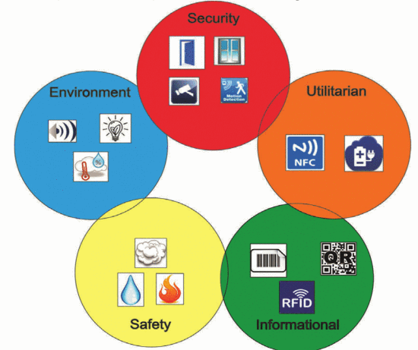
Summary of Literature Survey
Type of Sensors that Can Be Used in a Smart University:
Sensors and technologies can be identified depending on their usefulness in a university campus; then they can be used and after that split in the following categories:
EN (environment): noise, humidity, temperature, light;
SC (security): motion detection, window / door open / closed, video, fingerprint;
SF (Safety): smoke / gas, fire, water, radiation;
UT (utilitarian): NFC tags, electrical voltage;
IN (information): Barcode. OR tags. RFID card.

Slide 15
Summary of Literature Survey
A trusted and active community aided and supported by the Internet of Things (IoT) is a key factor in food waste reduction and management. Our paper proposes an IoT based context aware framework which can capture real-time dynamic requirements of both vendors and consumers and perform real-time match-making based on captured data.
We describe our proposed reference framework and the notion of smart food sharing containers as enabling technology in our framework. A prototype system demonstrates the feasibility of a proposed approach using a smart container with embedded sensors.

Slide 16
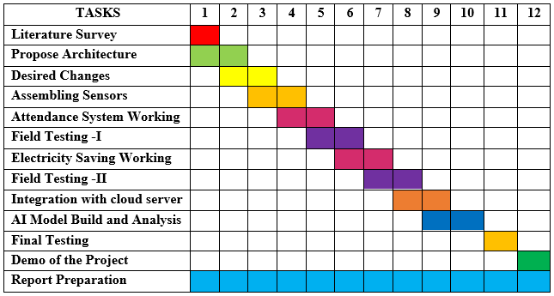
Capstone (Phase-I & Phase-II) Project Timeline

Slide 17
Conclusion
We are currently looking to add some more features and extend the project from classroom level to university level thereby renaming it to “Smart Campus System”.
We are also looking forward to add a Humanitarian Side to our project.
Regular studies about Edge Computing to add it into our project.
Looking at Feasible Algorithms for Analysis of data collected from the sensors.

Slide 18
References
https://ietresearch.onlinelibrary.wiley.com/doi/pdfdirect/10.1049/iet-net.2018.5182
https://iacis.org/iis/2018/3_iis_2018_33-41.pdf
https://ieeexplore.ieee.org/abstract/document/8553750
https://ieeexplore.ieee.org/abstract/document/9086010
https://link.springer.com/article/10.1007/s10462-018-9648-9
https://ieeexplore.ieee.org/document/8871173
https://ieeexplore.ieee.org/document/6907930
https://ieeexplore.ieee.org/document/8767229
https://ieeexplore.ieee.org/document/8519856

Slide 19
Thank You

