Slide 1

CODEFLOW COMPILER
Compiler-Based Code Optimization & Flowchart Visualizer
COMPILER DESIGN (21CS3204R) Project Review
DATE: 30-10-2026 TIME: 9:00 AM
 | Under the Guidance of Dr. V. Anu Ragavi Assistant Professor, Department of Computer Science and Engineering, KLH CSE Bowrampet Campus
Team Members 2420030144 - N. DEEPTHI 2420030332 - K. BHAVANA 2420030430 - G. TEJASHREE

Slide 2
Outline of Project Work
Focus
Introduction
Literature Survey
Challenges
Research Objectives
Conclusion & Future Work
References
Publications Details

Slide 3
Problem Statement
Understanding how a compiler analyses and optimizes a program can be challenging for students because most compiler transformations take place internally and are not directly visible.
Traditional source-code representations generally display the original or transformed code without providing a unified visual comparison of the program's control flow before and after optimization.
Therefore, there is a need for an interactive educational system that can:
Accept source code through a code editor.
Identify tokens and validate program syntax.
Perform basic semantic analysis.
Detect and apply code optimization techniques.
Generate graphical flowcharts from the program structure.
Compare the original and optimized program flowcharts.
Display optimization results and diagnostic messages.
Project Focus:
"Transforming source code into an optimized program with a clear visual comparison of its control flow."

Slide 4
Objectives
1. Lexical Analysis
Identify keywords, identifiers, operators, numbers and delimiters.
Convert source code into a structured sequence of tokens.
2. Syntax Analysis
Validate source code according to the supported grammar.
Generate an Abstract Syntax Tree (AST).
Detect and report syntax errors.
3. Semantic Analysis
Identify undeclared variables.
Detect duplicate variable declarations.
Validate basic variable usage.
4. Code Optimization
Apply constant folding to simplify constant expressions.
Perform algebraic simplification.
Eliminate unnecessary conditional branches.
Remove redundant or unnecessary assignments where safe.
5. Flowchart Generation
Generate graphical representations of program execution.
Represent statements, conditions, branches and loops using standard flowchart symbols.
6. Visual Comparison
Display original and optimized flowcharts side by side.
Highlight the changes introduced through optimization.

Slide 5
Literature Survey
Authors | Research Paper | Methodology | Inferences | Limitations / Future Work
Frances E. Allen [1] | Control Flow Analysis, SIGPLAN Notices, 1970 | Examined program control flow and its representation for compiler analysis. | Established foundational approaches for understanding program flow and compiler optimization. | Focuses on compiler analysis; does not provide a modern interactive educational visualization interface.
Steven S. Muchnick [2] | Advanced Compiler Design and Implementation, 1997 | Presents compiler optimization methods, intermediate representations, and program analysis techniques. | Provides foundational techniques for developing optimization passes in a compiler. | The book is a technical reference rather than an interactive learning tool.
Alfred V. Aho, Monica S. Lam, Ravi Sethi and Jeffrey D. Ullman [3] | Compilers: Principles, Techniques, and Tools, 2006 | Explains lexical analysis, parsing, semantic analysis, intermediate code, optimization, and code generation. | Establishes the standard compiler pipeline and its major components. | Students may benefit from additional visual demonstrations of how optimization changes program structure.
Keith D. Cooper and Linda Torczon [4] | Engineering a Compiler, 2nd edition, 2011 | Discusses compiler architecture, intermediate representations, data-flow analysis, and optimization. | Demonstrates how analysis and optimization techniques work together in compiler construction. | Understanding the transformations can require substantial prior knowledge of compiler internals.

Slide 6
Problem Gap Identification
Existing Approaches
Existing compiler development tools and educational resources provide facilities for:
Understanding compiler phases and language grammar.
Examining source code and compiler diagnostics.
Studying intermediate representations.
Understanding individual optimization techniques.
Inspecting program control flow.
However, understanding how these stages work together and how optimization affects the overall program structure can be challenging for beginners.
Identified Gap
There is a need for an integrated educational platform that connects compiler analysis, code optimization and graphical control flow comparison within a single interface.
Our Project Addresses This Gap By
Integrating the major stages of a mini compiler.
Providing token-level and syntax analysis.
Performing basic semantic validation.
Applying selected optimization techniques to the program.
Generating flowcharts dynamically from the source program.
Comparing original and optimized control flow.
Displaying optimization reports and transformed source code.
Key Idea:
A unified platform that makes compiler transformations easier to understand through visual representation.

Slide 7
Innovation, Creativity, and Novelty
Innovation
Integrates multiple compiler phases into a single interactive application.
Connects code optimization with graphical flowchart visualization.
Displays the optimized source code alongside its original version.
Provides a structured view of the compiler processing pipeline.
Creativity
Uses a modern developer-style interface with a large source-code editor.
Dynamically generates flowcharts based on user-entered programs.
Provides side-by-side visualization of original and optimized programs.
Displays optimization results through interactive reports and statistics.
Novelty
Emphasizes the visual relationship between source-code transformations and program control flow.
Combines lexical analysis, syntax analysis, semantic analysis and optimization in one educational workflow.
Helps learners observe how selected optimization techniques change program structure.
Provides a visual approach to understanding compiler optimization rather than relying only on textual explanations.

Slide 8
Feasibility and Project Plan
Factor | Feasibility
Technical Feasibility | Compiler phases and optimization techniques can be implemented using established algorithms and data structures.
Technology | React, Python, FastAPI and Graphviz provide the required tools for compiler development and visualization.
Computational Requirements | The compiler can be developed and tested using standard computing resources.
Implementation | Modular architecture allows lexer, parser, semantic analyzer and optimizer to be developed and tested independently.
Scalability | Additional programming constructs and optimization techniques can be incorporated in future versions.
Cost | Uses open-source technologies and freely available development tools, minimizing implementation costs.

Slide 9
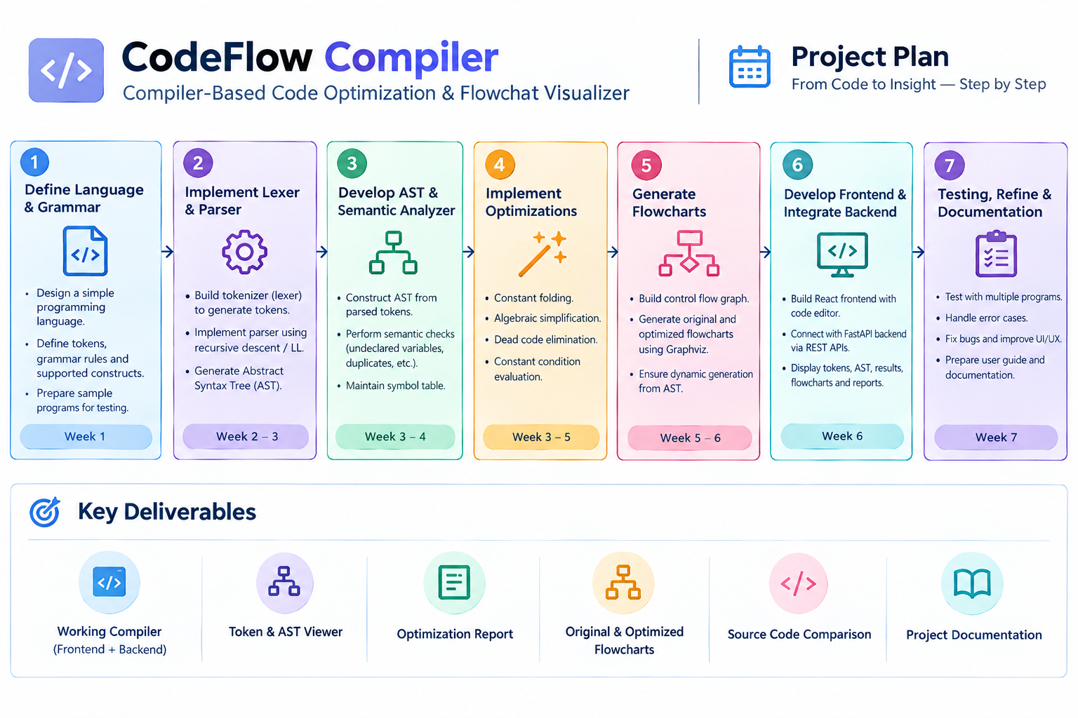

Slide 10
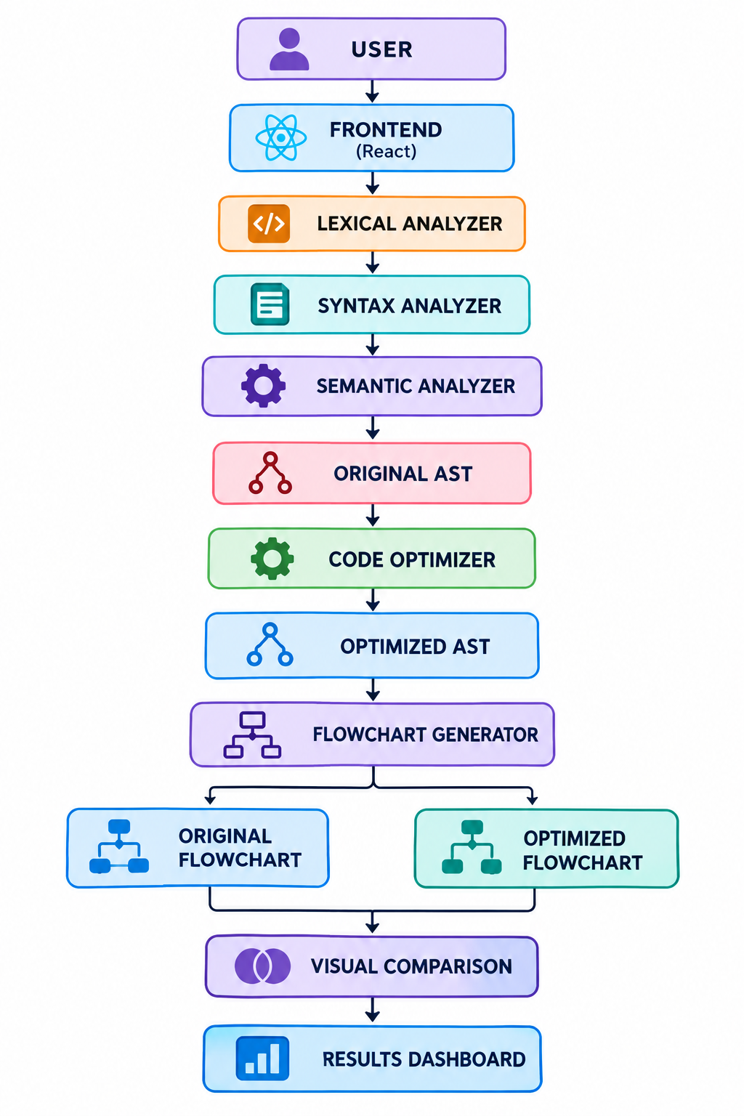
System Architecture – CodeFlow Compiler

Slide 11
THANK YOU

