Slide 1
LET’S LEARN CONSTITUTION IN A SIMPLER MANNER-CITIZEN PERSPECTIVE
CSE7101- Capstone Project
Final Review
Batch Number: CSE_244
Roll Number | Student Name
20221CSE0652 | ANEESA MA
20221CSE0658 | BHAVANA C
20221CSE0660 | BODHINI DB
Under the Supervision of,
Mr. Vinayak Raju Kage
Assistant Professor
School of Computer Science and Engineering
Presidency University
Name of the Program: CSE7101- Capstone Project
Name of the HoD: Dr. Blessed Prince
Name of the Program Project Coordinator: Mr. Muthuraju V
Name of the School Project Coordinators: Dr. Sampath A K
Examiners: Tigulla Rajitha, Varalakshmi T

Slide 2
Content
Problem Statement
Objectives
Background and Related work for title Selection
Analysis of Problem Statement
Innovation or Novel Contributions
Github Link
Timeline of the Project
References

Slide 3
Problem Statement Number : PSCS_333
Organization: Ministry of Law & Justice
Category : Software
Problem Description:
There is a lack of constitutional literacy among citizens due to the complex language and limited accessibility of the Constitution of India. This project aims to develop “Let’s Learn Constitution in a Simple Manner – Citizen Perspective: A Comprehensive Digital Learning Platform" — an innovative, interactive digital platform that simplifies key constitutional elements, including the Preamble, Fundamental Rights, Directive Principles, and Fundamental Duties, into an accessible and engaging format. The solution will feature a comprehensive backend database, multilingual support, and multimedia integration to promote inclusivity. Through interactive simulations and scenario-based activities, the platform will enhance understanding of constitutional concepts, enabling citizens—especially youth—to make informed decisions about their rights and duties.

Slide 4
Objectives of Problem Statement
Simplify key parts of the Constitution into clear, everyday language.
Build a structured digital knowledge hub for simplified content.
Create interactive, real-life scenario-based learning modules.
Integrate an AI assistant for quick, simple constitutional guidance.
Ensure multilingual and accessible design for all users.
Track user learning progress with milestones and leaderboards.
Deliver a functional, user-tested web application prototype.

Slide 5
Background and Related work for title Selection
Background
Constitution of India: Supreme law defining governance, rights, and duties.
Citizens face difficulty due to complex legal language & limited accessibility.
Ministry of Justice calls for an engaging, simplified, and inclusive platform.
Related Work
Govt. portals (e.g., India Code) → Detailed but not interactive or simplified.
Educational apps → Mostly static quizzes, lacking real-life context.
Awareness campaigns → One-time efforts, not continuous learning.
Gap
No unified platform combining simplified content + real-life simulations + AI guidance + multilingual access for sustained constitutional learning.
Proposed Solution
Nagrik Aur Samvidhan : Interactive, scenario-based web platform to enhance constitutional literacy for all citizens.

Slide 6
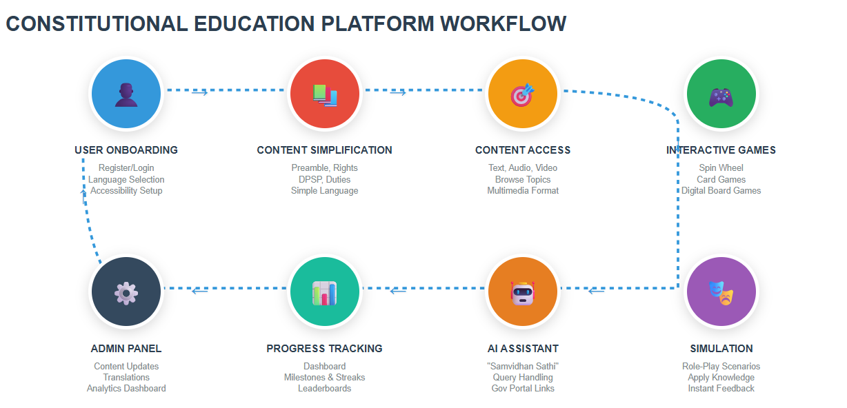
Analysis of Problem Statement

Slide 7
Analysis of Problem Statement (contd...)
Frontend: React.js | CSS / Tailwind CSS | JavaScript
Backend: Node.js | Express.js
Database: PostgreSQL / Firebase
AI/NLP: Hugging Face Transformers | OpenAI API / Rasa NLU
Hosting: Vercel / Netlify (Frontend) | AWS / Railway (Backend & DB)
User Onboarding: Multilingual + Accessibility settings.
Content Sources:
legislative.gov.in – Official Constitution text
ncert.nic.in – Civics textbooks (simplified language)
PRS Legislative Research – Summaries & analysis
Kaggle datasets on Indian Constitution & Fundamental Rights
Interactive Learning: Scenario-based modules + Spin-a-Wheel, Card, Board simulations.
AI Chatbot:
Hugging Face translation → facebook/mbart-large-50
QA model → deepset/roberta-base-squad2 (fine-tuned)
Progress Tracking: Milestones & Leaderboards.
Admin Panel: Manage content, scenarios, analytics.
External Links: Govt portals, legal aid resources, RTI filing.
TECH STACK

Slide 8
Innovation or Novel Contributions
Why It’s Unique???
Holistic Constitutional Learning Platform – Instead of static textbook material, our system integrates interactive visuals, timelines, and datasets to make concepts like Preamble, Fundamental Rights, and Duties engaging for learners.
Multi-Modal Delivery – Combines text, infographics, and audio (and potentially video) for better retention, catering to diverse learning styles.
Real-World Data Integration – Links constitutional topics to open datasets (e.g., Kaggle, Government portals) for contextual learning with current, relevant examples.
Gamified Engagement – Uses quizzes, challenges, and milestone badges to sustain interest and improve recall.
Adaptive Learning Path – Suggests topics dynamically based on user’s progress and knowledge gaps, creating a personalized civic education journey.

Slide 9
Github Link
This Github link has public access permission.
https://github.com/Bhavana-Chandra/CSE_244
Deployed through Vercel Link.
https://cse-244-4m7l.vercel.app

Slide 10
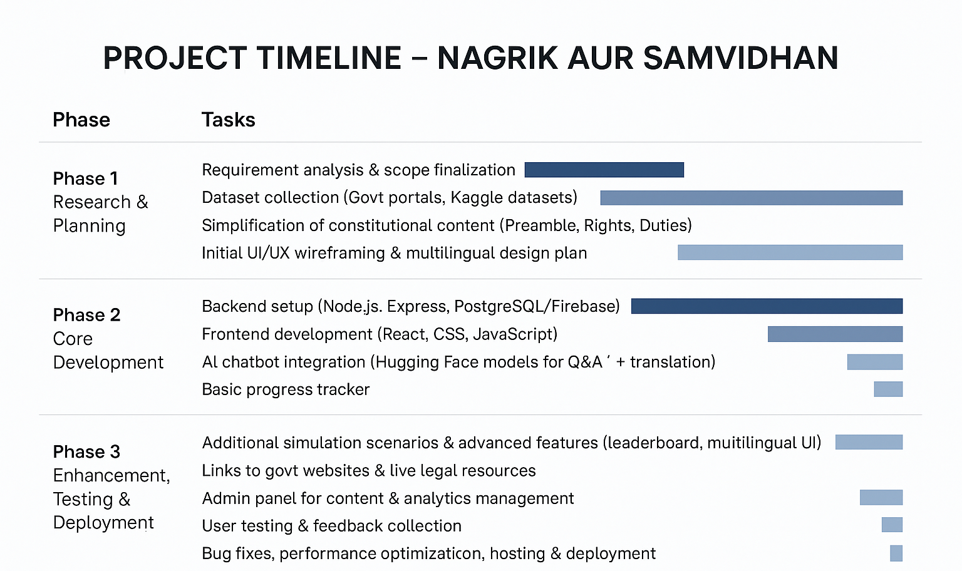
Timeline of the Project

Slide 11
References (IEEE Paper format)
[1] D. Panchal, A. Gole, V. Narute, and R. Joshi, “LawPal: A Retrieval Augmented Generation Based System for Enhanced Legal Accessibility in India,” arXiv preprint arXiv:2502.16573, Feb. 2025.
[2] S. K. Nigam, S. K. Mishra, A. K. Mishra, N. Shallum, and A. Bhattacharya, “Legal Question-Answering in the Indian Context: Efficacy, Challenges, and Potential of Modern AI Models,” arXiv preprint arXiv:2309.14735, Sept. 2023.
[3] S. Paul, A. Mandal, P. Goyal, and S. Ghosh, “Pre-trained Language Models for the Legal Domain: A Case Study on Indian Law,” arXiv preprint arXiv:2209.06049, Sept. 2022.
[4] A. Tiwari, P. Kalamkar, A. Banerjee, V. Hemachandran, and S. Gupta, “Aalap: AI Assistant for Legal & Paralegal Functions in India,” arXiv preprint arXiv:2402.01758, Feb. 2024.

Slide 12


