Slide 1
UGYAN TECH FULLSTACK MENTORSHIP
2025
Bhavana Jami

Slide 2
UGYAN TECH
AGENDA
01
INTRODUCTION, LET’S GET FAMILIAR
02
DISCUSS SURVEY INPUTS
03
FULLSTACK OVERVIEW, MERN STACK
04
TRAINING , HOW?
05
WHY FULLSTACK? WHY NOT OTHER DOMAINS?
06
THE END (for today haha ..)

Slide 3
UGYAN TECH
I am Bhavana, who are you?

Slide 4



UGYAN TECH
A TEAM OF 7 ?
UNKNOWN
RAMYA
HEMALATHA
UDAY
RAJA
Jyothi
Fullstack
MERN
Java Fullstack
Java Fullstack
Fullstack
UNKNOWN

Slide 5
UGYAN TECH
What is Full Stack?
Client Server Architecture?

Slide 6
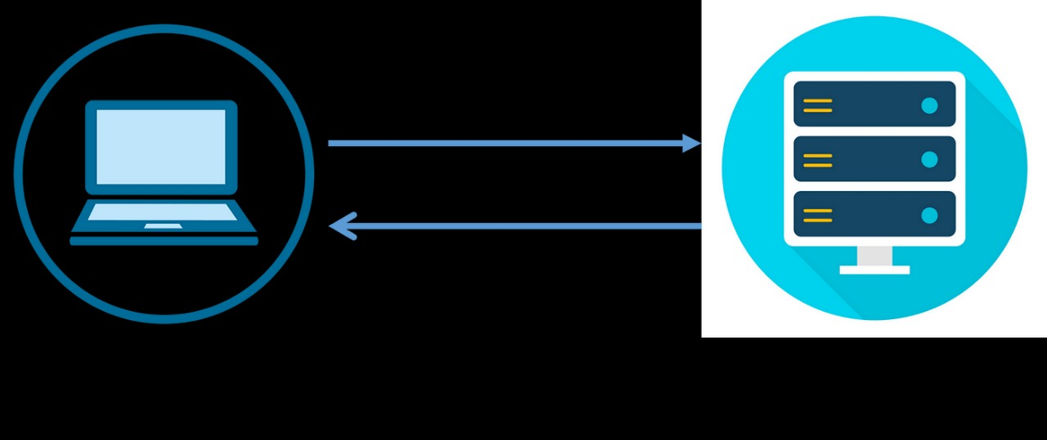
UGYAN TECH
Client, Server, Database, Request, Response, API Calls

Slide 7
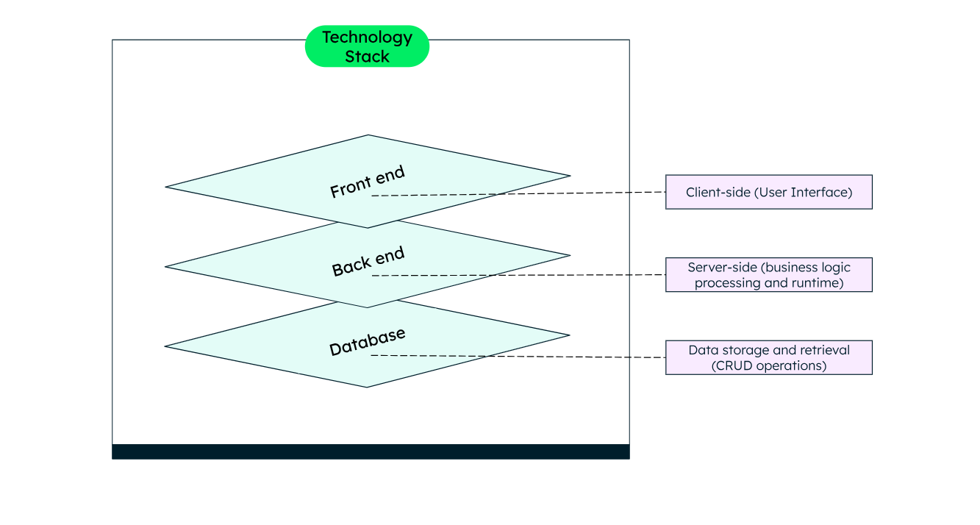
UGYAN TECH
Now, What is MERN ?

Slide 8
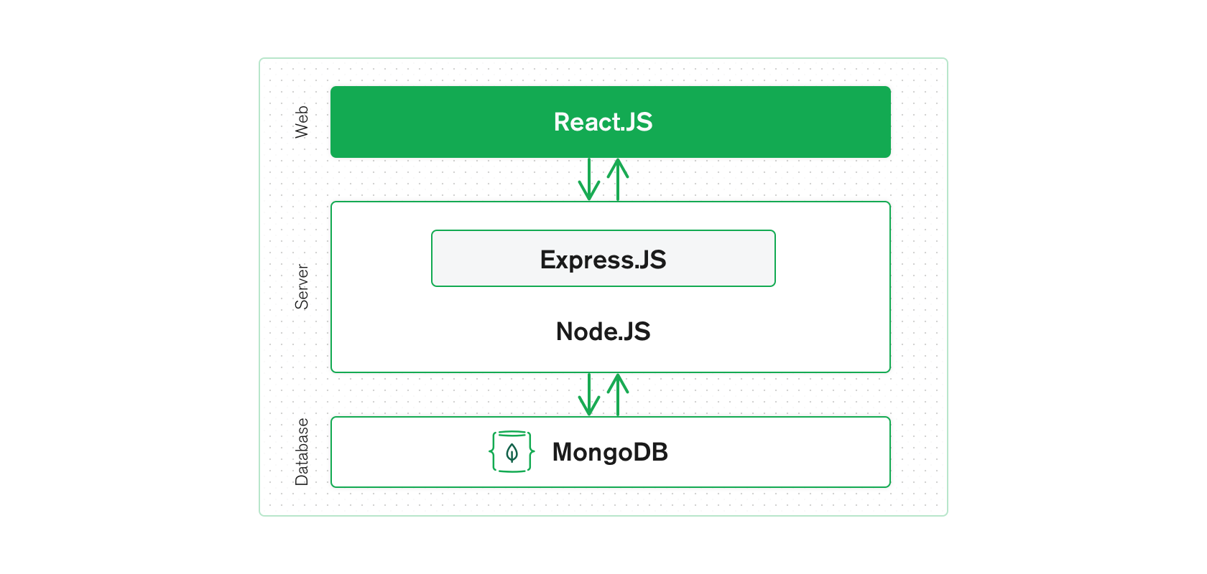
UGYAN TECH
Frontend -> React JS
Node + Express -> Server
MongoDB -> Database

Slide 9
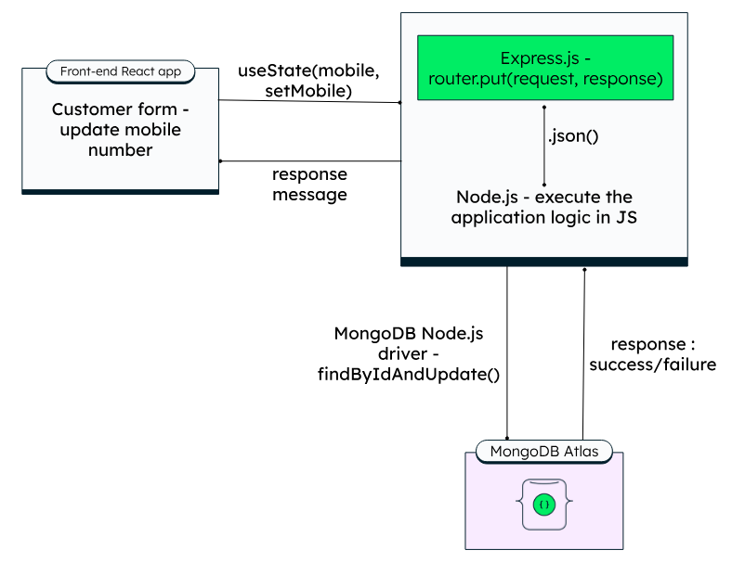
UGYAN TECH
Example Scenario: Update Customer Mobile Number

Slide 10
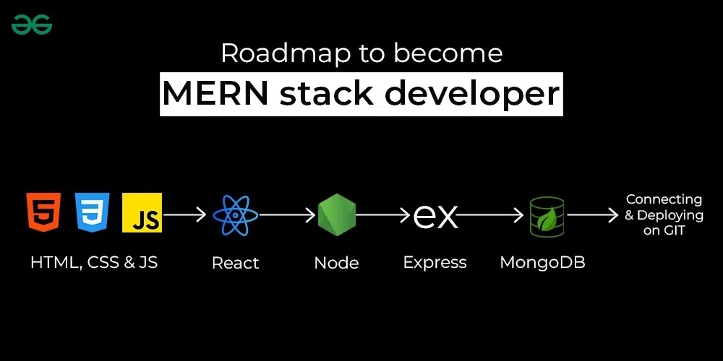
UGYAN TECH

Slide 11
UGYAN TECH
Why did you choose fullstack?
Now a days, Fullstack is an open book, do you agree?
Do you have personal portfolio? Deployed? Do you write online?
What’s your take on AI take over on Frontend/Fullstack Jobs

Slide 12
UGYAN TECH
OTHER STUFF
v
Full Stack Development has evolved a lot.
What was the situation, what do we need right now ?
Typescript, GraphQL, Jest, RTL, Basics of CI/CD Pipelines, Authentication (JWT, OAuth, cookies), Dev, Deploy, Debugging Tools, Security, Performance Optimizations, Accessibility, Responsiveness, SEO, Problem Solving, Agile, System Design, Code Quality and Maintainability, Fullstack with other domains AI integrations, DA, DS integrations.

Slide 13
UGYAN TECH
THE PLAN
LET’S TOUCH BASE WITH THE BASIC And Build Projects without any frameworks
JUMP TO FRAMEWORKS
Bootstrap and other, ReactJS, Express
MAKE IT FULLSTACK

Slide 14
UGYAN TECH
OUR ROUTINE
LEARN NEW STUFF
DEPLOY
VERCEL, NETLIFY, GITHUB PAGES
Step 01
Step 04
BUILD INDIVIDUAL TASKS, PROJECTS
PUSH TO GITHUB RELIGIOUSLY, KNOW GIT ON A DEEPER LEVEL
ASK DOUBTS, ITERATE ON THE PROJECTS, MERGE IN GIT
Step 02
Step 03
Step 05
PUT INTERNET AND CHAT GPT TO GOOD USE
Step 06

Slide 15
UGYAN TECH
THANK YOU
Any questions?

