Slide 1

Java Capstone Project

Slide 2
Group#10 1. Bhavana Shivaraju [ 7221863 ] 2. Mohammad Ali Moradi [ 7221791 ] 3. Aftab Makbul Makandar [ 7222045 ]

Slide 3
Agenda
Problem Statement and Tasks
Requirements to the system
Class Diagram
Component Diagram
Management I/O in the system
User interfaces
Results of the Unit Test of the System

Slide 4
Smart House: Simulation of the Energy supply and consumption

Slide 5
Tasks
Simulation of the Smart Objects
Simulation of the Energy Sources
Management system for the house consumption
Design of the User Interface for the Managing Smart Objects
Design of the User Interface for Managing Energy Sources

Slide 6
Agenda
Problem Statement and Tasks
Requirements to the system
Class Diagram
Component Diagram
Management I/O in the system
User interfaces
Results of the Unit Test of the System

Slide 7
System Requirements
Hardware Requirements
Processor: Dual-core processor (e.g., Intel Core i3 or AMD equivalent).
RAM: 4 GB.
Storage: 2 GB of free disk space (for Java Development Kit (JDK), Integrated Development Environment (IDE), and project files).
Graphics: Basic integrated graphics (no special GPU needed for Java programs).
Software Requirements
Operating System: Windows, macOS
Java Development Kit (JDK)
Integrated Development Environment (IDE): IntelliJ IDEA, Eclipse, or NetBeans

Slide 8
Agenda
Problem Statement and Tasks
Requirements to the system
Class Diagram
Component Diagram
Management I/O in the system
User interfaces
Results of the Unit Test of the System

Slide 9
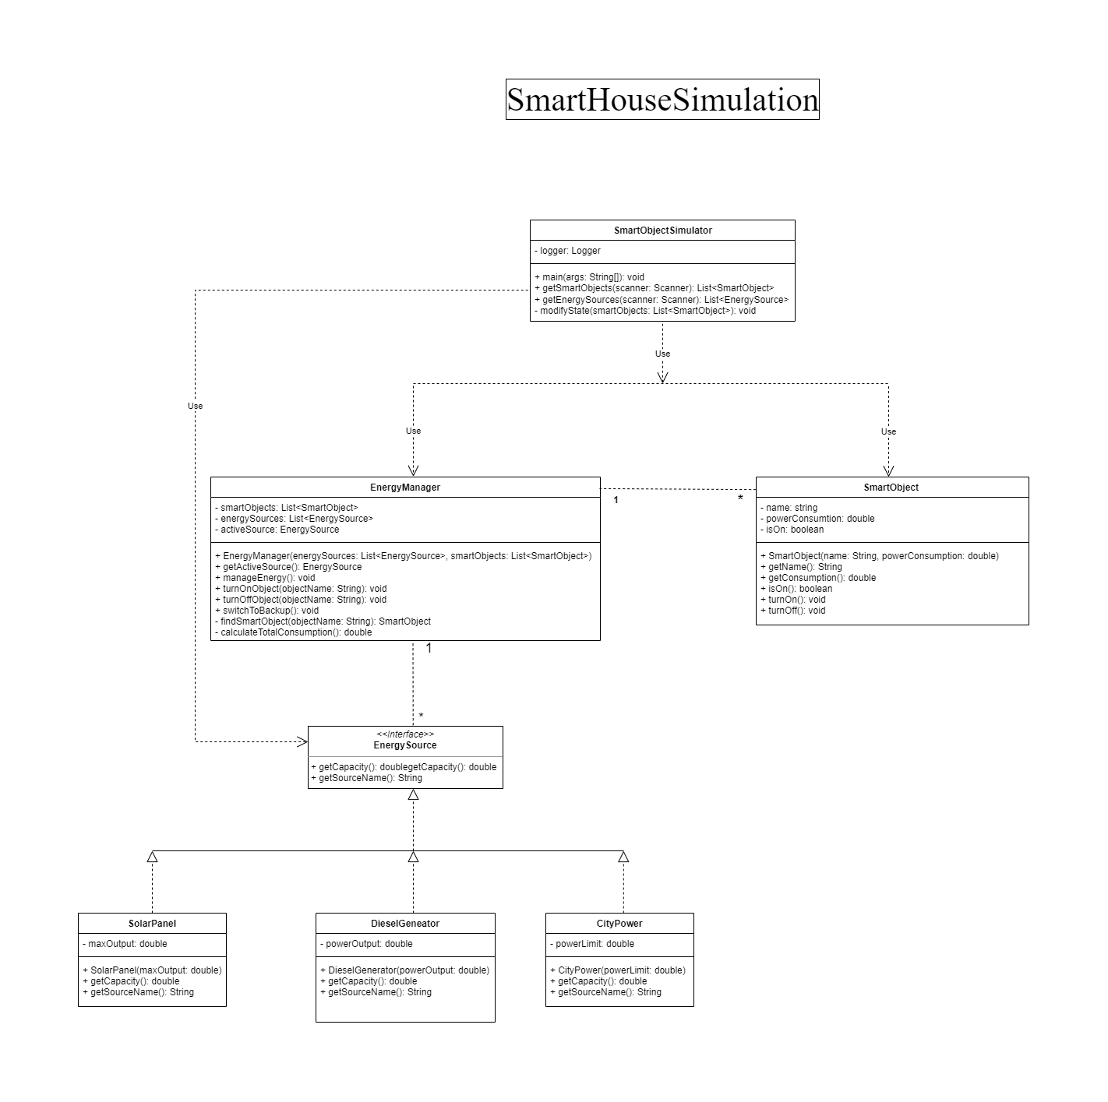

Slide 10
Agenda
Problem Statement and Tasks
Requirements to the system
Class Diagram
Component Diagram
Management I/O in the system
User interfaces
Results of the Unit Test of the System

Slide 11
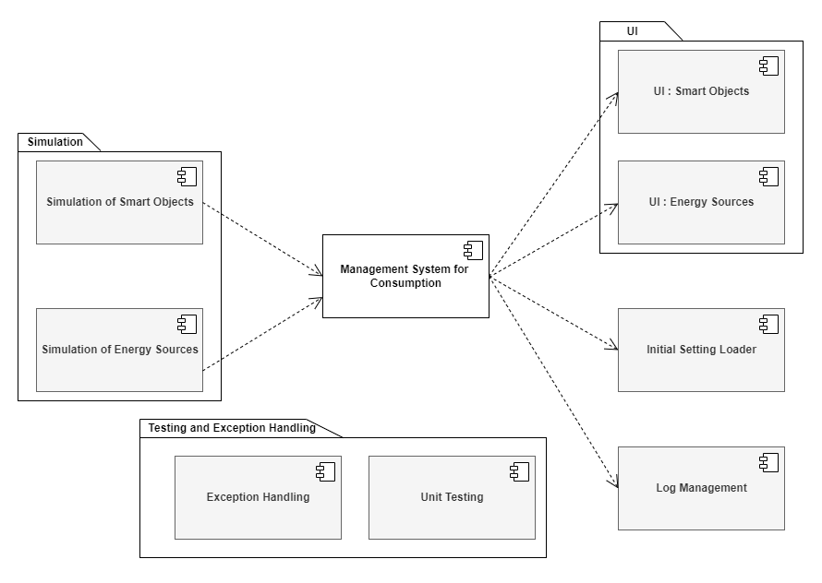

Slide 12
Agenda
Problem Statement and Tasks
Requirements to the system
Class Diagram
Component Diagram
Management I/O in the system
User interfaces
Results of the Unit Test of the System

Slide 13
Management I/O in the system
The System handles I/p and O/p for various operations across different methods, enabling user interactions like adding or removing Smart Objects and managing Energy Sources.
1.Energy Manager
User mange energy resources.
List Energy sources is displayed.
2. Smart Objects
Users can add new smart objects and as well remove.
List of smart objects is displayed

Slide 14
Agenda
Problem Statement and Tasks
Requirements to the system
Class Diagram
Component Diagram
Management I/O in the system
User interfaces
Results of the Unit Test of the System

Slide 15
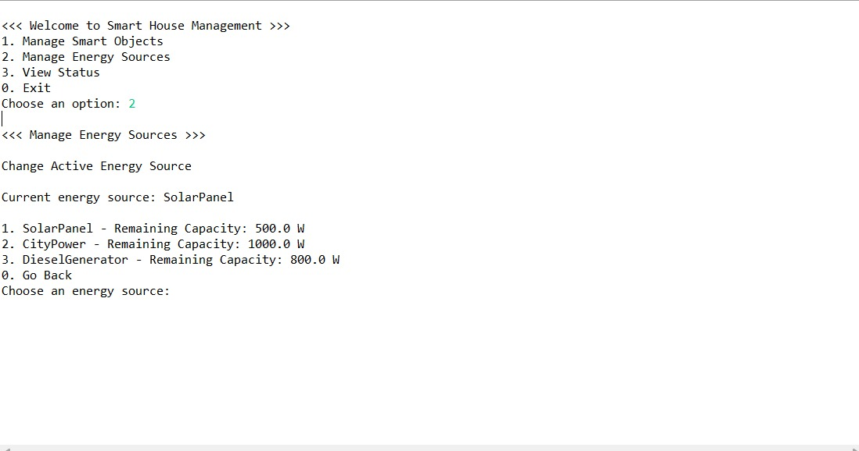
Available Energy Sources

Slide 16
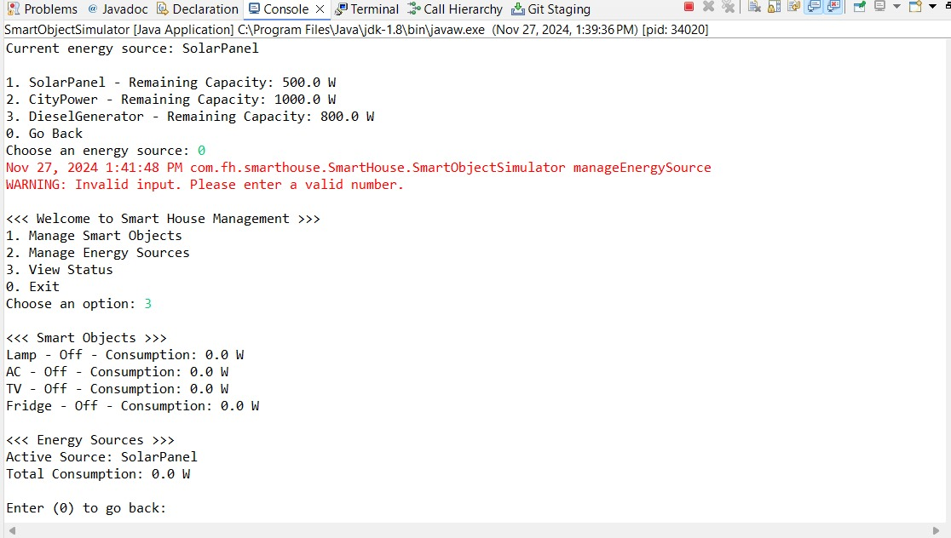
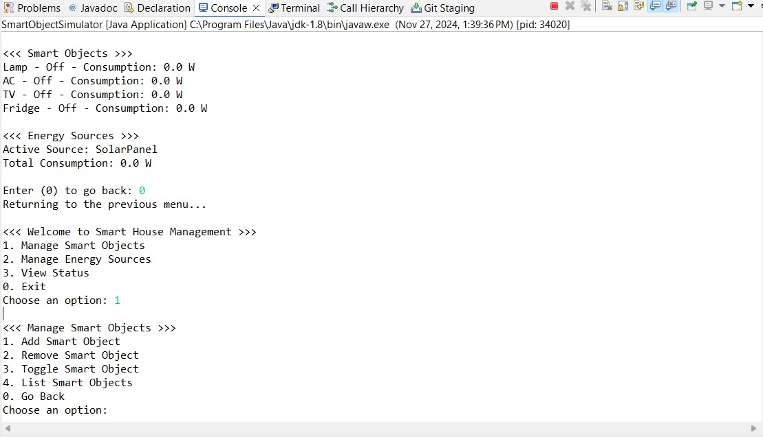
UI for Energy Sources and Smart Objects

Slide 17
Agenda
Problem Statement and Tasks
Requirements to the system
Class Diagram
Component Diagram
Management I/O in the system
User interfaces
Results of the Unit Test of the System

Slide 18
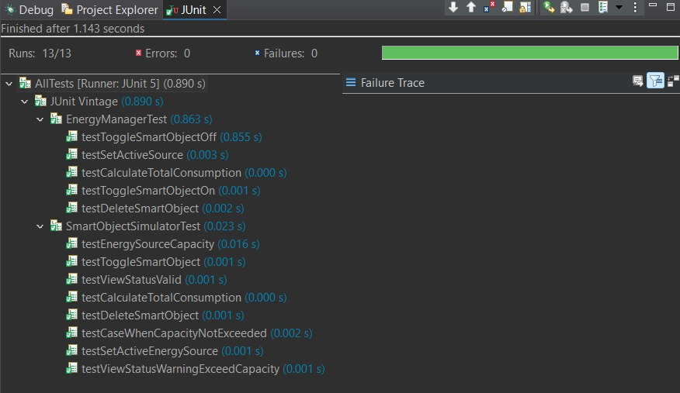
Junit Test Case for Energy Manager

Slide 19
Thank you

