Slide 1
Visual Image Caption Generator Using Deep Learning
Bhavana .R
Chandra Snehal
Akhil

Slide 2
PROBLEM STATEMENT
The challenge provides a captioning requirement, which necessitates the use of a computer vision system to both locate and describe important sections in images. When the descriptions are limited to a single word, the image captioning job generalises object detection.

Slide 3
Application
visually impaired people can greatly benefit and get a better sense of their surroundings using the text-to-speech technology that we have incorporated as well.
Google Photos: Sort your photo into categories like mountains, sea, and so on.
Self Drive Cars: All Self driving cars are using image caption generators so that computers can drive cars safely and efficiently.
Social Media

Slide 4
Introduction
Image caption generator, to teach a machine to accurately describe an image or surroundings in the same way that a human does.
They can be used for automatic image indexing. Image indexing is important for Content-Based Image Retrieval (CBIR) and therefore, it can be applied to many areas, including biomedicine, commerce, the military, education, digital libraries, and web searching

Slide 5
Traditional machine learning based
Deep machine learning based
Features are extracted from input data. They are then passed to a classifier such as Support Vector Machines (SVM) in order to classify an object.
Features are learned automatically from training data and they can handle a large and diverse set of images and videos.

Slide 6
In the last 5 years, a large number of articles have been published on image captioning with deep machine learning being popularly used.
Convolutional Neural Networks (CNN) are widely used for feature learning, and a classifier such as Softmax is used for classification. CNN is generally followed by Recurrent Neural Networks (RNN) or Long Short-Term Memory Networks (LSTM) in order to generate captions.

Slide 7
Methods
In the visual space-based methods, the image features and the corresponding captions are independently passed to the language decoder.
In Multimodal Space, The vision part uses a deep convolutional neural network as a feature extractor to extract the image features. The language encoder part extracts the word features and learns a dense feature each word. It then forwards the semantic temporal context to the recurrent layers. The multimodal space part maps the image features into a common space with the word features.

Slide 8
Supervised learning-based networks have successfully been used for many years in image classification , object detection and attribute learning . This progress makes researchers interested in using them in automatic image captioning.
Recently, researchers are focusing more on reinforcement learning and unsupervised learning-based techniques for image captioning.

Slide 9
Dense Captioning
Whole scene of Image
generate single or multiple captions for the whole scene.
The previous image captioning methods can generate only one caption for the whole image.

Slide 10
Architecture
ENCODER-DECODER ARCHITECTURE-BASED IMAGE CAPTIONING
In this network, global image features are extracted from the hidden activations of CNN and then fed them into an LSTM to generate a sequence of words.
A CNN is used to obtain the scene type, to detect the objects and their relationships.
The output of this is used by a language model to convert them into words, combined phrases that produce an image captions

Slide 11
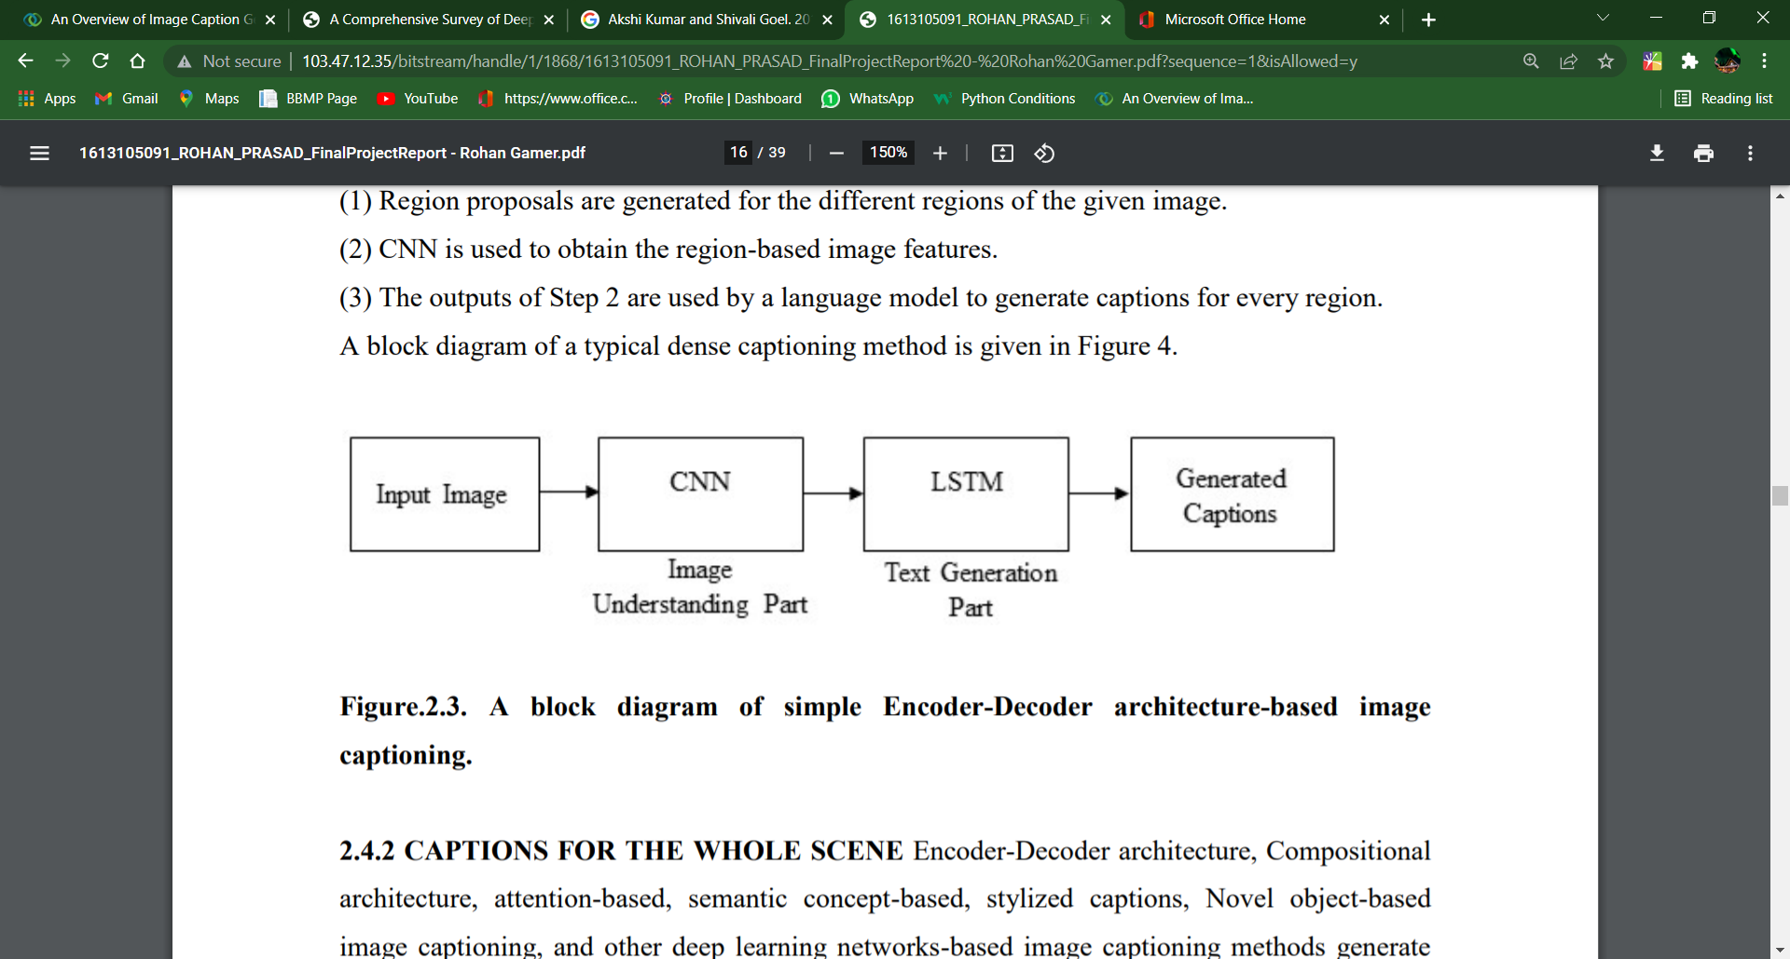

Slide 12
COMPOSITIONAL ARCHITECTURE
Image features are obtained using a CNN.
Visual concepts (e.g. attributes) are obtained from visual features.
Multiple captions are generated by a language model using the information of CNN.
The generated captions are re-ranked using a deep multimodal similarity model to select high quality image captions

Slide 13
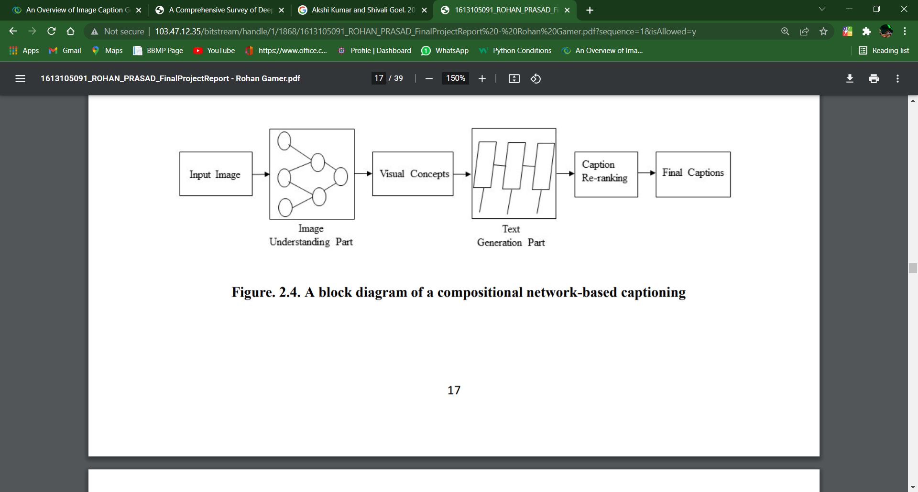

Slide 14
Language Models
LSTM networks are a type of RNN that has special units in addition to standard units.
In recent years, LSTM based models have dominantly been used in sequence to sequence learning tasks.
LSTMs ignore the underlying hierarchical structure of a sentence. They also require significant storage due to long-term dependencies through a memory cell.

Slide 15
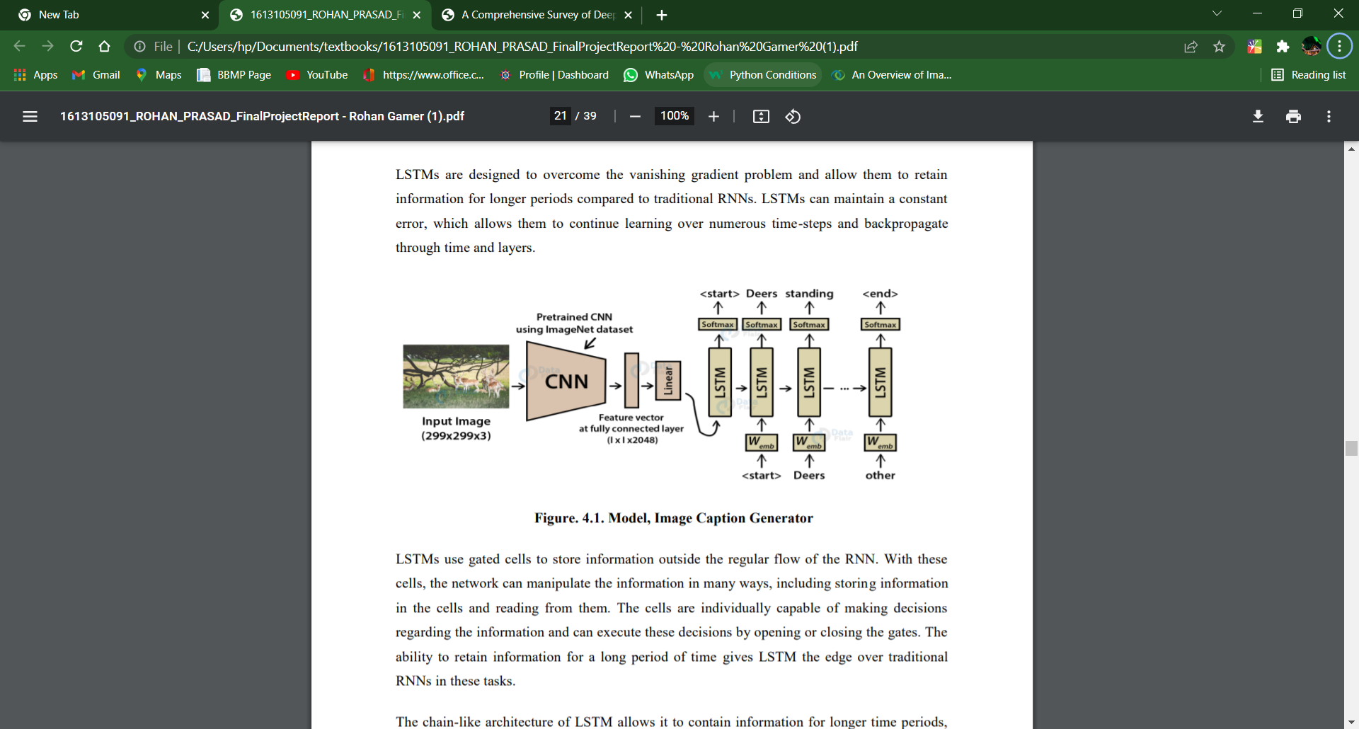

Slide 16
Another network, Gated Recurrent Unit (GRU) has a similar structure to LSTM but it does not use separate memory cells and uses fewer gates to control the flow of information.
recently, convolutional architectures are used in other sequence to sequence tasks.
(Jiuxiang Gu, Gang Wang, Jianfei Cai, and Tsuhan Chen. 2017. An empirical study of language cnn for image captioning. In Proceedings of the International Conference on Computer Vision (ICCV). 1231–1240) proposed a CNN language model-based image captioning method. This method uses a language-CNN for statistical language modelling.

Slide 17
(Jyoti Aneja, Aditya Deshpande, and Alexander G Schwing. 2018. Convolutional image captioning. In Proceedings of the IEEE Conference on Computer Vision and Pattern Recognition. 5561–5570). network with the languageCNN to model the temporal dependencies properly. Aneja et al. [5] proposed a convolutional architecture for the task of image captioning. They use a feed-forward network without any recurrent function.
(Qingzhong Wang and Antoni B Chan. 2018. CNN+ CNN: Convolutional Decoders for Image Captioning. arXiv preprint arXiv:1805.09019.) proposed another CNN+CNN based image captioning method. it uses a hierarchical attention module to connect the vision-CNN with the language-CNN.

Slide 18
The authors of this method also investigate the use of various hyperparameters, including the number of layers and the kernel width of the language-CNN.
They show that the influence of the hyperparameters can improve the performance of the method in image captioning.

Slide 19
Problem
The Vanishing Gradient Problem.
the architecture of basic RNNs restricts its long-term memory capabilities, which are limited to only remembering a few sequences at a time.
Consequently, the memory of RNNs is only useful for shorter sequences and short time-periods.
This mainly occurs when the network parameters and hyperparameters are not properly set.
Training an RNN is a very difficult task

Slide 20
Conclusion
The amount of data will never stop increasing and new information will keep appearing.
Supervised learning requires a huge amount of labelled data for training and therefore, unsupervised learning and reinforcement learning will gain more relevance in the future in image captioning.
So, to make an image caption generator model, we have merged architecture. It is also called a CNN-RNN model.
CNN is used for extracting features from the image. We will use the pre-trained model Xception. LSTM will use the information from CNN to help generate a description of the image.

Slide 21
References
https://www.cv-foundation.org/openaccess/content_cvpr_2015/html/Vinyals_Show_and_Tell_2015_CVPR_paper.html
https://papers.ssrn.com/sol3/papers.cfm?abstract_id=3368837
https://www.ijitee.org/wp-content/uploads/papers/v10i3/C83830110321.pdf
https://www.researchgate.net/publication/333651453_Detection_and_Recognition_of_Objects_in_Image_Caption_Generator_System_A_Deep_Learning_Approach/link/5cfa6941299bf13a38443a3e/download
Seo, P. H., Sharma, P., Levinboim, T., Han, B., & Soricut, R. (2020). Reinforcing an Image Caption Generator Using Off-Line Human Feedback. Proceedings of the AAAI Conference on Artificial Intelligence, 34(03), 2693-2700. https://doi.org/10.1609/aaai.v34i03.5655

