Slide 1
PROJECT TITLE:
CAMPUS POLL AND FEEDBACK SYSTEM

Slide 2
TEAM:
B.Bhavana - 2403A52249
CH.Vyshnavi - 2403A52252
S.Namitha - 2403A52255

Slide 3
Project Objectives
Enable secure, one-vote-per-student polling across multiple campus categories with real-time result tracking.
Provide role-based dashboards: Students vote, In-charges view category analytics, Admin manages all polls
& sees full results.
Display live, interactive doughnut charts for every poll using aggregated data from all students.
Support poll management & data export: Admin can add/delete polls; In-charges can download results as CSV.
Deliver a responsive, dark-mode-enabled, no-backend web app using Tailwind, Chart.js, and localStorage for persistence.

Slide 4
Stake Holders:
Students – Vote & give feedback
In-Charges – View category results & export data
Admin – Manage polls & see all charts
College Leadership – Use insights for decisions
IT Team – Maintain & upgrade system

Slide 5
Programming Languages,Tools and Software
HTML5 – Structure of the web app
CSS3 + Tailwind CSS – Responsive & modern UI styling
Vanilla JavaScript – Core logic, voting, charts, storage
Chart.js – Interactive doughnut charts for live results
Lucide Icons – Clean, scalable UI icons (via CDN)
localStorage – Persistent data storage (no backend)
Web Browser – Chrome/Firefox (for testing & deployment)
Text Editor – VS Code (recommended for development)

Slide 6
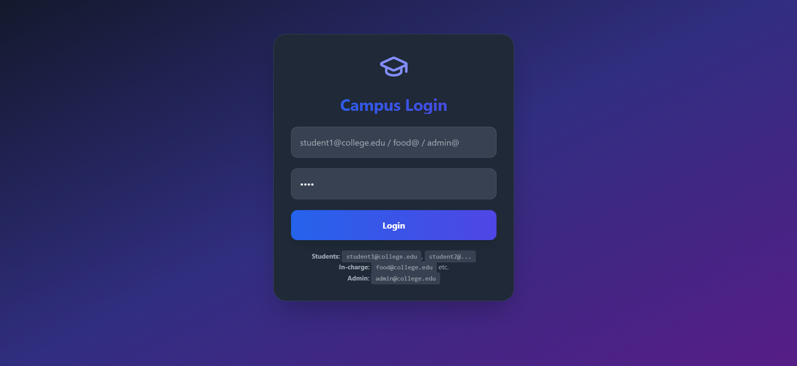
View of the Web Application

