Slide 1
Maven
Date : 26/09/2019
Author : Karthik Sivakumar

Slide 2
Agenda
Basic Maven POM File and Project Structure
1 Maven Introduction
5 Lab/Exercise
2
Maven POM File & Project Structure
3
Create, Build & Test Maven Project
4
Maven Build Life Cycle

Slide 3
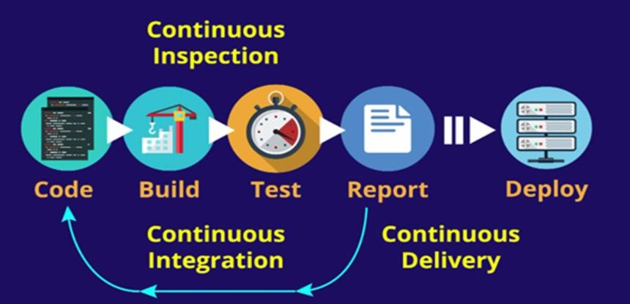
Continuous Integration (CI)
“Continuous Integration is a software development practice where members of a team integrate their work frequently, usually each person integrates at least daily - leading to multiple integrations per day. Each integration is verified by an automated build (including test) to detect integration errors as quickly as possible”
– Martin Fowler

Slide 4
Continuous integration
In Continuous Integration approach, for every commit, the system under
goes the following stages:
Integrated: All changes done so far are combined into the integrated code
Build: The integrated code is the compiled into an package
Tested: An Automated test suit tests this executable & provides a test report
Archived: The various artefacts are versioned and stored so that it can be distributed as is as and when required
Deployed: The final executable is loaded into the system where team members can interact with it

Slide 5
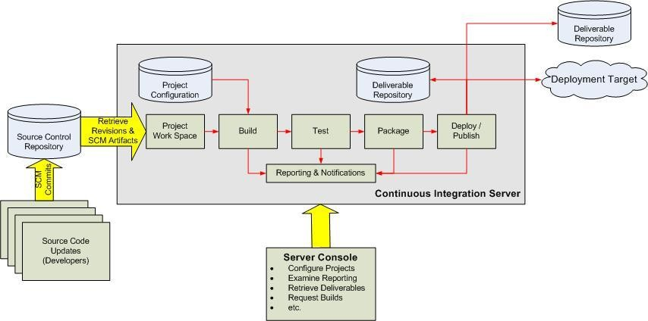
Continuous Integration Overview
source: http://www.javaworld.com/javaworld/jw-12-2008/images/CIOverview.jpg

Slide 6
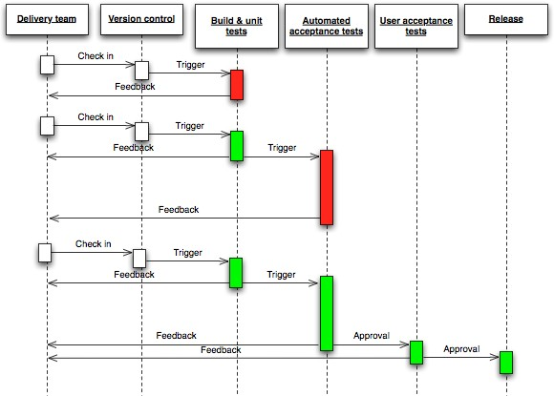

Slide 7
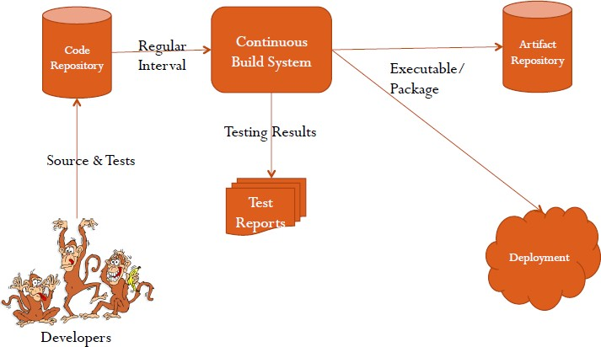
Workflow
Benefits
Bugs can be detected immediately
There is no separate integration step in the lifecycle
At any time, a readily deployable system is available
CI keeps a record of the progress made in the project
Tools Example:
SCM
GIT, Mercurial, SVN
Continuous Build Systems
Jenkins & Bamboo
Test Frameworks
Cucumber, JUnit
Artifact Repositories
Artifactory & Nexus

Slide 8
Principles of Continuous Delivery
The releasing/deploying software process MUST be reliable and repeatable
Automation of everything
Do it often, If performing somethings is painful
Keep all artefacts in source control
Done means “released”
Build the quality in, is part of continuous delivery
Team members have their responsibility for the release process
Improve continuously by way of continuous feedback

Slide 9
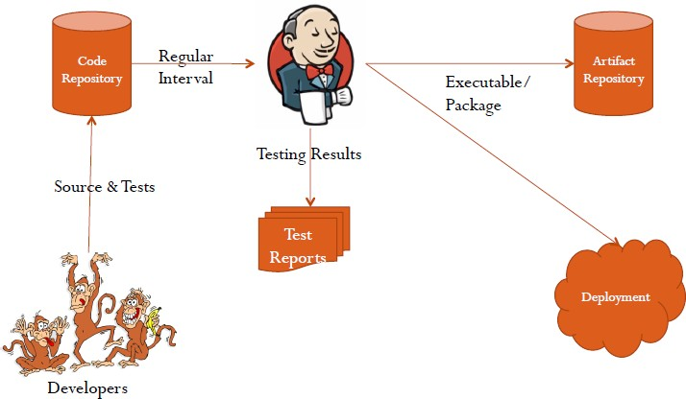
Introduction to Jenkins
Jenkins is Java based Continuous Build/Integration System
It is highly configurable system by itself using numerous available plugins
Jenkins monitors the whole build process and provides reports and
notifications to alert maintainers on success or errors
Jenkins runs in a servlet container
Glassfish, Tomcat

Slide 10
Maven Introduction
Overview & Features

Slide 11
Challenges while Building a Project
Lack of Uniform directory Structure: The team needs a uniform
directory structure of the Project while working in a project
Too many dependencies on Jar file: During integration injecting proper dependency and jar files would always be a challenge as it is difficult to assess transitive dependency at first place.
Building and deploying Project: Even though build tools like ant can solve this problem in a limited way, a proper life cycle management of Build has been the need of the hour.

Slide 12
Objectives
Understand the challenges of Project Development Build
Recognize the need of a tool to automate build process & Managing projects
Configure Maven and check the set up
Describe the features of Maven

Slide 13
Maven Overview
Maven is a Java build tool
It is a project management & comprehension tool
It used for building & managing any Java-based project.
It stores libraries & plugins in a Maven central repository
Maven Home Page URL: https://maven.apache.org. One can find the
reference documentation for Maven & the core Plugins
Why Maven?
Fairly large software projects generally contain many projects/modules
Build process without automation in such projects, is challenging to
understand and maintain it with in stipulated time.

Slide 14
Features of Maven
Easier configuration
Consistent project structure
Provides project templates known as archetypes.
Dependency Management
Multi-module builds
Build model can be sliced and diced
During Maven build process the dependencies are resolved
Repository
Project dependencies can be accessed from local file system and/or from central or from public repositories.
Plugin oriented - Extensible via plug-ins
This feature helps to keep Maven core small with basic functionalities
E.g. Maven core doesn’t know how to compile the available Java source code. Compilation is handled by compiler plug-in
Additional features can be easily linked with suitable plug -ins
Maven Central
Maven central repository is an open repository.
Maven’s central repository hosts libraries. These libraries can be used in your build.
Maven build uses by default the central library to search for required libraries.

Slide 15
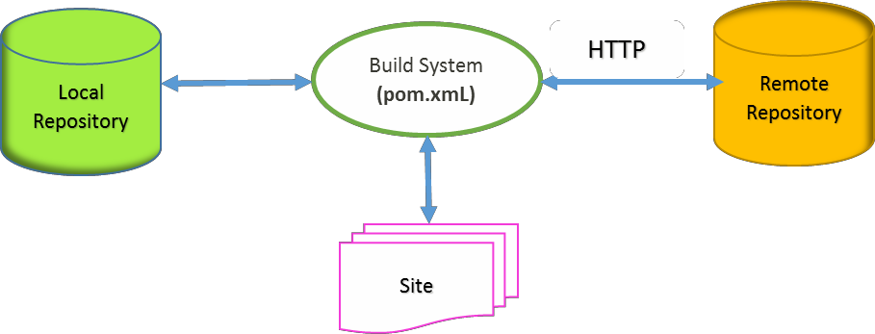



Build Process
Maven Project Object Model (POM) is a fundamental unit of work in Maven
POM is an XML file.
This XML file contains information about project & configuration details
.m2

Slide 16
Lab 1: Environment Setup

Slide 17
Objectives
Install and set environment variables for using Java & Maven

Slide 18
Step 1: Java Configuration
System Requirement
JDK version: 1.5 or above
Memory / Disk Space : no minimum requirement.
Set JAVA Environment
Set environment variable
JAVA_HOME – This variable points to the base directory location
E.g. JAVA_HOME = C:\Program Files\Java\jdk1.x.x
Append location of Java compiler System variable ‘Path’
E.g. Path = %path%;C:\Program Files (x86)\Java\jdk1.8\bin
Verify Java & your settings on your machine
C:\Users\avitepa>java -version
java version "1.8.0_121"
Java(TM) SE Runtime Environment (build 1.8.0_121-b13) Java HotSpot(TM) Client VM (build 25.121-b13, mixed mode)
C:\Users\avitepa>path
C:\Users\avitepa>echo %classpath%

Slide 19
Step 2: Maven Setup
Download Maven - http://maven.apache.org/download.cgi
Windows: apache-maven-<<Version>>-bin.zip
Extract/ Unzip => apache-maven-<<Version>>--bin.zip
C:\avitepa\apache-maven-<<Version>>
Include bin directory of the just created directory to ‘PATH’
environment variable
Verify Maven installation => C:\Users\avitepa>mvn -v
Apache Maven 3.3.9 (bb52d8502b132ec0a5a3f4c09453c07478323dc5;2015-11-
10T22:11:47 + 05:30)
Maven home: C:\apache-maven-3.3.9
Java version:1.8.0_121, vendor: Oracle Corporation Java home:C:\Program Files (x86)\Java\jdk 1.8.0_121\jre
Default locale:en_US, platform encoding: Cp1252
OS name:"windows 8", version: "6.2", arch: "x86", family: "windows"

Slide 20
Step 3: Maven Configuration
set M2_HOME=C:\ avitepa \apache-maven-<<Version>>
M2 is the variable defined while setting Maven environment variables
Append string %M2% to end of system variable ‘PATH’
verify settings with ‘set M’ command to list environment variables
starting with 'M'
C:\Users\avitepa>set M M2_HOME=C:\apache-maven-3.3.9
MAVEN_HOME=C:\apache-maven-3.3.9
MAVEN_OPTS=Xms256m -Xmx1G -XX:PermSize = 512m –noverify
Note: If you get "out of memory" errors when running your projects, the specified memory settings
can be changed as required.

Slide 21
Understanding Environment Variables
JAVA_HOME stores the path of the directory in which JDK can be found.
M2_HOME stores the path of top directory in which MAVEN is "installed" (or unzipped).
The M2 directory indicates to maven application (mvn) regarding where the required maven repositories are found
MAVEN_OPTS - Specify Java command line arguments which will be in effect for the execution of Maven itself
-Xms – initial heap size
-Xmx - maximum heap size

Slide 22
Quiz
Command to check if Maven is properly installed is
java –version
mvn –v
mvn – version
2. Which of the following environment variable points to top directory in
which maven is installed:
JAVA_HOME
MAVEN_HOME
M2_HOME

Slide 23
Quiz
POM is a
XML file
Word doc
Excel file

Slide 24
POM

Slide 25
Objectives
At the end of this module you would be able to
Recognize POM structure
Describe mandatory fields of POM
Create a Project Structure
Understand the hierarchy of the folders

Slide 26
Maven POM
Project Object Model (POM)
pom.xml describes a project in terms of its,
Name and Version
Artifact Type
Source Code Locations
Dependencies
Plugins
Commands (goals) that can be executed
Profiles (Alternate build configurations)
POM uses standard build order, directories and plugins
Pom.xml identifies the dependencies provides uniformity and
enables the build process easier
A POM can call it’s child POMs

Slide 27
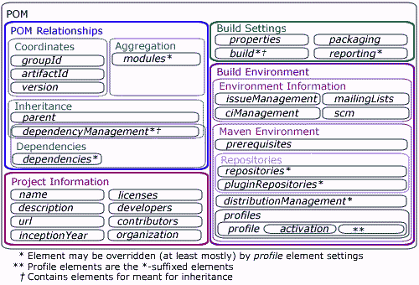
POM - Structure

Slide 28
Mandatory Fields -POM
groupId
- A Maven project has a group ID.
This ID is Unique amongst Organization
It represents the id for group project.
artifactId
- artifactId is the id of the project i.e. the name of Project
Version
- It gives information whether it is a development version or release version
etc. For example: 1.0-SNAPSHOT signifies it is development version.

Slide 29
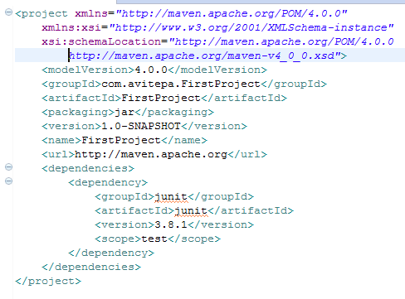





POM - Example
groupId: Id of Project group
artifactId: Id of project
version: version of project
Note: Project Notation in repository -
groupId:artifactId:version

Slide 30
Lab 2: Create & Build Maven Project

Slide 31
Objectives
Build a java project by creating a simple Maven project
Perform Compile, unit test & package the result

Slide 32
Maven Project Creation & Execution
Create Maven Project
mvn archetype:generate -DgroupId=com.avitepa.FirstProject -
DartifactId=FirstProject -DarchetypeArtifactId=maven-archetype-quickstart -
DinteractiveMode=false
Go through the generated project
Go through the generated POM
Make Maven Project as an Eclipse project
Go to the Project folder created in the above step & then run - mvn eclipse:eclipse
site/clean, clean package

Slide 33
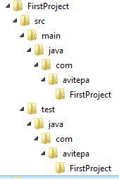
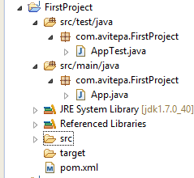

Maven Project Creation & Execution contd..
Compile your sources
mvn compile
Create a JAR file
mvn package
Run the program
..\FirstProject\target\classes>java com.avitepa.FirstProject.App
Hello World!
Clean the project by removing all build
mvn clean
Note: Invokes just clean
Rebuild
mvn package
Mvn clean package
Running the test
mvn test
Create a report
Mvn site

Slide 34


Review generated POM
groupId: Id of Project group
artifactId: Id of project
version: version of project
Note: Project Notation in repository -
groupId:artifactId:version

Slide 35

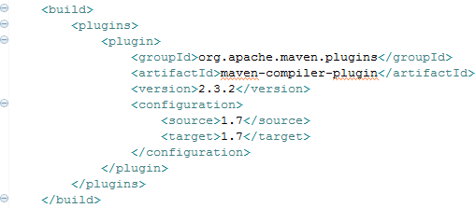
Update POM
Generated pom.xml, may have mappings to JDK 1.4 & Junit test for
version 3.8.x
Let us update the versions of JDK and Junit.
JDK configured to 1.7

Slide 36
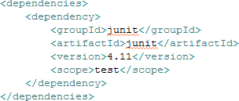
Update POM (contd..)
Version changed to 4.11

Slide 37
Compile, Run & Test
Compile your sources
mvn compile
Create a JAR file
mvn package
Run the program
..\FirstProject\target\classes>java com.avitepa.FirstProject.App
Hello World!
Clean the project (Remove entire build results)
mvn clean
Note: Invokes just clean
Rebuild
mvn package
Mvn clean package
Running the test
mvn test
Create a report
Mvn site

Slide 38
Quiz
.m2 repository which is local repository can be found inside
Maven home directory
Maven bin folder
users home directory
None of the above
2) A unit of work/ task in Maven is called as
Task
goal

Slide 39
Quiz
3) Give the proper sequence of attributes of POM file which identifies an
Object properly
Version
groupId
artifactId

Slide 40
Maven Lifecycle

Slide 41
Objectives
At the end of this section you would be able to
Comprehend different phases of Maven build life cycle
Have an understanding of the commands associated with the build
Explain command hierarchy.

Slide 42
Maven plug-ins & goals
A plugin is a set of goal or goals.
A goal is a “task” in Maven.
Goals can be executed independently
Goals can be executed as a part of a chain of goals.
Goals can have parameters with default values
Goal(s) can be attached to a Maven Life cycle Phase
These goals are executed based on input found in pom.xml of that project
e.g., compiler:testCompile goal checks the input found in POM.xml for relevant parameters.

Slide 43
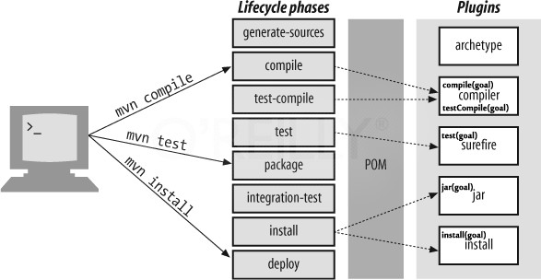
Lifecycle Phases & Plugins

Slide 44
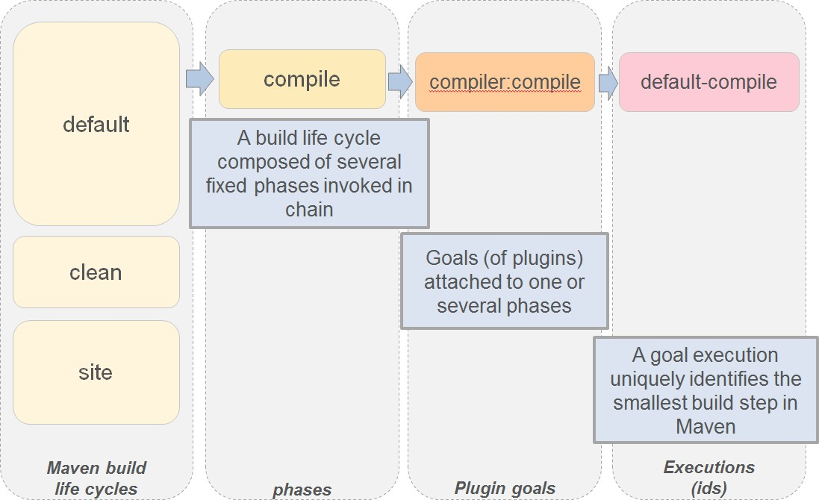
Lifecycle Phases & Plugins contd..

Slide 45
Maven Project Structure Creation
Maven provides "standardized" folder structure for different kinds of software projects.
Create a maven project by using archetype plugin and by specifying suitable
goal
Maven generation process switches into interactive mode to make relevant settings If goals are not specified,
Maven provides archetypes from a Java app to a complex web app
.: mvn archetype:generate
maven-archetype-quickstart: It generates a sample Maven project.
maven-archetype-simple: It generates a simple Maven project.
maven-archetype-webapp: It generates a sample Maven Webapp project.
For more information on archetype, visit https://maven.apache.org/guides/introduction/introduction-to-archetypes.html

Slide 46
Maven life cycle
Maven’s default life cycle include the most common build phases like testing.
The important Maven life cycle phases include the following list:
validate – It checks whether the project is correct & all information is available
compile – It compiles source code into binary artifacts
test – It executes the tests
package – It takes the compiled code & package it into jar/war/ear files
integration-test – It takes packaged result & executes additional tests, that
requires the packaging
verify – It performs checks whether the package is valid
install – It installs the result of package phase into local Maven repository
deploy – It deploys the package to a local or remote repository

Slide 47
Invoke Maven build by setting a lifecycle “goal”
mvn install: triggers generate*, compile, test, package, integration-test, install
mvn clean: Clean old builds from project folder
mvn clean compile: Cleans old builds & then executes generate*, compile
mvn compile install: triggers generate*, compile, test, integration-test, package, install in that sequence
mvn test clean: triggers generate*, compile, test and then cleans
For a complete list of the Maven phases see
http://maven.apache.org/guides/introduction/introduction-to-the-lifecycle.html
If you instruct Maven to execute a phase, it executes all previous phases in the pre-defined sequence until it has executed the defined phase. All relevant goals are executed during this process. A goal is relevant for a phase if the Maven plug-in or the pom binds this goal to the corresponding life cycle phase.

Slide 48
Maven lifecycle is a combination of phases (one or more)
By default, Maven knows, the following 3 lifecycles:
Default: It Is used for most activities on artifacts like performing a build.
Clean: It Is used to delete generated parts
Site: It Is used to generate a website for the current artifact
A maven lifecycle has one or more phases & the goal(s) can be mapped to a phase. When the phases of the lifecycle start, few pre-defined plugin- goals automatically gets executed

Slide 49
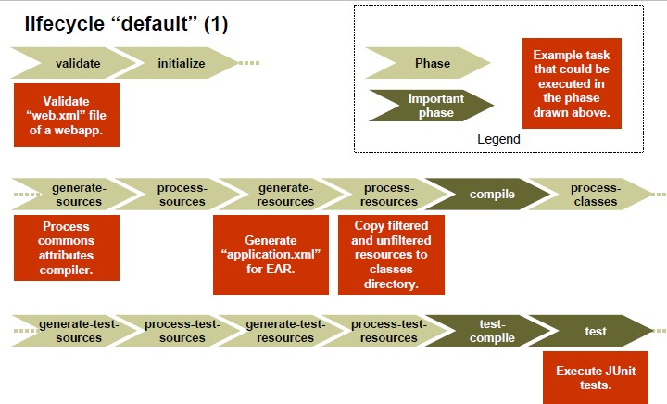
Life Cycle – “Default”

Slide 50
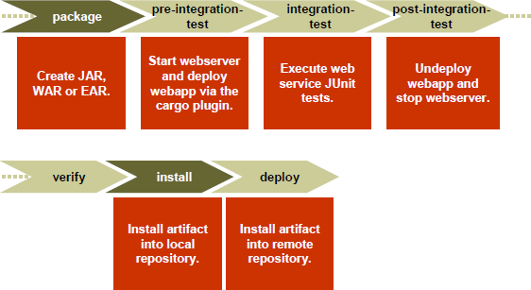
Life Cycle “default” (2)

Slide 51
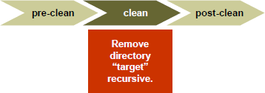
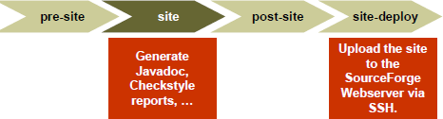
Lifecycle “clean” & “site”

Slide 52
Quiz
List of the proper hierarchy of Build lifecycle
Verify
Validate
Compile
Package
Integration test
Test
Deploy
Install

Slide 53
Quiz
2) Command which generates jar file is
Deploy
Install
Validate
Package
3) Command which helps to release the build is
Install
Deploy
Package
Integration-test

Slide 54
References
1. https://www.cs.colorado.edu/~kena/classes/5828/s12/presentation-
materials/bowesjesse.pdf

Slide 55
THANK YOU !
- Karthik Sivakumar

