Slide 1
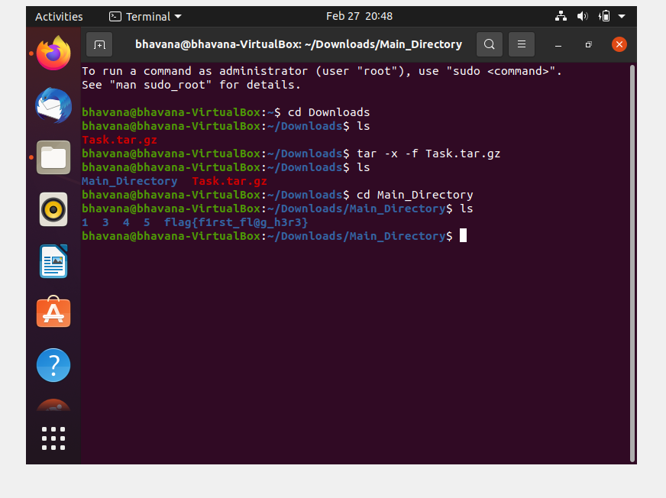
First Flag: flag{first_fl@g_h3r3}​

Slide 2
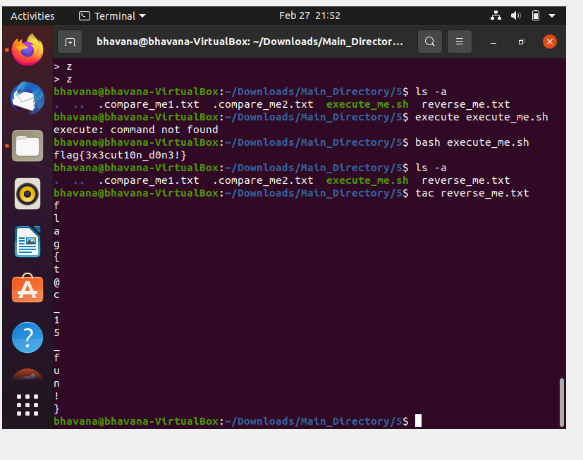
Second Flag: flag{t@c_15_fun!}​

Slide 3
Third Flag: flag{3x3cut10n_d0n3!}​

Slide 4
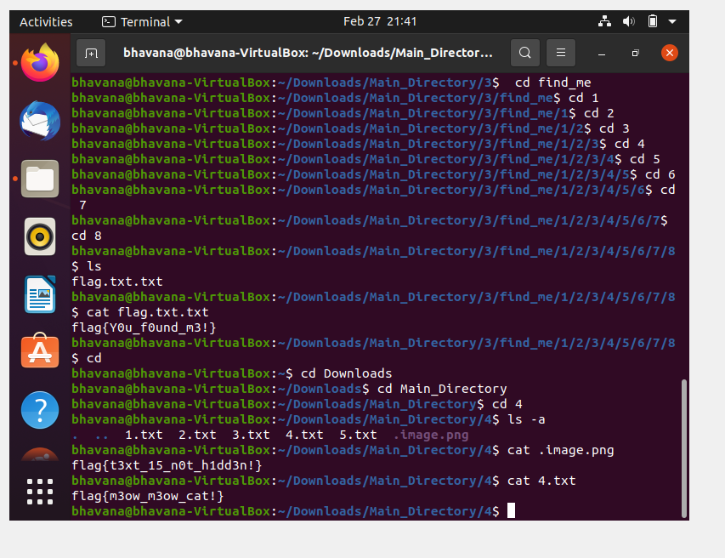
Fourth Flag: flag{m3ow_m3ow_cat!}​

Slide 5
Fifth Flag: flag{t3xt_15_n0t_h1dd3n!}​

Slide 6
Sixth Flag: flag{Y0u_f0und_m3!}​

Slide 7
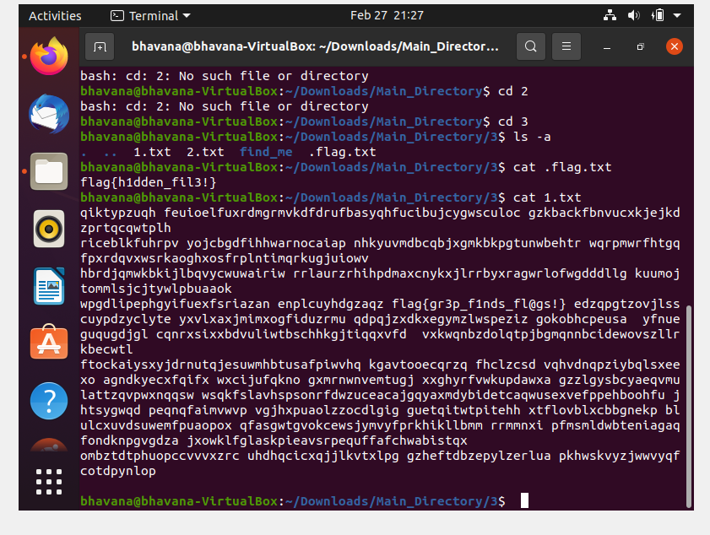
Seventh Flag: flag{h1dden_fil3!}​

Slide 8
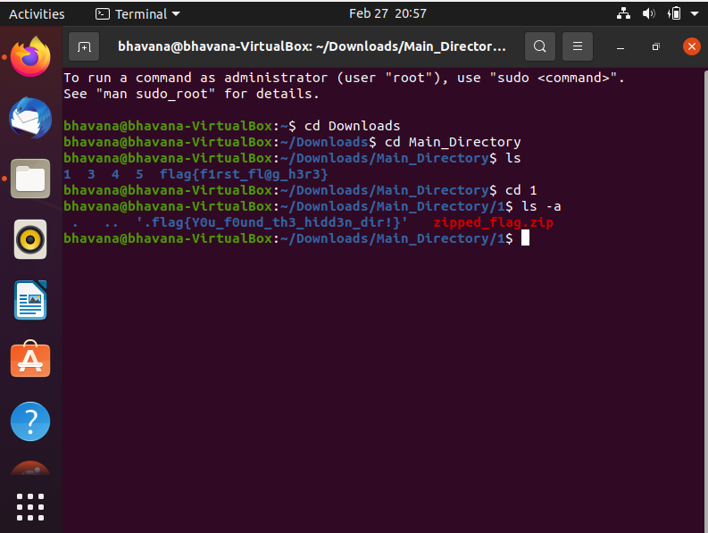
Eighth Flag: flag{Y0u_f0und_th3_h1dd3n_dir!}​

Slide 9
Nine Flag: flag{e@5y_p@ssw0rd!}​

Slide 10
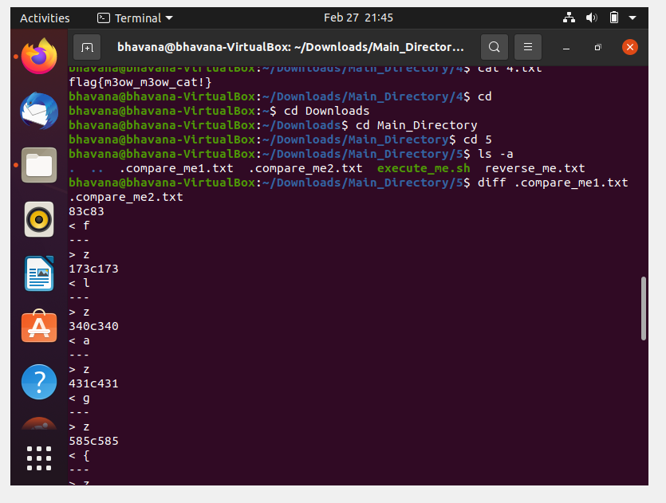
Tenth Flag: flag{diff_15_u53ful!}​

Slide 11
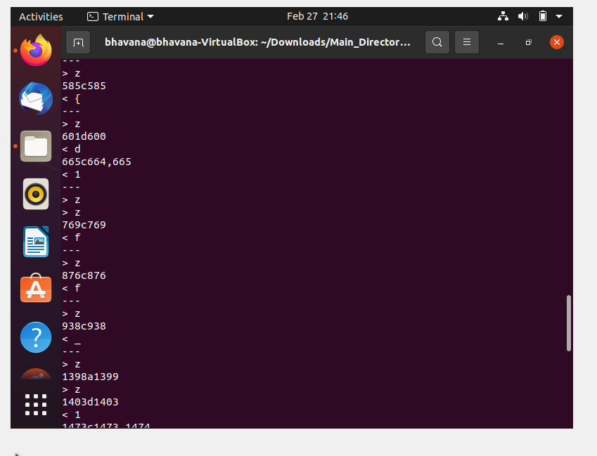

Slide 12
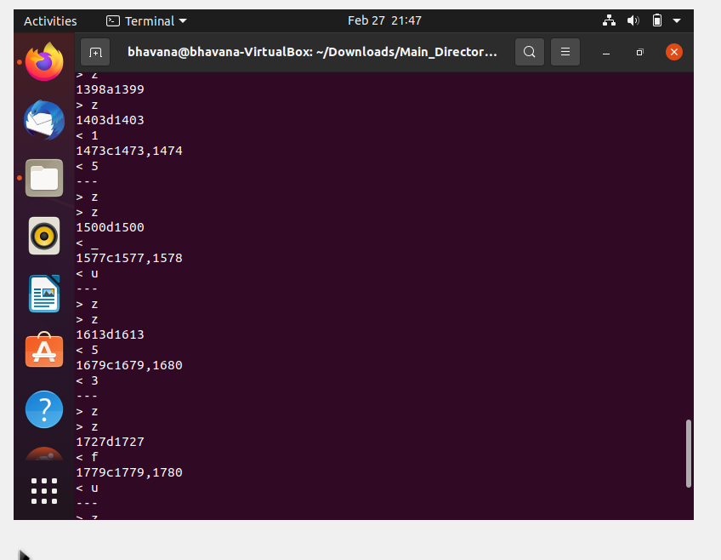

Slide 13
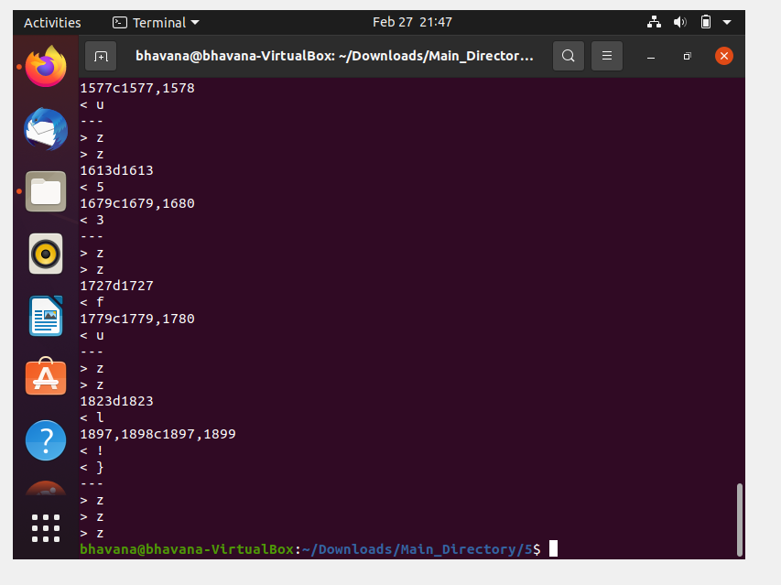

Slide 14
Eleventh Flag: flag{gr3p_f1nds_fl@gs!}​

Slide 15
mkdir: New Directory​
cp: Copy file​

Slide 16
mv: Move file​
rm: Remove file​

