Slide 1

GOLD PRICE PREDICTION USING MACHINE LEARNING ALGORITHMS
HCL INTERNSHIP
Project Supervisor: Dr .M. SELVI,
Name of the Student: Achanta Sai Bhavana Priya
Register Number: 39110016

Slide 2
Presentation Outline
Introduction
Objective
System Architecture
Implementation
System Requirements
Methodology
Steps
Snapshots
Result
Conclusion

Slide 3
INTRODUCTION
Financial data processing and analysing are gaining importance nowadays.It is very hard and computationally complex to study the behaviour of financial data.
Many factors are affecting the pricing of different commodities. The fluctuations in the market, economic policies, epidemics, weather conditions, etc are some of the factors that greatly affect it.
The financial area is highly complex and nonlinear with profuse factors influencing the estimation.
So the financial data always shows a nonlinear behaviour.The nonlinearity in the data can be extracted to analyse the behaviour and is an exquisite nowadays so that proper financial plans can be executed.
People used to go behind the gold price analysis even in the early seventies and they analysed that government policies in the US are a key factor in gold pricing.

Slide 4
OBJECTIVE
The main objective of the system is to predict gold price by collecting the data set and by applying machine learning algorithms.

Slide 5
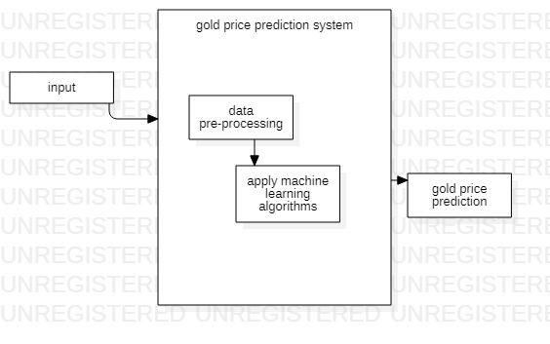
SYSTEM ARCHITECTURE

Slide 6
IMPLEMENTATION
The implementation of the project step by step:
Data collection
Data pre-processing
Feature extraction
Apply machine learning algorithms
Prediction of gold price

Slide 7
Data Collection: The data set is collected from the Kaggle dataset which is an open source which consists of 6 attributes and entries more than 2k.
Data pre-processing: The dataset which is uploaded is previewed and the process of finding out missing values or checking if any redundancy is present checked and remove all null values, redundancy and noise data is the dataset.
Feature Extraction: Here the important features i.e from the dataset which features are required for the prediction of gold price is required are identified.

Slide 8
Apply Machine learning algorithm: After training the dataset machine learning algorithms are applied to the selected features then it will predict the gold price prediction.
Prediction of gold price: After applying machine learning algorithms it will predict gold price by comparing with each and every year and provides accuracy.

Slide 9
SYSTEM REQUIREMENTS
HARDWARE REQUIRMENTS
Hard Disk : 40 Gb
Ram : 512 Mb
SOFTWARE REQUIRMENTS Operating system : Window 7(32 bit)
Coding Language : Python
IDE : JupyterNotebook

Slide 10
METHODOLOGY
Logistic regression alogorithm
Logistic regression is one of the most popular Machine Learning algorithms, which comes under the Supervised Learning technique. It is used for predicting the categorical dependent variable using a given set of independent variables.
Logistic regression predicts the output of a categorical dependent variable. Therefore the outcome must be a categorical or discrete value.

Slide 11
It can be either Yes or No, 0 or 1, true or False, etc. but instead of giving the exact value as 0 and 1, it gives the probabilistic values which lie between 0 and 1.
Logistic Regression is much similar to the Linear Regression except that how they are used. Linear Regression is used for solving Regression problems, whereas Logistic regression is used for solving the classification problems.

Slide 12


Logistic regression equation:

Slide 13
STEPS
To implement the Logistic Regression using Python, we will use the same steps as we have done in previous topics of Regression. Below are the steps:
1.Data Pre-processing step
2.Fitting Logistic Regression to the Training set
3.Predicting the test result
4.Test accuracy of the result(Creation of -Confusionmatrix)
5.Visualizing the test set result.

Slide 14
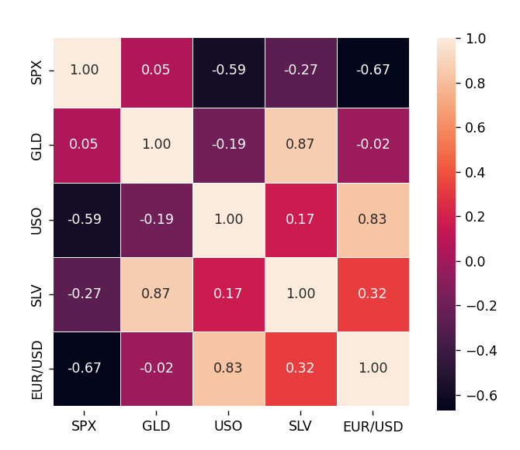
SNAP SHOTS (Confusion matrix)

Slide 15
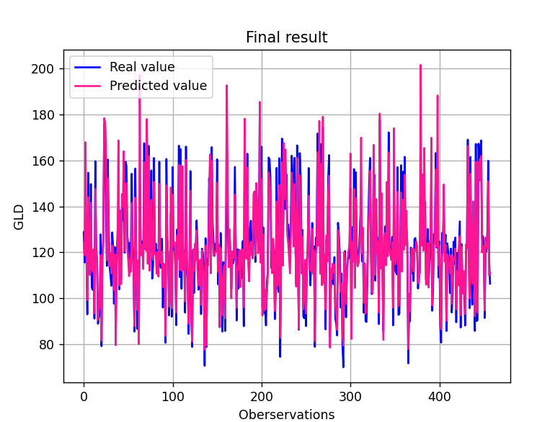
Final Result

Slide 16
Conclusion
In this system, an Random forest and logistic regression is used to predict the nature of the gold rate. The results indicate that our proposed model outplays traditional methods such as machine learning algorithms.
Moreover, it would be better to test different machine learning algorithm to predict gold price is better to find with the gold price with achieving high accuracy.

