Slide 1
OTP Verification System
By
Bhavana Balasa
S9322

Slide 2

Table OF Content
Introduction
Tools and Libraries
Process Flow Diagram
Project Output Showcase
Constraints

Slide 3
1. Introduction

Slide 4
Problem Statement: To develop an OTP verification system in Python. The system should generate a 6-digit OTP and send it to the user's email address for verification. Upon receiving the OTP, the user should enter it into the system for validation. If the entered OTP matches the generated OTP, access should be granted; otherwise, the user should be allowed to re-enter the OTP by providing 5 chances. Although OTP does not match then access should be denied.

Slide 5
2. Tools And Libraries

Slide 6
Tools:
Visual Studio Code:
is a popular and lightweight source-code editor developed by Microsoft. It's widely used for programming in various languages.
Libraries:
Tkinter: Used to create a Graphical User Interface(GUI).
Random: Is used to generate random numbers and make random selections.
Yagmail: simplifies sending emails via Gmail.
PIL(Pillow): Python Imaging Library (PIL) is designed to work with images.

Slide 7
3. Process Flow Diagram

Slide 8
TMain Code
Create a window to enter a user’s email id.
By pressing the Send OTP button.
Tsend_otp()
It sends a random OTP to the user’s email.
Calls
Tverify_otp_window()
It creates another window to provide received OTP
By pressing the Verify button.
Otp_verify()
It validates the OTP and in case of incorrect OTP provides 3 attempts.

Slide 9
4. Project OutPut Showcase

Slide 10
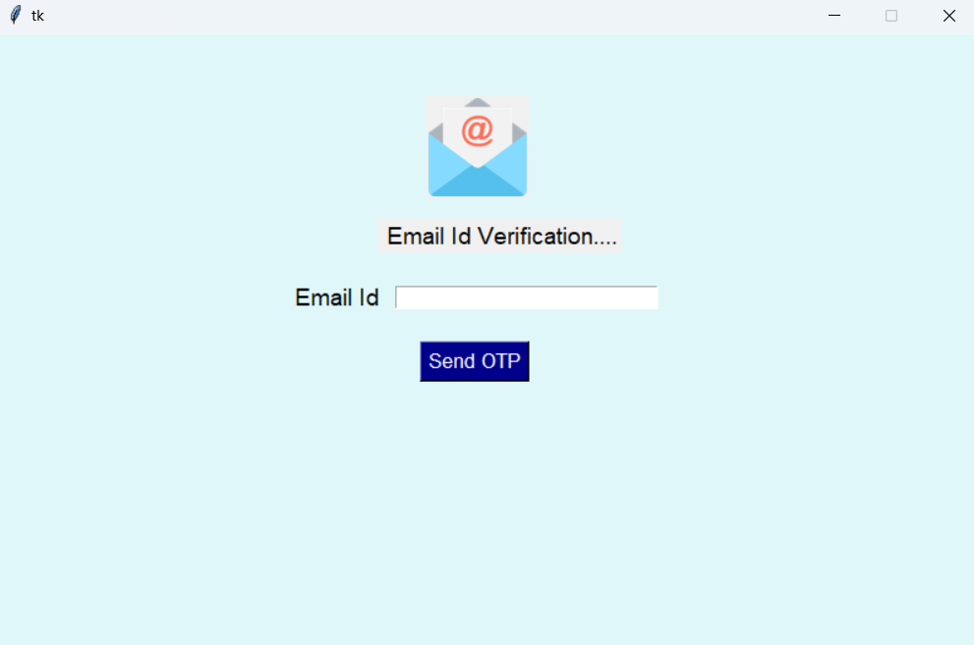

Slide 11
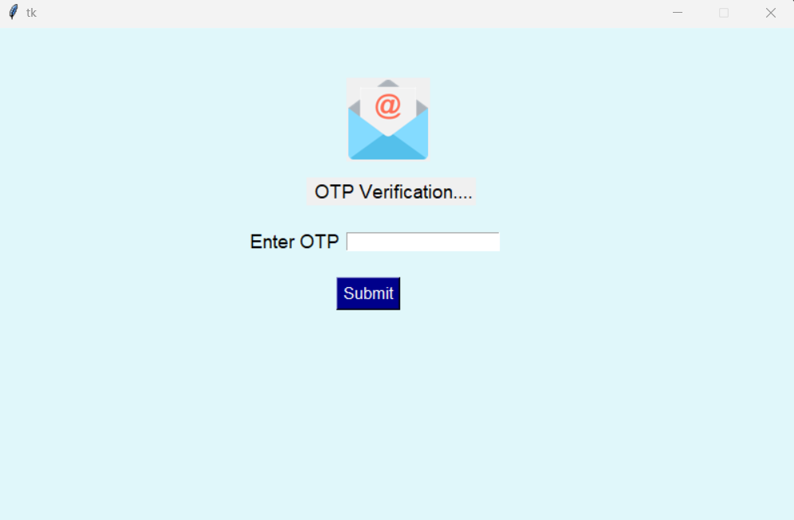

Slide 12
5. Constraints

Slide 13
Emails might not reach the user instantly due to delays in the mail server.
SMTP Server may face downtime.
Security issues
Email services like Gmail limit the number of daily or minute emails.

Slide 14
Thank You

