Slide 1


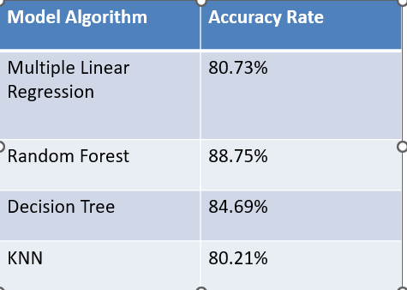
LAPTOP PRICE PREDICTION
Batch no:114
2103A52065-P.BHAVANA
2103A52063-H.DHARANI
2103A52156-V.SHIVANI
INTRODUCTION
LIMITATIONS
Machine learning techniques like multiple linear regression, decision tree, random forest, and KNN algorithms assist in predicting laptop prices accurately, helping customers make informed purchasing decisions for this essential device in our daily lives.
OVERVIEW
This model predicts salaries based on features like education level, years of experience, job title, and location using regression algorithms. After preprocessing, including handling missing values, feature encoding, and scaling, the model undergoes training and evaluation .
Limited data: Salary or price prediction models need vast amounts of data to be accurate. Lack of data can lead to misleading results. Model bias: Models can inherit biases from the data used to train them. This could lead to unfair salary predictions or inaccurate price estimates.
PROPOSED METHODOLOGY
Accuracy depends on the quality of the data. With large data, the prediction stage might be slow. Sensitive to the scale of the data and features. Require high memory – need to store all of training data .
PROBLEM STATEMENT
In laptop stores, a lot of people don't know the details of different laptops, like how much each model costs and what price range they should be looking at to get the features they want.
OBJECTIVES
The main objective of our project is to predict the laptop by asking some basic questions to the user to know what type of laptop the user needs For above we predict the price of the laptop that is close to the real ones .
MODELS USED
We used some of the Machine Learning Models. Multiple linear regression ,Random Forest , Decision tree and KNN.
The accuracies are resulted as:
CONCLUSION
Our website predicts laptop prices based on user-desired configurations using the Decision Tree algorithm, aiding students in selecting ideal laptop specifications. By leveraging this tool, students can make informed purchasing decisions tailored to their needs and buying power.
REFERENCES
https://github.com/mathangpeddi/Laptop-Prices-Predictor
https://github.com/Paras-bakshi/laptop-price-Predictor
https://github.com/NehalGund/Laptop-Price-Prediction
HOD, CSAI Dept. - Dr. M. Sheshikala
PROJECT GUIDE - Dr.K.Rajchandar Sir ,Asst.Prof., CSE Dept
CO-ORDINATOR – P.Praveen , Prof., CSAI Dept
ACKNOWLEDGEMENT

