Slide 1

TRANSLATING TELUGU IMAGE WORD TO ITS MEANINGFUL ENGLISH WORD
Batch No: A-15 Project Guide:
D. Bhavana (164G1A0515) Mrs.S.L.Sailaja M.Tech ( Ph. D)
N. Harika (164G1A0528) Assistant Professor.
Arbaaz Dilkush Mohammad(164G1A0506)
M . Lakshmi Madhav krishna (164G1A0545)
Srinivasa Ramanujan Institute of Technology
Department of Computer Science & Engineering

Slide 2
Contents
Abstract
Problem Statement
Literature Survey
Proposed System
Project Planning
Requirements
Limitations
Design
Implementation
Previous Review Queries

Slide 3
Abstract
Telugu is the language spoken by more than 100 million
People in South India. Telugu script consists of rounded
characters with no horizontal and vertical lines as in Hindi
script.
Here, in our project, the digitalized Telugu word can be given as input by creating some dataset of Telugu words.
Preprocessing, feature-extraction, classification and segmentation, all these processes are performed on a digitalized Telugu word which is given as an input.

Slide 4
Contd..
The output can be given as an English word for the recognized Telugu word.
The objective of the project is to convert the digitalized Telugu word to its English meaning word.

Slide 5
Problem Statement
There are 56 characters and several compound characters are possible in Telugu.
The objective of this work is to recognize the basic printed characters of Telugu scripts/words and convert it into English. Due to the segmentation and pre-processing errors some of the characters could not be recognized by this system but overall performance of the system with clean background will results good.

Slide 6
Literature Survey
Existing System :
Currently, all the existing system works on foreign languages like Spanish, English, Chinese. In India, languages like Tamil, Hindi and Marathi are well known for this kind of development when compared with Telugu. Since Telugu is our regional language and due to some illiteracy problem, Telugu has been selected for this project.

Slide 7
Contd…
Optical Character Recognition (OCR) for Telugu: Database, Algorithm and Application by Chandra Prakash Konkimalla, Manikanta Srikar Yellapragada, Trishal Gayam, Souraj Mandal, Sumohana S. Channappayya
Telugu is a Dravidian language spoken by more than 80 million people worldwide. The optical character recognition (OCR) of the Telugu script has wide ranging applications including education, health-care, administration etc. The beautiful Telugu script however is very different from Germanic scripts like English and German.

Slide 8
Contd…
This makes the use of transfer learning of OCR solutions to Telugu a non-trivial task. To address the challenge of OCR for Telugu, we make three contributions in this work: (i) a database of Telugu characters, (ii) a deep learning based OCR algorithm, and (iii) a client server solution for the online deployment of the algorithm. For the benefit of the Telugu people and the research community.

Slide 9
Contd…
“A Study on Recognition Methods of Telugu Numerals and Characters”, Ch. N. Manisha, E. Sreenivasa Reddy, Y.K. Sundara Krishna.
Recognition of Characters in digital data is a very big challenging issue for the researchers. Recognition of printed Telugu digital documents is a more complicated issue. The digital format of hardcopy of a document is called document image. This paper analyzes the various methods to recognize the numerals and characters of Telugu language.

Slide 10
Proposed System
We are proposing a model which will take images with Telugu words in it and then convert it into its English meaningful word at offline.
Advantages:
People who are unable to understand Telugu, like tourists and what to understand our culture and monuments, this model can help them read and understand Telugu posts.

Slide 11
Project Planning
Time Schedule
TASK | DATE
Software Installation & Requirements Gathering | 27-01-2020
Analysis & Design | 05-02-2020
Implementation | 28-02-2020
Testing | 20-03-2020
Documentation & Verification | 05-04-2020

Slide 12
Requirements
Software Requirements:
Operating Systems - Windows, Linux
Platform - Python 3.7
Programming - Python
Hardware Requirements:
i3 processor
4GB RAM

Slide 13
Limitations
The input image should not exceed the dimensions of 400 * 600.
The image with one word performs good.
The image should be in .jpg or .jpeg format.

Slide 14
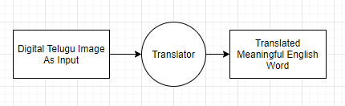
Design
Data Flow Diagram(DFD) : Level-0

Slide 15
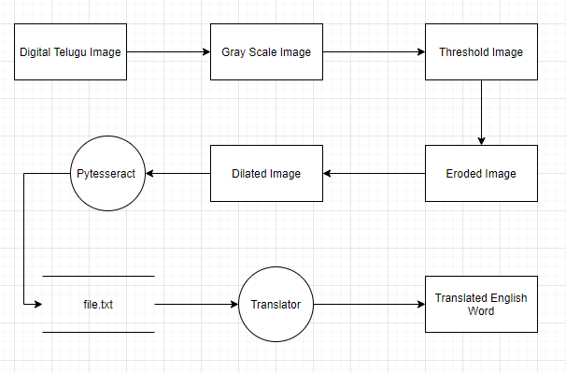
Contd…
DFD Level-1

Slide 16
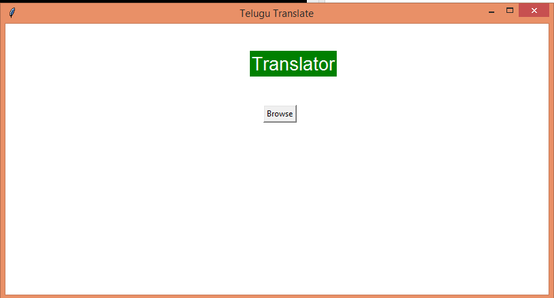
Implementation
Our project is an attempt to recognize the Telugu text of an image and to convert into its Meaningful English word. Here we have to upload the image and it will convert the Telugu text to its meaningful English word.
Step 1 : After Running the application can see the template of the Project.

Slide 17
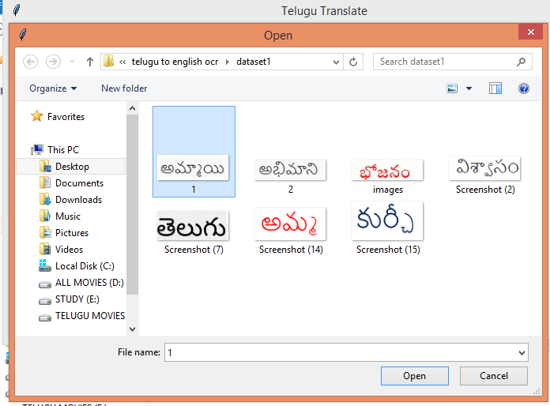
Contd…
Step 2 : When we click on Browse button to upload the image ,then we have to select on image from the location.

Slide 18

Contd…
1.jpeg
The image that we are uploading should have the dimensions of upto 400 X 600.
The image should be in the .jpg or .jpeg format.

Slide 19
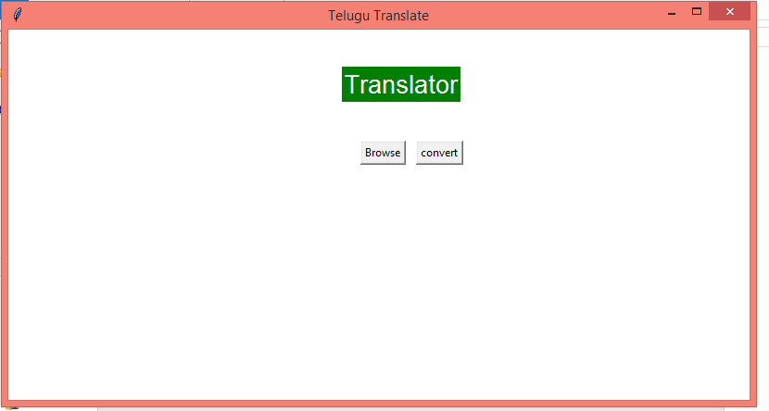
Contd…
Step 3 : After uploading the image, the application will enables the convert Button.

Slide 20
Contd…
After clicking on convert button the process undergoes as mentioned below:
Using cv2 module the uploaded image can perform the grayscale conversion , threshold and Morphological operations.
Grayscale Conversion :
cv2.cvtColor( img,cv2.COLOR_RGB2GRAY)
Threshold Conversion :
cv2.threshold(img,127,255,cv2.THRESH_BINARY)
Morphological Operations :
There are two morphological operations .
Erosion :
cv2.erode(img, kernel, iterations=1)
Dilation :
cv2.dilate(img, kernel, iterations=1)

Slide 21
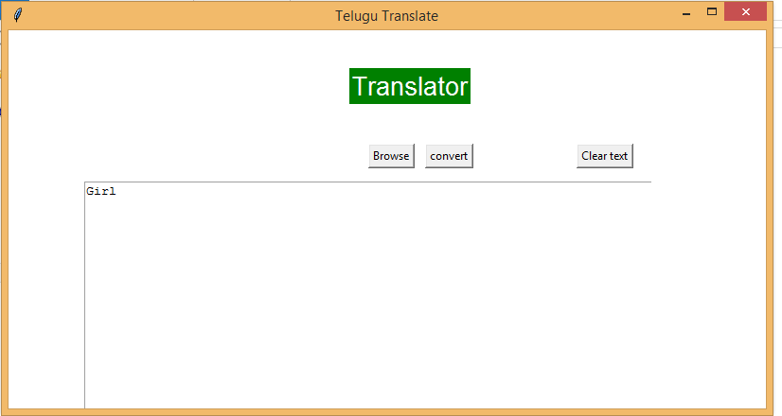
Contd…
Step 4 : After processing the image, we can see the English word output of the input Telugu image.

Slide 22
Previous Review Queries
Change the Title. (Digitalized or Image)
Dimensions of the Image.
Limitations should mention in the ppt.
Input of the project (Digitalized or Handwritten).
Mention the algorithm technique that are using in the project.

Slide 23
THANK YOU
Queries
?

