Slide 1




Integrating Data Catalog With Content search Technologies
Team : Mindbots

Slide 2
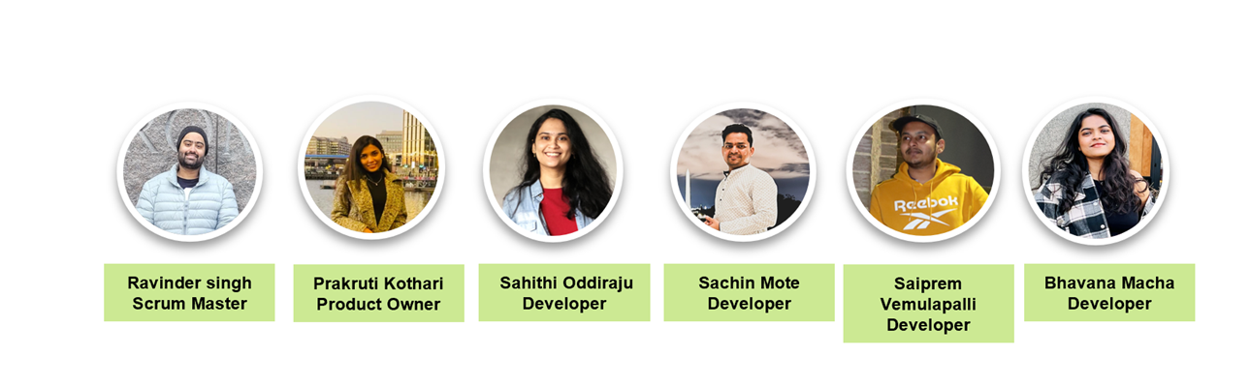

Slide 3



Agenda
Introduction
Exploring ,Integrating & Transforming Data
Data Catalog and Metadata Standards
Results, Conclusion & Next Steps

Slide 4

Our Partners
Domain: Multiple
Goal : Fast and Efficient Data Discovery
Partner :Mitre University Exchange Capstone
Dr Charles Howard
Nick Pesce
Chris Basel
Brianna Salameh

Slide 5
Problem Statement
Integrating Two Distinct Communities which are data catalog and content search technololy to leverage each other .
01
Ensuring Data consistency on the the platform .
02
Designing a scalable architecture that can manage growing data volumes while retaining search performance
03
Making sure that the data catalog and search technology are secure and that only authorized people have access is crucial
04

Slide 6
Existing Industry scenario Prior to Data Catalog
Lack of Visibility
Limited Collaboration
Time Consuming Data Discovery
Limited Data Governance

Slide 7

Dataset Source
MITRE Synthea Health Data
https://synthea.mitre.org/downloads
Dataset Access: Open source
Dataset Size: Multiple Files, 512 MB

Slide 8

Datasets
Supplies​
Payers​
Allergies​
Conditions​
Encounters​
Imaging_Studies​
Medications​
Devices​
MITRE Synthetic Health Data
(16 CSV Files)
Immunizations​
Careplans​
Organizations​
Procedures​
Observations​
Payer_Transitions​
Providers​
Patients​

Slide 9
Our Proposal
Integrating Data catalogs with content search technology
Increased data scalability and data relevance.
Data privacy

Slide 10
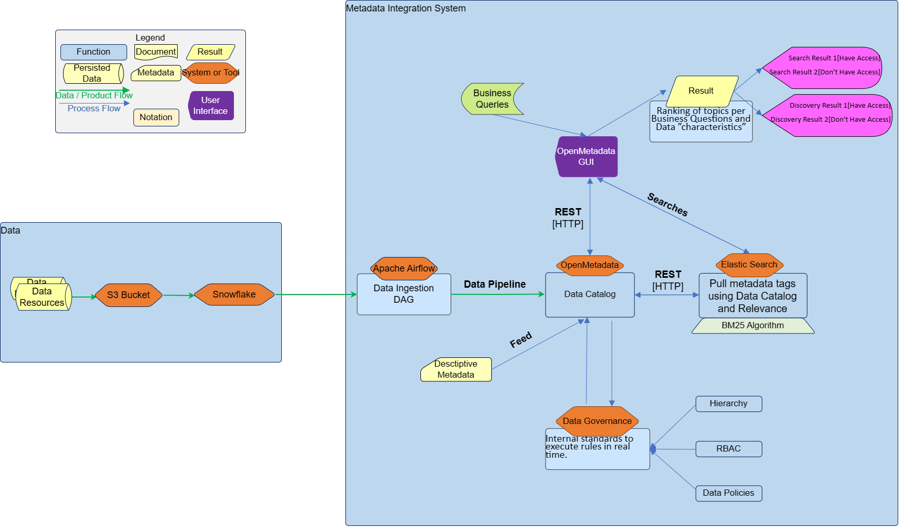
Schematic Diagram

Slide 11

Open Metadata
Metadata Management
Data Lineage Tracking
Data Profiling and Data Quality
Data Collaboration
Data Security

Slide 12

Elastic Search
Keyword Search
Faceted Search
Cross Platform search
Content Analytics

Slide 13
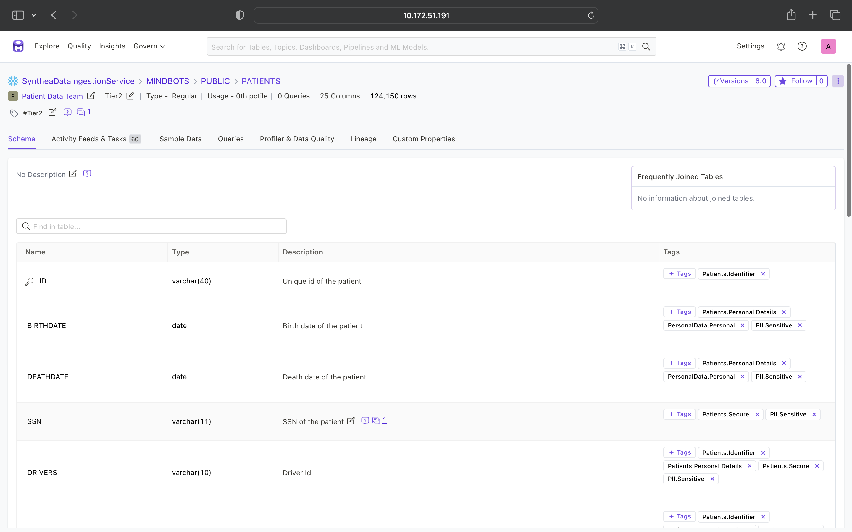
Integration – Enabling Keyword Search
ELASTIC SEARCH
COMPONENT
OPEN METADATA

Slide 14
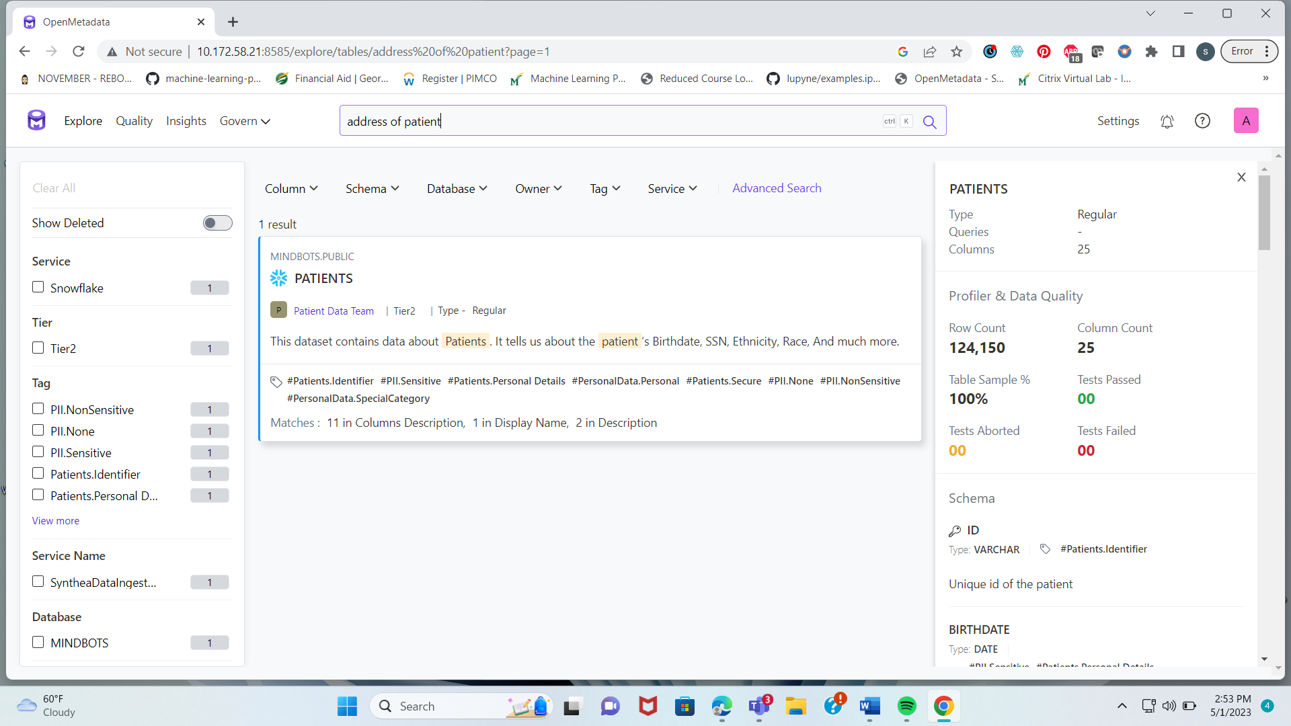
Integration – Enabling Keyword Search –II
ELASTIC SEARCH
COMPONENT
SEARCH RESULTS

Slide 15
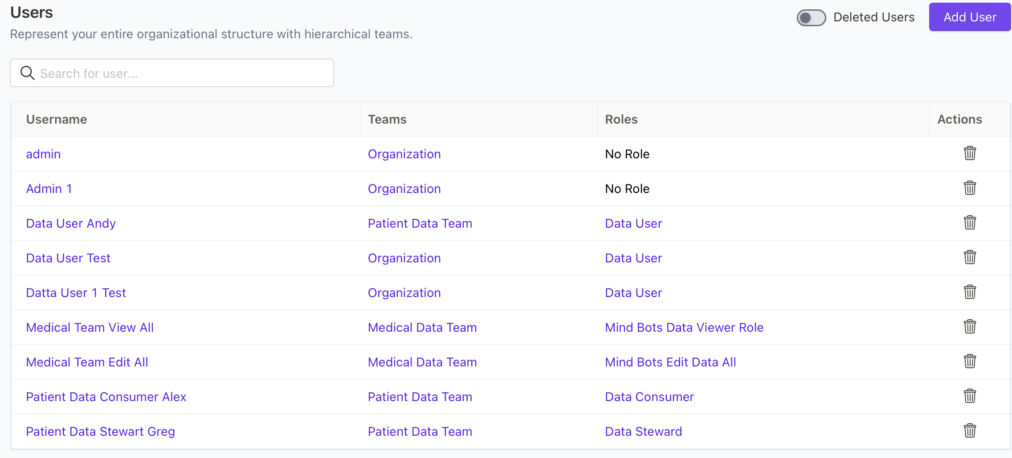
Integration – Implementing Security
DATA SECURITY FROM
OPEN METADATA
ELASTIC SEARCH
COMPONENT

Slide 16

Supporting Analytics
Data assets with description
Data assets reach
Active users

Slide 17
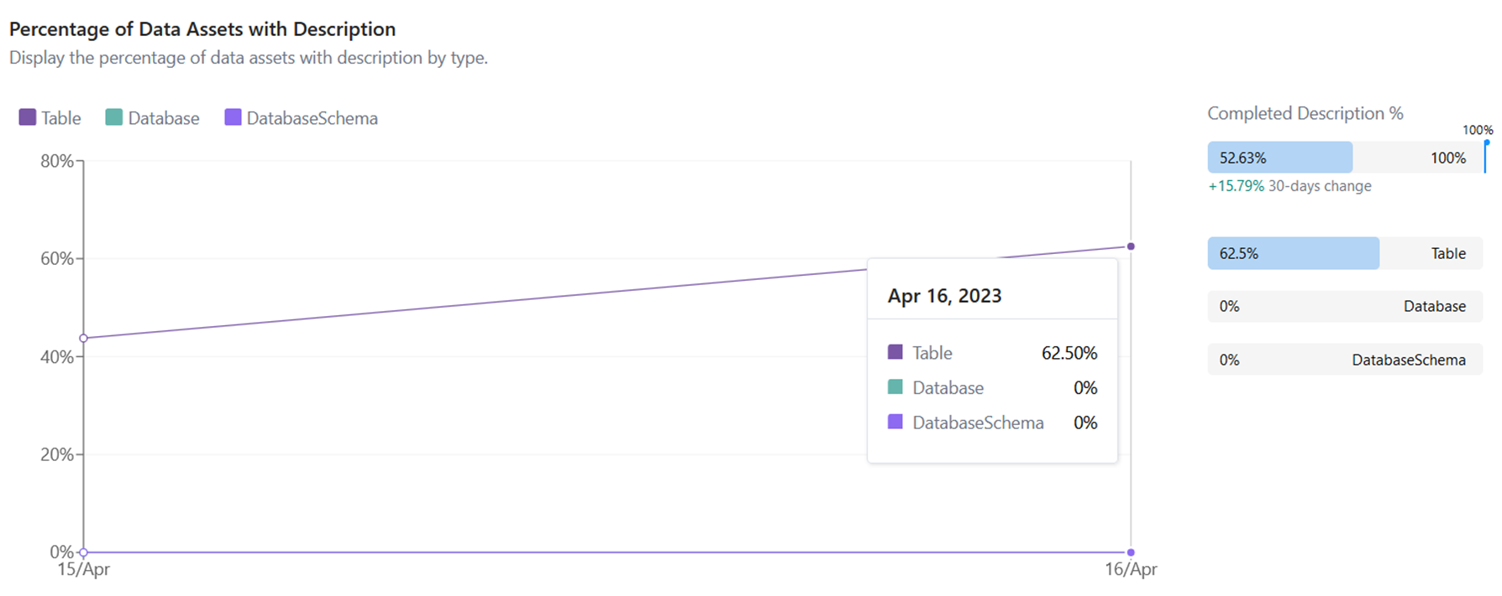
Data Assets with Description

Slide 18
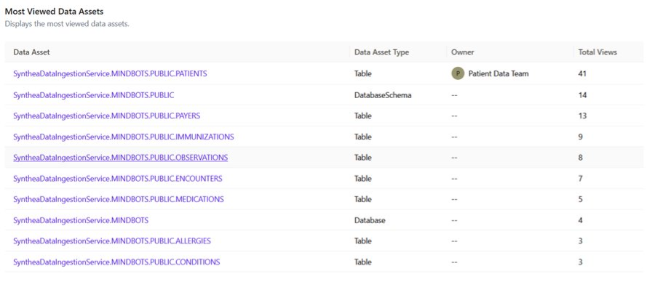
Data Assets Reach

Slide 19
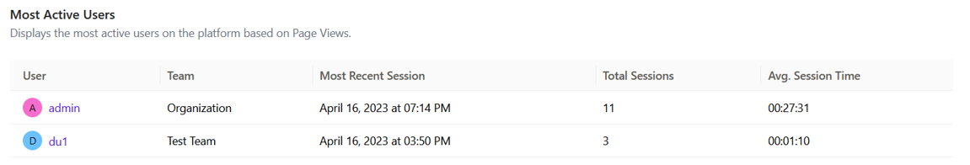
Active Users

Slide 20

Learnings

Slide 21

Learnings
Current Industry
Problem Statement Understanding
Model Development
Integrating Software (Elastic, Open Metadata, AWS)
Deriving Statistics

Slide 22

Future Scope

Slide 23
Future Scope
Results Post Large Scale Deployment
Introducing ML/AI to Leverage Product Potential
Dynamic Tags Generation with ML
Robust Policies for User control
Indepth Analytics which used derive Data Purging, Retention Policies

Slide 24

Thank you

Slide 25

Questions?

