Slide 1
ASE Literature Review Mining Software Engineering Repositories
Bhavana Pallepati Venkata Sarath Kumar Galimelu

Slide 2
Outline
Introduction
Brief History of MSR
Mining Methodology
Problems in Software Project Management
Software Engineering Data
Data Preprocessing
Mining Challenges in SE
Mining Methods
Tasks that Benefits from Mining.
Software Intelligence-Future Directions
Tools in Mining
Survey

Slide 3
Introduction
A large amount of data is produced in software development process.
Data from Software Repositories.
Data from Program Executions.
Mining Software Repositories analyzes and cross-links the rich data available in software repositories
To understand the Software artifacts and processes
To uncover interesting and actionable information about software systems and projects to assist the software tasks.
To build the Prediction models, Pattern Identification tools and techniques by using large amount of Information Technology in various domains.
To support future software development.

Slide 4
Introduction Contd..
Although software repositories are readily available for most large software projects, the data stored in these repositories has not been the focus of software engineering research until recently primarily because of two reasons.
Limited Access to Repositories. - Companies in many cases are not willing to give researchers access to such detailed information about their software systems
Complexity of Data Extraction. -Most repositories are not designed with automated bulk data-extraction and mining in mind, so they provide limited support for automated extraction.
With the advent of open source systems, easy access to repositories of large software systems became a reality

Slide 5
Brief History of MSR
Mining software repositories (MSR) workshop started in 2004 as a workshop session of highly rated international conference on software engineering (ICSE) in order to bring all the researchers and practitioners together working on this field.
Focuses on identifying and development of new tools and techniques
to understand software development and evolution,
to support predictions about software development, and
to exploit this knowledge concretely in planning future development.
Software Mining Challenge

Slide 6
Problems in Software Projects
Understanding the Software Systems
Understanding large software systems remains a challenge.
Propagating Changes
Propagating the code changes to other entities
Predicting and Identifying Bugs
Code that has bugs in the past are likely to have bugs in the future.
Understanding the Team Dynamics
Many Projects discuss through mailing lists, instant messaging etc.
Improving the User Experience
Reusing the Code

Slide 7
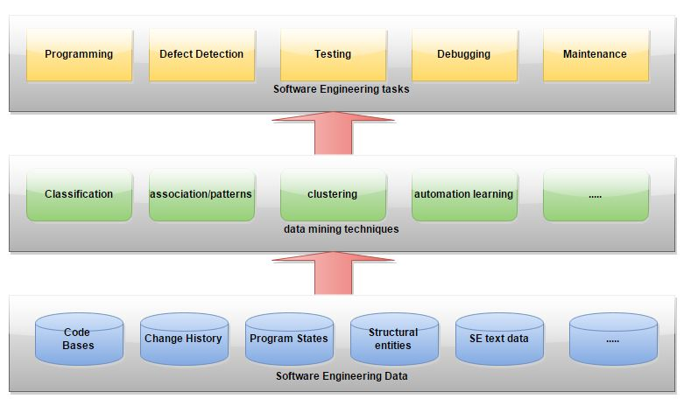
Overview of mining software engineering data Layered model

Slide 8
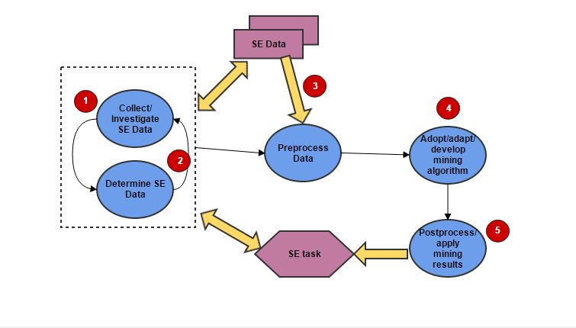
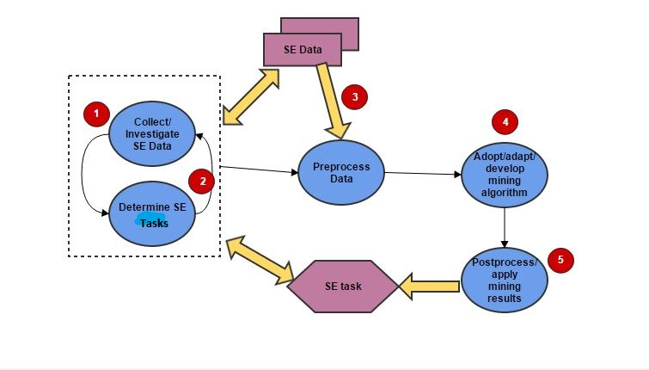
Mining Methodology

Slide 9
Software Repositories
Historical Repositories
Source control repositories
Bug repositories
Archived personnel communications
These data record several information about the evolution and progress of a project.
Run-time repositories
Deployment logs and Execution traces contain information about the execution and the usage of an application at a single or multiple deployment sites, error messages reported.
Code repositories
Data from Sourceforge.net, Google code, and Codeplex.com contain the source code of various software systems developed by a team of developers

Slide 10
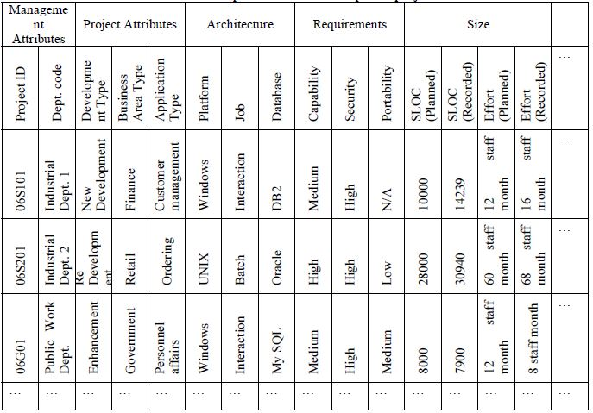
Example of Software Development Project data

Slide 11
Data Understanding
Relevance
What data is available for the task?
Is this data relevant?
Is additional relevant data available?
How much historical data is available?
Who is the data expert ?
Data in the real world is dirty
incomplete: l ack ing at tribute values, lacking certain at tr ibutes of interest, or containing only aggr gate data
noisy: containing errors or outliers
inconsistent: co nt aining di sc repancies in codes or names

Slide 12
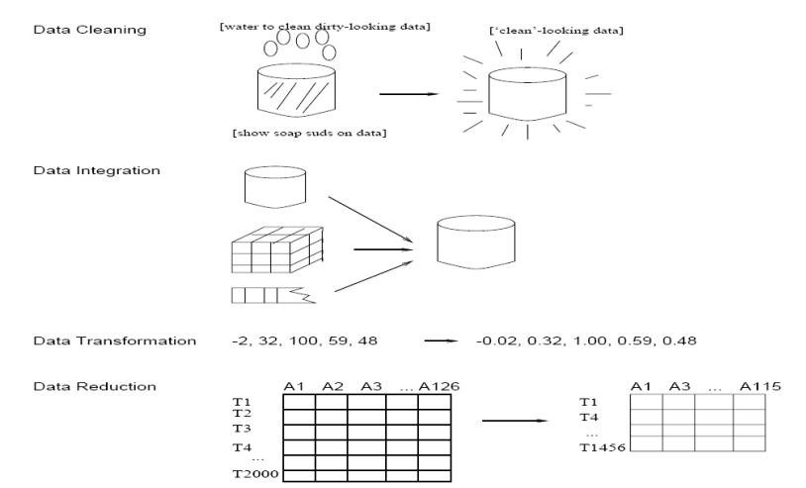
Forms of Data Preprocessing

Slide 13
Data Cleaning-Acquisition & Reformatting
Data in a flat file
Fixed-column format, Delimited format: tab, comma “,” , other
E.g. C4.5 and Weka “arff” use comma-delimited data
Verify the number of fields before and after
Reformatting
Convert data to a standard format (e.g. csv or arff)
Missing values
Binning of numeric data
Fix errors and outliers
Convert nominal fields whose values have order to numeric.

Slide 14
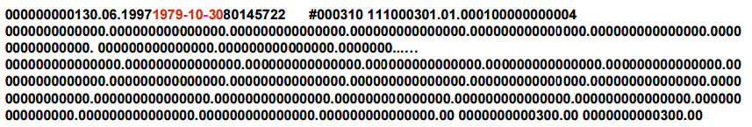
Data Cleaning
Original data
Clean Data

Slide 15
Missing Data
Missing data ignoring techniques
List wise deletion
This method omits the cases containing missing values.
Pair wise deletion
This method considers each feature separately. For each feature, all recorded values in each observation are considered and missing data are ignored.
Missing data toleration techniques
These techniques use a probabilistic approach to handle missing data. They do not predict missing data but assign a probability to each of the possible values. Thus they are internal missing data treatment strategies, which perform analysis directly using the data set with missing values.

Slide 16
Missing Data Contd..
Missing data imputation techniques
Mean imputation
This method imputes each missing value with the mean of reported values. The disadvantage is that it leads to underestimation of the population variance.
Regression imputation
The regression model is built using the complete observations. It tends to perform better than MI, but still underestimates variance.
Hot-deck imputation
Fill in missing data by taking values from other observations in the same data set.. The choice of which value to take depends on the observation containing the missing value. Randomly choosing observed values from donor cases is the simplest hot-deck method.

Slide 17
Other Data cleaning Forms
Unified date format
We want to transform all dates to the same format internally
Some systems accept dates in many formats
e.g. “Sep 24, 2003” , 9/24/03, 24.09.03, etc
dates are transformed internally to a standard value
Converting nominal to numeric
Some tools can deal with nominal values internally
Ordered attributes can be converted to numbers preserving natural order. For Ex
A -> 4.0
A- -> 3.7
B+ -> 3.3
B -> 3.0

Slide 18
Other Data cleaning forms
Identify outliers and smooth out noisy data(random error or variance in a measured variable)
Clustering
detect and remove outliers
Combined computer and human inspection
detect suspicious values and check by human
Regression
smooth by fitting the data into regression functions
Correct inconsistent data
Make it consistent by removing unnecessary data.

Slide 19
Preprocessing forms contd..
Data Integration
combines data from multiple sources into a coherent store
Detecting and resolving data value conflicts
for the same real world entity, attribute values from different sources are different.
Careful integration of the data from multiple sources may help reduce/avoid redundancies and inconsistencies and improve mining speed and quality.
Data Transformation
Smoothing: remove noise from data
Aggregation: summarization, data cube construction
Generalization: concept hierarchy climbing
Normalization: transforming all variables in the data to a specific range.

Slide 20
Preprocessing forms contd..
Data Reduction
Obtains a reduced representation of the data set that is much smaller in volume but yet produces the same (or almost the same) analytical results.
Data reduction strategies
Data cube aggregation
The aggregated data for an individual entity of interest
Dimensionality reduction
Important for modeling and DM algorithms work better if dimensionality(number of attributes) is reduced. Can lead to more understandable model.
Numerosity reduction
Reduce data volume by choosing alternative, smaller forms of data representation

Slide 21
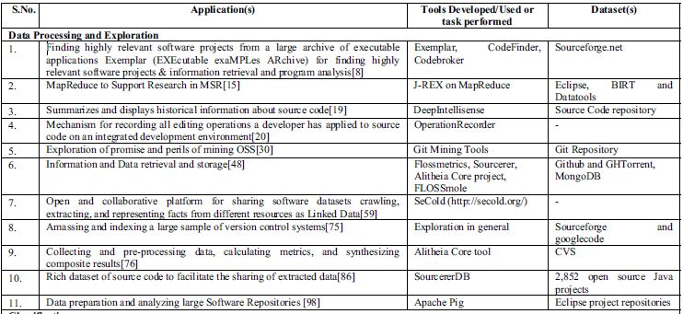
Data Processing Tools

Slide 22
Mining Challenges -Requirements unique to SE
Most SE data mining studies rely on well-known, publicly available tools.
Compromise the requirements unique to SE by fitting them to the tools undesirable features.
SE researchers may lack the expertise to adapt or develop mining algorithms or tools, while data mining researchers may lack the background to understand mining requirements in the SE domain.
One promising way to reduce this gap is to foster close collaborations between the SE community (requirement providers) and the data mining community (solution providers).

Slide 23
Mining Challenges -Complex data and patterns
SE researchers typically mine individual data types alone to accomplish a certain SE task.
However, SE tasks increasingly demand the mining of multiple correlated data types, including both sequence and text data, together to achieve the most effective result.
Even for a single data type, rich information is commonly associated not only with an individual data item but also with the linkage among multiple data items. In addition, pattern representation in the SE domain can be complex.
There might be no existing mining algorithms that produce desired pattern representations, and developing new algorithms for such representations can be difficult. Overall, ensuring a scalable yet expressive mining solution is difficult.

Slide 24
Mining Challenges -Large-scale data
SE researchers often mine only a few local repositories.
However, there may be too few relevant data points in these repositories to support the mining of desirable patterns, .
One way to address this problem is to mine Internet-scale software repositories—for example, via a code search engine.
Mining can then be applied to the entire open source world or to many software repositories within an organization or across organizations. Further, execution traces collected from even an average-sized program can be very long, and dynamically or statically extracted call graphs can be enormous.
Analyzing such large-scale data poses a challenge to existing mining algorithms.

Slide 25
Mining Challenges -Just-in-time mining
SE researchers usually conduct offline mining of data already collected and stored.
However, in modern integrated SE environments, especially collaborative environments, software engineers must be able to collect and mine SE data on the fly to provide rapid just-in-time feedback.
Stream data mining algorithms and tools could be adapted or developed to satisfy such challenging mining requirements.

Slide 26
Tasks that Benefit from Data Mining
Programming
Benefit the novice Developers in extracting and understanding the source code developed by previous developers.
Static defect detection
Helps in detecting the bugs based on the previous defects. Generally previous bugs are good predictors of future bugs.
Testing
Helps in assigning bugs and knowing the expertise of the developers.
Management Tasks
Assists the managers of large projects to prevent the introduction of faults,ensure quick discovery and immediate repair while the software evolve gracefully to handle new requirements of the customers.

Slide 27
Mining in SE
Based on the mining requirements derived by collecting the SE data and determining the SE task, In general, mining algorithms fall into four main categories:
Estimation and Prediction-
Estimation consists of examining attributes of a set of entities(products, processes, and resources) and, based on these attribute values, assigning values to an unknown attribute that one wants to quantify.
Classification –
Classification consists of examining the attributes of a given entity and, based on these attribute values, assigning it to a predefined category or class.

Slide 28
Mining in SE
Association
Association discovery consists of identifying which attributes are associated with each other in a given environment.
It is capable of discovering interesting attributes of large databases.
Clustering
Clustering is the task of segmenting a heterogeneous population into a set of more homogeneous subgroups.
Clustering differs from classification, as it does not rely on predefined classes.
Clustering splits a population into classes on the basis of self similarity between the class members.

Slide 29
Estimation and Prediction
Classification
Algorithms
Training
Data
Classifier
(Model)
IF rank = ‘professor’
OR years > 6
THEN tenured = ‘yes’

Slide 30
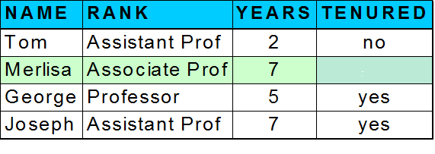
Estimation and Prediction
Classifier
Testing
Data
Unseen Data
(Jeff, Professor, 4)
Tenured?

Slide 31
Association Rule Mining
It is one of the most important and well researched techniques of data mining. It aims to extract interesting correlations, frequent patterns, association or casual structures among sets of items in the transaction databases or other data repositories.
Association analysis is defined as follows:
Let I={ I_{1,} I_{2,} I₃ ……I_{m} } be set of items.Let database D be multi-set of I. Each Tϵ D is called a transaction. Now an association rule is denoted by an expression A => B, where B=I_{K} (1 ≤ k ≤ m), A∩B=Φ.

Slide 32
An Example of Association rule mining
A Small Bank Example For Finding The Regular(Frequent) Customers And The Type Of Loans They Are Taking
The data samples are described by the attributes:gender,age,student.
The class label attribute ,type of loan has three distinct values(namely,{education,car,housing}).
Gender | Age | Student | Type of loan
male | 16-25 | yes | education
male | 30-40 | no | car
female | 16-25 | yes | education
male | 16-25 | no | car
female | 30-40 | no | housing
male | 16-25 | yes | education
male | 30-40 | no | housing

Slide 33
An Example of Association rule mining
Each tuple is taken as a transaction with the attribute value in that tuple as an item.
The attribute with the same value in multiple tuple represents the same item,but if the attribute is bearing different values in different tuples it used represent different items.So in this example also we are considering the
Gender=male------------------------I11
Gender=female----------------------I12
Age=16-25----------------------------I21
Age=30-40----------------------------I22
Student=yes--------------------------I31
Student=no---------------------------I32
Type of loan=education------------I41
Type of loan=car---------------------I42
Type of loan=housing---------------I43
Here we are considering support as 2% i.e each item should be present in atleast 2 transaction.If it is not present then it will be rejected from the frequent item set.Thus the number of times the above mentioned items present in all the above tuples are as follows

Slide 34
An Example of Association rule mining
ITEMSET ONE: I11=5,I12=2
I21=4,I22=3
I31=3,I32=4
I41=3,I42=2,I43=2
ITEMSET TWO: I11,I21=3 I21,I41=3
I11,I22=2 I21,I42=1
I11,I31=2 I21,I43=0
I11,I32=3 I22,I31=0
I11,I41=2 I22,I32=3
I11,I42=2 I22,I41=0
I11,I43=1 I22,I42=1
I12,I21=1 I22,I43=2
I12,I31=1 I31,I41=3
I12,I32=1 I31,I42=0
I12,I41=1 I31,I43=0
I12,I42=0 I32,I41=0
I12,I43=1 I32,I42=2
I12,I31=3 I32,I43=2
I21,I32=1
Now in the above item set one, as all the items are satisfying the support value ,thus no item is eliminated. Now similarly we have to find the item set two and find out whether they satisfy the support or not.
In the item set two the bold items in red are not satisfying the support value,thus they have to be eliminated.Now we have to find the three item set.

Slide 35
An Example of Association rule mining
ITEMSET THREE: I11,I21,I31=2
I11,I22,I32=2
I11,I21,I41=2
I21,I31,I41=1
I22,I32,I42=1
I22,I32,I43=2
I11,I31,I41=2
I11,I32,I42=2
ITEMSET FOUR:
I11,I21,I31,I41=2
I11,I22,I3,I43=1
I11,I22,I32,I42=1
In the item set three there are two items which are not satisfying the support. Thus they are eliminated from the list. Now the four item set is as follows
In the itemset four also the two items which are not satisfying support value are eliminated and as the further combinations are not possible. Thus the final frequent item is I11,I21,I31,I41.

Slide 36
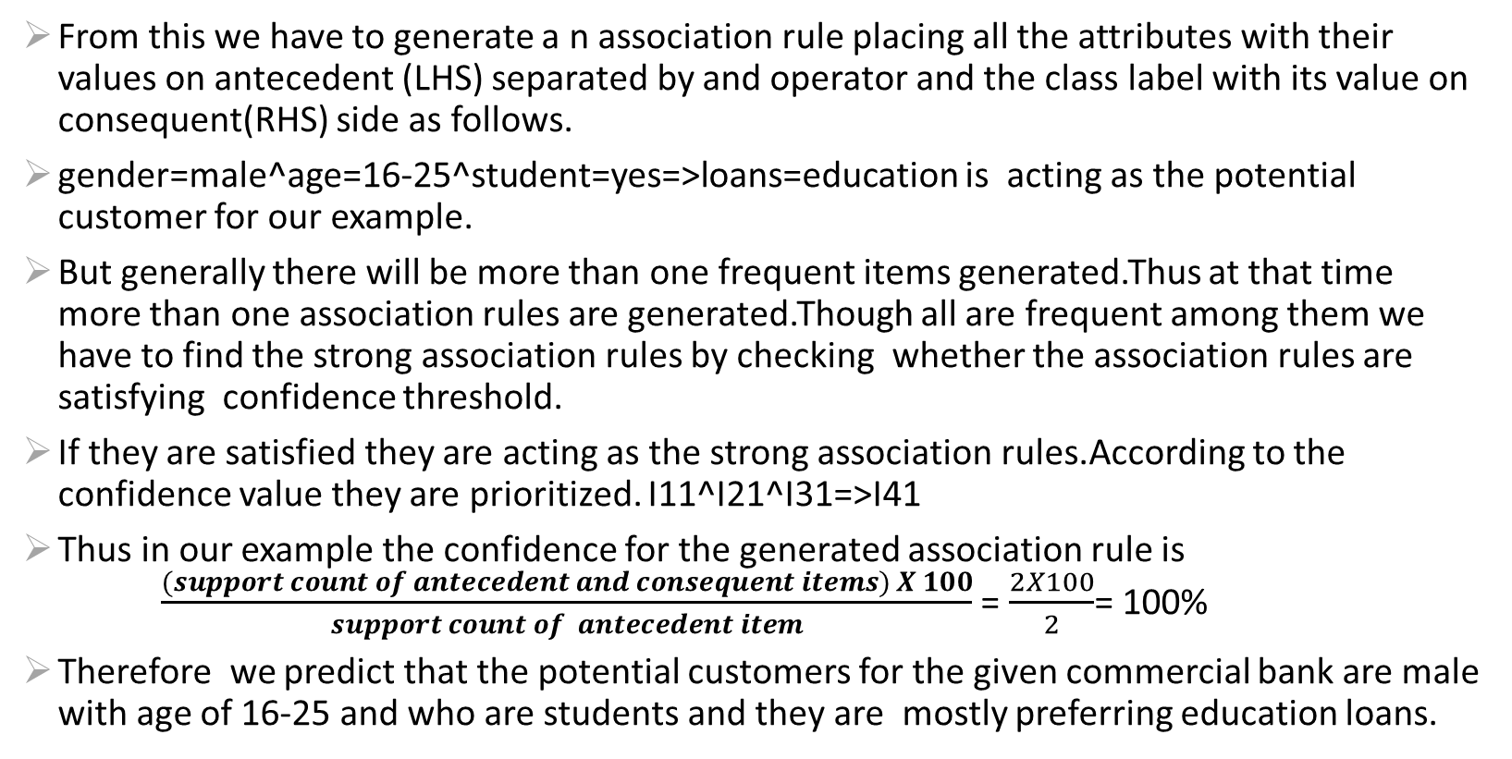
An Example of Association rule mining
From this we have to generate a n association rule placing all the attributes with their values on antecedent (LHS) separated by and operator and the class label with its value on consequent(RHS) side as follows.
gender=male^age=16-25^student=yes=>loans=education is acting as the potential customer for our example.
But generally there will be more than one frequent items generated.Thus at that time more than one association rules are generated.Though all are frequent among them we have to find the strong association rules by checking whether the association rules are satisfying confidence threshold.
If they are satisfied they are acting as the strong association rules.According to the confidence value they are prioritized. I11^I21^I31=>I41
Thus in our example the confidence for the generated association rule is $\frac{(support count of antecedent and consequent items) X 100}{support count of antecedent item}$ = $\frac{2X100}{2}$= 100%
Therefore we predict that the potential customers for the given commercial bank are male with age of 16-25 and who are students and they are mostly preferring education loans.

Slide 37
Mining Algorithms in Association
Apriori Algorithm(referred as Market Basket Analysis)
Apriori is designed to operate on databases containing transactions.
The purpose of the Apriori Algorithm is to find associations between different sets of data. Each set of data has a number of items and is called a transaction.
The output of Apriori is sets of rules that tell us how often items are contained in sets of data
RDB Miner Algorithm
Mines True Relational Databases represented using the relational data model as opposed to basked data format.
Performs inter-attribute frequent item-set mining.
FP Growth Algorithm
An efficient and scalable method to complete set of Frequent Patterns
It allows frequent Itemset discovery without candidate itemset generation.

Slide 38
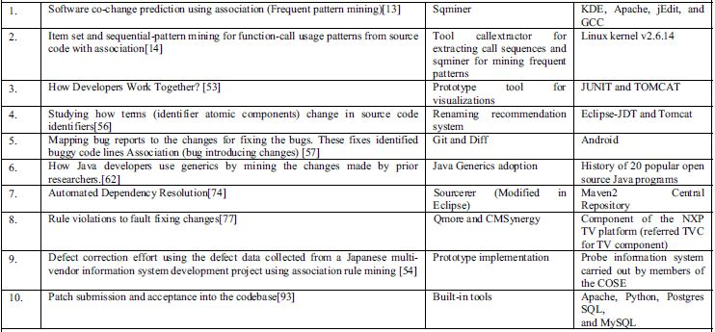
Tools in Association

Slide 39
Classification
Software organizations frequently use bug tracking software to manage defects and correlate them with fixes. Bugs are assigned a severity and assigned to someone within the organization.
But few have researched automatic classification of defects i.e they have studied methods for determining who should fix the bug.
Both these approaches use data mining and learning algorithms to determine which bugs are similar and how a specific bug should be classified
The intuition is that categories of warnings that were fixed in previous software changes are likely to be important for the next projects.
Knn Classification, Decision tree Algorithm, Naïve Bayes Classifier are examples for Classification algorithms

Slide 40
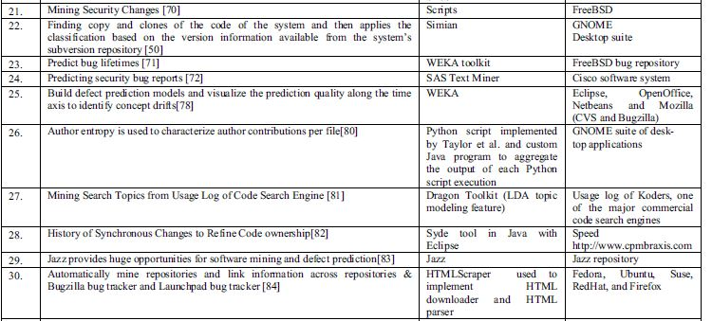
Classification Tools

Slide 41
Clustering
Clustering techniques to software engineering data relate to the discovery and localization of program failures.
The focus on comparing procedures for filtering and selecting data, each of which involves a choice of sampling strategy and a clustering metric.
Failure proximity metric which pairs failing execution traces and regards them as similar if they suggest roughly the same fault location.
These traces are created when a crash is detected and are sent back to developers of the software. Their approach improves on previous methods that group traces which exhibit similar behaviors, although the same fault may be triggered by different sets of conditions.
K Means Clustering, Em Algorithm are most frequently used algorithms for Clustering.

Slide 42
Text Mining
We may not have the required data in a very specific format(e.g., numerical data ,database entries etc.,) text mining seeks to discover high quality unknown information from textual data.
Widely used in Testing.
Common types of text mining algorithms include text clustering, classification, and matching.
Example text clustering applications include clustering bug reports to detect duplicate bug reports and thereby reduce inspection efforts, and assigning reports to specific developers to fix the bugs.
Example text classification applications include recommending assignment of a new bug report to a specific developer based on the past assignment of old bug reports
Example text matching applications include searching keywords in code comments, API documentation, or bug reports, and detecting duplicates of a given bug report among old reports.

Slide 43
Software Intelligence throughout Lifecycle of a Project
Current State
80% of the published papers focus on source code and bug-related repositories.
Reasons could be that the used bug repositories or source control repositories are commonly available, well structured, facilitating automated data analysis and processing.
documentation repositories (e.g., requirements) are rarely studied, likely due to their limited availability.
strong emphasis in assisting software engineering tasks in the coding phase of a project’s lifecycle, benefiting primarily developers.
Future Directions:
MSR work should look beyond the coding phase as this phase represents a small portion of the lifecycle of a project.
Managers, testers, deployers, and support teams are all stakeholders of a software system and they all need SI support from the software engineering community.

Slide 44
Software Intelligence using Non-Historical Repositories
Current State
MSR started with strong focus on Historical data(Source Code & Bug Repositories).
MSR is about mining any type of software engineering data (e.g., execution logs, code snippets scattered throughout the Internet, and API documents), even when these data are not stored in an explicit “repository”.
Future Directions
Storing all kind of data beyond traditional data
Developer interaction data with tools within IDEs, developer meeting notes (even voice recording and recognition with advances in natural/spoken language processing), recordings of support calls, and online posting about software products.
Large Volume and Privacy Concerns
Special attention in research required collecting the data.
MSR work should make proactive suggestions and influences on improving the repository or IDE design to ease the collection of data.

Slide 45
Software Intelligence use of Effective Mining Techniques
Current State
MSR work heavily exploited basic off-theshelf data mining (DM) algorithms(such as association rule mining and frequent itemset mining) or tools (such as Weka).
Commonly compromised their mining requirements to overfit what these basic off-the-shelf algorithms or tools could provide.
Future Directions
Follow a problem-driven methodology in advancing the field:
Empirically investigate problems in the software engineering domain
identify mining requirements for addressing those problems,
adopt or adapt advanced mining algorithms from the DM community, or develop new mining algorithms for satisfying the mining requirements.
SI and DM fields should work together.

Slide 46
Software Intelligence Adoption in Practice
Current State
Some of the companies integrate ideas and innovations in their products based on mining software data.(Eg. Coverty and Pattern Insight)
The barrier and cost for experimentation with SI innovations are considerably low compared to other software engineering innovations and techniques. if your company has a repository, you can mine it with minimal effort.
Future Directions
To enable the widespread adoption of SI, we must first consider the level at which SI support is being provided
The lower and more focused the challenges or questions that an SI technique provides, the more likely it will be adopted.
Make sure that SI techniques are intuitive and SI results are easy to explain & describe

Slide 47
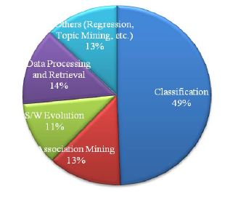
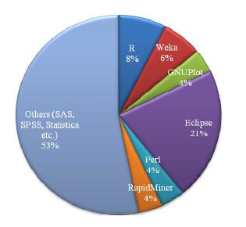
Survey in Mining Software Data
Mining tasks in MSR
Mining tools in MSR

Slide 48
Don’t Program on Friday’s
Don’t Program on Friday’s
Percentage of Bug –introducing changes for Eclipse.

Slide 49
References
[1] K.K. Chaturvedi, V.B. Singh and Prashast Singh, “Tools in Mining Software Repositories”, 2013 13th International Conference on Computational Science and Its Applications.
[2] Marco D’Ambros and Romain Robbes, “Effective Mining of Software Repositories”, 2011 27th IEEE International Conference on Software Maintenance (ICSM).
[3] S. Alam, “Association Rule Mining for Re-planning Decisions of Software Product Releases”, IDoESE, 2013
[4] Ahmed E. Hassan and Tao Xie, “Software Intelligence: The Future of Mining Software Engineering Data”2010
[5] Wahidah Husain, Pey Ven Low, Lee Koon Ng, Zhen Li Ong, “Application of Data Mining Techniques for Improving Software Engineering”, ICIT 2011 The 5th International Conference on Information Technology
[6] Quinn Taylor and Christophe Giraud-Carrier, “Applications of data mining in software engineering”, Int. J. Data Analysis Techniques and Strategies, Vol. 2, No. 3, 2010
[7] Ms Anupama Das, Ms.Kaberi Das, Prof (Dr) B.Puthal, “Improving Software Development Process through Data Mining Techniques Embedding Alitheia Core Tool”, Anupama Das et al, / (IJCSIT)
International Journal of Computer Science and Information Technologies, Vol. 2 (2) , 2011, 629-632

Slide 50


