Slide 1
PAPER REVIEW
FrugalGPT
How to Use Large Language Models While Reducing Cost
and Improving Performance
Lingjiao Chen · Matei Zaharia · James Zou — Stanford University
arXiv:2305.05176v1 [cs.LG] · 9 May 2023

Slide 2
1. MOTIVATION
Cost model of an LLM API query
Each API's cost decomposes into three additive, linear components:
cᵢ(p) = c̃ᵢ,₂ ‖fᵢ(p)‖ + c̃ᵢ,₁ ‖p‖ + c̃ᵢ,₀
output-length term · prompt-length term · fixed per-request fee (c̃ᵢ,ⱼ are constants)
2. FORMALIZATION
problem statement
maximize E(q,a) ∈ Q×A [r(a, â(s,q))] s.t. E(q,a) ∈ Q×A [c(s,q)] ≤ b
Learn a query-answering strategy s (prompts + LLM selection + aggregation) that maximizes expected reward subject to an average per-query cost budget b.
a: ground-truth answer â(s,q): answer under strategy s c(s,q): cost under s r(·,·): reward (answer quality) b: budget
Query-answering task.
Search space for s is combinatorial:
prompt choice / length per query (Strategy 1)
which LLM API(s) to invoke, in what order (Strategy 2 & 3)
2

Slide 3
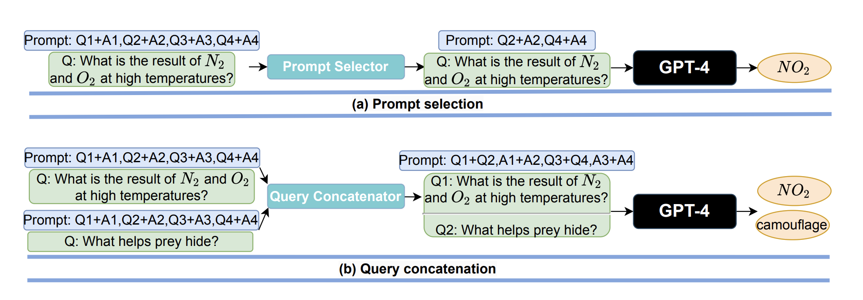
3. DESIGN SPACE
Three cost-reduction strategies
Prompt Adaptation
Prompt selection
Query concatenation
Retain a subset of in-context examples instead of all k. Reduces ‖p‖ linearly;
choose subset per-query without hurting task accuracy.
Batch m queries into one prompt so the shared context is processed once instead of m times – reduces fixed prompt cost across the batch.
{Q1A1,Q2A2,Q3A3,Q4A4} → {Q2A2,Q4A4}
cost(q1)+cost(q2) → cost({q1,q2}) < 2·cost(q1)
4

Slide 4
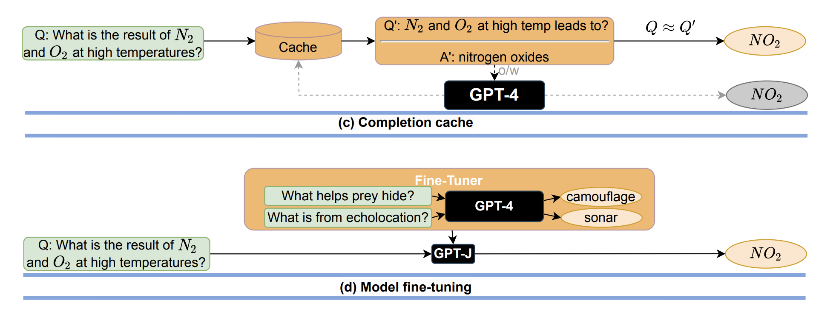
LLM Approximation
Completion cache
Model fine-tuning (distillation)
Store (q,a) pairs. On a new query q', look up a similar cached q (Q ≈ Q'); return cached a if found, else call fᵢ and cache the result.
(1) sample queries, get labels from expensive fᵢ (2) fine-tune small affordable f̂ on (q, fᵢ(q)) pairs; (3) serve f̂ at inference.
Removes long in-context prompt entirely → lower cost AND lower latency (time delay).
5

Slide 5
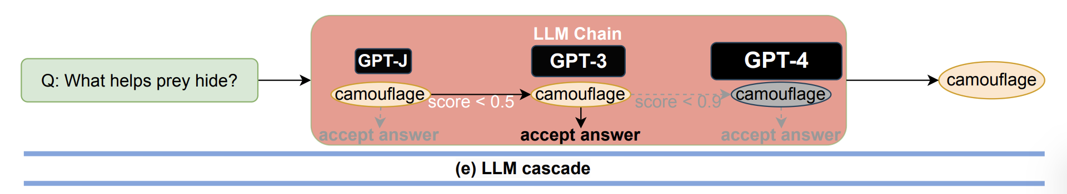
LLM Cascade
Two learned components:
Generation scoring function
LLM router
g(.,.): Q × A → [0, 1]
L ∈ [K]ᵐ , τ ∈ [0,1]ᵐ
Predicts reliability of answer a for query q. Trained as a regression model on labeled (q, a, correctness) triples.
Selects an ordered list L of m APIs to try, and an acceptance threshold vector τ - one per position in the cascade.
Inference procedure - given a new query q:
for i = 1 to m:
a_i = f_{L_i}(q) # call the i-th API in the list
if g(q, a_i) ≥ τ_i: # scoring function accepts
return a_i # stop early - cheap models resolved it
return a_m # fall through to the last (priciest) API
z = argmin_i { g(q, f_{Lᵢ}(q)) ≥ τᵢ } - the stopping index; only APIs L₁…L_z are ever queried for q.
3

Slide 6
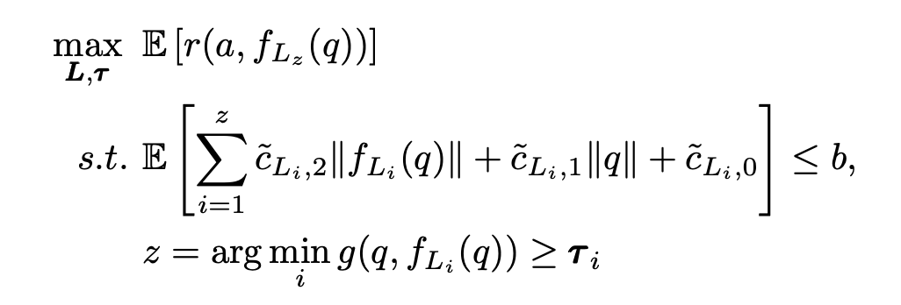
The cascade optimization problem
This is a mixed - integer optimization and thus computationally expensive to solve.
Practical optimizer - two approximations make this tractable:
① Search-space pruning
② Objective interpolation
Discard candidate lists L whose member APIs show small pairwise answer disagreement - they're redundant, unlikely to help the cascade, so pruning shrinks the combinatorial search over [K]ᵐ.
Approximate E[r(·)] by evaluating it on a handful of sampled (L, τ) configurations and interpolating between them, instead of exhaustively evaluating every configuration on the full training set.
7

Slide 7
4. EXPERIMENTS
Experimental setup
12 LLM APIs · 3 datasets · cascade length m = 3, trained/tested with a train-test split per dataset.
Datasets
Providers covered
Dataset | Domain | Size | # ex in prompt
HEADLINES | Finance (gold-price trend) | 10,000 | 8
OVERRULING | Law (case overruling) | 2,400 | 5
COQA | Reading comprehension | 7,982 | 2
OpenAI — GPT-Curie, ChatGPT, GPT-3, GPT-4
AI21 — J1-Large, J1-Grande, J1-Jumbo
Cohere — Xlarge
ForeFrontAI — QA
Textsynth — GPT-J, FAIRSEQ, GPT-Neox
Metrics & method
Task accuracy r(a, â) as the reward signal
Average query cost c(s,q) in USD, as measured by Table 1's pricing
Scoring function g(q,a): DistilBERT (smaller/cheaper than every LLM under test) fine-tuned for regression
Cascade of length m = 3 learned per dataset via the pruned + interpolated optimizer
8

Slide 8
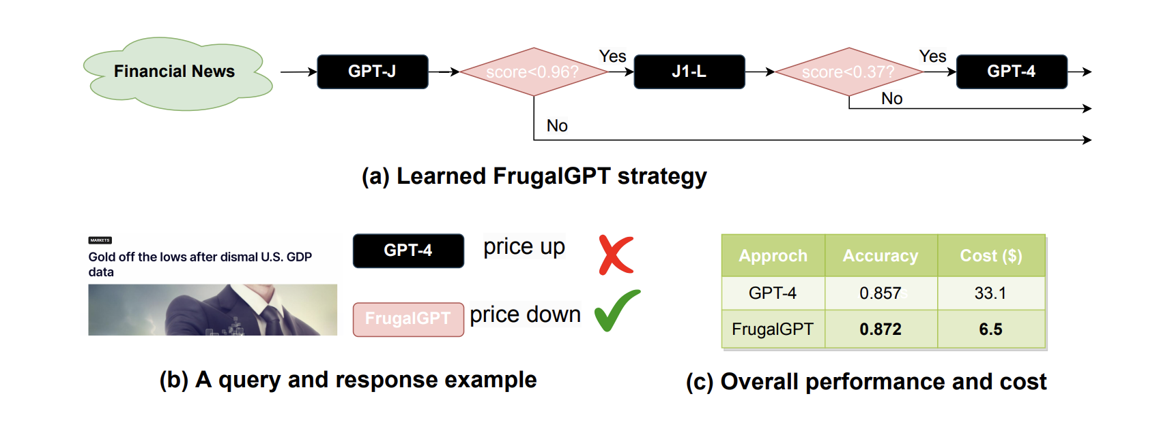
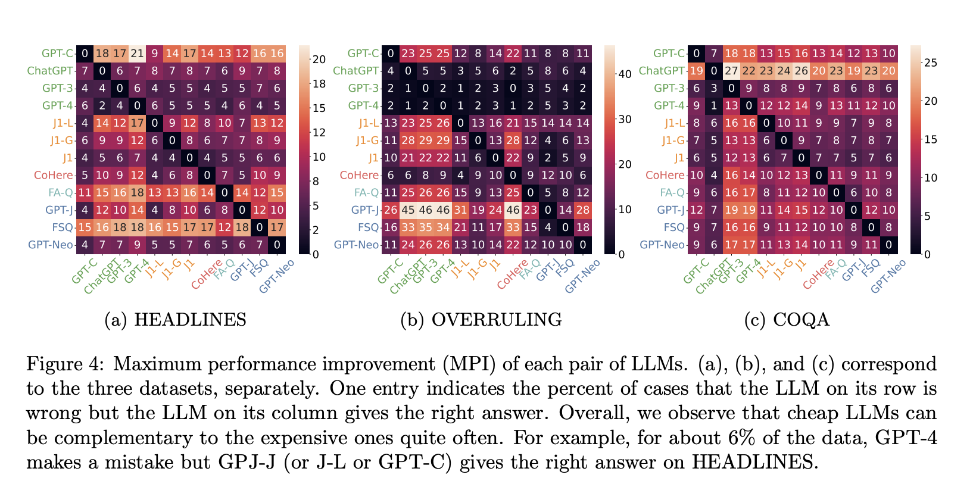
FrugalGPT reduces the cost by 80%, while improves the accuracy by 1.5% compared to GPT-4.
9

Slide 9
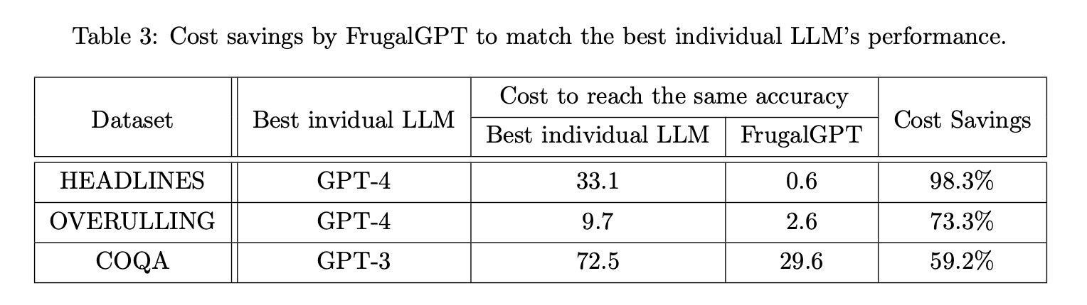
When incurring the same cost, FrugalGPT can improves the accuracy by up to 5%.
11

Slide 11
6. CONTEXT
Same abstraction, in production LLM routers
The (Q,{fᵢ},cᵢ,g,router) abstraction from FrugalGPT maps directly onto today's model-routing/gateway APIs:
OpenRouter
Vercel AI Gateway
Not Diamond
Single endpoint over {fᵢ}; picks a cost-effective model per request; automatic fallback on failure.
One key, provider-agnostic routing; automatic retry to a different provider; per-request spend tracked, no token markup.
Pre-trained or custom-trained router sends each query to the model expected to perform best; ships prompt optimization too.
≈ the marketplace {fᵢ} + a lightweight, unlearned router
≈ router with reliability guarantees + cost accounting for c(s,q)
≈ closest analogue of g(q,a) + learned router, trained per-customer
13

