Slide 1
Learning to Route Queries
Across Five LLMs
An online RL orchestrator vs. the HybridLLM approach: a total-cost comparison
56.9T
vs 88.5T

Slide 2
The problem: not every query needs the biggest model
Five models, cheapest to costliest. Cost is measured by parameter count, normalised so Llama-2-7b = 1.0.
7B
3B
cost 1.000
780M
cost 0.429
250M
cost 0.111
80M
cost 0.036
cost 0.011
flan-t5-small
flan-t5-base
flan-t5-large
flan-t5-xl
llama-2-7b-chat
Goal: send each query to the cheapest model that still satisfies the user.
2

Slide 3
The RL orchestrator learns on every query
1
2
3
4
5
State
Action
Delegate
Reward
Update
Query encoded by DeBERTa-v3-small
ε-greedy pick of 1 of 5 models (ε 0.30 → 0.05)
Only the chosen model generates an answer
+1 / −1 satisfaction − λ·cost (λ = 0.5)
MSE on the chosen model’s predicted value
Repeat for all 15,000 queries: no train/test split, no frozen policy. The system is always deciding and learning.
Satisfaction here is a proxy: BARTScore ≥ τ (−4.55) → +1. In deployment this is a real thumbs up/down; nothing else changes.
τ is the median BARTScore of flan-t5-base on 40 queries.
3

Slide 4
Same 15,000 queries, two very different pipelines
HybridLLM
RL orchestrator
10k train queries: every one is sent to both the small and large model to build labels
Router trained once, then frozen
5k test queries routed with the frozen router
Evaluated on three pairs: small, medium and large capability gap (all with Llama-2-7b as the large model)
All 15k queries are both training and serving
Only the chosen model is ever called
Policy updates after every query
5 models, one orchestrator
4

Slide 5
RL costs 1.6–2.2× less than HybridLLM
56.9T
RL total cost, 15k queries
HybridLLM total (mid):
125T / 97.3T / 88.5T
Even best-case large-gap (71.2T) is 1.25× RL.
5
Notes:
Hybrid totals = label-building (exact: 10k x (S+L params)) + 5k test queries at midpoint routing assumption. RL = sum of params of the model actually called, over 15k queries. Ratios use midpoint: 2.20x, 1.71x, 1.56x.

Slide 6
Why: label-building dominates HybridLLM’s bill
≈80%
1 call
3.8B
of HybridLLM’s cost is label-building: both models run on every train query
per query for RL: the orchestrator never asks the models it did not pick
average params per RL query, vs 5.9B (large-gap) to 8.3B (small-gap) for HybridLLM
The gap comes from the training design, not from RL being cheaper at serving time.
6

Slide 7
What the orchestrator learned to delegate
Mean reward: +0.385 whole run, +0.454 in the last 20%.
Mean satisfaction (proxy): 83%.
Llama still takes about half the traffic, and its share grows as ε shrinks. The reward weights quality more than cost at λ = 0.5.
7

Slide 8
Caveats and next steps
Next
Cost-only comparison: HybridLLM’s answer quality at its operating point was not measured, so the two are not quality-matched.
HybridLLM costs are analytical (best/mid/worst), not from a run.
Router and BARTScore compute are excluded on both sides.
Satisfaction is a BARTScore proxy; τ comes from 40 calibration queries.
Sweep λ to trace the cost–quality frontier.
Score the HybridLLM router’s test outputs with the same proxy.
Add an always-Llama baseline (105T) and a random-router baseline.
Replace the proxy with real user feedback.
8

Slide 9
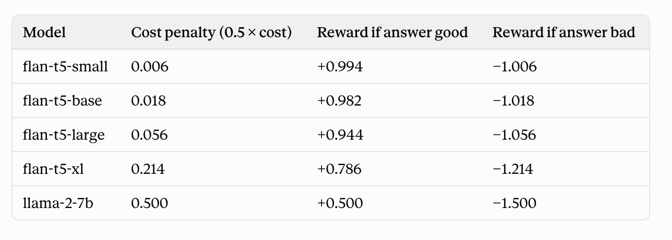
expected reward = P × (good reward) + (1−P) × (bad reward) ≈ (2P − 1) − 0.5 × cost
Where, p is the probability with which the corresponding model is good.

