Slide 1
Learning to Route Queries
Across Five LLMs
An online RL orchestrator vs. the HybridLLM approach: a total-cost comparison
56.9T
vs 88.5T
Bhavana | IIT Gandhinagar

Slide 2
The problem: not every query needs the biggest model
Five models, cheapest to costliest. Cost is measured by parameter count, normalised so Llama-2-7b = 1.0.
7B
3B
cost 1.000
780M
cost 0.429
250M
cost 0.111
80M
cost 0.036
cost 0.011
flan-t5-small
flan-t5-base
flan-t5-large
flan-t5-xl
llama-2-7b-chat
Goal: send each query to the cheapest model that still satisfies the user.
2

Slide 3
The RL orchestrator learns on every query
1
2
3
4
5
State
Action
Delegate
Reward
Update
Query encoded by DeBERTa-v3-small
ε-greedy pick of 1 of 5 models (ε 0.30 → 0.05)
Only the chosen model generates an answer
+1 / −1 satisfaction − λ·cost (λ = 0.5)
MSE on the chosen model’s predicted value
Repeat for all 15,000 queries: no train/test split, no frozen policy. The system is always deciding and learning.
Satisfaction here is a proxy: BARTScore ≥ τ (−4.55) → +1. In deployment this is a real thumbs up/down; nothing else changes.
3

Slide 4
Same 15,000 queries, two very different pipelines
HybridLLM (paper-faithful)
RL orchestrator
10k train queries: every one is sent to both the small and large model to build labels
Router trained once, then frozen
5k test queries routed with the frozen router
Evaluated on three pairs: small, medium and large capability gap (all with Llama-2-7b as the large model)
All 15k queries are both training and serving
Only the chosen model is ever called
Policy updates after every query
5 models, one orchestrator
4

Slide 5
RL costs 1.6–2.2× less than HybridLLM
56.9T
RL total cost, 15k queries
HybridLLM total (mid):
125T / 97.3T / 88.5T
Even best-case large-gap (71.2T) is 1.25× RL.
5
Notes:
Hybrid totals = label-building (exact: 10k x (S+L params)) + 5k test queries at midpoint routing assumption. RL = sum of params of the model actually called, over 15k queries. Ratios use midpoint: 2.20x, 1.71x, 1.56x.

Slide 6
Why: label-building dominates HybridLLM’s bill
≈80%
1 call
3.8B
of HybridLLM’s cost is label-building: both models run on every train query
per query for RL: the orchestrator never asks the models it did not pick
average params per RL query, vs 5.9B (large-gap) to 8.3B (small-gap) for HybridLLM
The gap comes from the training design, not from RL being cheaper at serving time.
6

Slide 7
What the orchestrator learned to delegate
Mean reward: +0.385 whole run, +0.454 in the last 20%.
Mean satisfaction: +0.656 on the ±1 scale, i.e. about 83% of answers pass τ (proxy).
Llama still takes about half the traffic, and its share grows as ε shrinks. The reward weights quality more than cost at λ = 0.5.
7

Slide 8
Quality of the five models (1,500 held-out queries)
Model | Cost | BARTScore | Pass @ τ | ROUGE-L | Avg words
flan-t5-small | 0.011 | −4.720 | 53.1% | 0.085 | 7.9
flan-t5-base | 0.036 | −4.750 | 50.1% | 0.086 | 8.1
flan-t5-large | 0.111 | −4.727 | 50.0% | 0.086 | 7.2
flan-t5-xl | 0.429 | −4.344 | 57.8% | 0.098 | 8.6
llama-2-7b-chat | 1.000 | −3.424 | 90.9% | 0.223 | 40.5
Only Llama is clearly ahead: it passes τ on 91% of queries against 50–58% for every flan-t5 model. Its answers are about 5× longer (40 vs 8 words) and match the references far better (ROUGE-L 0.22 vs 0.09–0.10). The four flan-t5 models are hard to tell apart on this metric.
8

Slide 9
At equal serving cost, RL matches HybridLLM
Method | Cost | BARTScore | Pass @ τ | ROUGE-L | Utility
Always Llama | 1.000 | −3.424 | 90.9% | 0.223 | +0.319
RL (trained) | 0.674 | −3.329 | 88.8% | 0.202 | +0.439
HybridLLM large gap (r_det) | 0.678 | −3.381 | 88.3% | 0.201 | +0.427
HybridLLM large gap (r_trans) | 0.678 | −3.352 | 89.3% | 0.201 | +0.447
HybridLLM medium gap (r_det) | 0.666 | −3.250 | 90.1% | 0.201 | +0.469
HybridLLM medium gap (r_trans) | 0.666 | −3.317 | 88.2% | 0.201 | +0.431
HybridLLM small gap (r_det) | 0.672 | −3.344 | 84.9% | 0.181 | +0.363
HybridLLM small gap (r_trans) | 0.672 | −3.331 | 85.1% | 0.184 | +0.366
HybridLLM is read at the threshold whose cost is closest to RL’s. In 5 of 6 comparisons the BARTScore difference is not significant (95% bootstrap CI); medium-gap r_det is better by 0.08. The small-gap pair is weaker because 57% of its traffic goes to flan-t5-xl.
9

Slide 10
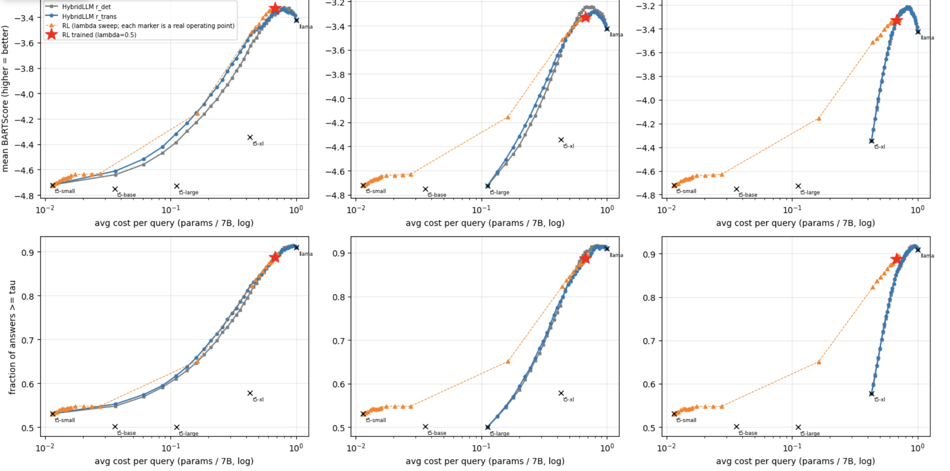
Cost–quality curves overlap near the top
large gap: t5-small + Llama
medium gap: t5-large + Llama
small gap: t5-xl + Llama
Top row: mean BARTScore. Bottom row: pass rate. X axis: cost per query (log).
Red star = trained RL policy. Orange markers = RL at other λ (each marker is a real operating point).
Near RL’s cost the curves coincide. RL can also go below the small-gap pair’s floor (cost 0.43).
10

Slide 11
Same quality, 1.7–2.2× less total compute
Pair | HybridLLM label-building | HybridLLM serving (5k) | HybridLLM total | RL total (15k) | HybridLLM / RL
Large gap | 70.8T | 23.7T | 94.5T | 56.9T | 1.66×
Medium gap | 77.8T | 23.3T | 101.1T | 56.9T | 1.78×
Small gap | 100.0T | 23.5T | 123.5T | 56.9T | 2.17×
Units: trillions of parameter-calls. Label-building is exact (10k queries × both models). Serving assumes HybridLLM answers 5k test queries at the cost measured above (≈0.67 of Llama). RL’s total covers all 15k queries, learning included.
The gap comes from label-building (≈75–80% of HybridLLM’s total), not from cheaper serving.
11

Slide 12
Both routers over-use Llama
Router (% of queries) | t5-small | t5-base | t5-large | t5-xl | Llama
RL (trained) | 5.9 | 1.5 | 28.6 | 0.0 | 64.1
HybridLLM large gap | 32.5 | 0.0 | 0.0 | 0.0 | 67.5
HybridLLM medium gap | 0.0 | 0.0 | 37.5 | 0.0 | 62.5
HybridLLM small gap | 0.0 | 0.0 | 0.0 | 57.5 | 42.5
Oracle (cheapest model that passes τ) | 53.2 | 10.9 | 5.2 | 5.2 | 25.5
An oracle could answer over half of the queries with flan-t5-small and still pass τ, and needs Llama for only a quarter. Both routers see only the query text, which limits how well they can tell easy queries from hard ones. RL never uses flan-t5-xl: it learned xl is not worth its cost.
12

Slide 13
Caveats and next steps
Read these before presenting
Next
Quality is measured with BARTScore, which is also the training signal. ROUGE-L agrees (0.20 for RL and the large/medium pairs, 0.18 for small gap).
Only the BARTScore differences have confidence intervals; pass-rate and utility gaps in the table do not.
One eval set (1,500 queries) and one trained router per pair and label.
Costs count generation parameters only; router and BARTScore compute are excluded on both sides.
Repeat on a simple exact-match dataset, where quality needs no BARTScore.
Add confidence intervals to pass-rate and utility; repeat with several seeds.
Try a richer routing signal to close the gap to the oracle.
Replace the BARTScore proxy with real user feedback.
13

