Slide 1
RL Orchestrator vs the
FrugalGPT LLM Cascade
Cost and accuracy on MMLU, with HybridLLM for reference

Slide 2
The comparison paper: FrugalGPT (LLM cascade)
Chen, Zaharia, Zou (Stanford). arXiv 2305.05176; TMLR per the authors’ repository.
Stage 1
Stage 2
Stage 3
Cheapest model answers
Scorer g(q, a) → [0,1]
score ≥ τ1 → return
Next model answers
Scorer g(q, a)
score ≥ τ2 → return
Final model answers
no scorer needed
always returned
if rejected →
if rejected →
Scoring function: a DistilBERT regression per LLM, trained to predict whether that LLM’s answer is correct.
Model list and thresholds are chosen to maximise accuracy under an average-cost budget (cascade length 3).
Unlike RL and HybridLLM, it may call several models per query, and its cost includes the rejected attempts.
2

Slide 3
Setup: same models, same questions, same cost scale
Shared with the RL study
Cascade learning data
Five models: flan-t5 small/base/large/xl and Llama-2-7b-chat. Cost = parameters / 7B. MMLU zero-shot; 1,531 held-out questions never used for training or tuning.
First 9,500 pool questions: 6,500 train the scoring functions, 3,000 tune lists and thresholds. All 5 models answer every one.
Two scoring functions
Search
A: DistilBERT on question + answer, as in the paper. B: logistic regression on the model’s own confidence (our extension, not in the paper).
All ordered lists of up to 3 models × threshold grid: 38,005 candidate cascades, best one kept per cost budget.
3

Slide 4
Can a score tell right answers from wrong ones?
Model | Accuracy | AUROC: model’s own confidence | AUROC: scorer A (text) | AUROC: scorer B (confidence)
flan-t5-small | 29.3% | 0.542 | 0.563 | 0.542
flan-t5-base | 33.4% | 0.588 | 0.549 | 0.578
flan-t5-large | 42.0% | 0.666 | 0.617 | 0.649
flan-t5-xl | 49.8% | 0.726 | 0.650 | 0.724
llama-2-7b-chat | 45.6% | 0.718 | 0.684 | 0.720
AUROC 0.5 means no information, 1.0 means perfect. Every signal is weak: 0.54–0.73 on held-out questions. Only flan-t5-xl and Llama give a usable signal, and the text scorer is no better than the model’s own confidence. A cascade can only be as good as this signal.
4

Slide 5
RL beats the cascade at λ = 0.25, but not at low λ
RL policy (λ) | RL cost | RL acc | Cascade A (paper) | RL − A (95% CI) | Cascade B (+confidence) | RL − B (95% CI)
0.05 | 0.301 | 42.8% | 44.4% | −1.5 pt [−3.4, +0.3] | 45.3% | −2.4 pt [−4.4, −0.3]
0.1 | 0.685 | 45.6% | 49.5% | −3.9 pt [−6.5, −1.2] | 49.8% | −4.2 pt [−6.7, −1.8]
0.25 (adopted) | 0.238 | 47.5% | 43.4% | +4.0 pt [+1.6, +6.5] | 44.4% | +3.1 pt [+0.6, +5.5]
0.5 | 0.112 | 42.1% | 42.0% | +0.1 pt [0.0, +0.3] | 42.0% | +0.1 pt [0.0, +0.3]
1.0 | 0.071 | 38.5% | 34.3% | +4.2 pt [+1.4, +6.9] | 36.4% | +2.1 pt [−0.6, +4.8]
2.0 | 0.036 | 33.4% | 32.0% | +1.4 pt [−0.3, +3.1] | 33.4% | +0.0 pt [0.0, 0.0]
Each cascade is the operating point nearest in cost to that RL policy (within 0.02, except λ = 0.1 vs B: 0.08). Of 12 comparisons, RL is significantly ahead in 3, the cascade in 3 (λ = 0.05 vs B; λ = 0.1 vs A and B), and 6 are ties. At λ = 0.1 RL sends 62% of queries to Llama-2 even though flan-t5-xl is cheaper and more accurate, so low-λ training looks unstable (one run per λ; seed noise not tested). At λ = 0.5 and 2 both methods use one model, so those rows say little.
Example learned cascade at cost 0.24 (A): flan-t5-large (accept if score ≥ 0.24) → flan-t5-base (≥ 0.41) → flan-t5-xl.
5

Slide 6
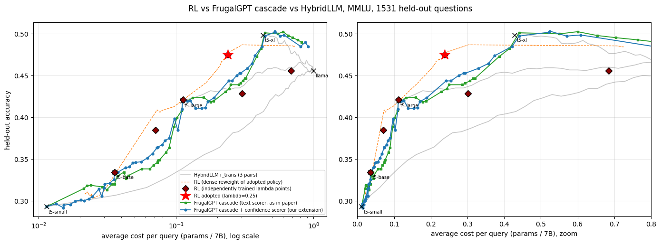
Cost–accuracy curves
Both cascades sit at or above the HybridLLM curves for costs of 0.1–0.4 and reach about 50% near cost 0.45–0.6, level with flan-t5-xl alone. RL’s adopted policy (red star) is above both cascades at cost 0.24. But the two new independently trained points (λ = 0.05 at cost 0.30, λ = 0.1 at 0.69) fall below the cascades and far below RL’s dashed reweighted curve, so that curve is not an achievable RL frontier above cost 0.25.
6

Slide 7
The cascade did not beat the best single model
Approach | Avg cost | Accuracy
Best single model (flan-t5-xl) | 0.429 | 49.8%
Always Llama-2-7b-chat | 1.000 | 45.6%
RL, adopted policy (λ = 0.25) | 0.238 | 47.5%
FrugalGPT cascade A, largest budget (picked on tuning split) | 0.815 | 49.0%
FrugalGPT cascade B, largest budget (picked on tuning split) | 0.911 | 48.5%
HybridLLM small gap, best threshold (picked on held-out) | 0.457 | 50.2%
Oracle: cheapest correct model (questions no model solves go to Llama) | 0.334 | 80.9%
The paper reports cascades that beat the best single LLM. Here they only match it. The oracle shows the models are strongly complementary (80.9% reachable), but the scores are too weak to find which question suits which model, so the cascade cannot exploit that. HybridLLM’s 50.2% is the best threshold on the held-out set, so it is optimistic.
7

Slide 8
The cascade is the most expensive to build
System | Serve cost / query | Training or label-building | Serving 1,531 questions | Total
RL (learns online over the pool) | – | 35.4T | 2.55T | 38.0T
HybridLLM, large gap | 0.234 | 67.3T | 2.51T | 69.8T
HybridLLM, medium gap | 0.245 | 73.9T | 2.62T | 76.5T
HybridLLM, small gap | 0.429 | 95.0T | 4.59T | 99.6T
FrugalGPT cascade A | 0.244 | 105.5T | 2.61T | 108.2T
FrugalGPT cascade B | 0.242 | 105.5T | 2.59T | 108.1T
Trillions of parameter-calls. The cascade needs every model’s answer on every training question (9,500 × 11.1B = 105.5T) to learn its scorers and thresholds, about 2.8× RL’s total. Serving costs at the matched point are similar, except HybridLLM small gap, which cannot go below cost 0.43. RL’s total counts only the adopted λ = 0.25 policy; the five other policies trained to choose λ are not included.
8

Slide 9
Takeaways and caveats
What the results show
Caveats
At matched cost, RL beats the cascade at λ = 0.25 (+3 to +4 pt) but not at low λ: the cascade is ahead at λ = 0.05 and 0.1.
RL’s adopted policy needs about 2.8× less total compute than the cascade and 1.8–2.6× less than HybridLLM (before counting the λ grid).
Likely reason for RL’s win at λ = 0.25 (not tested): RL reads the question before running anything, while the cascade must judge answers from weak confidence signals.
RL’s λ = 0.25 was picked by held-out utility, so its headline point is slightly optimistic.
RL streamed all 14,042 pool questions; the cascade and HybridLLM used 9,500.
One seed per λ, one dataset, zero-shot MMLU where small models are near chance. Low-λ RL policies (0.05, 0.1) trained unstably.
Scorer and router compute are excluded; DistilBERT would add about 0.009 per scored answer to cascade A.
RL total compute covers one policy; choosing λ meant training six.
9

