Slide 1
RL Orchestrator vs HybridLLM
Quality comparison on MMLU (accuracy-based, no judge model)
At about 0.24 of Llama-2's cost, RL reaches 47.5% accuracy, ahead of HybridLLM on two of three pairs; on the third, HybridLLM needs 80% more compute to edge it.

Slide 2
Setup
Same five models and cost scale as the MixInstruct study; every question scored once
Data & scoring
RL orchestrator
HybridLLM
MMLU, zero-shot, 4 options
Pool: 14,042 test questions
Held-out: 1,531 validation questions
One forward pass per model; correctness table cached once
Online over the pool; reward = +1/-1 correctness minus lambda x cost
DeBERTa-v3-small encoder, 5-way value head
Retrained at lambda = 0.25, 0.5, 1, 2
Best picked by utility at fixed lambda_eval = 0.5
3 pairs: small / large / xl + Llama-2-7b-chat
Router: DeBERTa-v3-small, 9,500 labelled questions
Labels r_det and r_trans from the same table
Threshold sweep on held-out set

Slide 3
Bigger is not better here
Held-out accuracy of each model alone (cost = params / 7B)
49.8%
flan-t5-xl beats Llama-2-7b-chat (45.6%) at 43% of its cost.
HybridLLM assumes the larger model is better. That fails for the small_gap pair, so a router has little reason to ever pick Llama.

Slide 4
RL: lambda = 0.25 gives the best trade-off
Four independently trained policies, judged on held-out utility at fixed lambda_eval = 0.5
lambda trained | avg cost | accuracy | utility | share to Llama
0.25 | 0.238 | 47.5% | -0.169 | 0%
0.50 | 0.112 | 42.1% | -0.214 | 0%
1.00 | 0.071 | 38.5% | -0.266 | 0%
2.00 | 0.036 | 33.4% | -0.349 | 0%
The chosen policy sends 787 held-out questions to flan-t5-xl and 744 to flan-t5-base, and none to Llama. It also beats every single-model baseline on utility (best baseline: -0.216).

Slide 5
Matched-cost result: RL leads on two of three pairs
RL at cost 0.238 and 47.5% accuracy vs HybridLLM at the nearest operating point; paired bootstrap 95% CI
pair | label | Hybrid cost | Hybrid acc | RL - Hybrid | 95% CI | verdict
large_gap | r_det | 0.234 | 35.2% | +12.3 pt | [+9.3, +15.5] | RL better
large_gap | r_trans | 0.234 | 37.5% | +10.1 pt | [+7.1, +13.1] | RL better
medium_gap | r_det | 0.245 | 43.6% | +3.8 pt | [+0.9, +6.6] | RL better
medium_gap | r_trans | 0.245 | 43.3% | +4.2 pt | [+1.5, +6.9] | RL better
small_gap | r_det | 0.429 | 49.8% | -2.4 pt | [-4.2, -0.5] | Hybrid better*
small_gap | r_trans | 0.429 | 49.8% | -2.4 pt | [-4.2, -0.5] | Hybrid better*
*small_gap's router predicts flan-t5-xl for almost every question, so it only reaches cost 0.429 or 1.0. That row compares HybridLLM at about 80% more compute than RL, not a same-cost test.

Slide 6
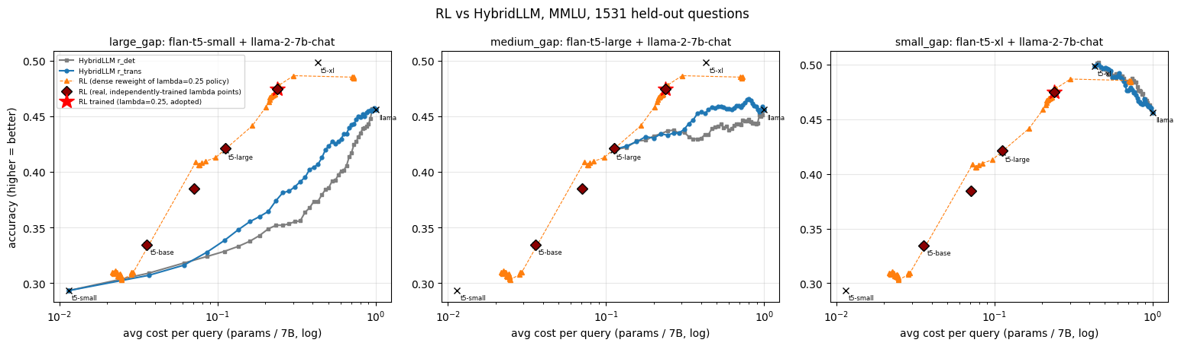
Cost-accuracy curves
RL (orange) sits above both HybridLLM label types for the large and medium gaps
Red star: adopted RL policy. Dark red diamonds: independently trained lambda points. Crosses: each model used alone.

Slide 7
Takeaways and caveats
What the results show
Caveats to state upfront
RL gets 47.5% at cost 0.238, with 12 pt and 4 pt gains over HybridLLM on large and medium gaps.
It learned to avoid Llama entirely, because flan-t5-xl is both better and cheaper on MMLU.
Oracle routing reaches 80.9% at cost 0.18, so routing headroom is large.
small_gap verdict is not a matched-cost comparison.
Best lambda is the smallest in the grid, so lower values were not tested.
Lambda was chosen on the same held-out set used for reporting, which slightly favours RL.
Single seed, zero-shot prompts; RL saw 14k streamed queries vs 9.5k labels for the routers.

