Slide 1




MACHINE LEARNING BASED DIABETES PREDICTION SYSTEM
KONGU ENGINEERING COLLEGE PERUNDURAI ERODE-638060
MACHINE LEARNING BASED DIABETES
PREDICTION SYSTEM
PRESENTED BY GUIDED BY
DATE:
Second Review
1
DEPARTMENT OF CSE
24GEP41- MINI PROJECT
FINAL REVIEW
PRESENTED BY
GUIDED BY
N.SHANTHI
SENIOR PROFESSOR
ANBUSELVAN M – 24CSR021
BHARANIDHARAN D - 24CSR037
BHAVANA R – 24CSR040

Slide 2
PROBLEM DESCRIPTION
PROBLEM STATEMENT:
Diabetes is a chronic metabolic disease where blood sugar levels are persistently high due to insufficient insulin production.
Diabetes affects 830 million people, causing 1.5 million deaths annually.
Leads to severe complications like heart disease and kidney failure.
Current diagnostic methods often fail to identify high-risk individuals early enough.
REQUIREMENT:
Urgent need for an efficient, machine learning based predictive tool that provide early risk assessment and supportive preventive healthcare.

Slide 3
DOMAIN OVERVIEW
CLINICAL SIGNIFICANCE
Early detection is critical to prevent these outcomes.
KEY CLINICAL DIAGNOSTIC MARKERS
The primary diagnostic thresholds used by medical professionals are
ROLE OF MACHINE LEARNING
Machine Learning can identify complex patterns in patient clinical data, enabling automated and scalable early risk prediction that complements clinical decision-making.
DIAGNOSTIC MARKER | OPTIMAL RANGE | DIABETICS RANGE
HbA1c (Glycated Haemoglobin) | Below 5.7% | >= 6.5%
Blood Glucose | 100 to 125 mg/dL | >= 126 mg/ dL

Slide 4
LITERATURE SURVEY
RESOURCE | FOCUS OF THE SOLUTION | MODELS USED | DATASET USED | ACCURACY OBTAINED
International Journal of Advanced Computer Science (2024) | Enhancing diabetes prediction through advanced feature engineering (RFECV) and hyperparameter tuning (GridSearchCV). | Ensemble model using Random Forest, Gradient Boosting, XGBoost, LightGBM, and CatBoost | PIMA Indians Dataset | 94% using XGBoost
MDPI Diagnostics (2023) | Addressing dataset imbalance and small sample sizes using synthetic oversampling (SMOTE) and dimensionality reduction (PCA). | Bernoulli Naïve Bayes (BNB), Decision Tree, Logistic Regression, and SVM. | PIMA Indians Dataset | 79.6% - KNN with SMOTE 77.2% - BNB
International Journal of Scientific Research in CSE & IT (2020) | Early-stage diabetes prediction by evaluating common classification algorithms | K-Nearest Neighbor, Logistic Regression, Random Forest, SVM, and Decision Tree | 2000-case dataset | 99% accuracy – Decision Tree

Slide 5
DATASET DESCRIPTION
FEATURE | TYPE | RANGE | CLINICAL RELEVANCE
gender | Categorical | Male / Female | Demographic factor
age | Continuous | 1 – 80 years | Risk increases with age
hypertension | Binary | 0 / 1 | Known comorbidity
heart_disease | Binary | 0 / 1 | Known comorbidity
smoking_history | Categorical | 4 categories | Lifestyle risk factor
bmi | Continuous | 10.0 – 60.0 | Obesity linked to Type 2
HbA1c_level | Continuous | 3.5 – 9.0% | Primary diagnostic marker
blood_glucose_level | Continuous | 80 – 300 mg/dL | Primary diagnostic marker
diabetes (target) | Binary | 0 / 1 | Non-diabetic / Diabetic
SOURCE : Kaggle
NO OF DATA: 100,000 patient records
NO OF FEATURES:
8 input features + 1 target variable

Slide 6
1. 100,000 records which is large enough for robust model training and evaluation 2. Contains real clinical biomarkers - HbA1c and blood glucose which are the gold standard diagnostic features for diabetes 3. Chosen over PIMA dataset which has only 768 records, covers only females of one ethnic group, and contains impossible zero values in clinical features
WHY THIS DATASET ?

Slide 7
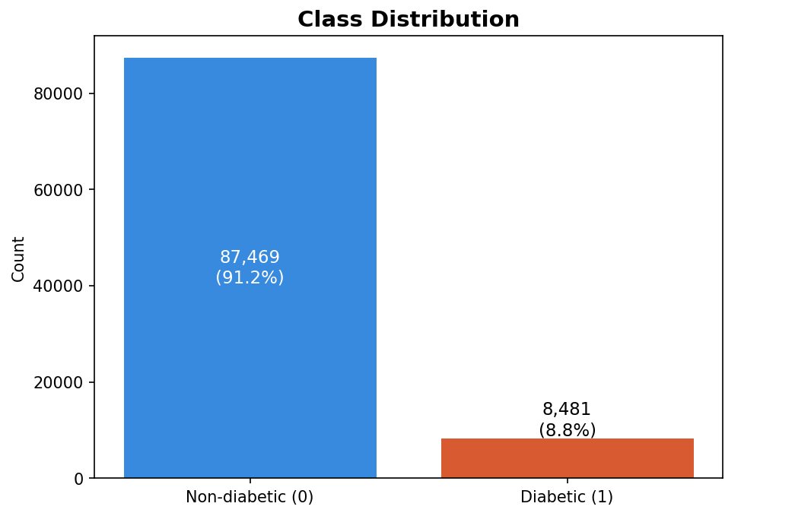
CLASS IMBALANCE IN THE DATASET
91,500 Non-diabetic (91.5%)
8,500 Diabetic (8.5%)
Severe imbalance addressed using SMOTE on training set only

Slide 8
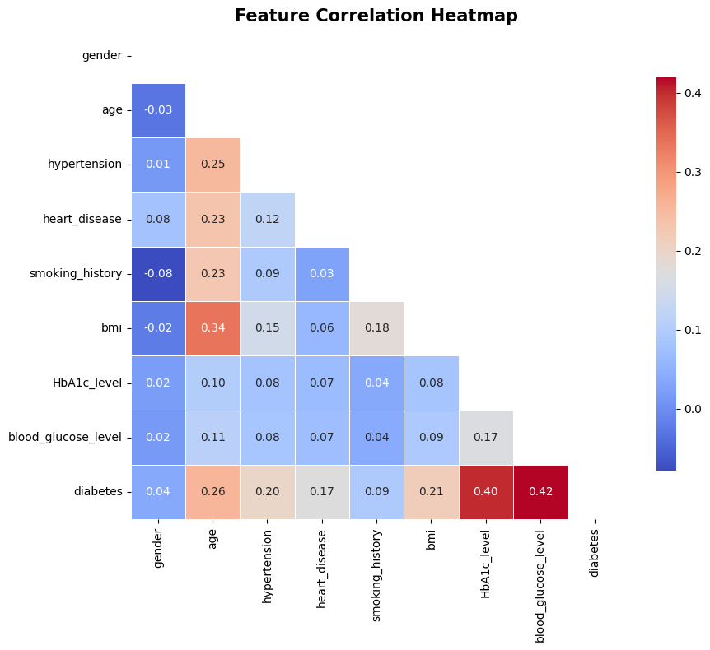
FEATURE CORRELATION HEATMAP
A correlation heatmap is used to visualize the relationship between features in a dataset using Pearson correlation coefficients. Helps identify the most influential features for diabetes prediction.
HbA1c level (r = 0.42) showed the highest positive correlation with diabetes.
Blood glucose level (r = 0.40) also exhibited a strong positive correlation with diabetes.
Age (r = 0.26) and BMI (r = 0.21) showed moderate positive correlations.
Gender and smoking history had near-zero correlations, indicating weak relationships with diabetes.

Slide 9
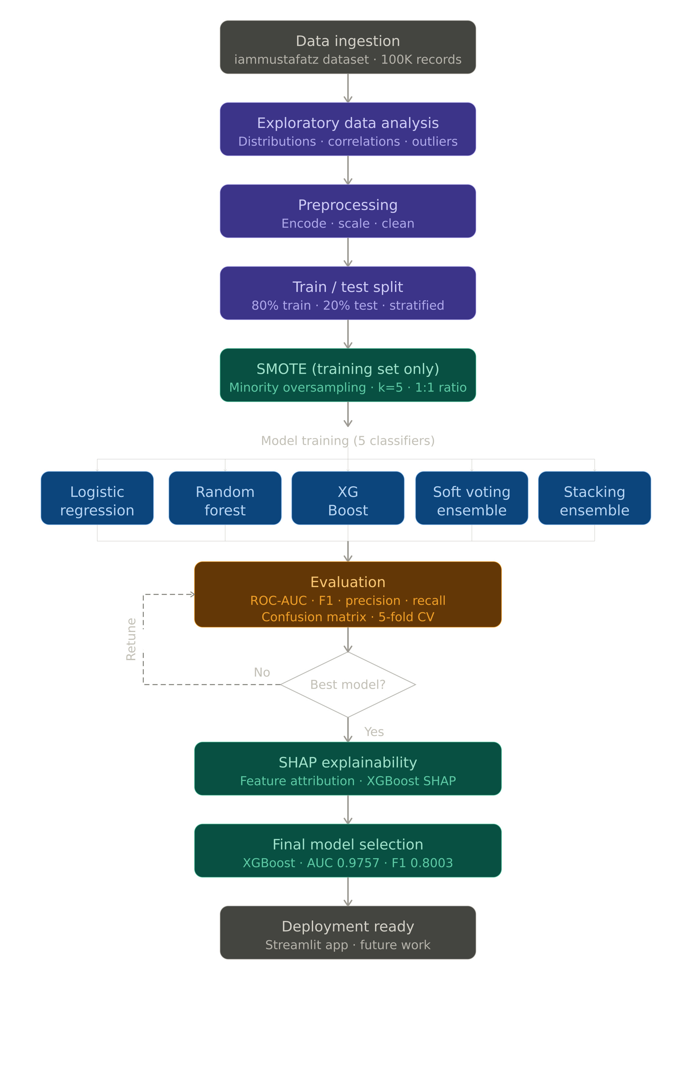
WORKFLOW OF THE PROPOSED SYSTEM

Slide 10
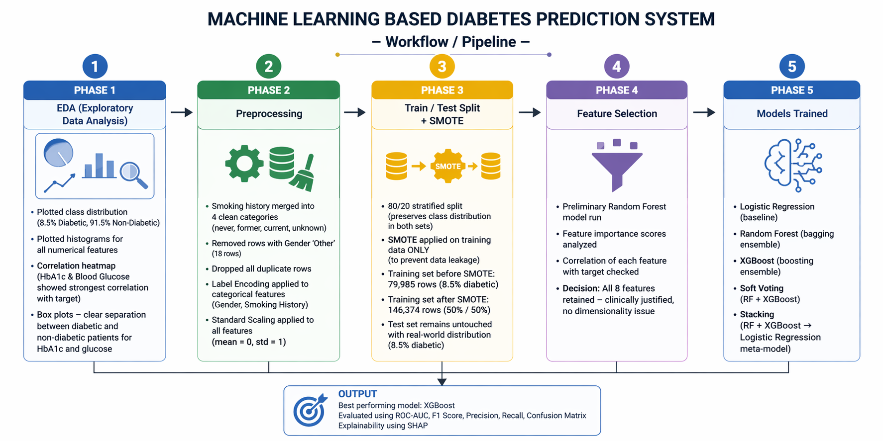

Slide 11
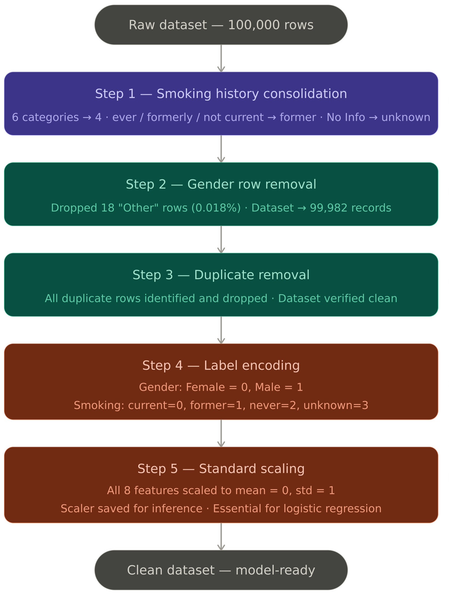
DATA PREPROCESSING

Slide 12
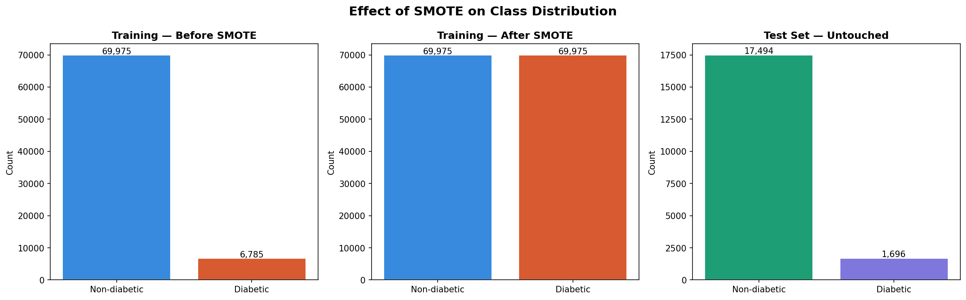
TEST AND TRAIN DATA SPLIT
We split the 99,982 records into 80% for training - about 79,985 rows and 20% for testing - about 19,997 rows.
Then Synthetic Minority Over-sampling Technique (SMOTE) was applied on the training set only, growing it from 79,985 rows to 146,374 rows with a perfectly balanced 50/50 class distribution.
The test set remained completely untouched at its original 8.5% diabetic distribution.

Slide 13
EFFECT OF SMOTE ON TRAINING DATA

Slide 14
EVALUATION METRICS
Model performance is evaluated using a comprehensive set of metrics that account for class imbalance and are clinically appropriate for binary medical classification. Accuracy alone is deliberately avoided – a classifier that predicts non-diabetic for every patient would achieve 91.5% accuracy.
Evaluation Metrics used :
1. Confusion Matrix
2. Precision
3. Recall
4. F1 Score
5. ROC-AUC (Receiver Operating Characteristic - Area Under the Curve)

Slide 15
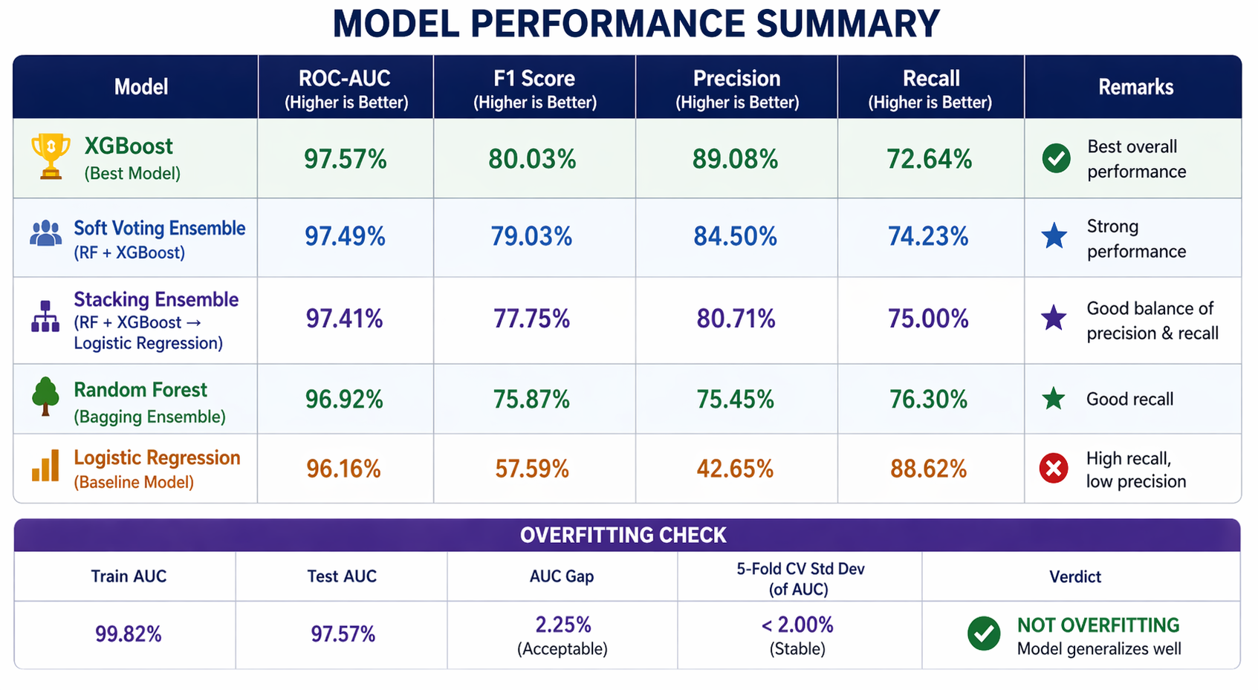
MODELS TRAINED

Slide 16
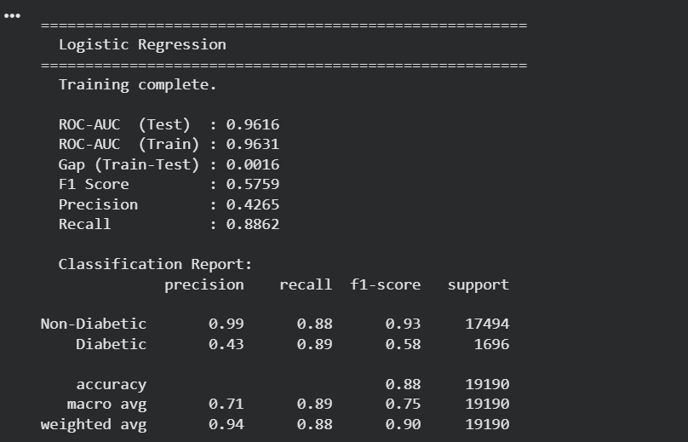
LOGISTIC REGRESSION

Slide 17
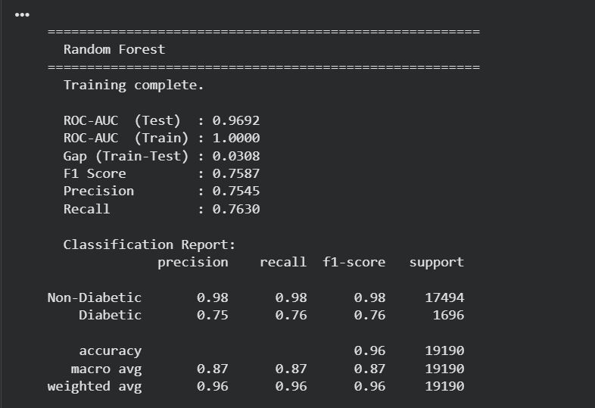
RANDOM FOREST

Slide 18
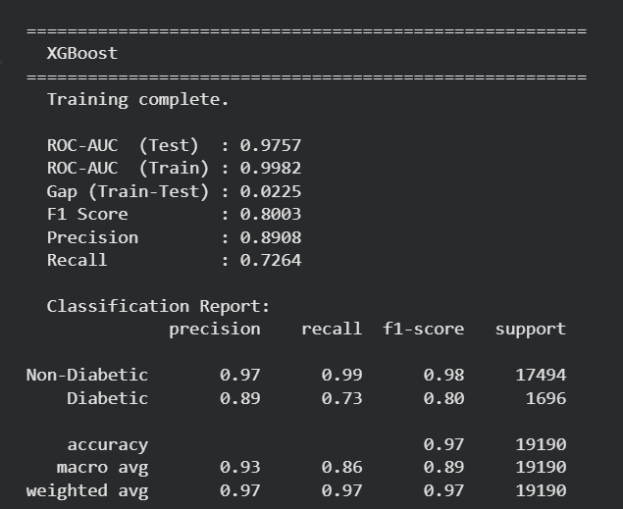
XG BOOST

Slide 19
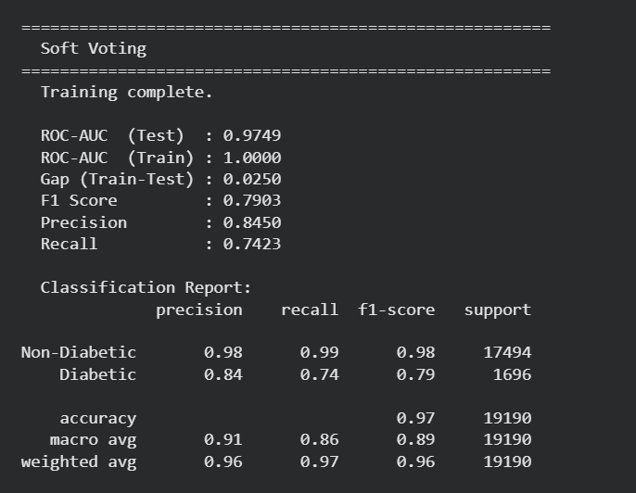
SOFT VOTING (RF + XGBOOST)

Slide 20
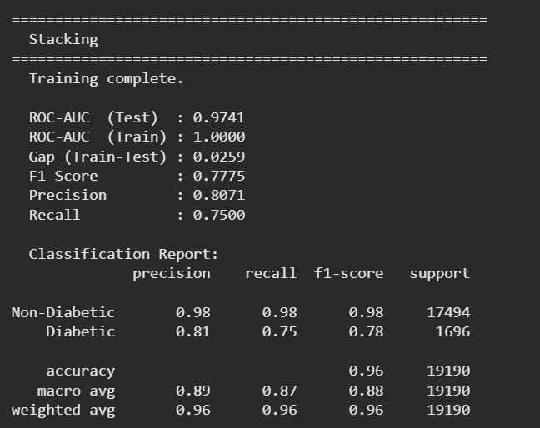
STACKING ENSEMBLE

Slide 21
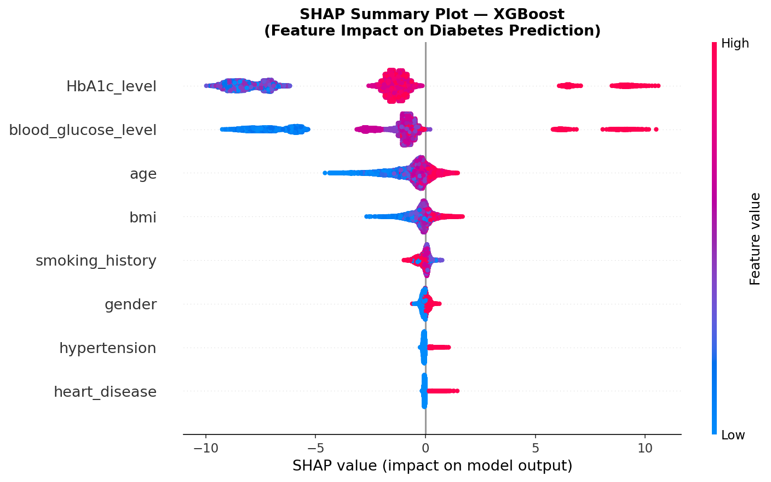
SHAP EXPLAINABILITYANALYSIS
SHAP analysis was performed using TreeExplainer on the XGBoost model.
HbA1c level and blood glucose level were identified as the most important features for diabetes prediction.
High values increased the probability of predicting diabetes, while low values reduced it.
Age and BMI showed moderate influence on predictions.
SHAP dependence plots matched clinical diagnostic thresholds such as:
1. HbA1c ≥ 6.5%
2. Blood glucose ≥ 140 mg/dL

Slide 22
THANK YOU

