Slide 1

CORAL: A CLOUD-BACKED PRUDENT FILE SYSTEM
BY
13WJ1A05D2: M.BHAVANA REDDY
Under Guidance of
S.MADHU

Slide 2
ABSTRACT
Cloud storage has become a lovely answer to change the storage management for each enterprises and individual users. However, ancient file systems with intensive optimizations for native disk-based storage backend can't absolutely exploit the inherent options of the cloud to get fascinating performance. Coral is designed to handle many key problems in optimizing cloud-based file systems like the info layout, block management, and billing model. With fastidiously designed information structures and algorithms, like distinctive semantically correlative information blocks, tree based caching policy with self-adaptive thrashing interference, effective information layout, and optimum garbage pickup, Coral achieves smart performance and value savings underneath varied workloads as incontestable by intensive evaluations.

Slide 3
INTRODUCTION
The Platform-as-a-Service cloud storage has become an infrastructure service of the Internet as a promising way to simplify storage management for enterprises and individual users. Coupled with the increasing demand for multi-device data synchronization and sharing, it is emerging as a new paradigm that helps migrate storage applications to the cloud. Due to its practical impact, significant research endeavors have been undertaken to address the problems in cloud storage based applications, such as the security of storage outsourcing, data consistency, and cost optimization.

Slide 4
EXISTING SYSTEM
EXISTING CONCEPT:
In Traditional file system extensive optimizations for local disk-based storage backend cannot fully exploit the inherent features of the cloud to obtain desirable performance.
By intelligently organizing storage objects in a local cache.
EXISTING TECHNIQUE:
HTTP-based interface

Slide 5
PROPOSED SYSTEM
PROPOSED CONCEPT: -
Here we present the design, implementation, and evaluation of Coral, a cloud based file system that strikes a balance between performance and monetary cost.
Storage objects are not stored in a local cache.
PROPOSED TECHNIQUE:-
FCFS

Slide 6
HARDWARE REQUIREMENTS
PROCESSOR : PENTIUM IV 2.6 GHz, Intel CoreDuo.
RAM : 512 MB DD RAM
MONITOR : 15” COLOR
HARD DISK : 50 GB

Slide 7
SOFTWARE REQUIREMENTS
Programming Language : JAVA (j2ee, Servlets, JSP),
Database : MySQL
Operating System : Windows 10
IDE : Net Beans, Eclipse

Slide 8
LITERATURE SURVEY
Title: A Five-Year Study of File-System Metadata
Author: Nitin Agrawal, William J. Bolosky, John R. Douceur, Jacob R. Lorch
Year:2007
DESCRIPTION:
For five years, we collected annual snapshots of file system metadata from over 60,000 Windows PC file systems in a large corporation. In this paper, we use these snapshots to study temporal changes in file size, file age, file-type frequency, directory size, namespace structure, file-system population, storage capacity and consumption, and degree of file modification.

Slide 9
Title: BORG: Block-reOrganization for Self-optimizing Storage Systems
Author: M. Bhadkamkar, J. Guerra, L. Useche, S. Burnett, J. Liptak, R. Rangaswami, and V. Hristidis
Year:2009
DESCRIPTION:
This presents the design, implementation, and evaluation of BORG, a self-optimizing storage system that performs automatic block reorganization based on the observed I/O workload. BORG is motivated by three characteristics of I/O workloads: non-uniform access frequency distribution, temporal locality, and partial determinism in non-sequential accesses.

Slide 10
MODULES
USER INTERFACE DESIGN
COMPANY GET SPACE
ADMIN PROCESS
FILE UPLOAD
COMPANY ADMIN PROCESS
SEARCH FOR FILES

Slide 11
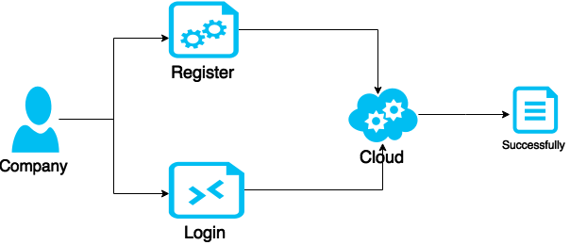
MODULE DIAGRAMS
User Interface Design

Slide 12
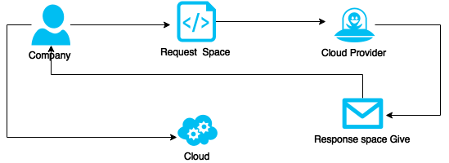
Company Get Space

Slide 13

Admin Process

Slide 14

File Upload

Slide 15
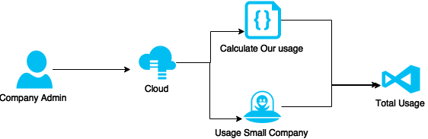
Company Admin Process

Slide 16
SYSTEM ARCHITECTURE
company
register
login
Request to cloud provider for space
Upload file
Get cloud access
Cloud provider
View file information
Monitor cloud spaces(used/free space)
File stored in cloud space
Upload files
Small company
Request company space
Get space

Slide 17
SYSTEM DESIGNS
Use Case Diagram

Slide 18
Class Diagram

Slide 19
Sequence Diagram

Slide 20
Collaboration Diagram

Slide 21
Activity Diagram

Slide 22
State Diagram

Slide 23
Component Diagram

Slide 24
CONCLUSION
This presentation presents the design, implementation and evaluation of Coral , a cloud based file system specifically designed for cloud environments in which improving performance and monetary cost are both principally important for end users. With the efficient data structures and algorithmic designs, Coral achieves our goals of high performance and cost-effective. In the future, we plan to investigate new ways to further reduce the storage cost.

Slide 25
FUTURE ENHANCEMENT
In Future precisely control how much data the client needs to download instead of fetching a complete segment each time. Investigate new ways to further reduce the storage cost.

Slide 26
REFERNCES
[1] N. Agrawal, W. J. Bolosky, J. R. Douceur, and J. R. Lorch, “A fiveyear study of file-system metadata,” in Proc. 7th Conf. File Storage Technol., 2007, pp. 31–45.
[2] J. L. Bentley, “Multidimensional binary search trees used for associative searching,” Commun. ACM, vol. 18, no. 9, pp. 509–517, 1975.
[3] A. N. Bessani, M. P. Correia, B. Quaresma, F. Andr_e and P. Sousa, “DepSky: Dependable and decure storage in a cloud-of-clouds,” in Proc. 6th Conf. Comput. Syst., 2011, pp. 31–46.
[4] A. N. Bessani, R. Mendes, T. Oliveira, N. F. Neves, M. Correia, M. Pasin, and P. Ver_ıssimo, “SCFS: A shared cloud-backed file system,” in Proc. USENIX Annu. Tech. Conf., 2014, pp. 169–180.
[5] M. Bhadkamkar, J. Guerra, L. Useche, S. Burnett, J. Liptak, R. Rangaswami, and V. Hristidis, “BORG: Block-reorganization for self-optimizing storage systems,” in Proc. 7th Conf. File Storage Technol., 2009, pp. 183–196.

