Slide 1

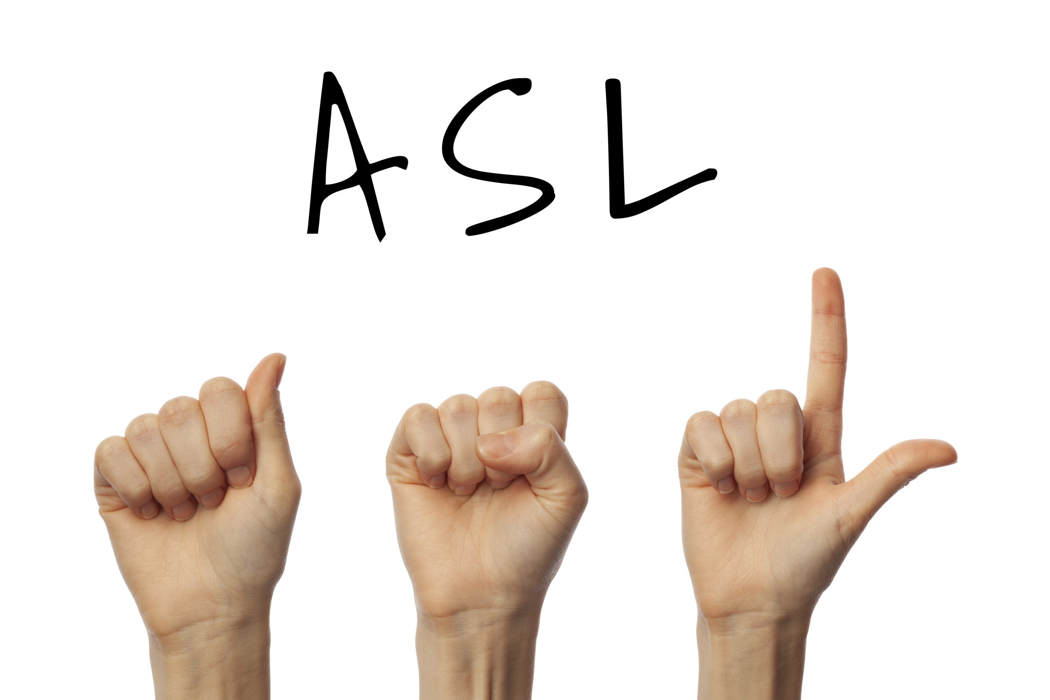
American Sign Language Alphabet Recognition using Deep Learning
Presented by:
Sharanya Desu
Bhavana Jadala
Praneeth Reddy Pappu

Slide 2
Contents
Introduction
Existing Approaches
Methodology
Design and Architecture
Implementation
Results
Future Improvements
Conclusion

Slide 3
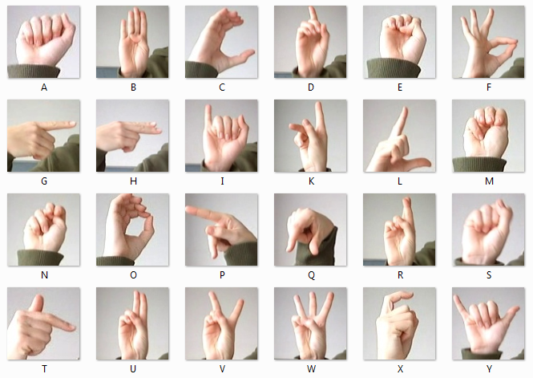
In
Introduction to ASL
American Sign Language Alphabet Recognition using Deep Learning offers real-time interpretation of ASL gestures, bridging communication gaps for the deaf and hard of hearing. Our project aims to enhance accessibility and communication, particularly in healthcare and interactive technology domains.

Slide 4
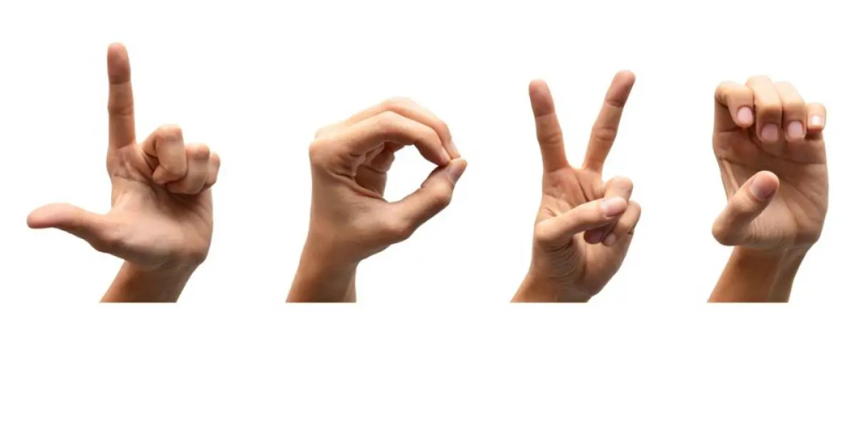
Existing Approaches
Pixel-Level Feature Assessment: Evaluation of pixel-level features using Histogram of Orientation Gradient (HOG), Histogram of Boundary Description (HBD), and Histogram of Edge Frequency (HOEF) for dual-handed sign language dataset, achieving accuracies ranging from 71.4% to 98.1%.
Feature-based Techniques: Extracting visual features like hand shape, orientation, and motion, then using machine learning classifiers for recognition.

Slide 5
Dataset
Dataset Size: 87,000 images
Classes: 29 ASL gestures (A-Z, del,nothing, space)
Splitting the dataset: Training, Testing
10% data is divided into testing set and rest is training set.
78300 images --> Training set
8700 images --> Test set

Slide 6
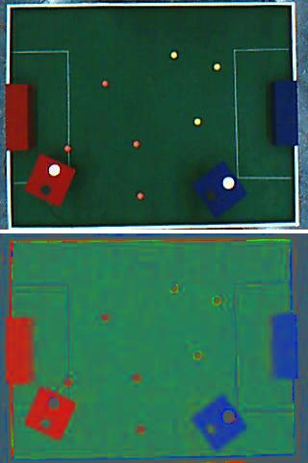
Data Preprocessing – Normalize RGB values
Objective: Standardize pixel values for consistent model training.
Normalization: Scaling RGB values from [0, 255] to [0, 1].
Benefits: Enhances model convergence and generalization.
Implementation: Applied to all training, validation, and test images.

Slide 7
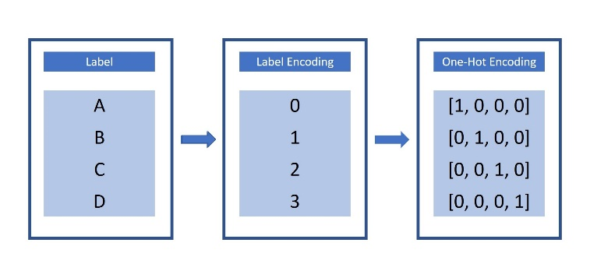
Data preprocessing
One-hot encoding
A is encoded as 0 B is encoded as 1 C is encoded as 2 D is encoded as 3 ... space is encoded as 28. So, currently, our labels for each of the letters are encoded as categorical integers, where 'A', 'B' and 'C' are encoded as 0, 1, and 2, respectively.

Slide 8
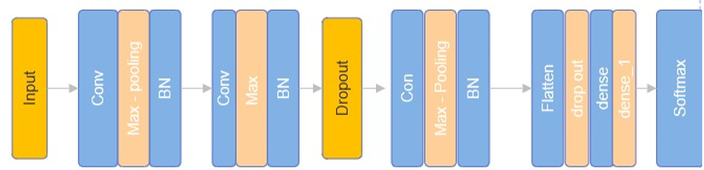
Design and Architecture
Input Layer: Receives RGB images of size 32x32 pixels.
Convolutional Layers: Three Conv2D layers with varying filters and kernel sizes.
Max-Pooling Layers: Halves spatial dimensions for feature extraction.
Batch Normalization: Stabilizes training by normalizing layer inputs.
Dropout Layers: Regularizes the model to prevent overfitting.
Dense Layers: Two dense layers for classification, with softmax activation for output.

Slide 9
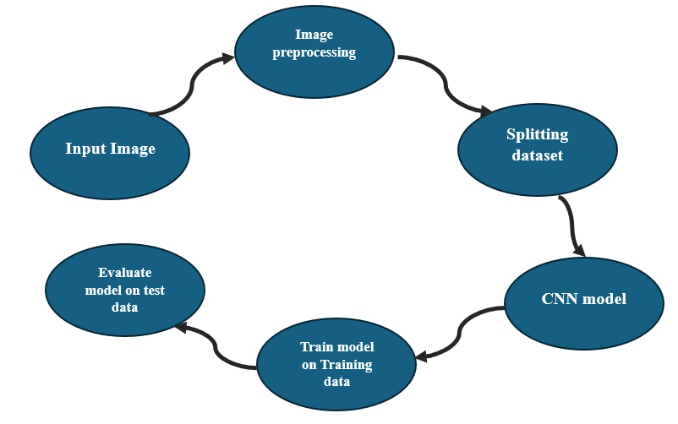
Implementation
Input Image: The ASL gesture images serve as input to the system.
Image Preprocessing: Normalize RGB values to enhance model performance.
Splitting Dataset: Divide data into training and testing sets for model evaluation.
CNN Model: Design a Convolutional Neural Network architecture for feature extraction and classification.
Train Model on Training Data: Use the training set to optimize the model's parameters.
Evaluate Model on Test Data: Assess the model's performance on unseen test data to validate its effectiveness.

Slide 10
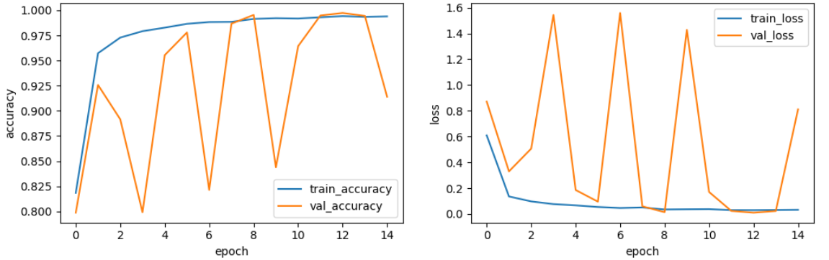
Results
Training Accuracy: 99.46%
Validation Accuracy: 91.40%
Testing Accuracy: 91.09%
The model demonstrates strong performance with high accuracy on both training and testing data, indicating robustness and generalization capability.

Slide 11
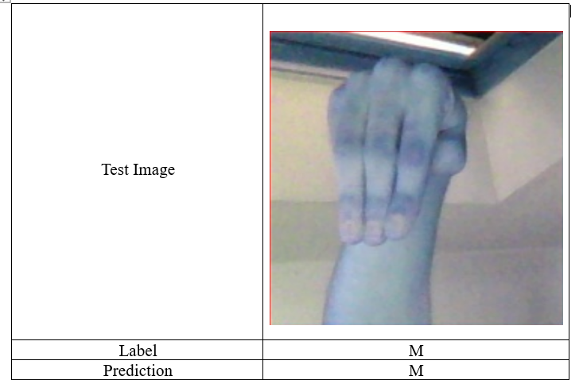
Testing
The model correctly predicted the label for the input image.
The testing accuracy is 91.09%

Slide 12
Future Improvements
Data Augmentation
2. Attention mechanisms
3. Real-Time Optimization
4. Multimodal learning
5. User Interface Improvements
6. Domain Specific Extensions

Slide 13
Conclusion
In conclusion, our project successfully implemented a deep learning model for American Sign Language (ASL) detection with impressive accuracy. Through rigorous training and validation, we achieved a high accuracy rate on both seen and unseen data, showcasing the model's robustness. The project also highlighted the importance of deep learning in ASL recognition and laid the groundwork for future enhancements such as data augmentation, attention mechanisms, and real-time optimization.

Slide 14
References
[1] Lilha, H., & Shivmurthy, D. (2011, December). Analysis of pixel level features in recognition of real life dual-handed sign language data set. In Recent Trends in Information Systems (ReTIS), 2011 International Conference on (pp. 246-251). IEEE.
[2] Mingyang Zhou, Jin Qi, Siyang Li, Qingmin Liao,"Deep Learning for Hand Gesture Recognition: A Comprehensive Survey"
[3] Muhammad Tanveer, Mahmood Akhtar, Shoab A. Khan ,"Sign Language Recognition: A Comprehensive Review of Techniques and Challenges"
[4] Ryan Szeto, Chris Bartley ,"Transfer Learning for Gesture Recognition"
[5] Akshay Verma, C.V. Jawahar, "Enhancing Sign Language Recognition using Multi-Modal Deep Learning"
[6] R. Mitchell, T. Young, B. Bachleda, M. Karchmer. How Many People Use ASL in the United States?: Why Estimates Need Updating". Sign Language Studies (Gallaudet University Press.) 6 (3). ISSN 0302-1475. Retrieved November 27, 2012.

Slide 15


