Slide 1

MUSIC STORE MANAGEMENT SYSTEM

Slide 2
TEAM NAME : QUERY BEES
TEAM LEAD:
BHAVANA MATTA
TEAM MEMBER 1:
NITHISHA POLSANI
TEAM MEMBER 2:
PAVITHRA CHENNURI

Slide 3
INTRODUCTION:
The Music Store Management System dataset provided for this project represents a real-world scenario with information about customers, employees, invoices, artists, albums, and tracks.
The project focuses on solving business questions such as finding the best customer, identifying popular genres, and analyzing top revenue-generating cities.
To analyze the data, We primarily applied joins, aggregate functions, and subqueries, which helped in uncovering meaningful insights.
Each query was designed to connect different tables and extract valuable patterns, showing how relational databases can support decision-making.
This project helps in understanding the importance of transforming raw data into actionable knowledge.

Slide 4

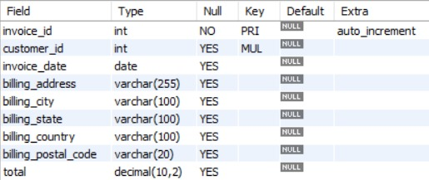

TABLES
Genre Table: Track Table:
MediaType Table:
Artist Table:

Slide 5
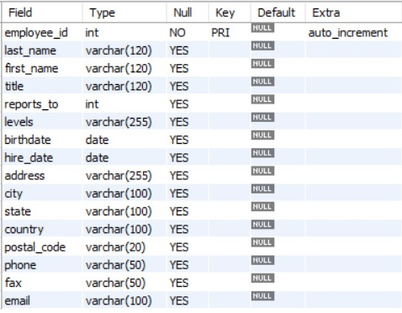
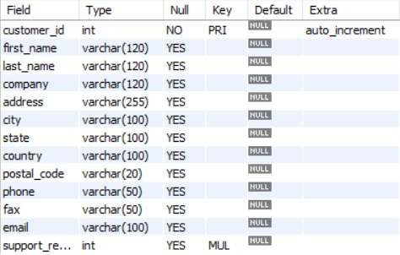
TABLES
Employee Table: Customers Table:

Slide 6

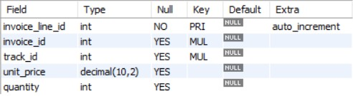

TABLES
Album Table: InvoiceLine Table:
Playlist Track Table:
Invoice Table:
Playlist Table:

Slide 7
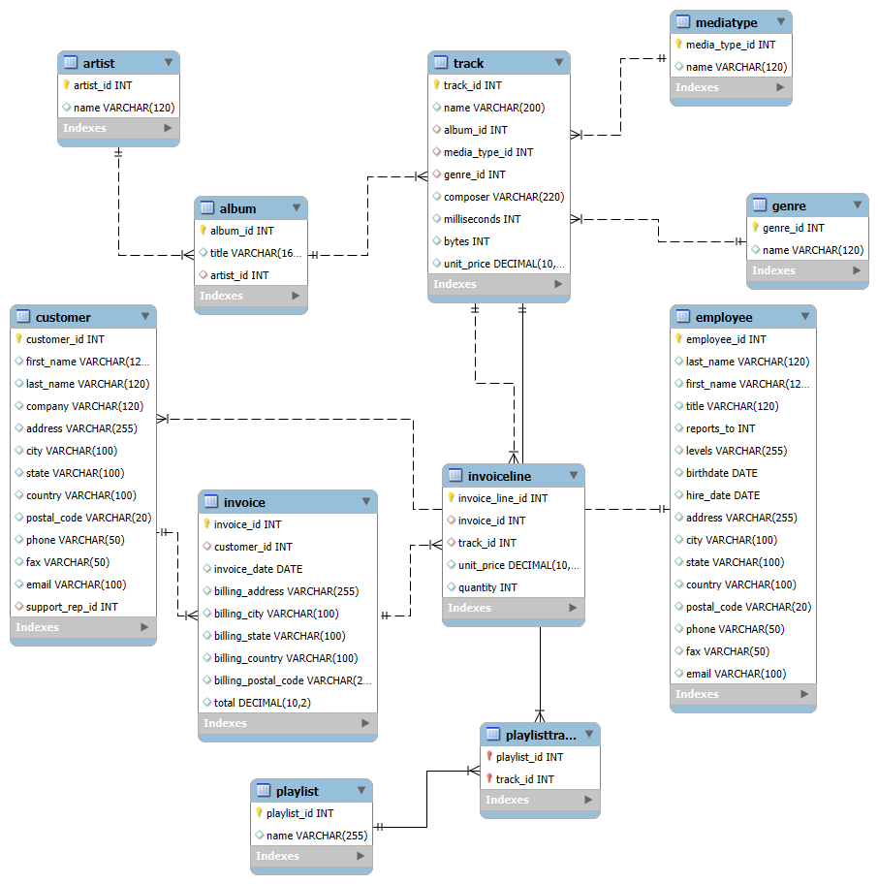
ER DIAGRAM

Slide 8
Problem Statement:
In today’s digital world, music stores collect a large amount of data about their customers, employees, artists, albums, tracks, invoices, and playlists. However, without proper organization, this data becomes difficult to analyze and use for decision-making. The challenge is to design a relational database that not only stores this information efficiently but also allows us to answer real-world business questions.
Think about how Spotify creates your “Daily Mix” playlist.
“Databases are the DJs behind your favorite playlists.”
“Databases are like Spotify’s memory—without them, it would forget your favorite song every day!”
In the same way, a structured music store database can help businesses identify their best customers, manage invoices efficiently, and uncover which music genres drive the most sales.

Slide 9

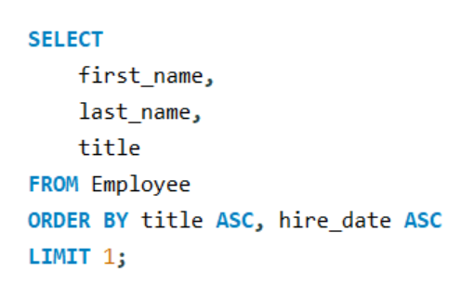

1. Who is the senior most employee based on job title?
Query:
Output:

Slide 10
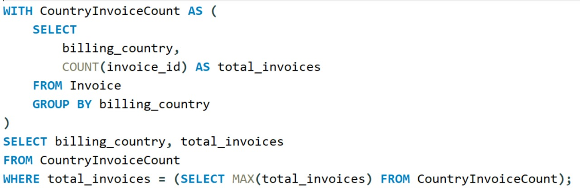
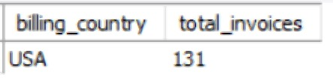
2. Which countries have the most Invoices?
Query:
Output:

Slide 11
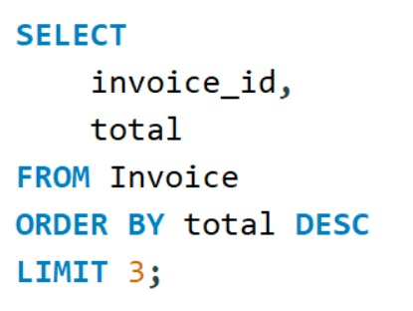
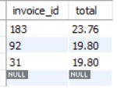
3. What are the top 3 values of total invoice?
Query:
Output:

Slide 12
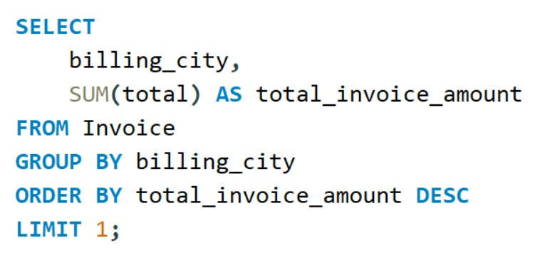

4. Which city has the best customers? - We would like to throw a promotional Music Festival in the city we made the most money. Write a query that returns one city that has the highest sum of invoice totals. Return both the city name & sum of all invoice totals
Query:
Output:

Slide 13
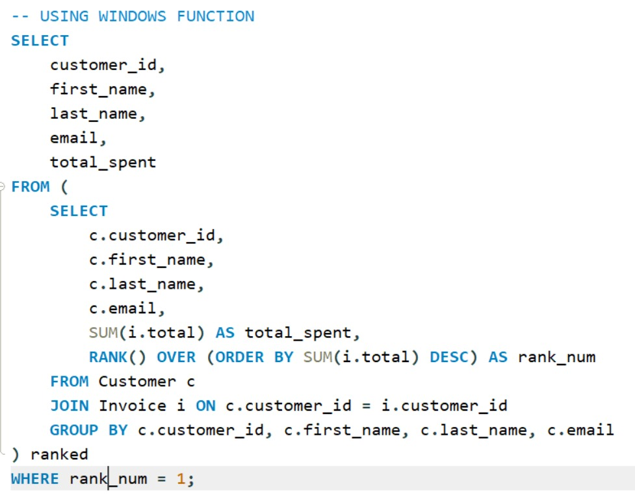

5. Who is the best customer? - The customer who has spent the most money will be declared the best customer. Write a query that returns the person who has spent the most money
Query:
Output:

Slide 14
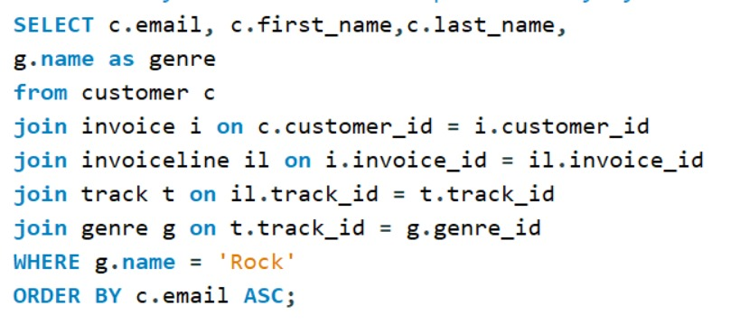
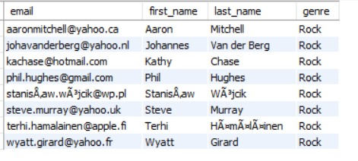
6. Write a query to return the email, first name, last name, & Genre of all Rock Music listeners. Return your list ordered alphabetically by email starting with A
Query:
Output:

Slide 15
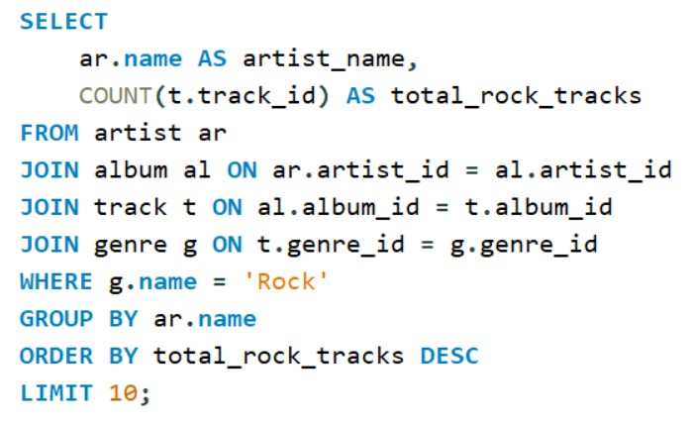
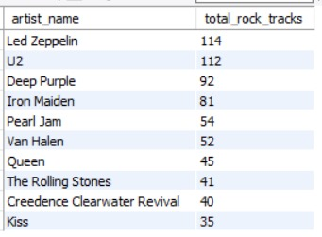
7. Let's invite the artists who have written the most rock music in our dataset. Write a query that returns the Artist name and total track count of the top 10 rock bands
Query:
Output:

Slide 16
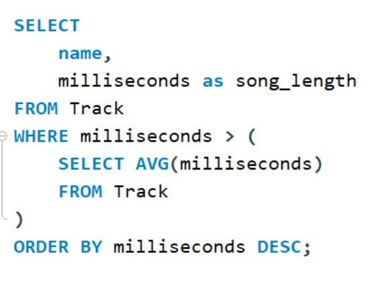
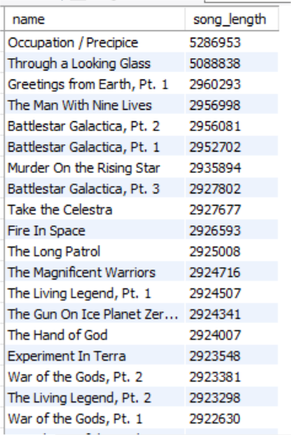
8. Return all the track names that have a song length longer than the average song length.- Return the Name and Milliseconds for each track. Order by the song length, with the longest songs listed first
Query: Output:

Slide 17
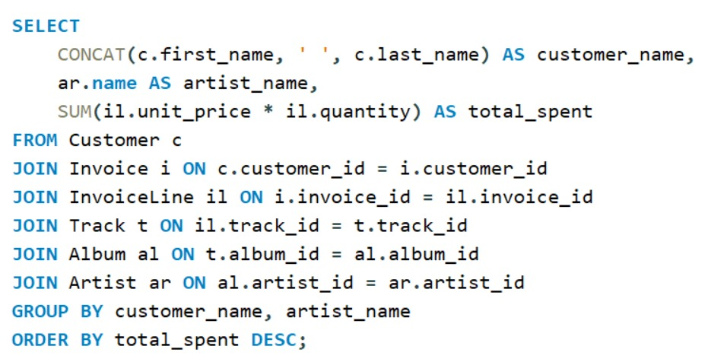
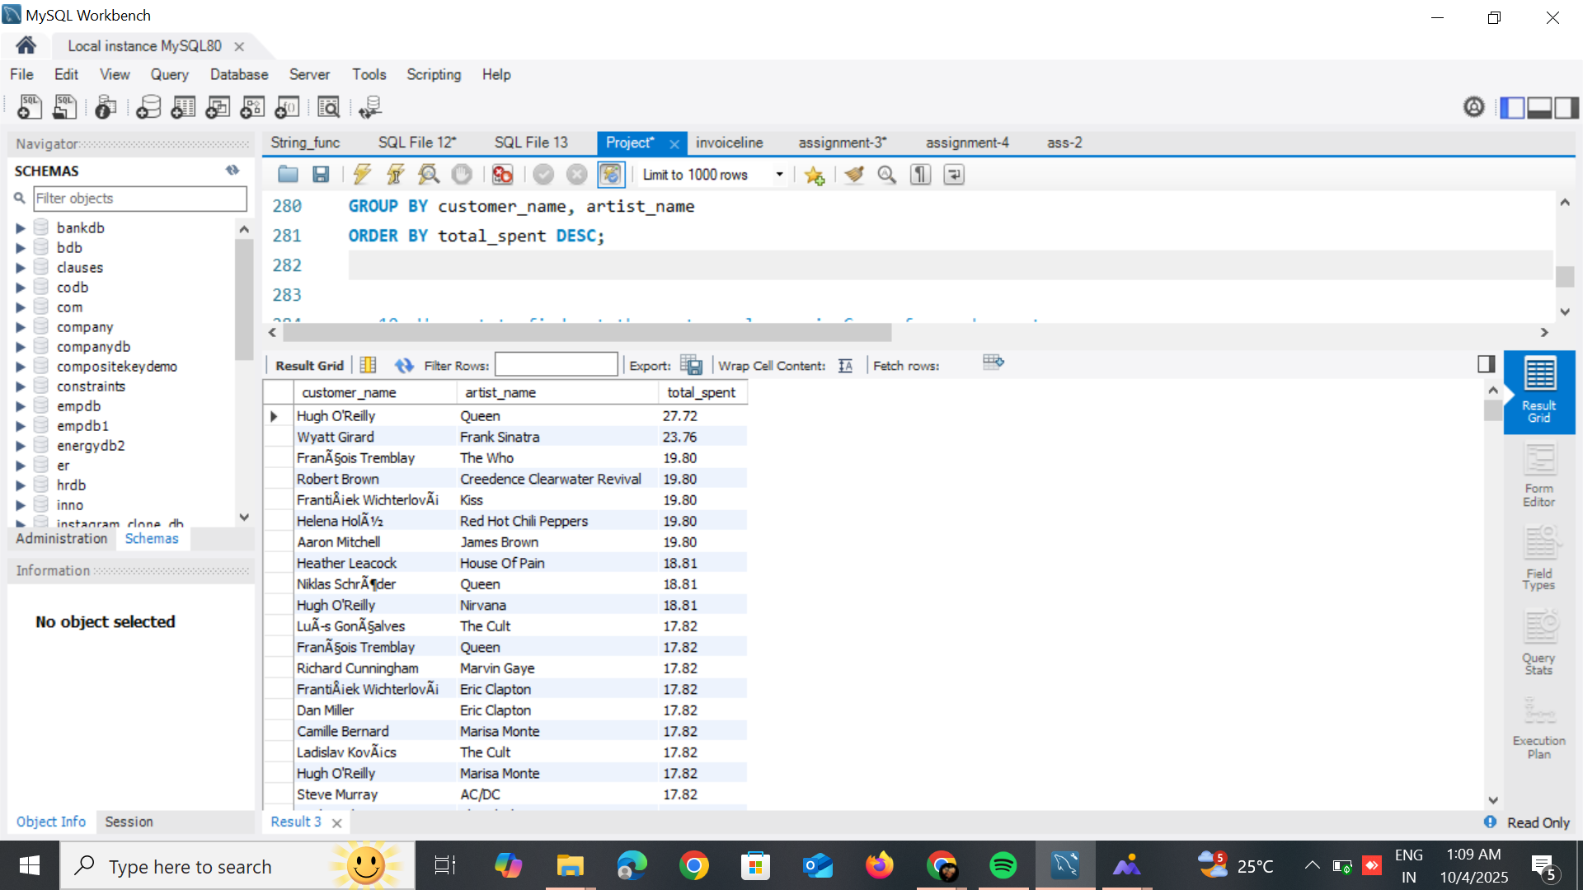
9. Find how much amount is spent by each customer on artists? Write a query to return customer name, artist name and total spent
Query: Output:

Slide 18
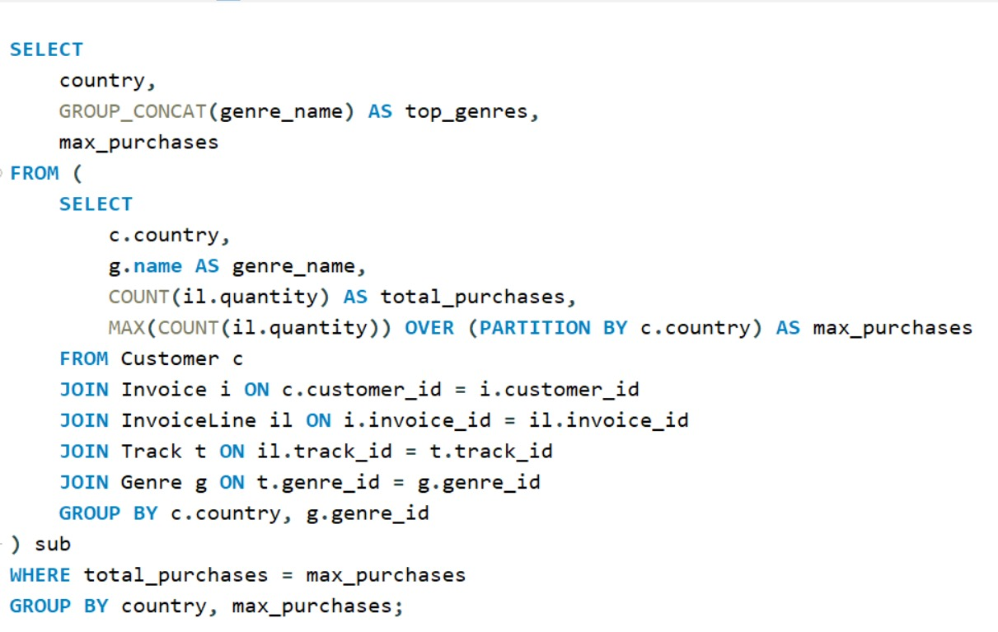
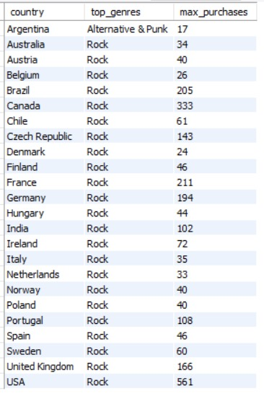
10. We want to find out the most popular music Genre for each country. We determine the most popular genre as the genre with the highest amount of purchases. Write a query that returns each country along with the top Genre. For countries where the maximum number of purchases is shared, return all Genres
Query: Output:

Slide 19
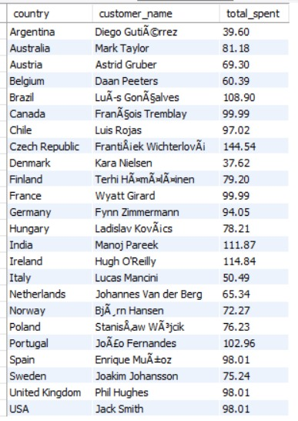
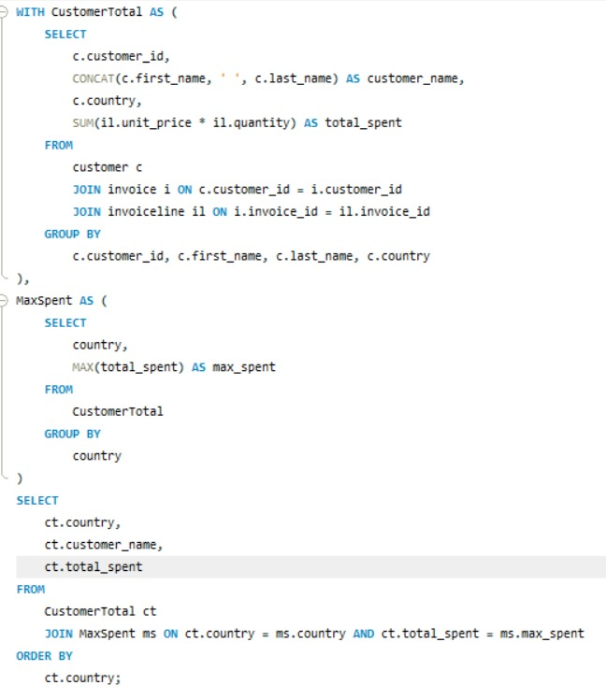
11. Write a query that determines the customer that has spent the most on music for each country. Write a query that returns the country along with the top customer and how much they spent. For countries where the top amount spent is shared, provide all customers who spent this amount
Query: Output:

Slide 20
CONCLUSION:
Our Music Store Management System project helped us understand how SQL can turn raw data into useful insights. We explored employee, customer, and music patterns using joins, aggregates, and subqueries. Overall, it was a great learning experience that showed us how databases help in real business decision-making.

Slide 21

THANK YOU

