Slide 1
PG
PROJECT PRESENTATION
PhishGuard
A Multi-Layered Cyber Threat Intelligence
Framework for Real-Time Phishing URL Detection
Submitted by
Bhavana Poli
Cyber Security Course • Academic Year 2025 – 2026

Slide 2
Agenda
02 / 15
01
Problem & Motivation
06
Risk Aggregator
Why single-model phishing detection is no longer enough
Weighted scoring and verdict bands
02
Objectives
07
Technology Stack
What this project sets out to achieve
Frameworks, libraries and tools
03
Literature Survey
08
Implementation & UI
Survey of existing detection techniques
Working product walkthrough
04
System Architecture
09
Results & Evaluation
Layered defence-in-depth design
Training curves and end-to-end tests
05
Detection Modules
10
Conclusion & Future Work
Five independent cyber-security signals
Contributions and the road ahead
PhishGuard — A Multi-Layered Cyber Threat Intelligence Framework

Slide 3
The Problem
03 / 15
1M+
unique phishing URLs reported per quarter (APWG)
Phishing is the front door of the modern threat landscape.
Attackers spin up cheap, short-lived domains to harvest credentials before defenders can respond. Conventional defences typically rely on a single technique — a static blocklist or one machine-learning classifier — and both can be evaded. A modern phishing-detection system needs multiple independent signals working together.
~24h
median time-to-takedown after detection
#1
attack technique reported to CERT-In every year
"Defence in depth is not optional — it is the cost of entry."
PhishGuard — A Multi-Layered Cyber Threat Intelligence Framework

Slide 4
Motivation — Why the Baseline Is Not Enough
04 / 15
BASELINE PROJECT
PHISHGUARD
Single Gradient Boosting Classifier
Multi-Engine Defence-in-Depth Platform
■ No second opinion — one classifier, one verdict.
■ Ignores out-of-band evidence (WHOIS, DNS, threat intel).
■ No audit trail or analyst workflow.
■ No input validation, logging, or graceful degradation.
■ Easily evaded by tuning surface URL features.
■ Five independent detection signals run in parallel.
■ External corroboration via Google Safe Browsing, VirusTotal, PhishTank.
■ Weighted aggregator produces a single risk verdict.
■ SIEM-style SQLite audit store and analyst dashboard.
■ Graceful degradation when any one source is unavailable.
PhishGuard — A Multi-Layered Cyber Threat Intelligence Framework

Slide 5
Objectives
05 / 15
1
2
3
4
5
Consolidate Multiple Signals
Weighted Risk Aggregation
SIEM-Style Audit Trail
Dual Interface
Operational Resilience
Combine at least five independent cybersecurity detection techniques into one platform.
Implement multi-engine scoring inspired by Defender SmartScreen, Cisco Talos.
Persist every scan to SQLite; expose analyst dashboard with KPIs and history.
Provide both an interactive web UI and a programmatic JSON API.
Graceful degradation when any external source is unreachable.
PhishGuard — A Multi-Layered Cyber Threat Intelligence Framework

Slide 6
Literature Survey — Approaches to Phishing Detection
06 / 15
Approach
Representative Tools
Strength
Limitation
Blocklist
PhishTank, Google Safe Browsing
Very high precision on known URLs
Reactive; lags fresh attacks
Heuristic / Rules
Domain age, brand-in-path checks
Cheap, explainable, easy to extend
False positives; evaded by variation
Machine Learning
Mohammad et al. dataset (UCI)
Generalises to unseen lexical patterns
Concept drift; ignores external evidence
Visual / Reference
Image hashing, brand corpora
Catches brand impersonation directly
Needs reference corpus; misses generic kits
Multi-Engine Fusion
Defender SmartScreen, VirusTotal
Aggregates strengths of all of the above
More moving parts and operational cost
PhishGuard adopts the Multi-Engine Fusion model — combining a blocklist channel, a threat-intel channel, WHOIS and DNS forensics, typosquatting detection, and one ML classifier.
PhishGuard — A Multi-Layered Cyber Threat Intelligence Framework

Slide 7
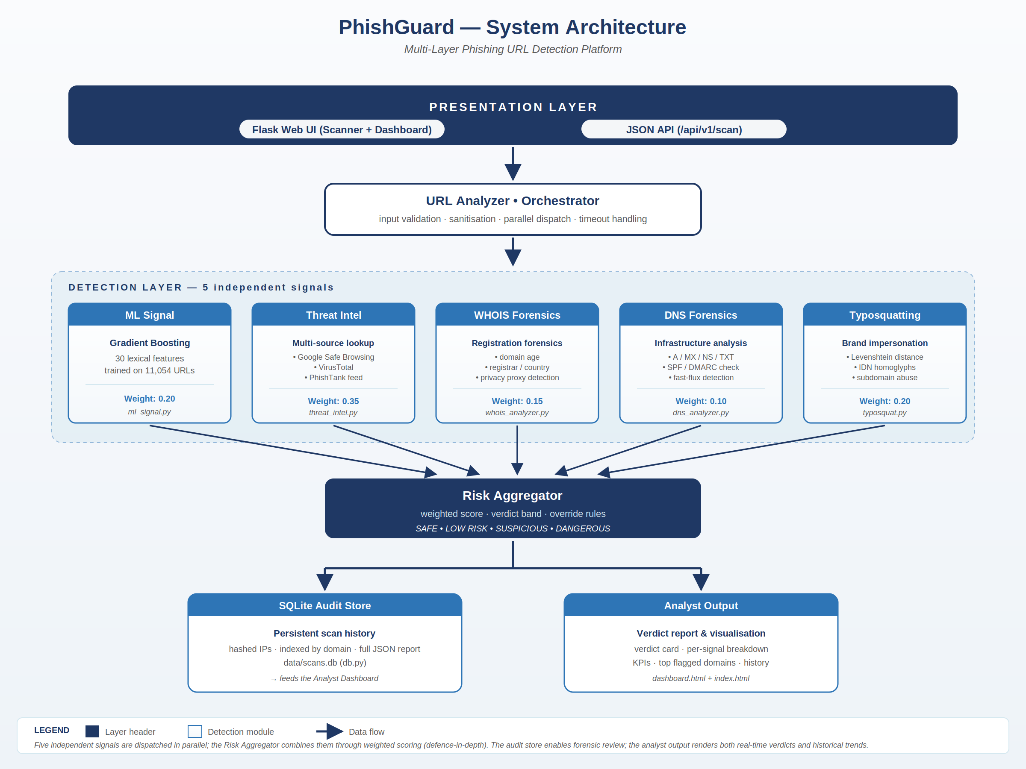
System Architecture
07 / 15
Multi-layered defence-in-depth — five independent signals feed a weighted aggregator and a persistent audit store.
PhishGuard — A Multi-Layered Cyber Threat Intelligence Framework

Slide 8
Detection Modules — Five Independent Signals
08 / 15
ML Signal
Threat Intel
WHOIS
DNS
Typosquatting
Gradient Boosting
External Lookups
Registration Forensics
Infrastructure Analysis
Brand Impersonation
30 lexical features, 11,054 URL training set
Google Safe Browsing · VirusTotal · PhishTank
domain age · registrar · privacy proxy detection
A/MX/NS/TXT · SPF/DMARC · fast-flux check
Levenshtein distance · IDN homoglyphs · subdomain abuse
Weight 0.20
Weight 0.35
Weight 0.15
Weight 0.10
Weight 0.20
Every module is self-contained — failure in one never blocks the rest. New modules can be added without touching existing code.
PhishGuard — A Multi-Layered Cyber Threat Intelligence Framework

Slide 9
Risk Aggregator — Weighted Scoring & Verdict Bands
09 / 15
How the final score is computed
Verdict Bands (0 – 100)
FinalScore = Σ ( signal_score × weight )
0 – 24
SAFE
with override: TI = malicious ⇒ verdict ≥ SUSPICIOUS
25 – 49
LOW RISK
Signal Weights
Threat Intelligence
0.35
Typosquatting
0.20
50 – 74
SUSPICIOUS
ML Classifier
0.20
WHOIS
0.15
75 – 100
DANGEROUS
DNS
0.10
PhishGuard — A Multi-Layered Cyber Threat Intelligence Framework

Slide 10
Technology Stack
10 / 15
BACKEND
DETECTION
Python 3.10+
Application language
scikit-learn / CatBoost
Gradient Boosting classifier
Flask 2.0+
Web framework, routing, templating
python-whois
WHOIS lookups
SQLite
Audit store, indexed scan history
dnspython
A / MX / NS / TXT / PTR queries
requests · bs4
HTTP fetch & DOM parsing
THREAT INTELLIGENCE
FRONTEND & TOOLING
Google Safe Browsing v4
Authoritative malicious-URL feed
HTML5 / CSS3
Dark-mode SOC-style UI
VirusTotal v3 API
90+ AV-engine consensus
Jinja2 templates
Server-side rendering
PhishTank local feed
Cached blocklist
Git, VS Code
Version control & development
PhishGuard — A Multi-Layered Cyber Threat Intelligence Framework

Slide 11
Implementation — Working Product
11 / 15
At a glance
~2,000
lines of Python, HTML, CSS, SQL
5
detection modules in a /modules/ package
[ PASTE SCREENSHOT ]
2
public API endpoints (/api/v1/scan, /stats)
PhishGuard Scanner – verdict card + module panels
25+
end-to-end test verdicts validated
PhishGuard — A Multi-Layered Cyber Threat Intelligence Framework

Slide 12
Machine Learning — CatBoost Training
12 / 15
1000
boosting iterations
0.2599
initial training logloss
0.0204
final training logloss
11,054
labelled URLs in dataset
30
lexical / content features
~1.8 s
total wall-clock training time
PhishGuard — A Multi-Layered Cyber Threat Intelligence Framework

Slide 13
End-to-End Test Verdicts
13 / 15
Aggregator behaviour across the full risk spectrum
URL
Verdict
Score
https://www.google.com
SAFE
4 / 100
https://www.github.com
SAFE
8 / 100
http://g00gle.com
SUSPICIOUS
58 / 100
http://аpple.com (Cyrillic а)
SUSPICIOUS
52 / 100
http://paypa1-secure-login.com/verify
SUSPICIOUS
60 / 100
http://faceb00k-account-recovery.tk
DANGEROUS
78 / 100
http://login.paypal.com.evil-site.tk
DANGEROUS
81 / 100
Note — homograph (Cyrillic) and brand-as-subdomain URLs resolve cleanly in DNS and appear in no blocklist; only the dedicated typosquatting module surfaces the threat. This is precisely the value defence-in-depth provides.
PhishGuard — A Multi-Layered Cyber Threat Intelligence Framework

Slide 14
Conclusion & Future Work
14 / 15
CONTRIBUTIONS
FUTURE WORK
What this project delivered
Where PhishGuard can go next
■ Reproducible defence-in-depth architecture combining five independent signals.
■ Threat-intelligence integration covering both online and offline sources.
■ Pure-Python typosquatting engine including IDN-homograph detection.
■ SIEM-style SQLite audit store and analyst dashboard.
■ Graceful degradation under partial outages.
■ Polished UI + JSON API for both human and machine use.
■ Headless-browser sandbox to capture redirect chains and rendered screenshots.
■ Email-header analyser (SPF / DKIM / DMARC alignment).
■ Chrome browser extension that calls /api/v1/scan automatically.
■ Meta-classifier learned over aggregator inputs instead of fixed weights.
■ Daily auto-refresh of PhishTank / OpenPhish feeds.
PhishGuard — A Multi-Layered Cyber Threat Intelligence Framework

Slide 15
Thank You
Questions & Discussion
PhishGuard • Cyber Security Project • Bhavana Poli
A Multi-Layered Cyber Threat Intelligence Framework for Real-Time Phishing URL Detection

