Slide 1





SISA
INFOSEC
CYBER
RANGE
STAY AHEAD OF THREATS, STAY SECURE.

Slide 2


SISA
INFOSEC
ABOUT CYBER
RANGES
A Cyber Range is a controlled and secure virtual environment designed to replicate real-world cybersecurity scenarios, enabling advanced training, research, and development. Similar to how a shooting range is used to enhance marksmanship, a cyber range provides a safe, realistic setting for developing and refining cybersecurity skills and response strategies.
LEARN MORE

Slide 3


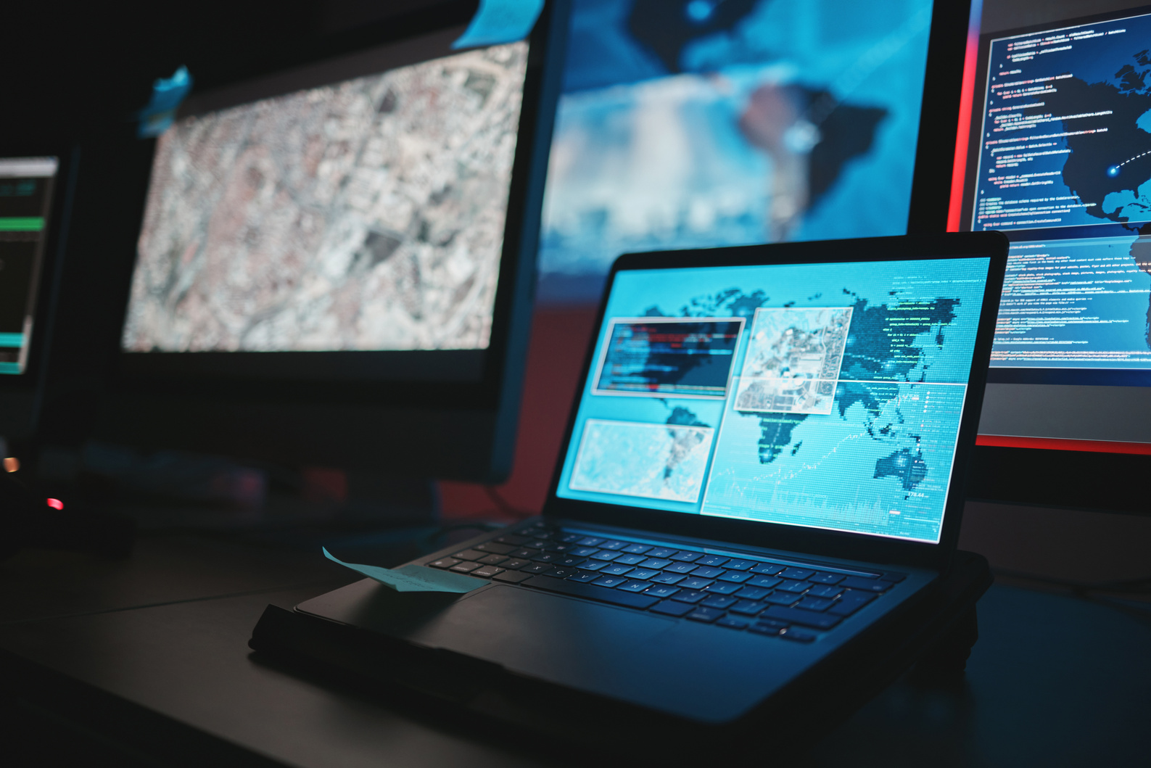
SISA
INFOSEC
WHY
CYBER RANGES
01 SAFETY
02 TRAIN
03 ENVIRONMENTS
Safe simulation of high-risk cyberattacks
Realistic hands-on training
Scenario-based learning for SOC teams, penetration testers, and analysts

Slide 4


SISA
INFOSEC
CYBER RANGES
HOW THEY WORK?
Technical Layers:
Virtual machines, routers, firewalls (virtualized)
Threat simulation tools (e.g., Metasploit, Cuckoo)
Real-time performance metrics and logs
Types:
Static (predefined scenarios)
Dynamic (adaptive or AI-generated scenarios)
Cloud-based (hosted on cloud platforms for scalability)
Hybrid (combination of physical and virtual infrastructure)

Slide 5

SISA
INFOSEC
LIMITATIONS
01 ONE-DIRECTIONAL TRAINING
Focuses only on Red or Blue teams not both limiting holistic, adversarial understanding.
OF TRADITIONAL CYBER RANGES
02 NO REAL-TIME FEEDBACK
Learners receive delayed insights, reducing engagement and slowing skill development.
03 LACK OF TEAM COLLABORATION
Minimal interaction between roles (Red, Blue, Purple), making it unrealistic for real-world SOC environments.

Slide 6
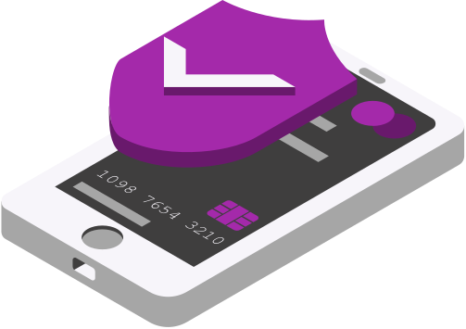
SISA
INFOSEC
SUMMARY
STATEMENT
Cyber Ranges are simulated training environments that empower cybersecurity teams to build real-world skills in a risk-free setting.
They help organizations strengthen their cyber defenses by providing hands-on experience in detecting, responding to, and recovering from sophisticated attacks.

Slide 7

SISA
INFOSEC
PURPLE
RANGE

Slide 8
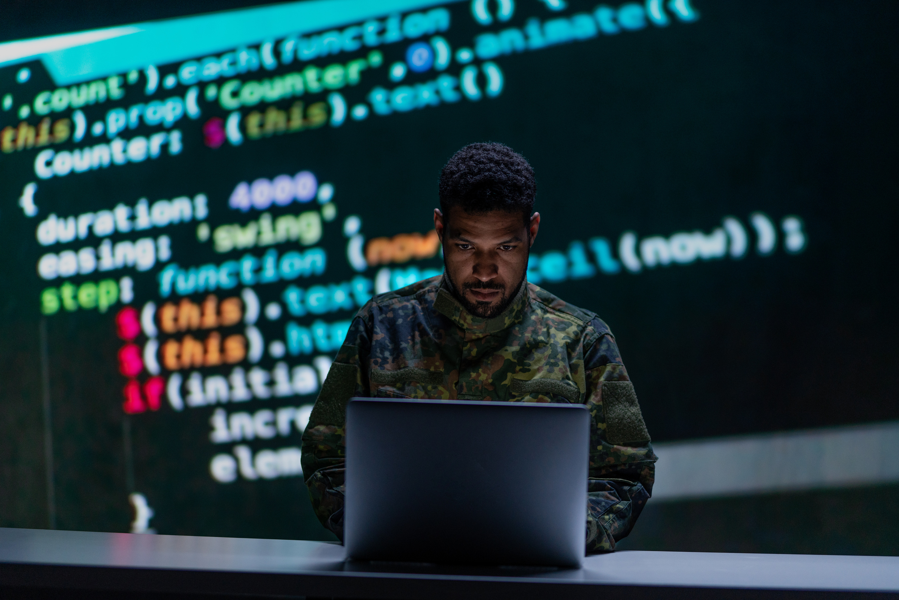
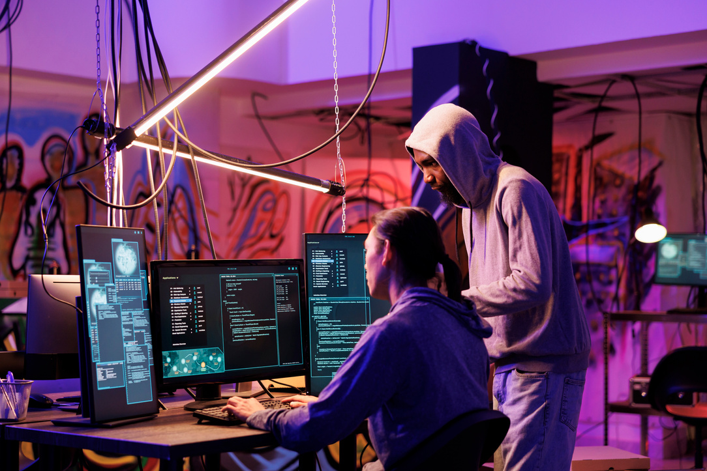

SISA
INFOSEC
ABOUT PURPLE
RANGES
A Purple Range is an evolved cyber range that fosters real-time collaboration between Red (attack) and Blue (defense) teams to improve threat detection and response
Key Idea:
“Learn by working together” Attackers and defenders actively share insights..

Slide 9
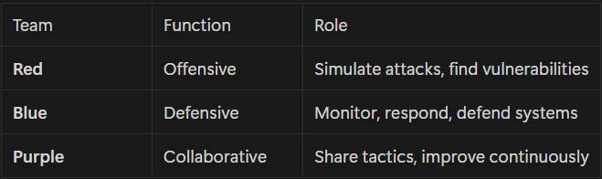
SISA
INFOSEC
TEAMS

Slide 10



SISA
INFOSEC
BENEFITS OF
PURPLE RANGE
Bi-directional learning
Faster security gap detection
Improves both offensive and defensive skills
Better communication between security teams
Continuous improvement of security posture

Slide 11
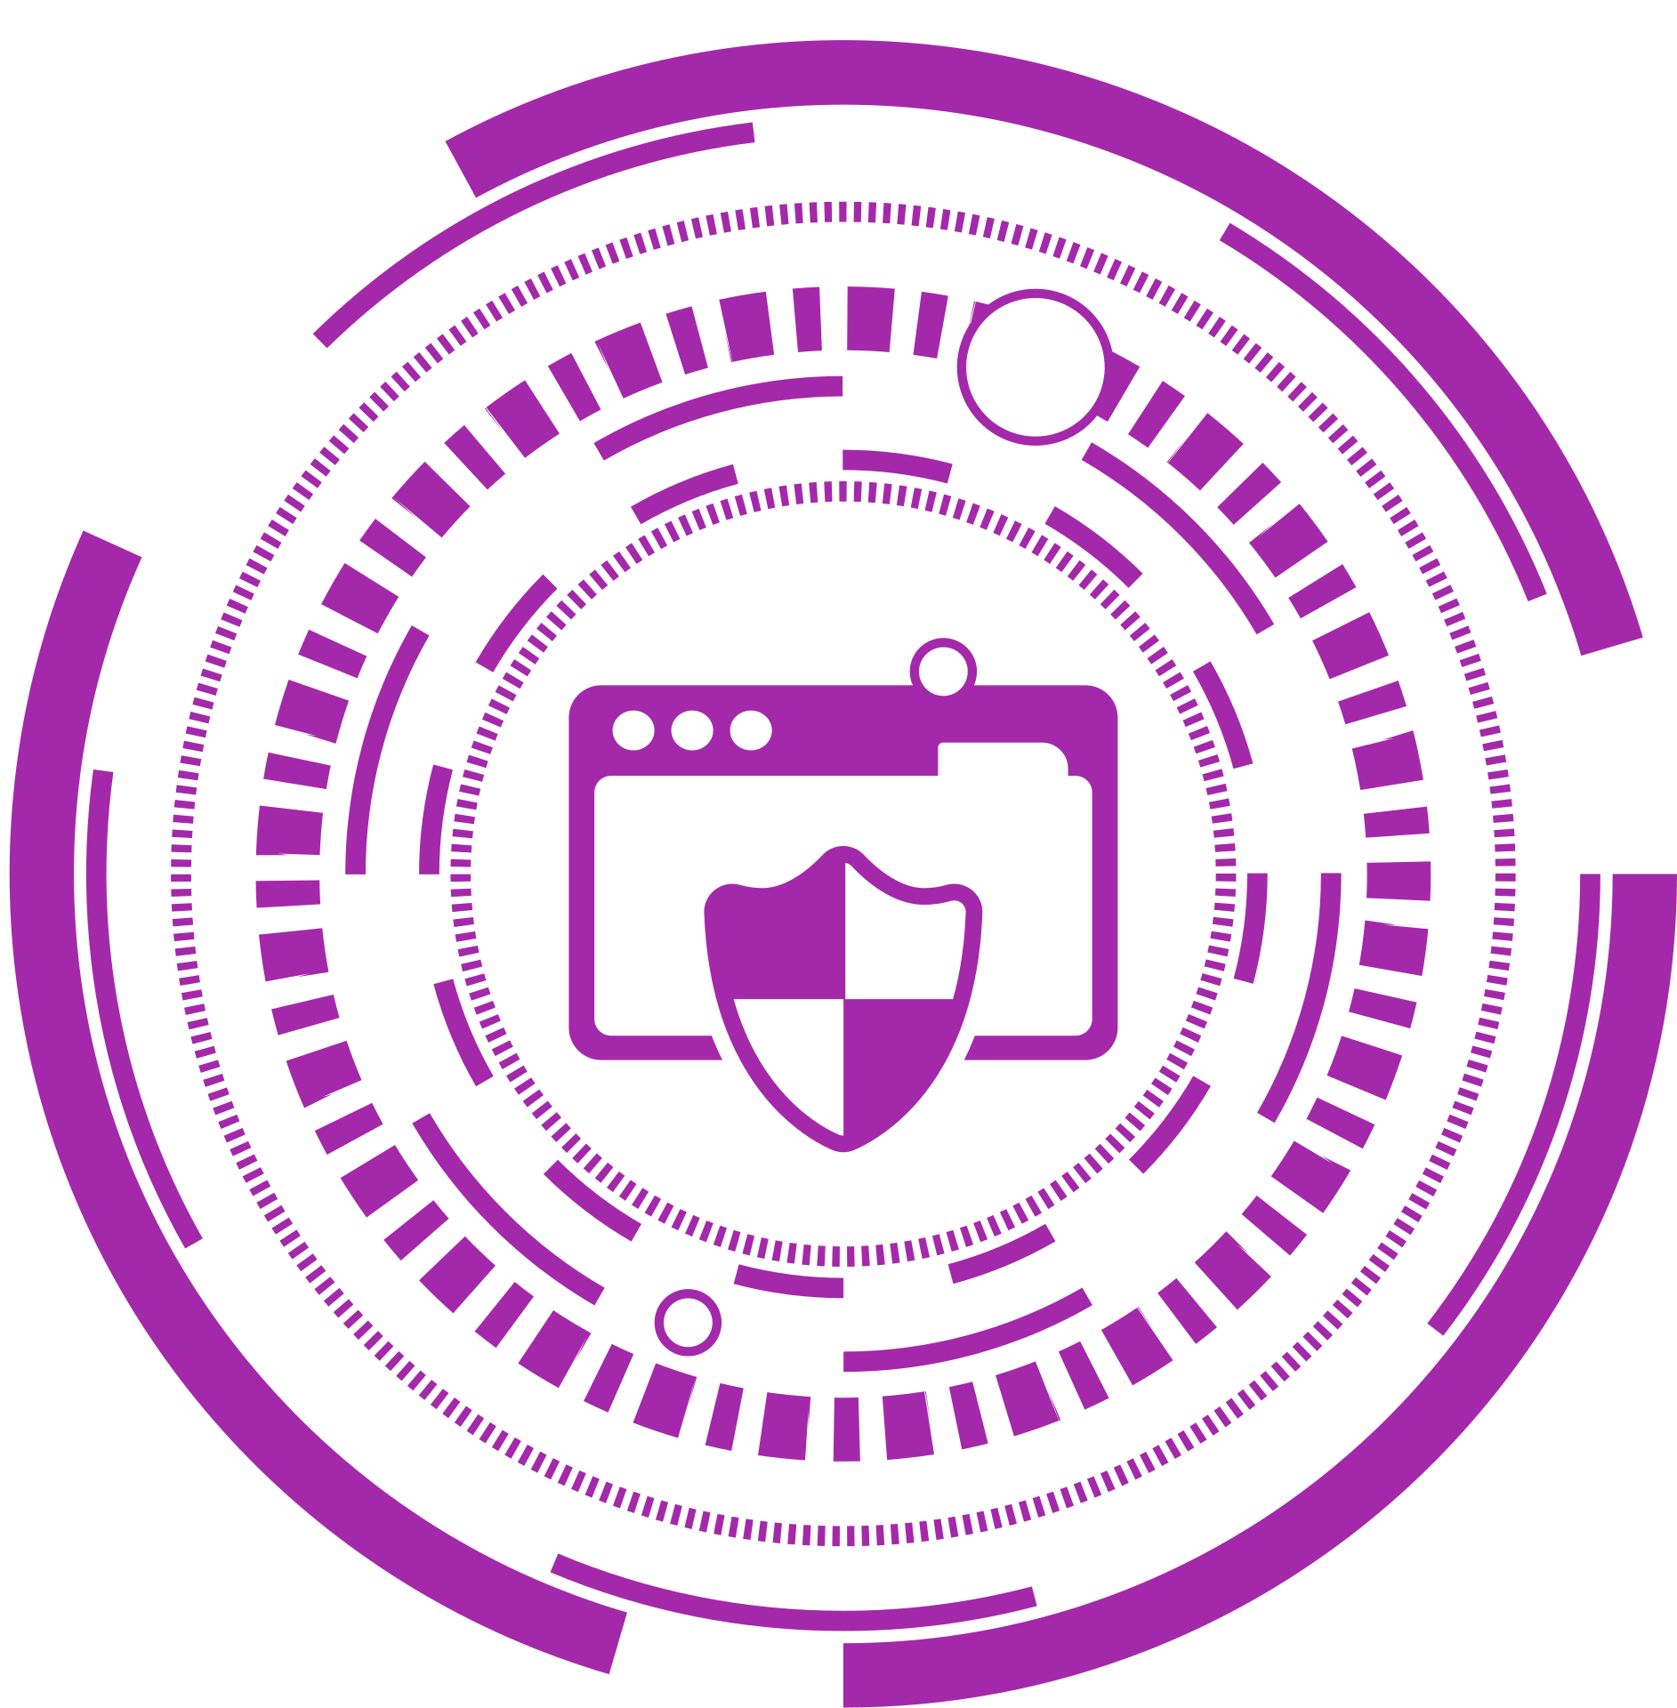
SISA
INFOSEC
REAL-WORLD
USE CASES
Banking Sector: Red team simulates phishing → Blue team detects + blocks → Purple team analyzes gaps
Defense Training: Simulated breaches in military networks
Enterprise SOC Labs: Continuous learning platform

Slide 12
SISA
INFOSEC
THANK
YOU
@ BHAVANARI SHIVA SATWIK
SATWIK.BHAVANARI@GMAIL.COM | LINKEDIN | PORTFOLIO

