Slide 1




SISA
INFOSEC
PURPLE
RANGE

Slide 2

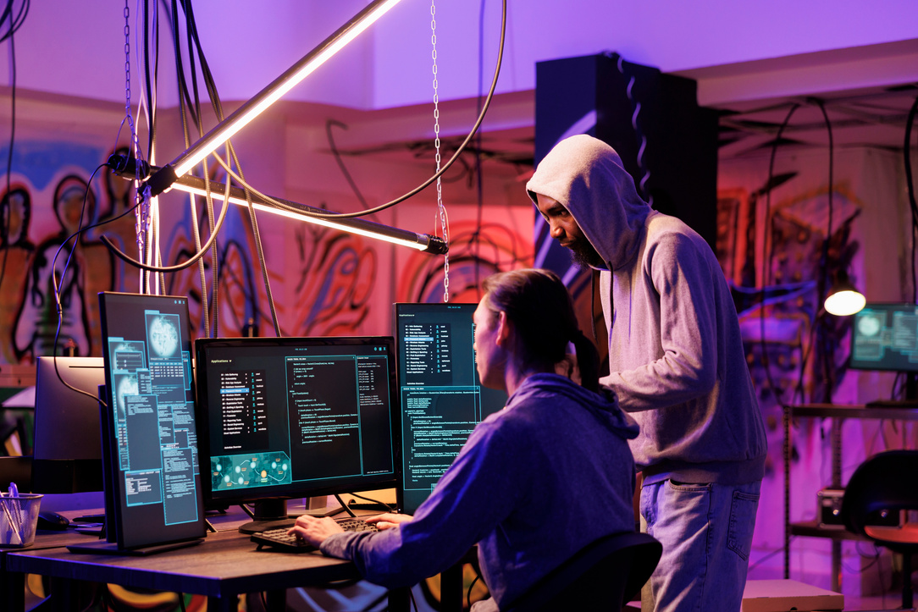

SISA
INFOSEC
ABOUT PURPLE
RANGES
A Purple Range is an evolved cyber range that fosters real-time collaboration between Red (attack) and Blue (defense) teams to improve threat detection and response
Key Idea:
“Learn by working together” Attackers and defenders actively share insights..

Slide 3
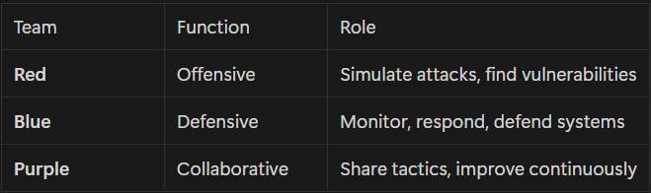
SISA
INFOSEC
TEAMS

Slide 4



SISA
INFOSEC
BENEFITS OF
PURPLE RANGE
Bi-directional learning
Faster security gap detection
Improves both offensive and defensive skills
Better communication between security teams
Continuous improvement of security posture

Slide 5

SISA
INFOSEC
REAL-WORLD
USE CASES
Banking Sector: Red team simulates phishing → Blue team detects + blocks → Purple team analyzes gaps
Defense Training: Simulated breaches in military networks
Enterprise SOC Labs: Continuous learning platform

Slide 6
SISA
INFOSEC
THANK
YOU
@ BHAVANARI SHIVA SATWIK
SATWIK.BHAVANARI@GMAIL.COM | LINKEDIN | PORTFOLIO

