Slide 1


BTCNE
OVERVIEW

Slide 2
BUISNESS OVERVIEW
BT → (Formerly British Telecom) is a British multinational telecommunications holding company headquartered in London, UK and founded in 1981.
It provides operations around 180 countries and it is largest provider of fixed-line, broadband and mobile services in the UK, and provides IT services.
Chairman : Adam Crozier → CEO: Philip Jansen → Group Finance Director : Simon Lowth
Revenue: £21.370 billion (2021) & Number of employees: 99,700 (2021)
EE → (Formerly Everything Everywhere) is a British mobile network operator and internet service provider, which is a brand within the BT Group. EE had its headquarters in Hatfield, England.
The EE company was formed in 2010 as a joint venture between Deutsche Telecom and France Telecom (now Orange). It was acquired by BT in January 2016 for £12.5 billion.
EE, part of the BT Group, runs the UK's biggest and fastest mobile network, offering 4G in more places than any other UK network. EE also provides home and business broadband using both 4G and fixed line connection.
EE was first to launch 4G in the UK in October 2012, and first to launch 5G in May 2019.
Note*: Both BT & EE are two different organization competing in the market

Slide 3
How is it known as BTCNE ??
Ericsson has sold his EEA product to EE (Everything Everywhere) and EE has further to BT (British Telecom) in sharing. Since EEA product is used by both the organization which in merger called as CNE (Customer Network Experience) and because the BT has a greater brand value, so it’s commonly known as BTCNE.
Ericsson Expert Analytics (EEA) is designed to gather metrics and events from the network and through complex event correlation it generates End-to-end Session Records (ESRs) for each subscriber and Enhanced Detailed Call Records (E-DCRs) for sessions, such as VoLTE calls, containing Key Performance Indicators (KPIs) from various sources. Current EEA Version used → v18.10
The EEA architecture consists of 2 platforms which are as below: -
AESR: Above Extended Session Record
BESR: Below Extended Session Record
Platform | Layers | Functions
EEA | Collection Layer | EEA collects info from Customer network
 | Correlation Layer | EEA makes its own records ESR(data) EDCR (detailed call record)
 | Aggregation Layer | Mapr/Hadoop ----> Load into DB (HBASE) --> Impala Query Server
 | Presentation Layer | Customer Agent or End Users

Slide 4
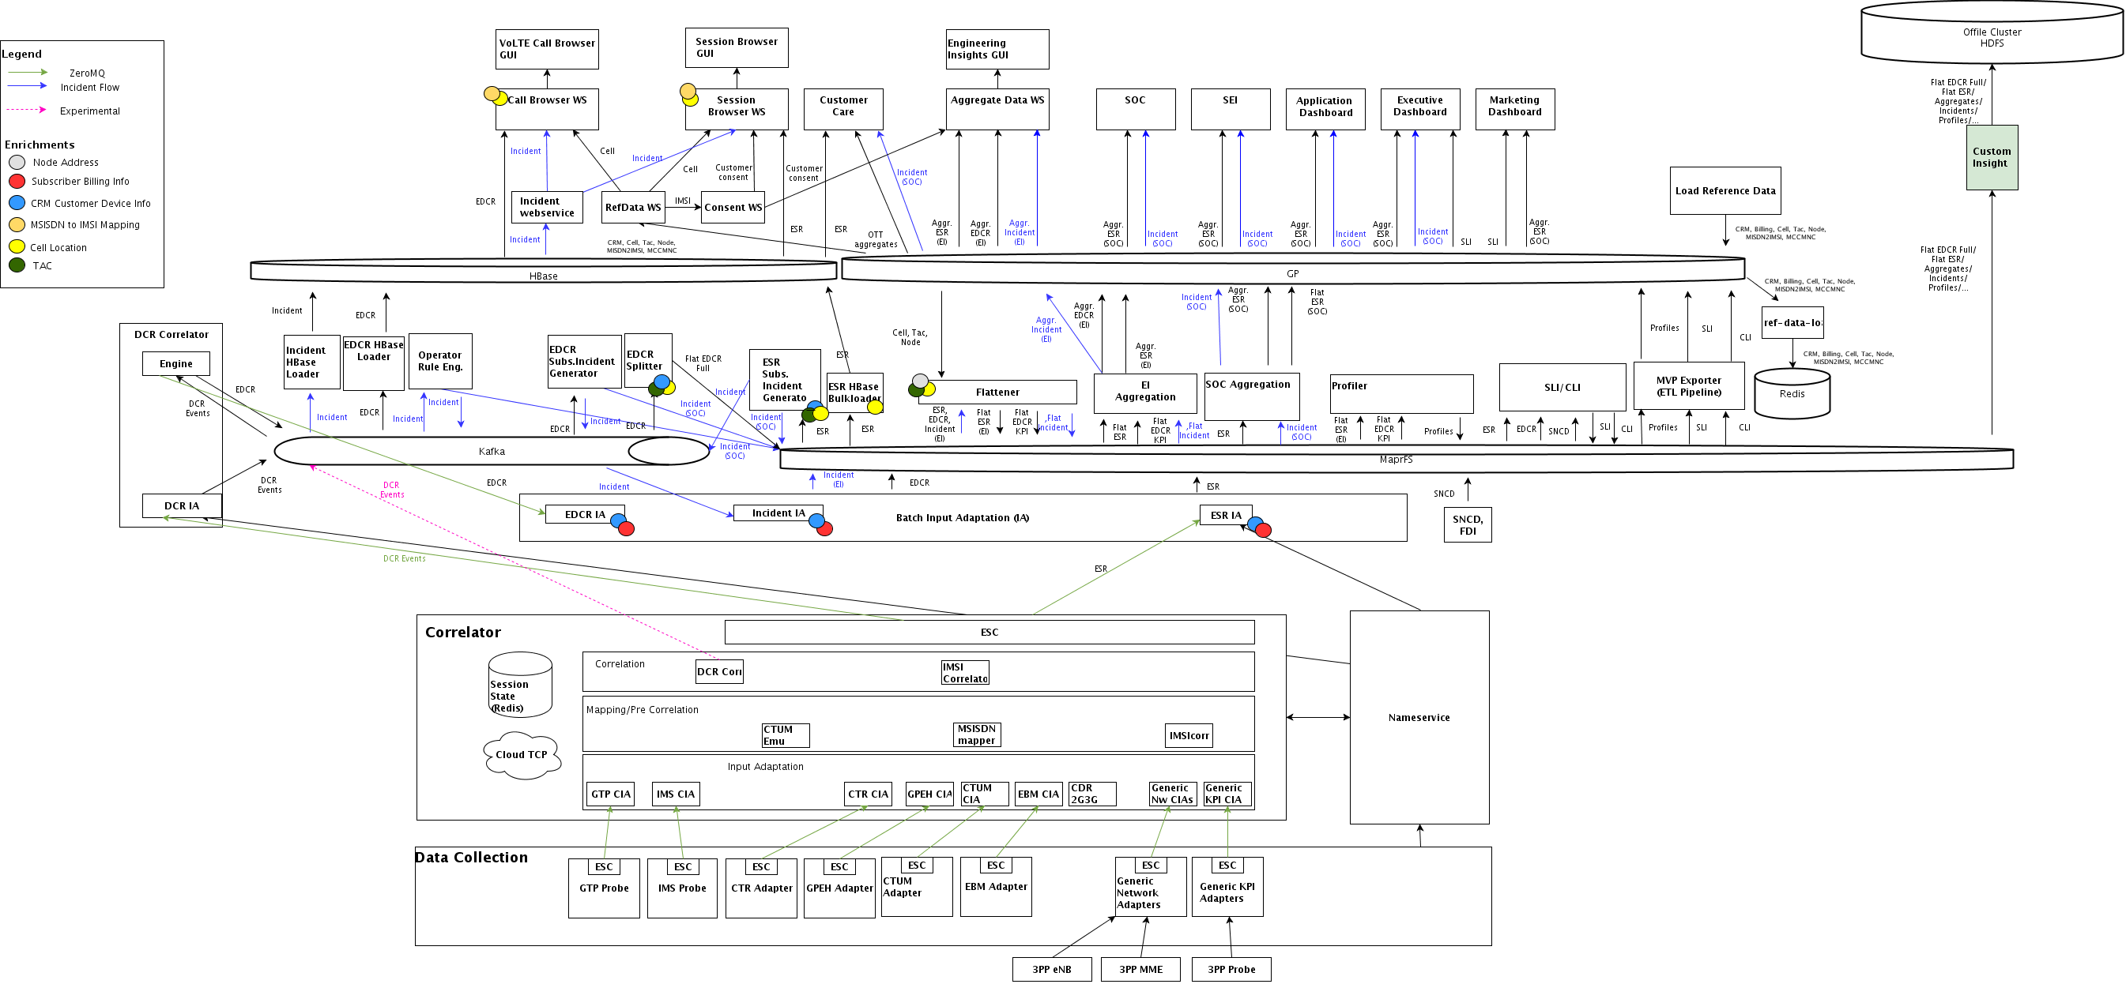
EEA Architecture

Slide 5
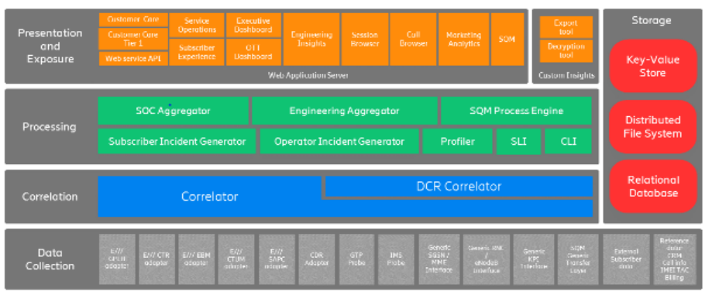
Data Flow

Slide 6
Details
Customer Side
BT/EE Operations Team : Ops Head : Dave Rowland & Tim Elliot
BT/EE Operations Team : Ops Lead : Dante Lacorte/Tracy Templeman/Mark Holder
BT/EE Customer Care Ops Head : Mark Gibney
BT/EE Customer Care Ops Lead: Jaclyn Livingstone
BT/EE Project Head : Alan Chan
Ericsson Side (Project Team)
Program Manager : Nilay
Project Manager : Rahul Banerjee/Hafiz
Integration Engg : Eriko Maki
Engineer (AESR/BESR) : Tyler/Attila Vasko
Performance Team : Nuria Armesto
Solution Architect & Design Specialist: Alfred Aparche

Slide 7
Important Terminology and My Contribution
SLA:- A service-level agreement is a commitment between a service provider and a client. Aspects of the service – quality, availability, responsibilities are agreed between the service provider and the service user.
WLA:- (Work Level Agreement) It defines the interdependent relationships in support of a service-level agreement (SLA). The agreement describes the responsibilities of each internal support group toward other support groups, including the process and timeframe for delivery of their services.
My Contribution and Achievement
No deviation in AESR BESR Platform, TT created if any deviations are found within SLA, primary Troubleshooting is done and informed to higher level if required.
Email acknowledged and customer required details shared within 30 min and informed to respective team for further enhancement if required.
Achievement:- Received AO Employee of month for Jan-2023
My Ticket creation and Resolution
Month | No. of TT Created | No. of TT Resolved
Oct-22 | 1 | 0
Nov-22 | 5 | 3
Dec-22 | 4 | 8
Jan-23 | 9 | 11
Feb-23 | 10 | 13
Total | 29 | 36

Slide 8
Thank you

