Slide 1

Bidarahalli, Virgo Nagar Post,, Bangalore-560049, Karnataka, India. Department of Electronics and Communication Engineering,
PROBLEM STATEMENT:
Innovative Monitoring System for TeleICU Patients Using Video Processing and Deep Learning
PRESENTER:
Bhavani M
USN:1EP21EC015
COLLEGE MENTOR:
Malini V L

Slide 2
Unique Idea Brief (Solution)
The Patients in Critical condition need intense monitoring and care, but with ICU we can provide this type of care.
In remote locations, it is not possible to give such intensive care to the critical patients.
This problem is overcome with the help of TeleICU.
With the help of TeleICU control center, one can monitor the patients in Critical Care unit and can assist the person or doctor available at the physical location.
With our trained model, face detection or face recognition is faster and it also detects if the patient is stable or unstable in very less time.

Slide 3
Features Offered
Fast detection
Stable or unstable patient detection
Accuracy and precision
Detection of critical aspects

Slide 4
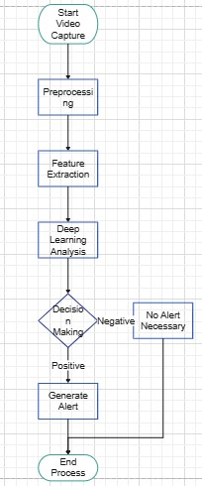
Process flow:

Slide 5
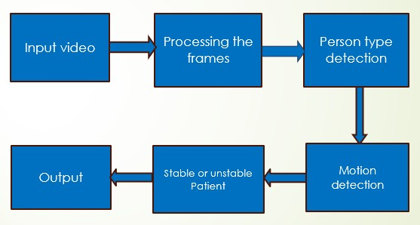
Architecture Diagram

Slide 6
Technologies used:
Python
Yolov8 model
Roboflow(Computer Vision tool)
Ultraedit

Slide 7
Conclusion
Innovative monitoring system for TeleICU patients using video processing and deep learning optimizes patient monitoring and care delivery also leads to improved healthcare outcomes and operational efficiency.
The system can generate real-time alerts and notifications for healthcare providers based on abnormal patient behaviors or critical events detected through video processing and deep learning algorithms.

Slide 8
THANK YOU

