Slide 1
Customer Churn Prediction using LLMs
Principles of Data Science – Project
Data Sorcerers

Slide 2
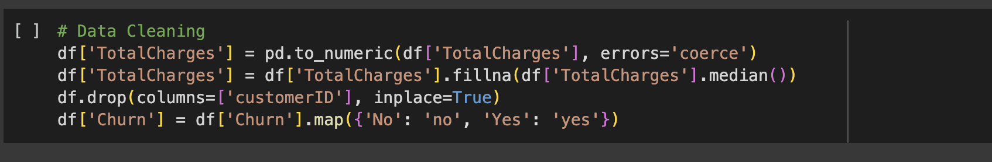
Dataset and Preprocessing
Dataset: Structured data on telecom users.
Features include demographics, usage, account info, and support interactions.
Preprocessing steps: • Null handling and type conversions • Label encoding for categorical columns • Train-test split (80-20 ratio) Created synthetic transcripts for sentiment analysis.

Slide 3
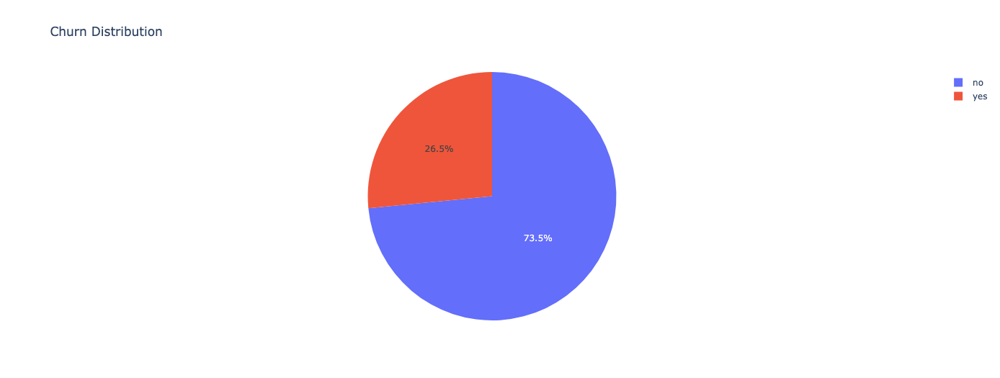
Visualisations
Pie chart represents the division of churned and not churned customers

Slide 4
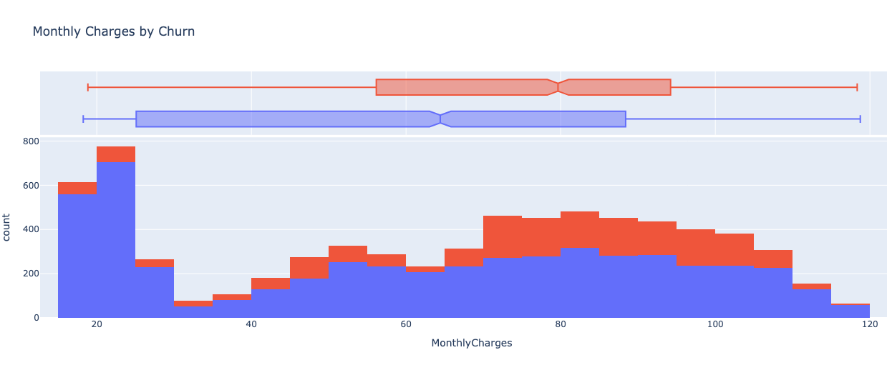
Visualisations
This histogram represents the count in churn and non churn values in relation to the monthly charges.

Slide 5
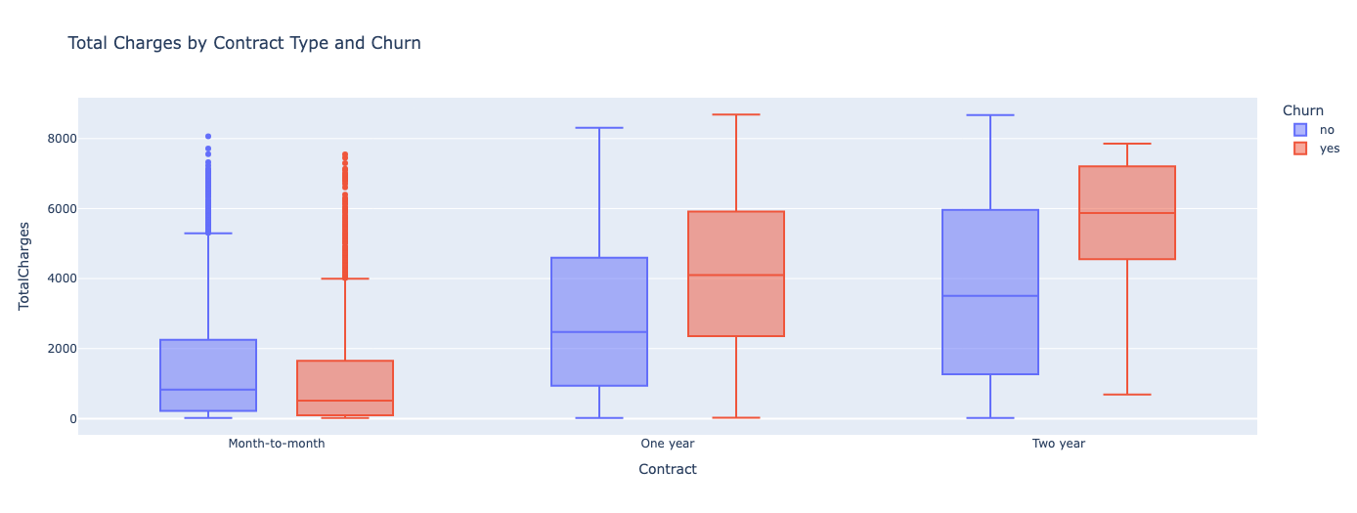
Visualisations
This is a box plot of comparison between churns in relation to the total charges according to various type of subscriptions.

Slide 6
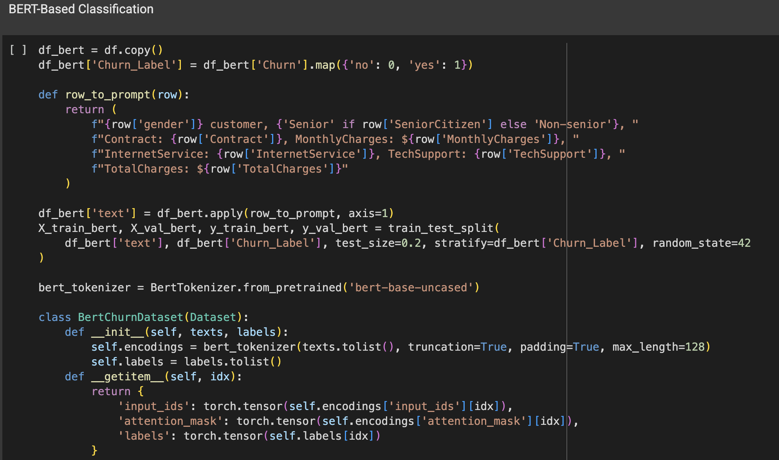
Model Overview – BERT (Methodology)
Used BERT from HuggingFace for churn prediction.

Slide 7
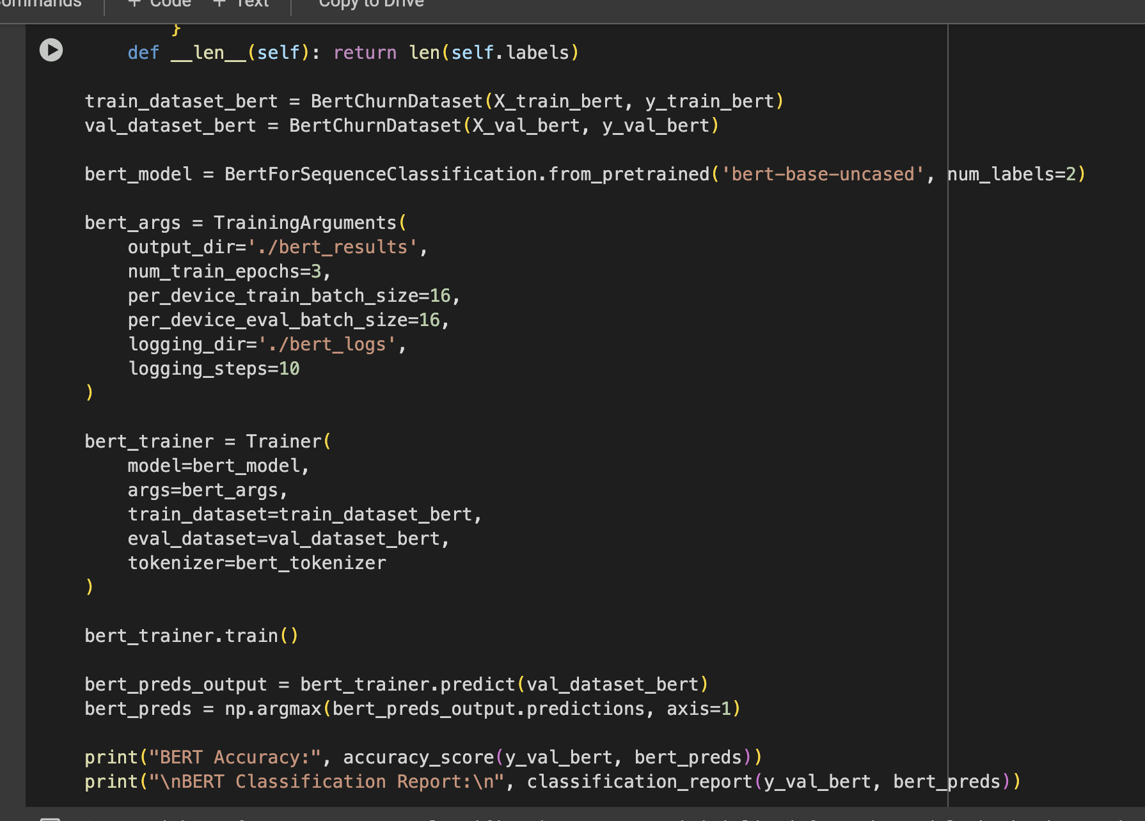
Model Overview – BERT (Methodology)

Slide 8
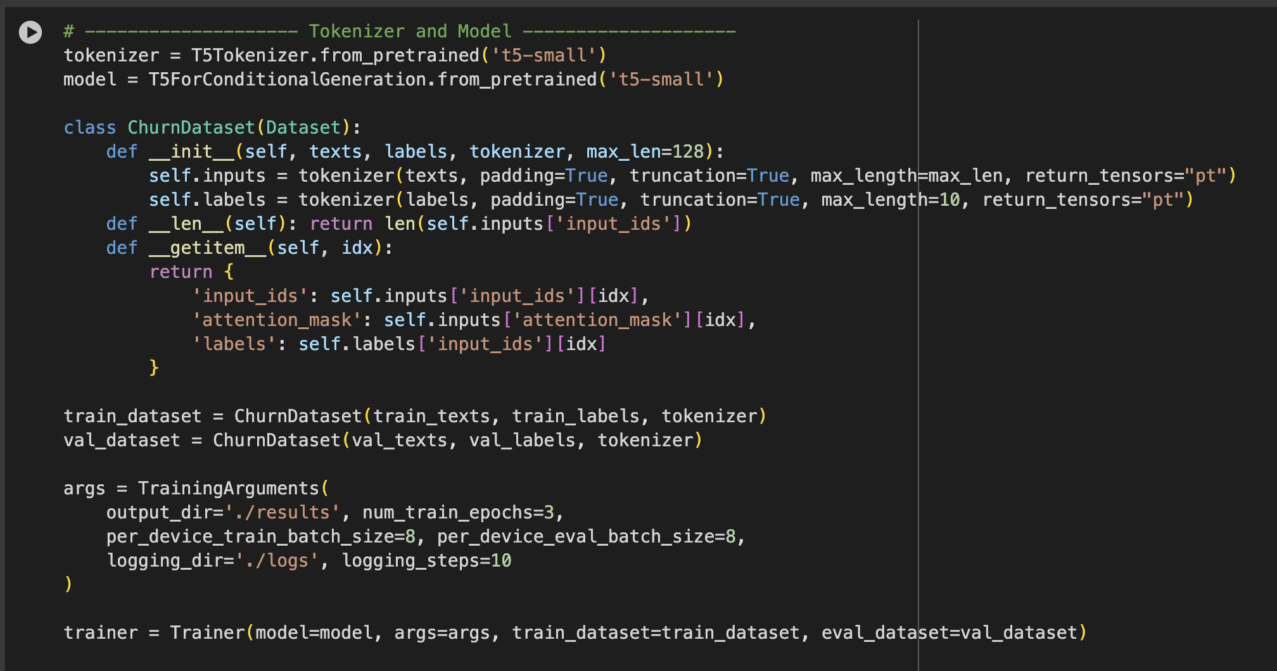
Model Overview – T5 (Methodology)
Tokenized features using T5 Tokenizer (T5-style format).
Fine-tuned using Trainer and TrainingArguments
Model predicts binary churn outcome (Yes/No).

Slide 9
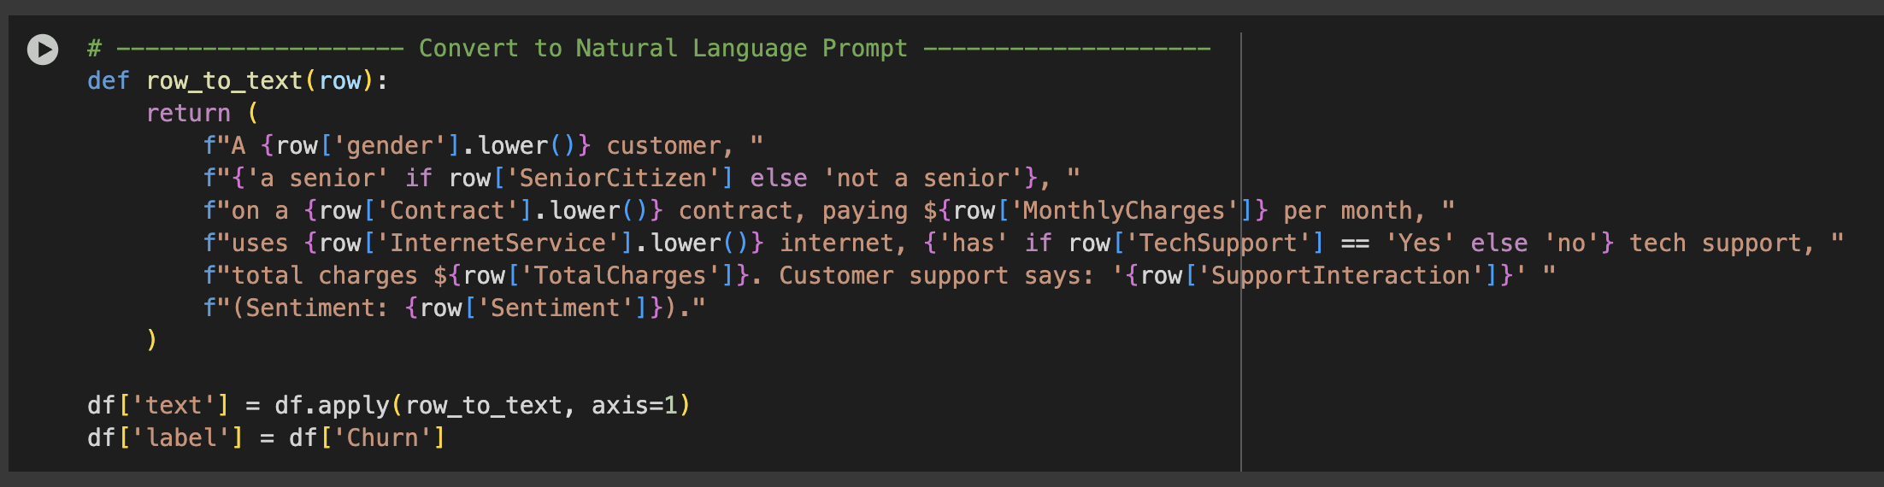
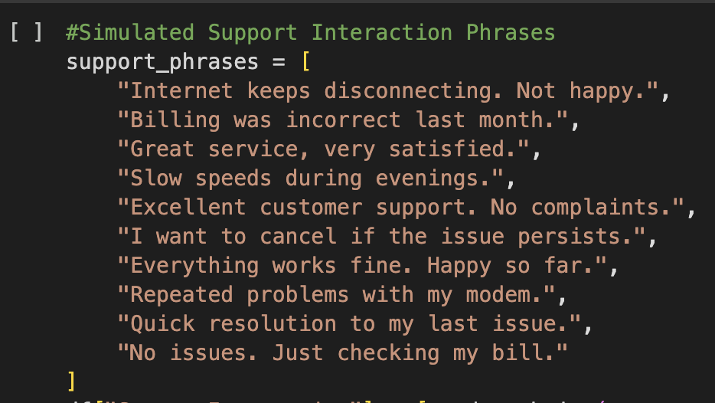
Methodology – Conversion and Sentiment analysis
We converted categorical values into human readable format or a general order of those as Bert and T5 need series as an input.
Synthetic customer support transcripts generated for testing.
Applied sentiment analysis using transformers.
Extracted pain points (e.g., billing issues, poor support).
Assigned satisfaction scores and classified risk levels.

Slide 10
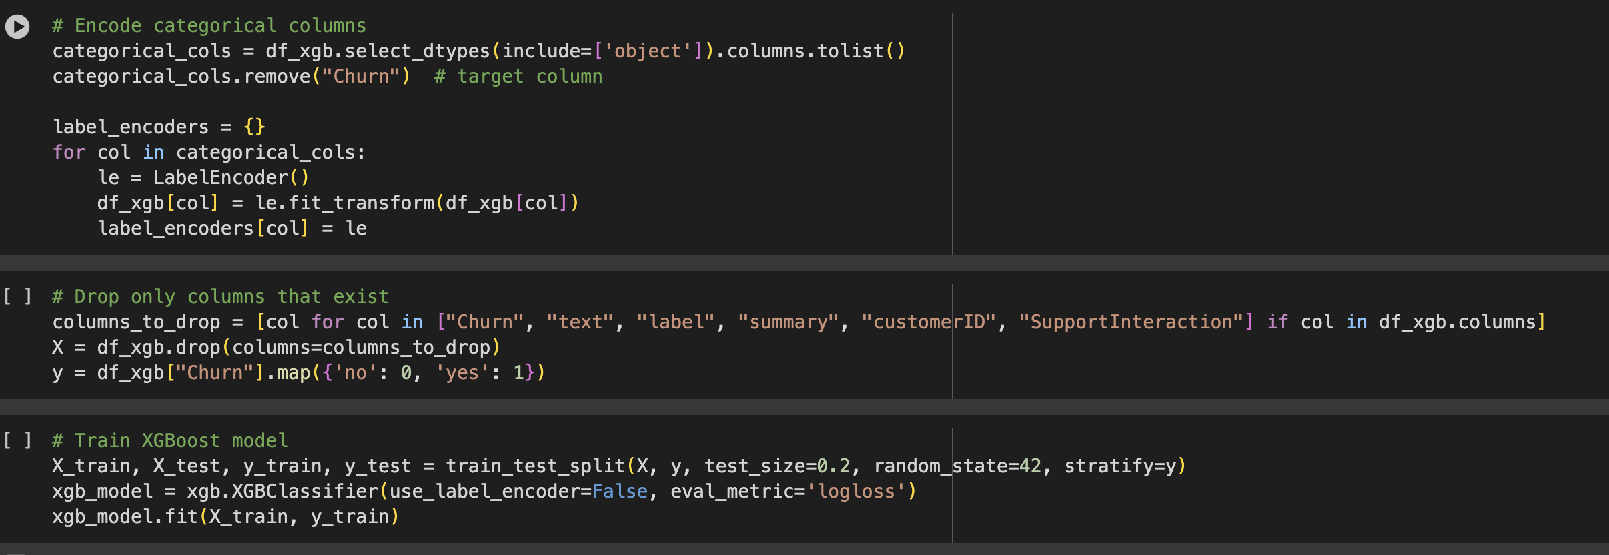
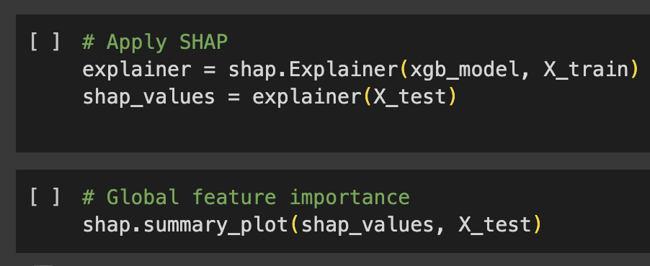
SHAP Explanations and XGBoost
Used SHAP (SHapley Additive exPlanations) to interpret model predictions.
Identified key features affecting churn (e.g., tenure, contract type, support calls).
Generated force plots and summary plots for individual customers.
Helped understand *why* a prediction was made.

Slide 11
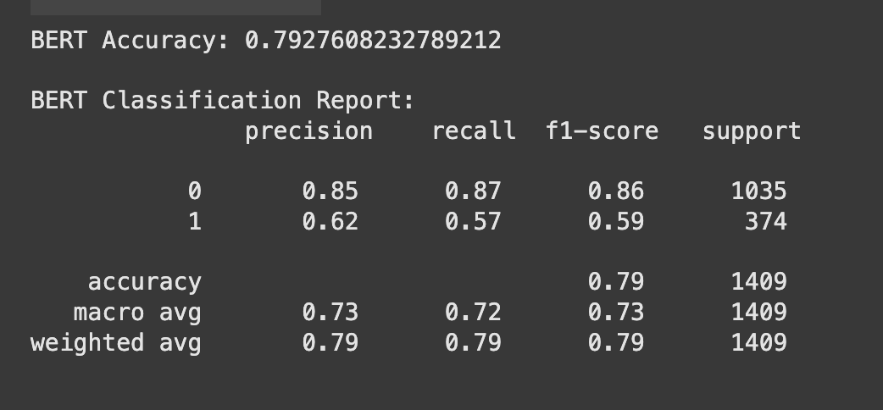
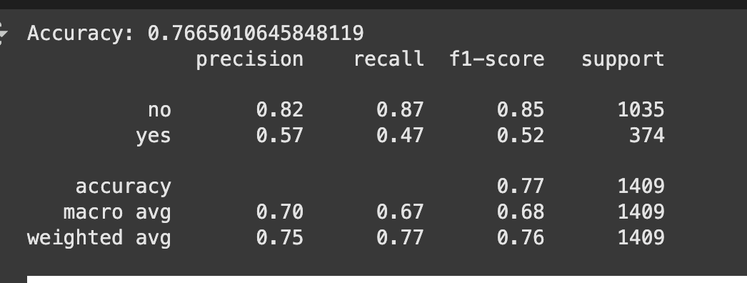
Results & Conclusion
Bert achieved an accuracy of approximately 79.3% and T5 was performed for 76.7% accuracy approximately.
Predictive model shows high accuracy with interpretability.
LLMs enrich predictions with human-readable summaries.
Sentiment analysis reveals customer satisfaction and pain points.

Slide 12
Team Contributions
Venkata Mohan Potturu
Bhavani Adula
Data Pre-processing, Exploratory Data Analysis
Bert model implementation, Profile analysis
Lakshmi Sri Kamal Kuturu
Sai Sathwik Goud Boguda
T5 Model Implementation, Sentiment and transcript analysis
SHAP explainations and XG Boost model implementation

