Slide 1
Image binarization USING CONVOLUTION NEURAL NETWORK

Slide 2
Team Members
Names ID Numbers
R. Anusha S190245
P. Bhavani S191132
K. Uma S190712
K.V. Kalyani S190238

Slide 3
Contents
Abstract
Problem Statement
Introduction
Objectives
Existing System
Proposed System
Approach
Feature Selection
Models Used
Conclusion

Slide 4
ABSTRACT
This work introduces the first free and open-source Telugu palm leaf dataset to advance research in digitization and Optical Character Recognition (OCR) of ancient Telugu scripts. The dataset consists of 36 images of Telugu palm leaf manuscripts.We evaluated several binarization algorithms, including Otsu, Niblack, and Sauvola, by creating ground truth images to assess their performance on the dataset. Additionally, we explored the effectiveness of deep learning models such as U-Net, LinkNet, and PSPNet,UNetPlusPlus,FPN in improving binarization quality. Our efforts contribute to the preservation of cultural heritage and foster the development of advanced image processing and machine learning techniques for analyzing historical documents.

Slide 5
Problem Statement
Develop and evaluate advanced image binarization techniques for Telugu palm leaf manuscripts using Otsu, Niblack, Sauvola, U-Net, LinkNet, and PSPNet. Enhance binarized image quality for improved OCR and preservation of cultural heritage.

Slide 6
INTRODUCTION
Historical documents, especially those on palm leaves, connect the past with the present, preserving knowledge in South Asia. Extensive research on Sundanese and Balinese documents reveals that Indic scripts hold valuable cultural heritage.
Telugu, the primary language in Andhra Pradesh and Telangana with around 80 million speakers, boasts a thousand-year literary tradition. Palm-leaf manuscripts, common in Southern India, sustain Telugu literature but degrade over time, making them hard to read.
Document enhancement and binarization are crucial preprocessing stages. Binarization transforms manuscripts into a binary format, improving text readability by reducing background noise. Inspired by Sundanese script research, similar strategies were applied to Telugu manuscripts. This presenation covers creating ground truth images, traditional machine learning algorithms, and deep learning strategies for binarization.

Slide 7
OBJECTIVES
The objective of this project is to enhance the readability and preservation of historical palm-leaf manuscripts through image binarization. By converting colored or grayscale images into binary format, the project aims to distinguish text from background noise and improve text clarity. This will make historical texts more accessible and readable, preserving valuable cultural information using traditional and deep learning algorithms.

Slide 8
Existing System:
Unet :
A common convolutional neural network (CNN) architecture for imagesegmentation.
It comprises a contracting path (encoder) with convolutional layers,activation functions, and pooling layers to extract features from the input image.
The expanding path (decoder) involves upsampling layers, skip connections, andconcatenation to increase feature map resolution and precise object location.
Anactivation function like a sigmoid follows the final convolutional layer. Optimized usingthe Adam optimizer.

Slide 9
Disadvantages
Limited Adaptability
Performance Variability
High computational Requirements
Manual Pre-Processing
Limited Dataset Availability
Lower Accuracy Rates

Slide 10
Proposed System
The proposed system aims to preserve Telugu palm leaf manuscripts through advanced image binarization techniques. The system leverages both traditional and deep learning methodologies to enhance the readability and accessibility of these historical documents.
The process can be divided into several key stages:
Deep Neural Networks
Such as U-net, LinkNet ,PSPNet and FPN
2. Modified architectures
such as U-Net++
3. High Resolution Images
4. Ground Truth Creation
5. Data Augmentation
for , Increasing DataSet Size
6. Challenges and Solutions

Slide 11
Advantages:
High Accuracy
Comprehensive DataSet
Automatic Pre-Processing
Versatile Binarization Techniques
Improved Readability and Preservation
Enhanced OCR Performance
Scalability and Efficiency

Slide 12
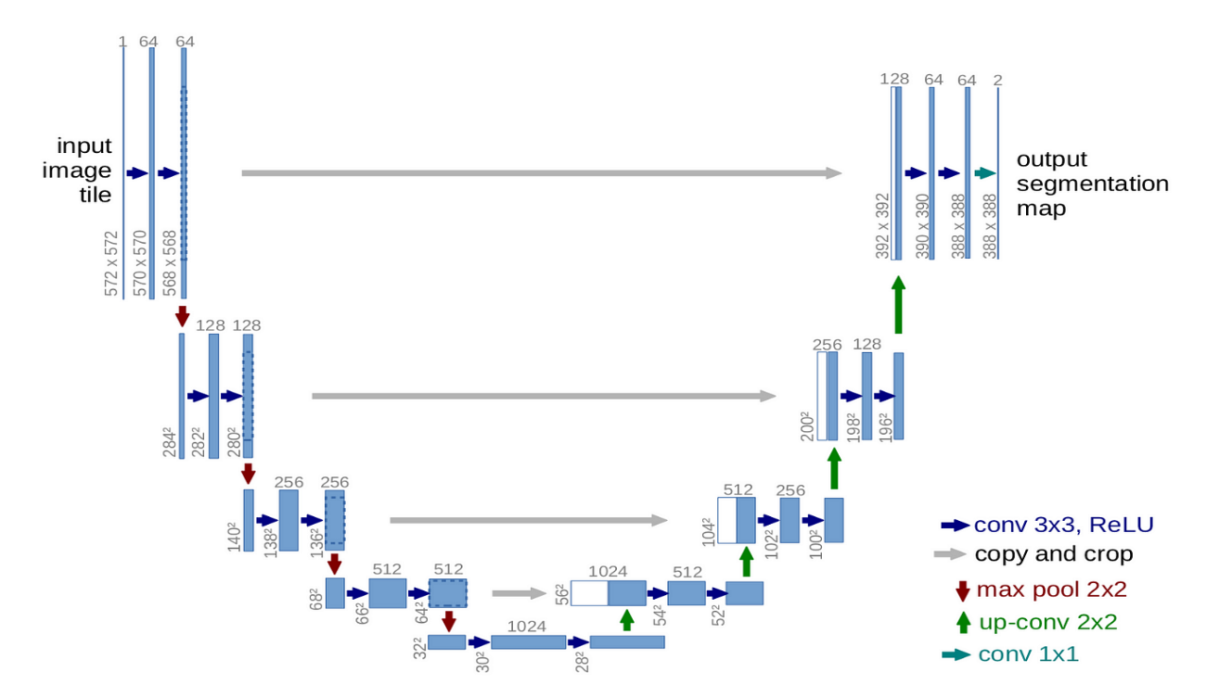

Slide 13
Approach
Data Collection: Gather diverse palm-leaf manuscript images.
Preprocessing: Clean images to remove noise and artifacts.
Binarization: Implement traditional and deep learning binarization methods.
Evaluation: Assess binarization quality using metrics like accuracy and F1 score.
Ground Truth: Create reference images for validation.
Fine-tuning: Adjust algorithms based on validation results.
Documentation: Document methods and report findings

Slide 14
Feature Selection
Image Quality Metrics: Assess contrast, sharpness, and brightness.
Texture Analysis: Differentiate text and background based on texture.
Edge Detection: Identify text edges for binarization.
Color Information: Use color features in colored manuscripts.
Local Patterns: Analyze patterns for intricate areas.
Machine Learning Features: Extract features from deep learning models.
Adaptive Thresholding: Include parameters for different styles.
Semantic Context: Preserve meaningful structures during binarization.

Slide 15
Traditional Binarization Techniques
Otsu's Method:
Otsu's method is a global thresholding technique that determines an optimal threshold to separate the foreground and background pixels.
It maximizes the between-class variance to find the best threshold value.
Sauvola's Method
An improvement over Niblack's method, Sauvola's method adjusts the threshold dynamically based on local mean, standard deviation, and a user-defined parameter k.
Niblack's Method
Niblack's method is a local thresholding technique that calculates the threshold for each pixel based on the local mean and standard deviation within a neighborhood window.
Su's Method
An improvement over Niblack's method, Sauvola's method adjusts the threshold dynamically based on local mean, standard deviation, and a user-defined parameter k.

Slide 16
Deep Learning Models Used
UNet:
Deep learning architecture for image segmentation.
Effective for biomedical images and semantic segmentation.
LinkNet:
Simplified deep learning model for semantic segmentation.
Efficient in capturing long-range dependencies.
PSPNet:
Pyramid Scene Parsing Network for scene parsing in images.
Includes a pyramid pooling module for multi-scale context.
Predictive Models:
Include regression, decision trees, random forests, and neural networks.
Used for predicting outcomes based on input data.

Slide 17
Input Image

Slide 18
OUTPUT IMAGE

Slide 19
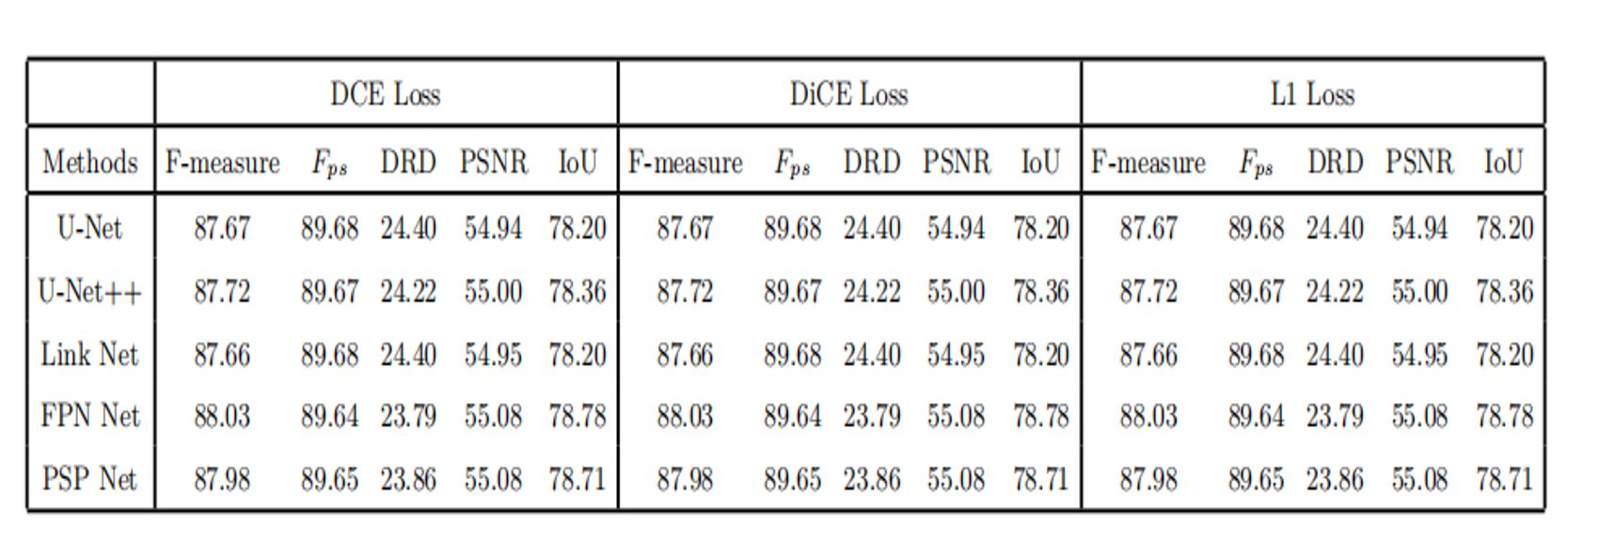
RESULTS

Slide 20
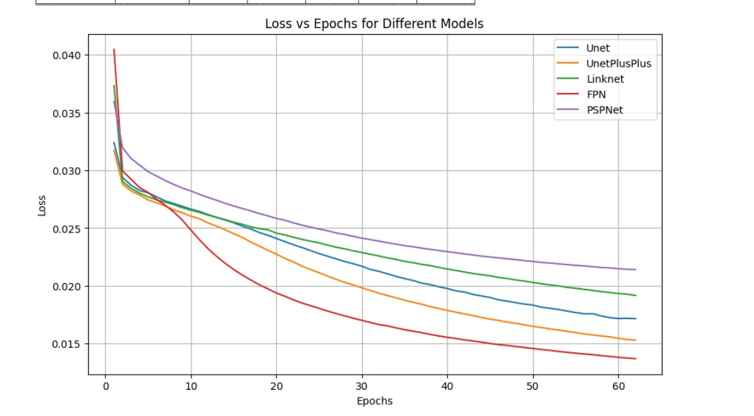

Slide 21
CONCLUSION
The document reviewed binarization techniques for preserving Telugu palm leaf manuscripts. Traditional methods had limitations, while advanced adaptive methods like Su’s technique and deep learning approaches such as CNNs and FCNs showed better performance in enhancing manuscript readability and accessibility on Telugu datasets.

Slide 22
THANK
YOU

